Slide 1
GDG AI HACK 2026 — SEE BEYOND TRACK
RESCUE VISION
AI-powered drone detection system for missing persons in hostile environments

Slide 2
THE PROBLEM
FINDING PEOPLE IN COMPLEX ENVIRONMENTS IS HARD
📡
👁
📶
Vast Areas
Human Fatigue
Poor Connectivity
Mountains, forests, and disaster zones cover enormous terrain that's impossible to scan manually.
Operators watching hours of drone footage miss critical details — victims hidden behind rocks or vegetation.
Remote locations have limited bandwidth. Streaming raw video from drones is often impractical.

Slide 3
SYSTEM PIPELINE
END-TO-END ON-DEVICE PROCESSING
01
02
03
04
05
🎯
📏
🔍
📐
📡
YOLO
DETECTION
DEPTH
ESTIMATION
PERSON
TRACKING
POSTURE
ANALYSIS
DASHBOARD
ALERT
Fine-tuned on COCO
with degradation augmentations
OAK stereo depth
GPS coords via camera pose
Stationary >5s
→ flagged as still
BBox aspect ratio
Standing vs. fallen
Sent only if confidence
≥ 65%
⚡ FULLY ON-DEVICE INFERENCE · LOW LATENCY · NO CLOUD REQUIRED · REAL-TIME STREAMING TO DASHBOARD

Slide 4
01 / YOLO DETECTION
FINE-TUNED MODEL FOR DEGRADED ENVIRONMENTS
BASE MODEL & TRAINING
ALBUMENTATIONS PIPELINE
Architecture
YOLO (OAK-optimized)
☀️
RandomBrightnessContrast
Simulates over/under-exposure
🌫️
RandomFog
Base Dataset
COCO
Fog & low-visibility conditions
💨
GaussianBlur
Task
Person detection
Motion blur, camera shake
🌿
CoarseDropout
Deployment
On-device (OAK-4D)
Occlusion by debris / vegetation
🌒
RandomShadow
Uneven lighting, partial shadows
Alert Threshold
≥ 65% confidence
⬛
ToGray
Thermal-like grayscale input
WHY FINE-TUNE?
📶
GaussNoise
Real emergencies involve smoke, fog, partial occlusion and poor lighting — stock COCO won't cut it.
Sensor noise & image artifacts
Applied with randomized probabilities for diverse training conditions.

Slide 5
ON-DEVICE INTELLIGENCE
POSTURE · DEPTH · TRACKING — ALL COMPUTED ON THE CAMERA
02
03
04
📏
🔍
📐
DEPTH
ESTIMATION
PERSON
TRACKING
POSTURE
ANALYSIS
OAK-4D stereo depth sensor
Individual tracker per person
Compute BBox aspect ratio
Distance computed per detection
Position sampled over time
width > 1.3 × height
GPS tracker on drone
Stationary > 5 seconds
→ person flagged as FALLEN
→ absolute GPS coords per person
→ flagged as STILL
Indicates injury or unconsciousness
Demo: fixed camera coords
Second urgency signal
Raises intervention priority

Slide 6
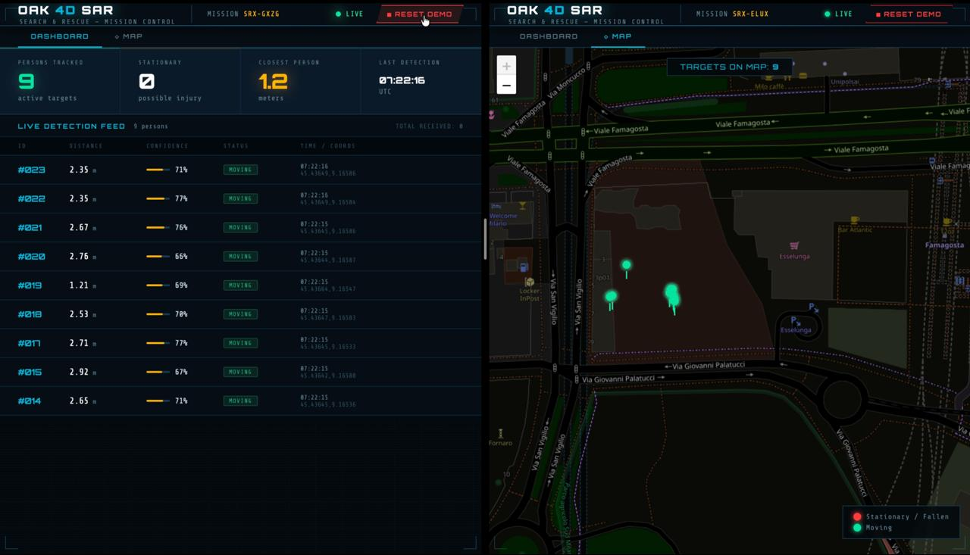
05 / MISSION DASHBOARD
REAL-TIME OPERATOR INTERFACE
FEATURES
🎯
Live Detection Feed
All detected persons, confidence, distance
🟢
Status Indicators
MOVING (green) / STATIONARY (red)
🗺️
GPS Map View
Geolocated targets on interactive map
⏱️
Real-time Updates
Instant refresh per detection cycle
📡
Mission Control
Multiple simultaneous drone streams
≥65%
5s
LIVE
GPS
CONFIDENCE GATE
STILL THRESHOLD
DATA STREAM
GEOLOCATED

