Slide 1

ACDC
Understanding coworking members
Exploratory Data Analysis
Data Mining 2026–2027
Group 21
Professors:
Fernando Bação
Yehor Malakhov
Ana Caleiro
Alfredo Soudo · 20260591
João Frade · 20260557
Maria Coutinho · 20260657
Notes:
Logo source: https://www.novaims.unl.pt/ (official header SVG, accessed 3 November 2026). The presentation follows the EDA stage of CRISP-DM: business understanding, data understanding and initial preparation.
Source: Group21_EDA_Code.ipynb, final local version reviewed on 4 November 2026. Dataset: acdc_dataset.csv. Guidelines: DM2627_ProjectGuidelines.pdf, Section 4. All numerical claims are descriptive.

Slide 2
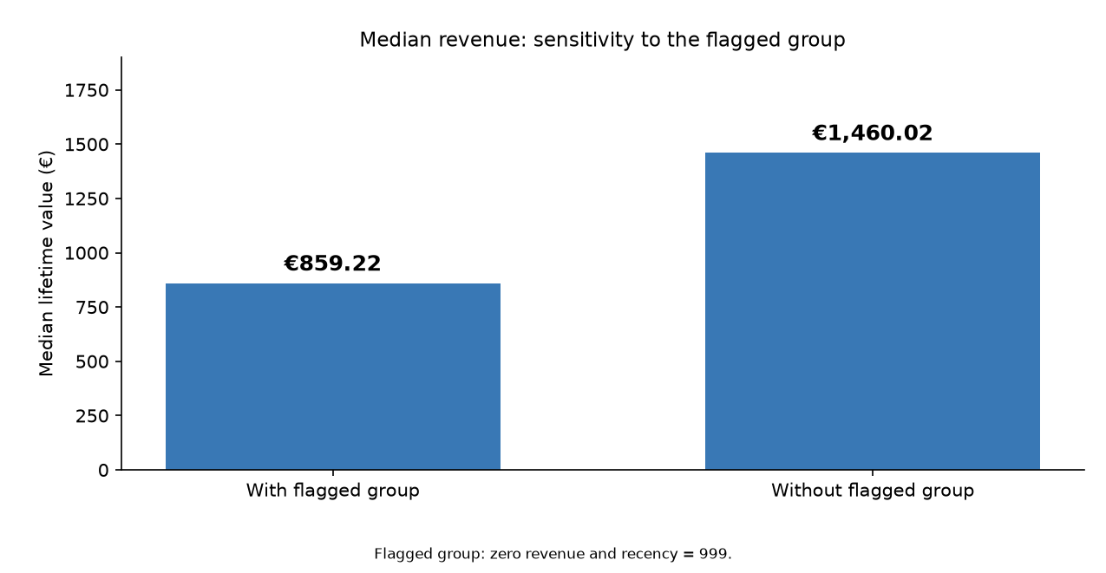
Data quality changes the interpretation
Objective: understand differences in value, usage and service needs
to prepare member segmentation.
15,450
1,296 members flagged
Zero revenue and recency = 999. All retained.
unique members
15 exact duplicates removed
1,040 missing + 82 negative
Revenue values excluded only
from economic comparisons.
This pattern does not prove inactivity or justify removing members.
Economic view: n = 14,328 with the flagged group and 13,032 without it. Original member records remain in the dataset.
01
Notes:
The original dataset has 15,465 rows. Exact deduplication leaves 15,450 unique members. There are 1,040 missing and 82 negative revenue values. The economic comparison includes observed nonnegative revenue only. The 1,296 zero-revenue/recency-999 members stay in the master dataset. Their temporary omission shifts median revenue from €859.22 to €1,460.02. This is sensitivity analysis, not an exclusion decision. Most flagged members have positive visits, so the pattern cannot be treated as confirmed inactivity. Notebook sections: Economic value and extreme values; Sensitivity to the flagged revenue pattern.
Source: Group21_EDA_Code.ipynb, final local version reviewed on 4 November 2026. Dataset: acdc_dataset.csv. Guidelines: DM2627_ProjectGuidelines.pdf, Section 4. All numerical claims are descriptive.

Slide 3
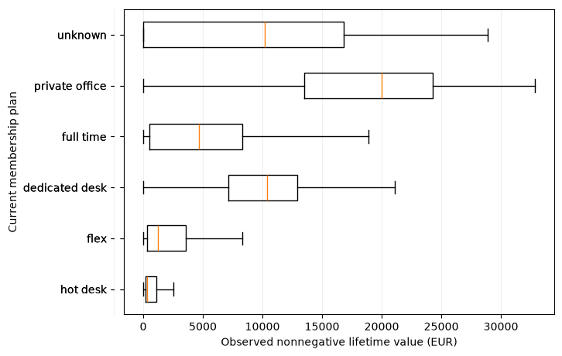
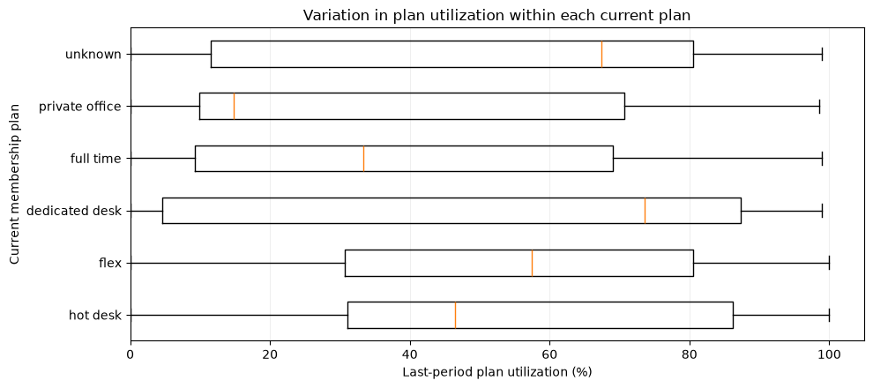
Higher value does not imply higher utilization
Private office
€20,000 median revenue / 14.79% median utilization
Dedicated desk
€10,379 median revenue / 73.60% median utilization
Lifetime revenue (€)
Last-period utilization (%)
Value and usage warrant separate segmentation perspectives.
Revenue and utilization use different time windows and available observations.
Boxes show the middle 50% and median. Revenue outlier markers are hidden, not removed.
02
Notes:
Boxplot statistics recomputed from the cleaned data using the notebook rules and standard 1.5×IQR whiskers. The original notebook PNG outputs are embedded. The revenue panel and its original category labels are cropped from the two-panel figure; the utilization output is embedded whole. No rows are removed by suppressing outlier markers. Revenue n=14,328, utilization n=15,440. Revenue observations by plan: 4,935; 5,067; 1,388; 2,261; 591; 86. Utilization observations: 5,209; 5,446; 1,549; 2,468; 663; 105. Current plan may differ from historical plans. Wide distributions show that plan labels alone do not describe every member. Notebook sections: Usage and value by plan; Utilization within current plans.
Source: Group21_EDA_Code.ipynb, final local version reviewed on 4 November 2026. Dataset: acdc_dataset.csv. Guidelines: DM2627_ProjectGuidelines.pdf, Section 4. All numerical claims are descriptive.

Slide 4
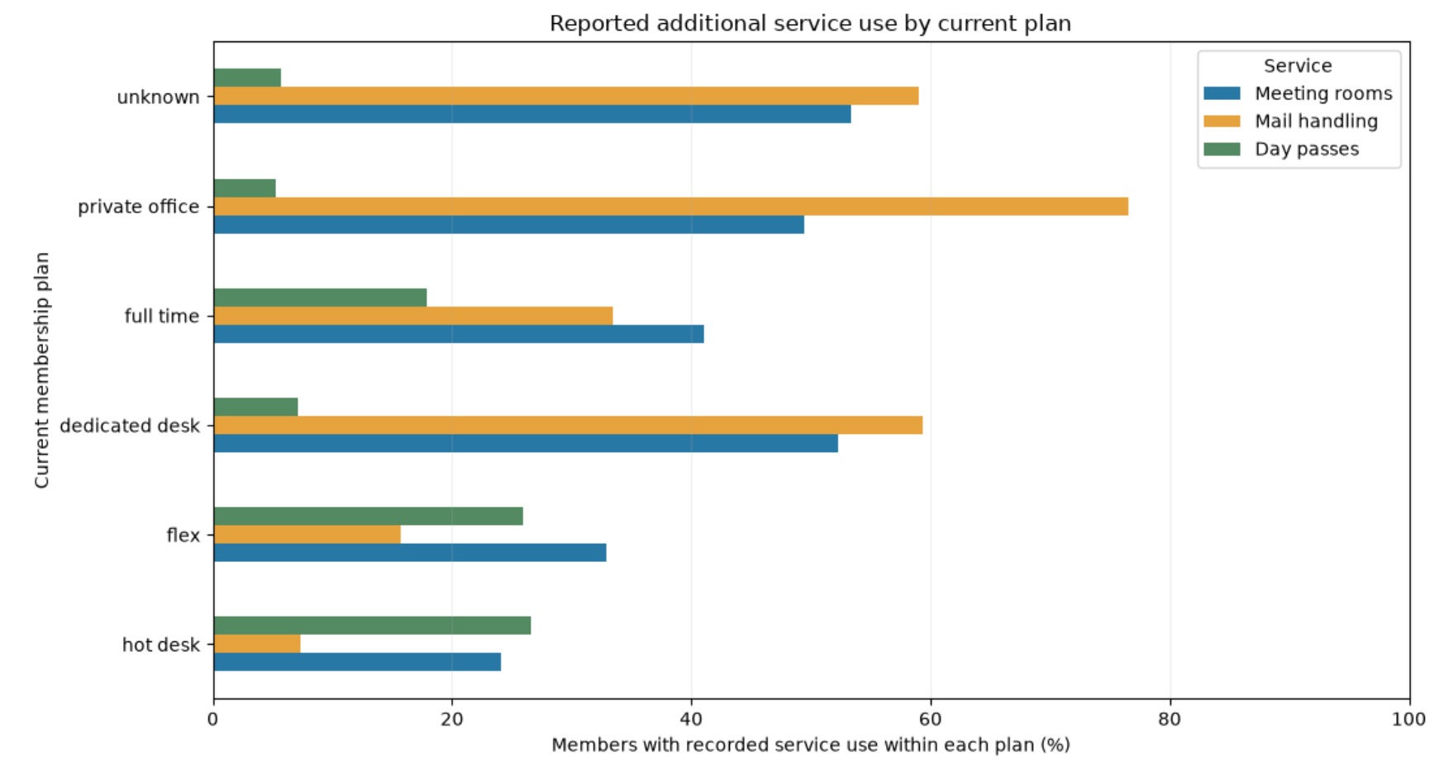
Services reveal different member needs
Private office VS hot desk
76.5% vs 7.4%
Mail handling
5.3% vs 26.6%
Day passes
≈20%
Have no recorded use of the nine services
Business support and flexible access are useful clues to member needs.
Percentages use all members within each current plan. Services can overlap. Flags describe past use, not intensity.
Existing meeting-room flag conflicts remain. These are segmentation clues, not confirmed segments.
03
Notes:
Notebook sections: Reported service use by current plan; Variety of services used. Group sizes: hot desk 5,212; flex 5,449; dedicated desk 1,549; full time 2,471; private office 664; unknown 105. Mail handling: private office 76.506%, hot desk 7.368%. Day passes: 5.271% and 26.592%. 3,087/15,450 members (19.98%) have all nine flags False. Flags refer to whether the service was ever used, while plan tier is current. There are 55 positive meeting-room-hour observations with a False usage flag. Associations do not establish causes or clusters.
Source: Group21_EDA_Code.ipynb, final local version reviewed on 4 November 2026. Dataset: acdc_dataset.csv. Guidelines: DM2627_ProjectGuidelines.pdf, Section 4. All numerical claims are descriptive.

Slide 5
New features add context, but may overlap
utilization_rate
n_services_used
Actual visits / entitled visits
Number of service flags marked True
Share of the last-period allowance used.
10 undefined cases with zero allowance.
Variety across nine services.
Does not measure usage intensity.
Potential redundancy: Spearman correlation
Weekly visits and last-period visits
0.933
Utilization and weekly visits
0.840
Correlated features may give attendance too much weight in clustering.
Compare feature sets during modeling. Service history and last-period utilization cover different time windows.
Spearman uses available pairs: n = 15,450 and 15,440, respectively.
04
Notes:
The notebook sections Plan utilization rate and Variety of services used define the engineered features. Utilization is calculated only for positive entitled visits and nonnegative actual visits. Ten zero allowances produce undefined ratios: eight with positive visits and two with zero visits. The service count sums nine boolean flags with equal weight. Spearman correlations independently recomputed on the cleaned notebook dataframe: avg_weekly_visits vs actual_visits_last_period = 0.932654 (n=15,450); utilization_rate vs avg_weekly_visits = 0.840053 (n=15,440). Correlations justify assessing redundancy, not automatically dropping variables.
Source: Group21_EDA_Code.ipynb, final local version reviewed on 4 November 2026. Dataset: acdc_dataset.csv. Guidelines: DM2627_ProjectGuidelines.pdf, Section 4. All numerical claims are descriptive.

Slide 6
Three broad profiles to investigate
Initial hypothesis: three broad profiles to validate.
The final number of clusters remains open.
01
02
03
Basic or flexible access
Frequent space users
High value,
lower presence
Lower attendance
Basic or flexible access needs
Higher attendance
More regular use of the space
Higher economic value
Business-support services
Main challenges
Unclear dates, extreme values, missing data and redundant measures.
Next: compare methods, cluster counts and stability across perspectives.
05
Notes:
These three profiles are broad hypotheses based on the EDA, not discovered clusters or mutually exclusive assigned groups. Current plans motivate hypotheses but are not treated as final segments. The next phase will compare at least two clustering approaches per perspective, assess numbers of groups and stability, and integrate the perspectives. Mitigation: clarify date semantics before duration/recency features; compare outlier and missing-data treatments; evaluate scaled feature sets and redundancy; retain sensitivity checks for the flagged zero-revenue/999 group. Source: Project Guidelines Sections 4 and 5.
Source: Group21_EDA_Code.ipynb, final local version reviewed on 4 November 2026. Dataset: acdc_dataset.csv. Guidelines: DM2627_ProjectGuidelines.pdf, Section 4. All numerical claims are descriptive.

