Slide 1
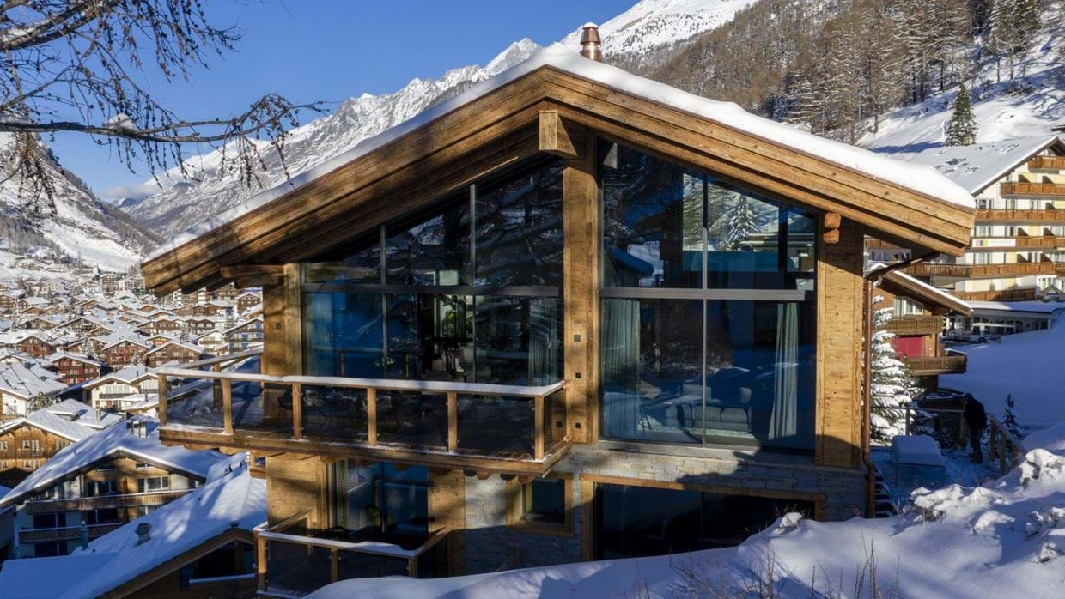
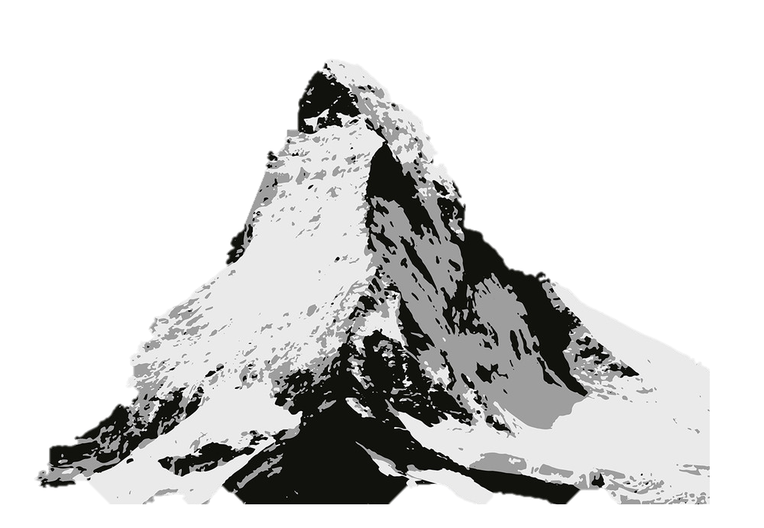
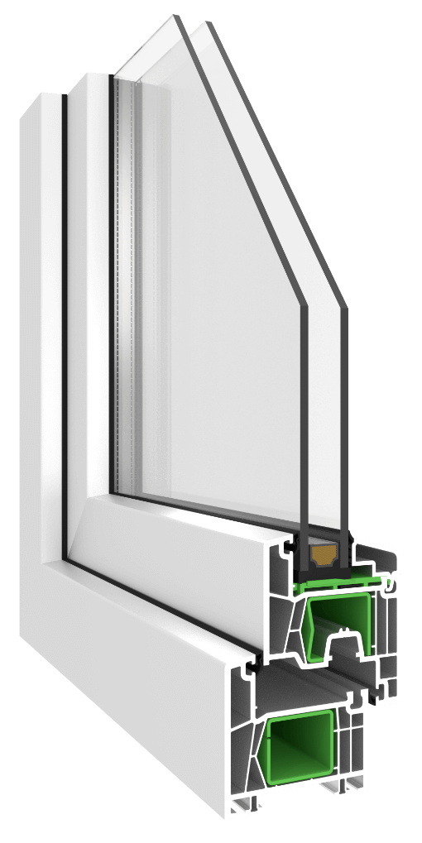
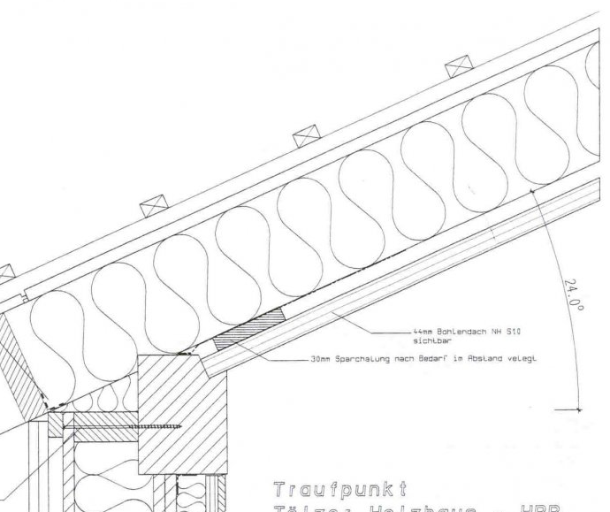
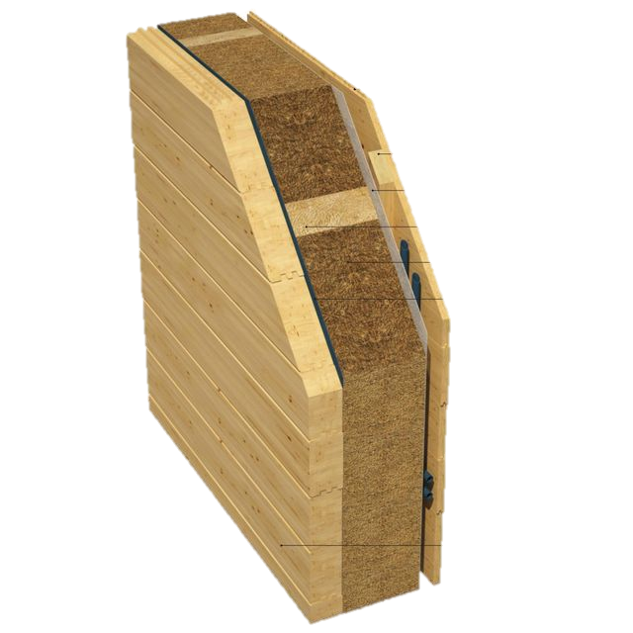

cv
cv
Roofbrick
Insolation
Oak
Doppelglass
cv
5m
2.5m
Beech
Insolation
Oak
10m
10m

Slide 2
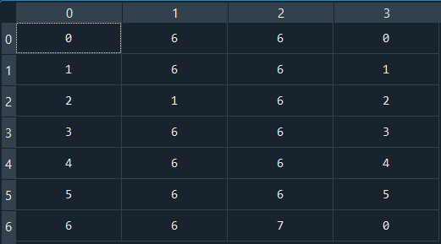



































































Node-Model, Chalet Zermatt
$$T_{o}$$
$$R_{o}$$
$$T_{SO,0}$$
$$R_{1}$$
$$T_{1}$$
$$R_{2}$$
$$T_{2}$$
$$R_{3}$$
$$T_{3}$$
$$R_{4}$$
$$T_{4}$$
$$R_{5}$$
$$T_{5}$$
$$R_{6}$$
$$T_{SI,6}$$
Nordwall (Big wall)
TCd0
- +
$$Q_{o}$$
$$C_{Beech}$$
$$C_{Insulation}$$
$$C_{Oak}$$
$$Q_{glass}$$
$$T_{o}$$
$$R_{o}$$
$$T_{SO,0}$$
$$R_{1}$$
$$T_{1}$$
$$R_{2}$$
$$T_{2}$$
$$R_{3}$$
$$T_{3}$$
$$R_{4}$$
$$T_{4}$$
$$R_{5}$$
$$T_{5}$$
$$R_{6}$$
$$T_{SI,6}$$
Eastwall (Small wall)
TCd1
- +
$$Q_{o}$$
$$C_{Beech}$$
$$C_{Insulation}$$
$$C_{Oak}$$
$$Q_{glass}$$
$$T_{o}$$
$$R_{o}$$
$$T_{SO,0}$$
$$R_{1}$$
$$T_{1}$$
$$R_{2}$$
$$T_{2}$$
$$R_{3}$$
$$T_{3}$$
$$R_{4}$$
$$T_{4}$$
$$R_{5}$$
$$T_{5}$$
$$R_{6}$$
$$T_{SI,6}$$
Westwall (Small wall)
TCd2
- +
$$Q_{o}$$
$$C_{Beech}$$
$$C_{Insulation}$$
$$C_{Oak}$$
$$Q_{glass}$$
TCd3
$$T_{o}$$
$$R_{o}$$
$$T_{SO,0}$$
$$R_{1}$$
$$T_{SI,1}$$
Southwall (Big wall)
- +
$$Q_{o}$$
$$T_{o}$$
$$R_{o}$$
$$T_{SO,0}$$
$$R_{1}$$
$$T_{1}$$
$$R_{2}$$
$$T_{2}$$
$$R_{3}$$
$$T_{3}$$
$$R_{4}$$
$$T_{4}$$
$$R_{5}$$
$$T_{5}$$
$$R_{6}$$
$$T_{SI,6}$$
TCd4
- +
$$Q_{o}$$
$$C_{Brick}$$
$$C_{Insulation}$$
$$C_{Oak}$$
$$Q_{glass}$$
Westroof
$$T_{o}$$
$$R_{o}$$
$$T_{SO,0}$$
$$R_{1}$$
$$T_{1}$$
$$R_{2}$$
$$T_{2}$$
$$R_{3}$$
$$T_{3}$$
$$R_{4}$$
$$T_{4}$$
$$R_{5}$$
$$T_{5}$$
$$R_{6}$$
$$T_{SI,6}$$
TCd5
- +
$$Q_{o}$$
$$C_{Brick}$$
$$C_{Insulation}$$
$$C_{Oak}$$
$$Q_{glass}$$
Eastroof
TCd0
TCd1
TCd2
TCd3
TCd4
TCd5
Convection Circuit:
$$T_{1}$$
$$T_{2}$$
$$T_{4}$$
$$T_{5}$$
$$T_{0}$$
$$R_{1}$$
$$R_{2}$$
$$T_{3}$$
$$R_{4}$$
TCd6
$$R_{0}$$
$$R_{3}$$
$$R_{5}$$
$$C_{Air}/2$$
Indoor Air Temperature
$$T_{6}$$
Energy Circuit (Ventilation an Control)
TCd7
$$C_{Air}/2$$
$$T_{0}$$
$$T_{o}$$
$$\dot{m}∙c$$
$$K_{P}$$
$$T_{,i,sp}$$
- +
$$Q_{PP}$$
$$Q_{rad}$$
$$Q_{a}$$
- +
Air Infiltration
Controller
Assembling Matrix
Auxiliary Power
HVAC Power
Transmitted Solar Radiation Power

