Slide 1
🔒
MICROSOFT DATA SOVEREIGNTY CHALLENGE — HR / TALENT SCENARIO
Sovereign Hiring Console
An AI that ranks candidates without ever seeing who they are — and never has the final word.
What becomes possible when trust is built in?
Notes:
Open with the hook: HR screening is one of the EU AI Act's named high-risk uses of AI. We built a hiring console that proves, on screen, that sensitive data stays under control and a human always makes the call.

Slide 2
AI hiring is high-risk — by law, not just by reputation
Organisations want AI to speed up screening. Regulators require organisations to prove the AI didn't quietly make the decision, and didn't need a candidate's identity to do its job. Most hiring tools can't show either.
The bar we set ourselves
✓
Show where the data lives
EU AI Act — Annex III & Art. 14
✓
Prove one privacy technique — don't just claim it
Employment screening is explicitly high-risk AI; human oversight is a legal requirement, not a nice-to-have.
GDPR — Art. 22
✓
Keep a human in the loop for the decision that matters
No candidate may be rejected by a solely automated decision.
✓
Name the regulation we're designing for
GDPR — Art. 5
Data minimisation: don't process personal data the task doesn't need.
2
Notes:
Name the regulation up front: EU AI Act Annex III makes employment screening high-risk AI, Article 14 requires human oversight, GDPR Article 22 bans solely-automated rejection, Article 5 requires data minimisation. These four bullets are the bar the whole product is designed against.

Slide 3
The Sovereign Hiring Console
A recruiter-facing screening tool that redacts every identifying field before an explainable, fully local rubric scores each candidate — and a named human must approve or reject every one.
🛡
📊
👤
Redact
Score transparently
Human decides
8 PII fields stripped outright; free text is regex-scrubbed for names, ages, pronouns before the scorer ever sees it.
A deterministic rubric, not a black box — every point in every score is named in a plain-English explanation.
Every candidate starts pending. Rejecting a top-3 score requires a written override reason.
3
Notes:
Three pillars, in the order the data actually flows: redact, then score, then a human decides. Each pillar is a real, running piece of the demo, not a slide-only claim.

Slide 4
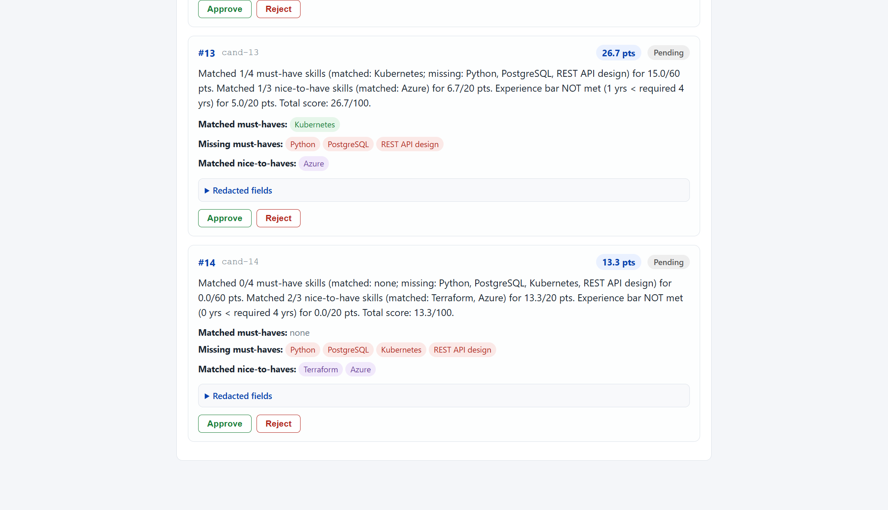
Proof, not a promise: every score is explainable
This is the live app, not a mockup. The rubric names exactly which requirements matched. A bias-check panel compares average scores across (unredacted, server-side-only) demographic groups to prove the redaction didn't leave a hidden gap.
Max spread across gender groups: 8.1 points on a 100-point scale — the redacted rubric doesn't systematically favor anyone.
Why a rubric, not a hosted LLM
This build environment has no Azure/OpenAI key configured — and a hosted call would mean candidate data leaving the machine, which undercuts the pitch. A deterministic, template-explained rubric is the stronger answer to “apply responsible-AI principles by default”: 100% explainable, reproducible, and it never phones home.
4
Notes:
This screenshot is the actual running app. Point at the explanation text: every one of the point totals in the score is named in the sentence next to it. Then point at the bias-check table — it's computed from the unredacted records server-side, only to prove the ranking doesn't quietly favor a group, and it's never used to re-identify anyone.

Slide 5
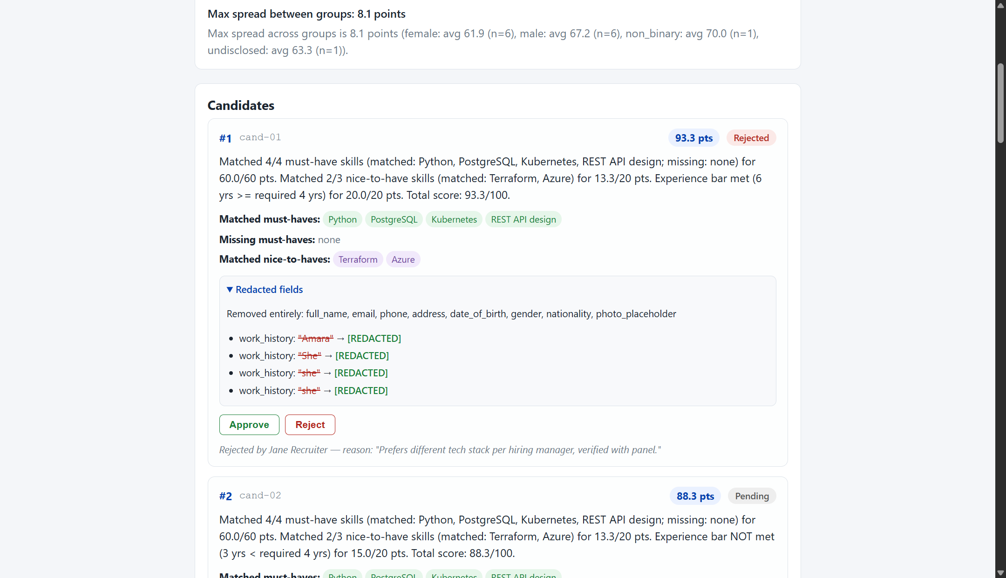
Proof: PII never reaches the scorer — and the human overruled it anyway
The redaction diff
8 fields — name, email, phone, address, DOB, gender, nationality, photo — are removed outright. Free text gets a second pass: the candidate's own name, age mentions, and pronouns are scrubbed and shown struck through, next to what replaced them. GDPR Art. 5 data minimisation, provable on screen.
The human veto
This candidate scored #1 (93.3). The recruiter rejected them anyway — and because it's a top-3 override, the app would not accept the decision without a written reason. Nothing here is ever auto-finalized.
5
Notes:
This is the exact card from the running app. Walk through the redacted-fields disclosure, then the reject reason at the bottom: the AI ranked this candidate first, a human said no anyway, and the app made them write down why because it was a top-3 override — that's Article 22 and Annex III satisfied in one screenshot.

Slide 6
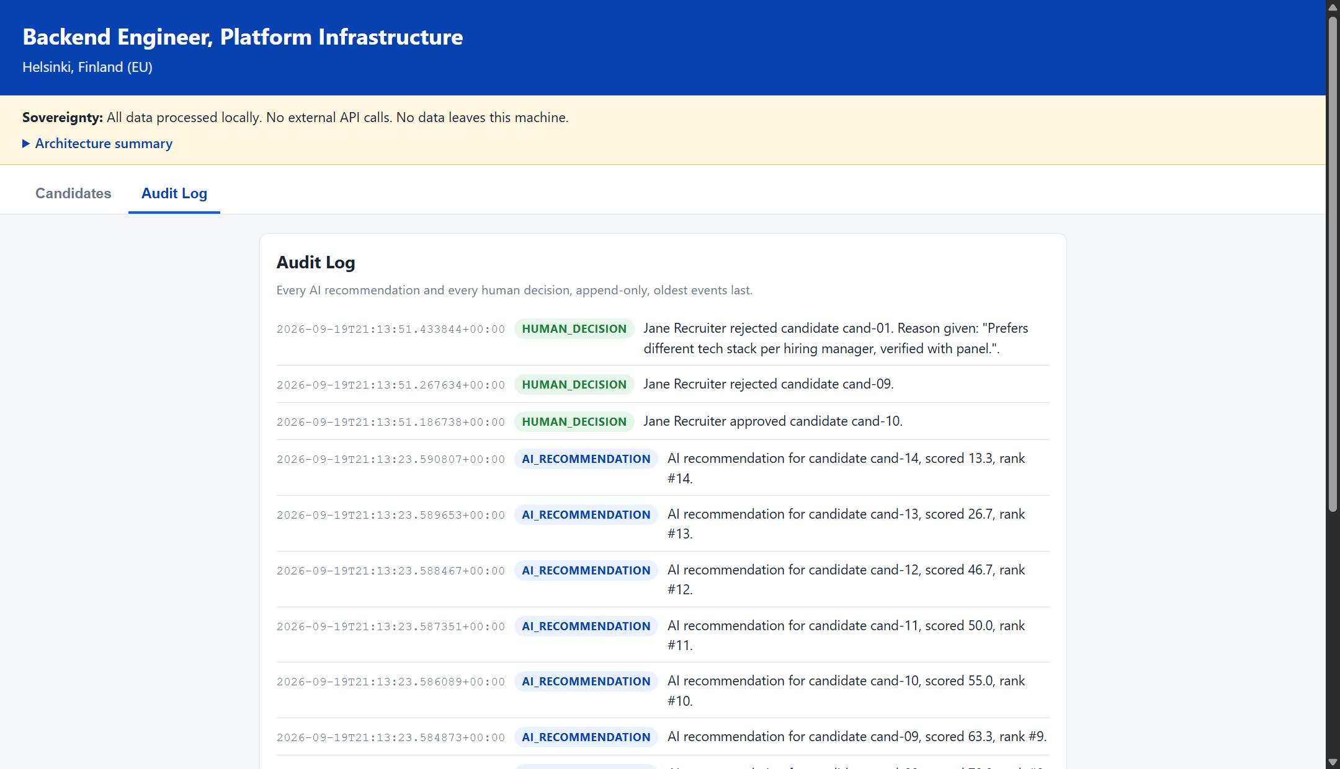
Proof: a compliance officer could read this tomorrow
Every AI recommendation and every human decision is written to an append-only log in plain English — not a database row a compliance team needs an engineer to decode.
6
Notes:
This is the Audit Log tab of the same running app. Every rank, every approval, every rejection with its reason — append-only, human-readable, and in the target Azure design this file lives in immutable storage so it can't be edited after the fact.

Slide 7
How the AI creates value — without taking the decision away
For 14 candidates, the rubric produces a consistent, defensible first pass in milliseconds — the same read every recruiter would eventually reach by hand, without fatigue or drift between candidates.
7
Notes:
Fourteen candidates, ranked in milliseconds, every bar backed by the same named-criteria explanation from the previous slide. This is the speed benefit — but the ranking is a starting point for the recruiter, not the outcome, which is the whole point of the human-veto step.

Slide 8
The sovereign target architecture
Today's demo runs on one machine with flat files — the hardest claims (no egress, human always decides) are already provable by reading the code. This is the production target it's a proof-of-concept for.
Microsoft Entra ID — RBAC + Conditional Access
EU DATA BOUNDARY — WEST EUROPE
Recruiter
Hiring Console
Confidential Compute
human-in-the-loop, MFA required
App Service / Container Apps — private endpoint only, no public egress
Candidate data decrypted only inside an attested enclave
Compliance officer
Key Vault
Storage + Purview
read-only access to the audit log
Customer-managed keys — the tenant controls key revocation
Immutable (WORM) audit log; data classified and lineage-tracked
8
Notes:
This is design, not deployment — there's no Azure subscription in this build environment, and the demo is honest about that. Confidential Compute plus customer-managed keys means even Microsoft can't read candidate data at rest; immutable storage means the audit log this app already writes can't be edited after the fact in production.

Slide 9
Does it meet the bar?
✓
A real, believable problem for a real user
A recruiter screening 14 real-shaped candidates against one job — not a toy dataset.
✓
Sensitive data shown, not claimed, to stay under control
The redaction diff (slide 5) and the zero-network-call server code are both on screen and in the repo.
✓
One concrete privacy technique + one human oversight moment
PII stripping and free-text scrubbing (Art. 5) + the mandatory approve/reject veto with override reasons (Art. 22, Annex III).
✓
A working end-to-end demo
Every screenshot in this deck is the real app, running locally, with 28 passing automated tests behind it.
9
Notes:
Walk the four judging bullets in order and point back at the exact slide/screenshot that proves each one — don't just assert them again here.

Slide 10
Try it yourself
python app/server.py → http://localhost:8080
No pip install. No API key. No data leaves the machine.
Sovereign Hiring Console — What becomes possible when trust is built in.
Notes:
Close on the run command — it's a genuine invitation for judges to click through the demo themselves during Q&A, not just watch a recording.

