Slide 1
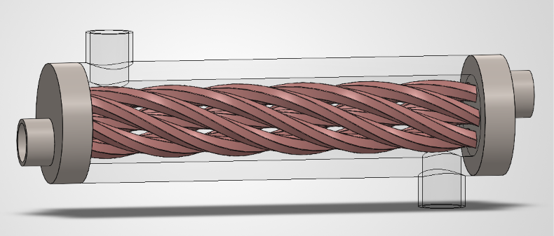
COMPUTATIONAL FLUID DYNAMICS • CAD • CONJUGATE HEAT TRANSFER
CAD Design and Simulation of a
Swirled Tube Heat Exchanger
Turbulent nonisothermal flow simulation with a hybrid Al₂O₃–CuO–CNT nanofluid coolant, using the k–ε turbulence model
Frais Asghar
Simulation Platform: COMSOL Multiphysics | September 2026
4.14 kW
75.3%
220 W/K
HEAT DUTY
EFFECTIVENESS
CONDUCTANCE

Slide 2






ROADMAP
What We Will Cover
01
02
03
CAD Geometry
Methodology
Governing Physics
Swirled tube assembly, domains, and construction sequence
Physics, materials, mesh, and solver roadmap
Continuity, RANS momentum, k–ε turbulence, energy
04
05
06
Simulation Results
Hand Calculations
Conclusions
Temperature, velocity, and pressure fields
Heat duty, LMTD, effectiveness–NTU cross check
Performance summary and future work
1

Slide 3

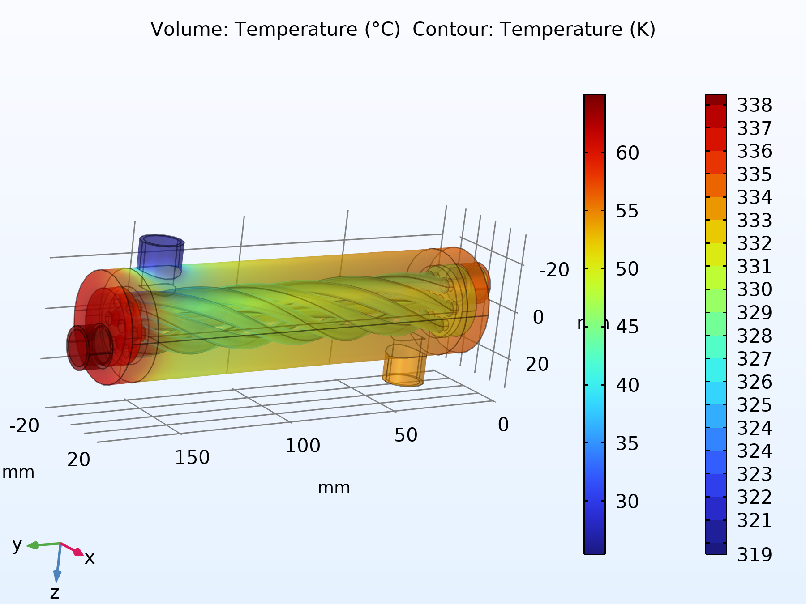


INTRODUCTION
Why Swirl and Nanofluids?
Two proven augmentation strategies, combined in one compact exchanger.
Helical Swirl Geometry
A twisted inner tube forces both streams into a continuously rotating secondary flow, disrupting the thermal boundary layer and boosting radial mixing.
Hybrid Nanofluid Coolant
An Al₂O₃–CuO–CNT hybrid nanofluid raises thermal conductivity by up to 35% over the base fluid across the tested concentration range.
Figure: coupled temperature field of the exchanger
Compounded Benefit
Combining both strategies drives a high rate of heat recovery from a laboratory scale unit, at a very small pumping power penalty.
2

Slide 4

PROJECT SCOPE
Objectives
Reconstruct the CAD Model
Formalise the Physics
Present the imported swirled tube assembly in clear, documented form.
Express the governing conjugate flow and heat transfer equations in proper notation.
Document the Setup
Interpret the Fields
Summarise materials, boundary conditions, mesh, and solver configuration.
Report simulated temperature, velocity, and pressure results with figures.
Calculate Performance
Validate Consistency
Hand calculate heat duty, LMTD, UA, effectiveness, and NTU from boundary data.
Cross check results using two independent thermal design methods.
3

Slide 5


CAD WORKFLOW
From SolidWorks Assembly to Simulation Ready Geometry
1
2
3
4
5
SolidWorks Assembly
Boolean Operations
Domain Tagging
Geometry Finalised
→
Import and Orient
→
→
→
Helically swirled inner tube and shell built as a 3D parasolid assembly.
Difference, delete entities, and union define the fluid and solid domains.
Twelve domains and 120 boundaries tagged for inlets, outlets, and walls.
Ready for material assignment, physics setup, and meshing.
Imported to COMSOL; rotated 90° and translated to align the flow axis.
4

Slide 6
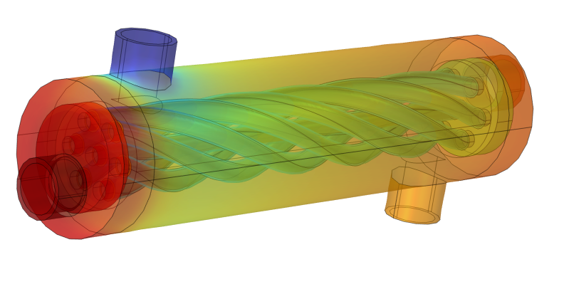
CAD GEOMETRY
Domain Breakdown and Materials
1–3
Acrylic Plastic
Transparent outer shell and end headers
4
Al₂O₃–CuO–CNT 1.2%
Hot nanofluid, swirled inner tube passage
5
Water (liquid)
Cold working fluid, annular shell passage
6–12
Steel AISI 4340
Tube wall, baffles, structural end plates
Overall flow length ≈ 180 mm | Shell diameter ≈ 40 mm
5

Slide 7

SIMULATION METHODOLOGY
Six Stage Numerical Workflow
Geometry
→
Materials
→
Physics
→
Mesh
→
Solve
→
Post-process
Import & domain setup
Steel, acrylic, water, nanofluid
Turbulent flow + conjugate heat transfer
Tetrahedral + boundary layers
Stationary, segregated AMG solver
Fields, tables, hand calculations
Every stage feeds the next: geometry defines where materials sit, materials and physics define the mesh resolution needed, and the solved fields are what the hand calculations of Section 7 build upon.
6

Slide 8

MATHEMATICAL FORMULATION
Governing Equations
Continuity
Momentum (RANS)
∇·(ρ u) = 0
ρ(u·∇)u = −∇p + ∇·[(μ+μₜ)(∇u+∇uᵀ)]
Steady state conservation of mass in both fluid domains.
Time averaged turbulent momentum balance.
k–ε Turbulence
Conjugate Energy
μₜ = ρ Cμ k² / ε
ρ Cp u·∇T = ∇·(k∇T)
Two equation closure with standard wall functions.
Coupled fluid convection and solid conduction, no assumed film coefficient.
7

Slide 9
MATERIALS
Nanofluid Enhancement Over Base Fluid
Thermal Conductivity vs. Nanoparticle Concentration
Hot Stream
Al₂O₃–CuO–CNT, 1.2%
Density
1021.7 kg/m³
Specific heat
3997 J/(kg·K)
Conductivity
1.003 W/(m·K)
Cold Stream
Water (liquid)
Density
997 kg/m³
Specific heat
4182 J/(kg·K)
Conductivity
0.613 W/(m·K)
8

Slide 10
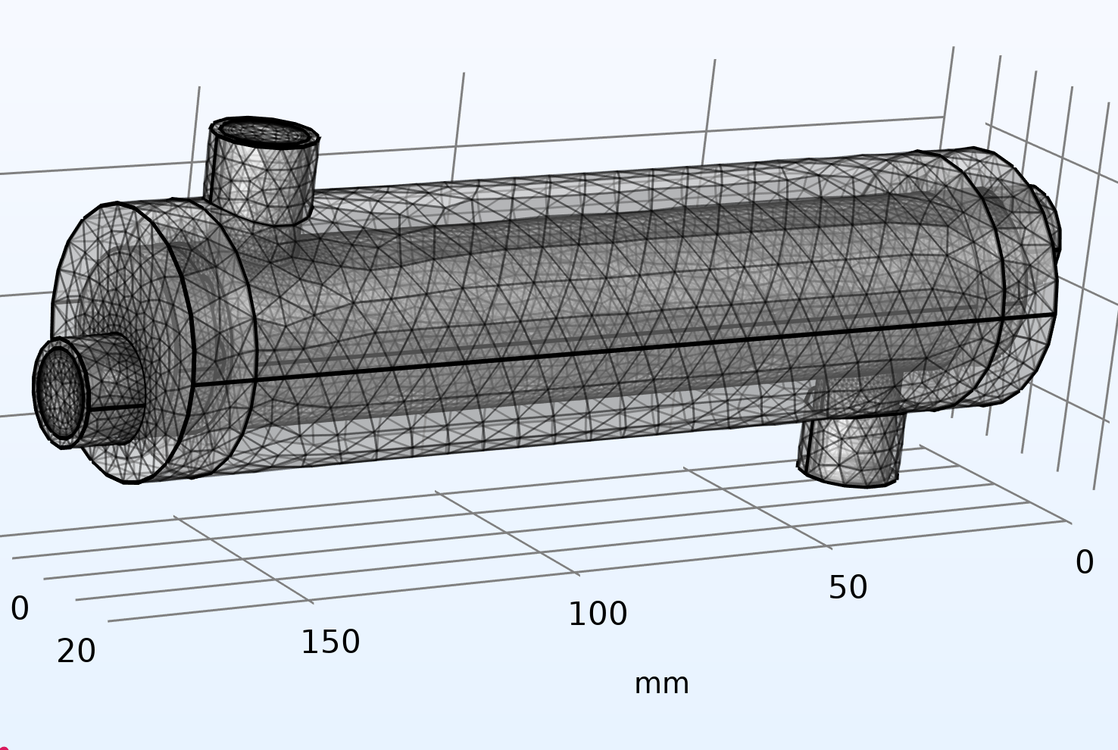
NUMERICAL SETUP
Mesh and Solver Configuration
Fluid Element Size
6.89 mm max, 1.291 mm min, with resolution of narrow regions at 0.5
Boundary Layers
5 prismatic layers at every fluid wall, thickness adjustment factor 2.5
Solver
Stationary study, segregated solver with 3 groups, AMG linear solver
Tolerance
User controlled relative tolerance of 1 × 10⁻⁴
9

Slide 11
SIMULATION RESULTS
Temperature Field
The hot nanofluid enters the swirled inner tube at 65.0°C and is progressively cooled as it releases heat through the steel wall to the cold water stream, which is heated in the annular shell passage. The helical banding visible in the volume plot is the signature of swirl induced secondary flow, which repeatedly folds hot and cold fluid layers together along the tube length.
65.00°C → 57.15°C
Hot inlet → outlet
25.40°C → 55.00°C
Cold inlet → outlet
Volumetric temperature field with contour lines over the complete assembly
10

Slide 12
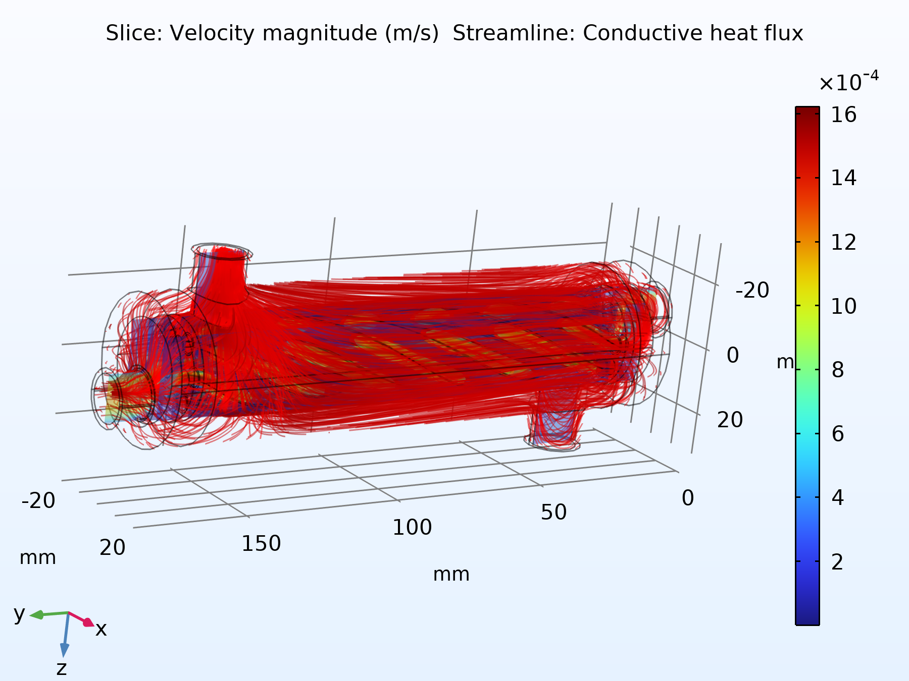
SIMULATION RESULTS
Velocity Field and Streamlines
Streamlines confirm that both fluid streams closely follow the intended helical path imposed by the swirled tube geometry. The highest velocity magnitudes occur where the flow cross section is locally constricted by the swirl, consistent with mass continuity, and this constant redirection is exactly what drives the enhanced radial mixing.
8 L/min (nanofluid)
Hot flow rate
2 L/min (water)
Velocity streamlines illustrating the helical secondary flow pattern
Cold flow rate
11

Slide 13
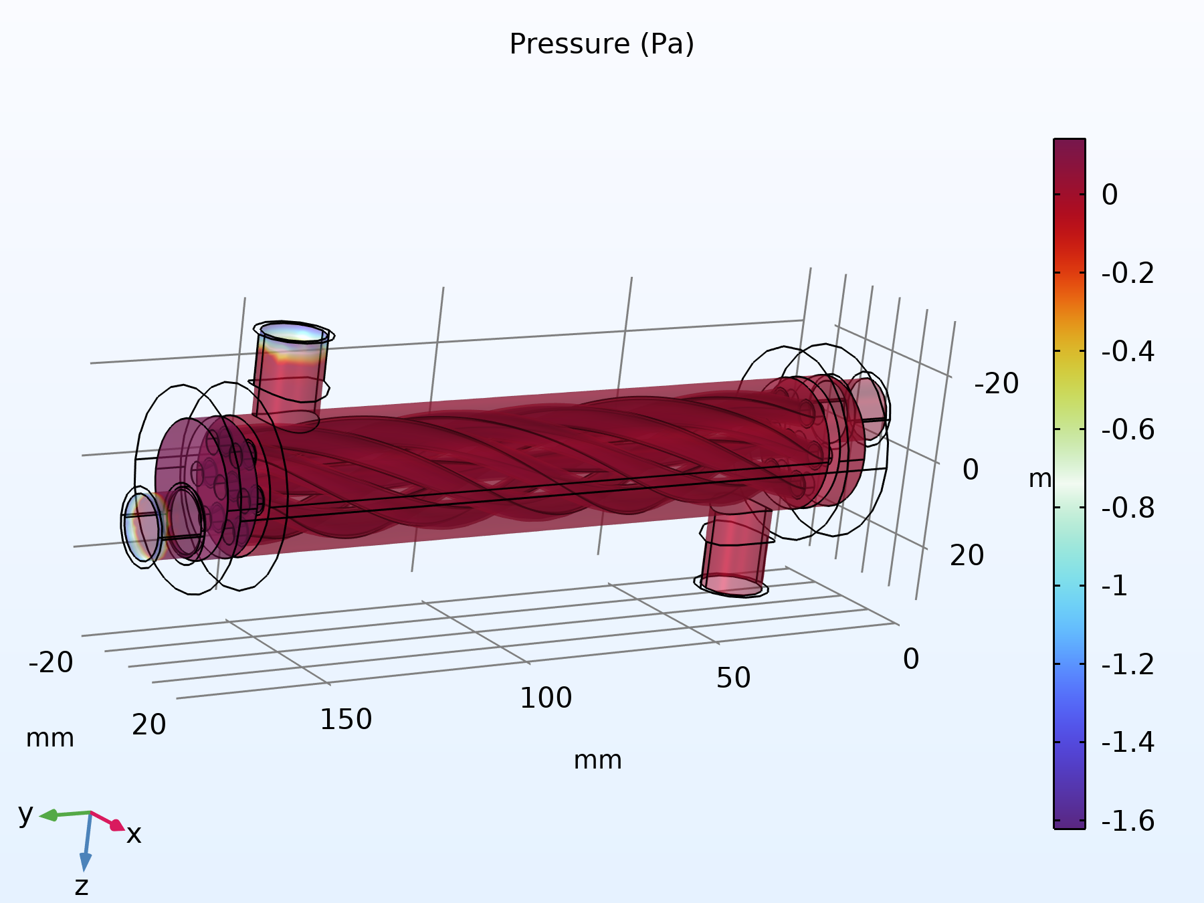
SIMULATION RESULTS
Static Pressure Field
Because the exchanger operates at low mean velocity, of order 2 to 8 litres per minute through a compact cross section, the overall magnitude of the static pressure variation across the unit is small. Both outlets are referenced to a fixed 0 Pa gauge condition, so the plotted field reflects only the small frictional and swirl induced dynamic pressure changes within each circuit.
≈ 2.39 Pa
Hot side pressure change
Static pressure field throughout the fluid domains
≈ 1.22 Pa
Cold side pressure change
12

Slide 14

HAND CALCULATED PERFORMANCE
From Raw Fields to Validated Performance
1
2
3
4
5
6
Mass Flow Rates
→
Heat Duty
→
LMTD
→
Overall UA
→
ε–NTU Method
→
Validated Result
ρQ for hot and cold streams
Energy balance, both streams
Counter current log mean ΔT
Q / ΔTlm
Independent cross check
Agreement within 0.8%
Two independent methods, the LMTD method and the effectiveness–NTU method, converge to within 0.8% of one another, confirming the extracted boundary values are thermodynamically self consistent.
ΔTlm = (ΔT₂ − ΔT₁) / ln(ΔT₂/ΔT₁)
UA = Q / ΔTlm
ε = [1 − exp(−NTU(1−Cr))] / [1 − Cr·exp(−NTU(1−Cr))]
18.83 K
220.0 W/K
75.3%
13

Slide 15
PERFORMANCE SUMMARY
Key Results at a Glance
Heat Exchanger Effectiveness
4.14 kW
220 W/K
Recovered Heat Duty
Overall Conductance (UA)
75.3%
Average of hot and cold side energy balances, agreeing to 1.4%
Cross validated by LMTD and ε–NTU methods
18.83 K
≈ 2 Pa
of thermodynamic maximum
Log Mean Temperature Difference
Hydraulic Pressure Penalty
Counter current arrangement
Negligible pumping power cost for the thermal benefit gained
14

Slide 16

CONCLUSION
What This Study Demonstrates
Effective Dual Augmentation
Swirl geometry and hybrid nanofluid together deliver strong heat recovery from a compact, laboratory scale exchanger.
Thermodynamically Consistent
Independent LMTD and effectiveness–NTU calculations agree to within 0.8%, validating the extracted CFD results.
Low Hydraulic Cost
Both circuits show pressure changes of only 1 to 2 pascals, a negligible pumping penalty for a 75.3% effectiveness.
Future Work
Compare the 0.3, 0.6, and 0.9% nanofluid concentrations, compute the wetted area for a true U value, and run a mesh independence study.
15

Slide 17
Thank You
Questions and discussion are welcome.
Frais Asghar
CAD Design and CFD Simulation | Swirled Tube Heat Exchanger
16

