Slide 1
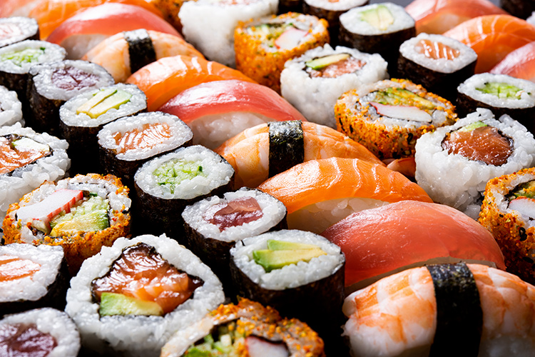
Capstone Project
Sushi in Milan

Slide 2
Introduction: If you ask an Italian what the national food is, he/she will 99% respond "Pizza". That 1% belongs to the citizens of Milan, if you by chance pick up one of them, you are likely to be answered "Sushi". I want to understand how the Sushi arena can be accessed in the city I live in: Milan.
Dataset: I will be using the Foursquare location data to understand where Sushi makers are located and to specifically discover how many are located close to my house.

Slide 3
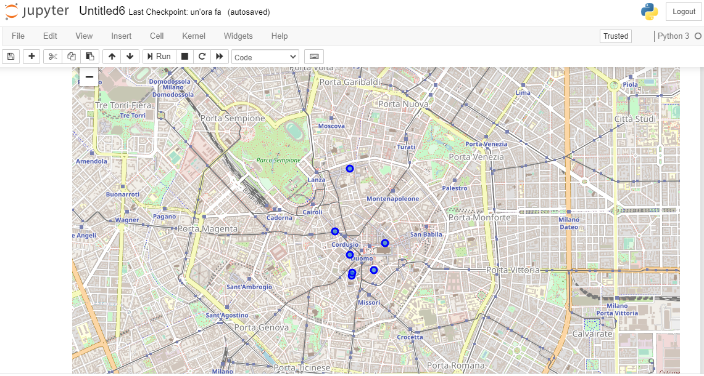
Results
List of Sushi restaurants in Milan and visual representation:

Slide 4
Results
Focus on the tips from a selected Sushi restaurant:

Slide 5
Thank you for attention!

