Slide 1
1090507演練課

Slide 2

109 05 20(三) 第二次期中考
時間：109.05.20 15:30～17:20
要到學校考，會多借一間教室 (到時會公布)
範圍：ch8～9 (如有更動會再公布到moodle)
滿分也是120

Slide 3
Review Ch8

Slide 4
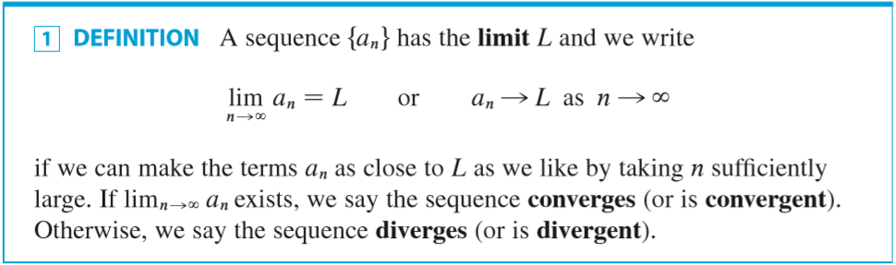
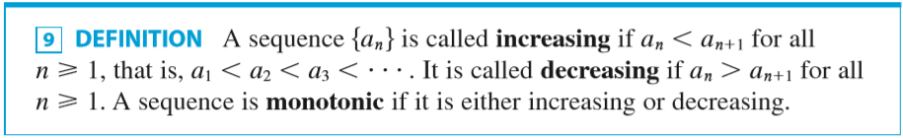

Slide 5
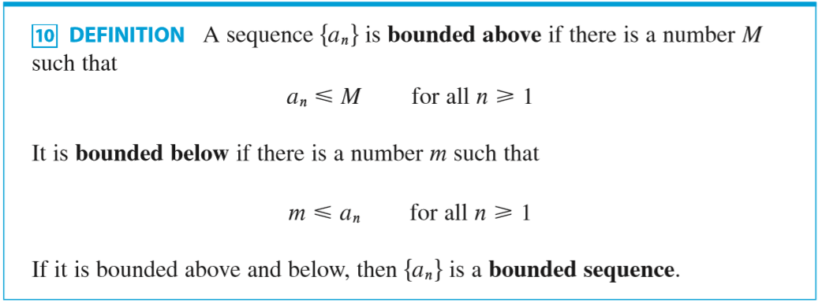
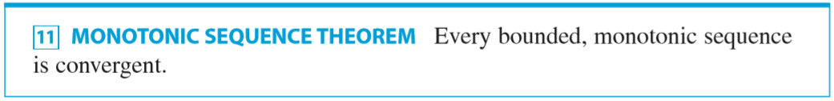

Slide 6
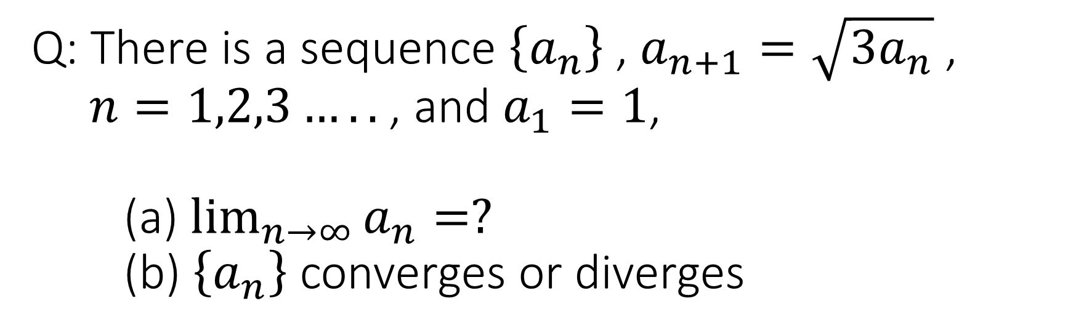
Q: There is a sequence $\left\{a_{n}\right\}$ , $a_{n+1}=\sqrt{3a_{n}}$ , $n=1,2,3…..$ , and $a_{1}=1$, (a) $\lim_{n→∞}{a_{n}}=?$ (b) $\left\{a_{n}\right\}$ converges or diverges

Slide 7
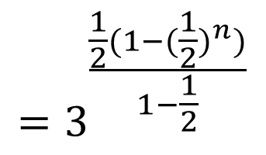
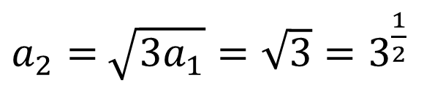

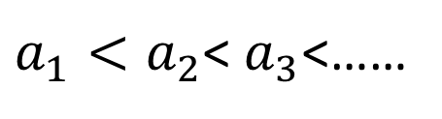

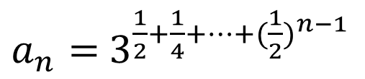
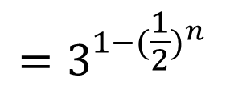
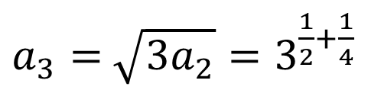
$$a_{1}=1$$
$a_{2}=$ $\sqrt{3a_{1}}=\sqrt{3}=3^{\frac{1}{2}}$
$a_{1}<a_{2}$< $a_{3}$<……
$a_{3}=$ $\sqrt{3a_{2}}=3^{\frac{1}{2}+\frac{1}{4}}$
Monotonic increasing
.
.
.
Bounded above?
$$=3^{\frac{\frac{1}{2}(1−{(\frac{1}{2})}^{n})}{1−\frac{1}{2}}}$$
$a_{n}=$ $3^{\frac{1}{2}+\frac{1}{4}+…+({\frac{1}{2})}^{n−1}}$
$$=3^{1−{(\frac{1}{2})}^{n}}$$
$$<3$$
Bounded above
By monotonic sequence theorem $\left\{a_{n}\right\}$ is convergent

Slide 8
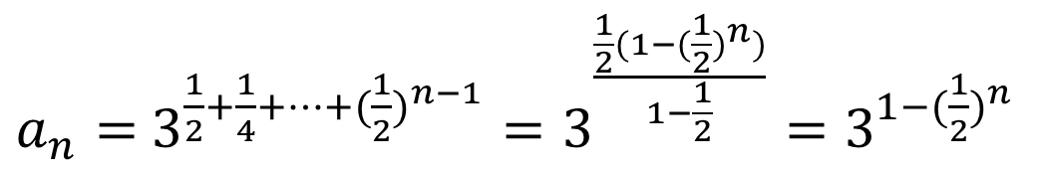
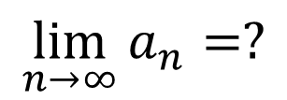

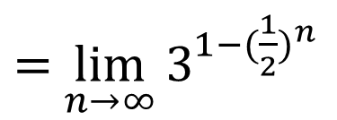
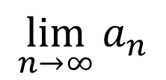
$$\lim_{n→∞}{a_{n}}=?$$
$a_{n}=$ $3^{\frac{1}{2}+\frac{1}{4}+…+({\frac{1}{2})}^{n−1}}=3^{\frac{\frac{1}{2}(1−{(\frac{1}{2})}^{n})}{1−\frac{1}{2}}}=3^{1−{(\frac{1}{2})}^{n}}$
$$\lim_{n→∞}{a_{n}}$$
$=$ $\lim_{n→∞}{3^{1−{(\frac{1}{2})}^{n}}}$
$$=3$$

Slide 9
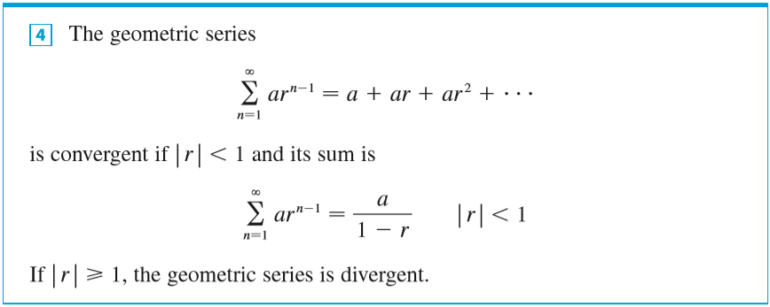

Slide 10
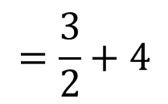
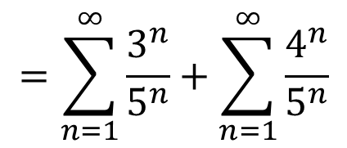

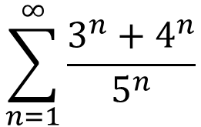
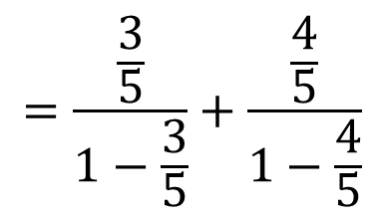
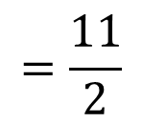
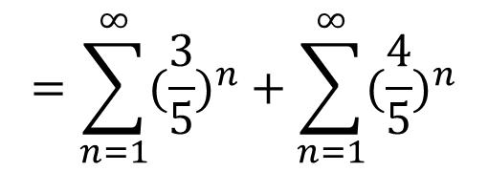
$$\sum_{n=1}^{∞}{\frac{3^{n}+4^{n}}{5^{n}}}$$
$$=\sum_{n=1}^{∞}{\frac{3^{n}}{5^{n}}}+\sum_{n=1}^{∞}{\frac{4^{n}}{5^{n}}}$$
$$=\sum_{n=1}^{∞}{{(\frac{3}{5})}^{n}}+\sum_{n=1}^{∞}{{(\frac{4}{5})}^{n}}$$
$$=\frac{\frac{3}{5}}{1−\frac{3}{5}}+\frac{\frac{4}{5}}{1−\frac{4}{5}}$$
$$=\frac{3}{2}+4$$
$$=\frac{11}{2}$$
$$\left|r\right|<1$$

Slide 11




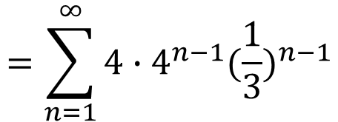
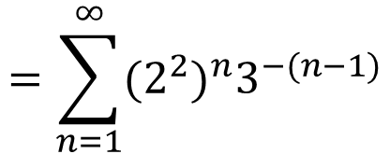

$$\sum_{n=1}^{∞}{2^{2n}3^{1−n}}$$
converges or diverges?
$$=\sum_{n=1}^{∞}{ar^{n−1}}$$
$$=\sum_{n=1}^{∞}{4∙{(\frac{4}{3})}^{n−1}}$$
$$=\sum_{n=1}^{∞}{{(2^{2})}^{n}3^{−(n−1)}}$$
$$\left|r\right|≥1$$
$$=\sum_{n=1}^{∞}{{4∙4}^{n−1}{(\frac{1}{3})}^{n−1}}$$
$$∴\text{diverges}$$

Slide 12
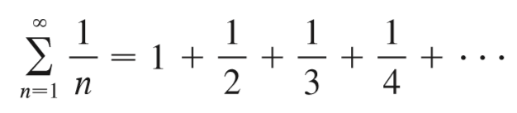


Harmonic series
is $\text{diverges}$

Slide 13

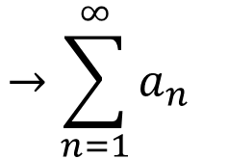

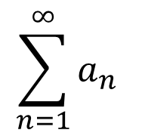
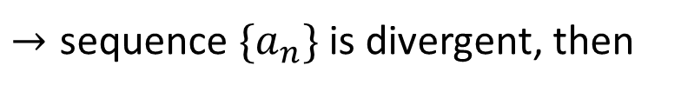

換言之
$$→\sum_{n=1}^{∞}{a_{n}}$$
is convergent, then $\text{sequence} \{a_{n}\}$is convergent
$$\sum_{n=1}^{∞}{a_{n}}$$
$→\text{sequence} \{a_{n}\}$is divergent, then
is divergent
$$←$$
不一定

Slide 14


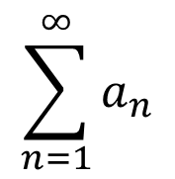
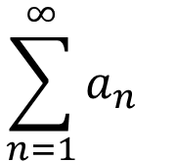
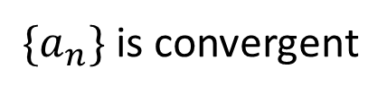


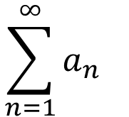
$$\sum_{n=1}^{∞}{a_{n}}$$
False
$\text{sequence} \{a_{n}\}$is convergent, then
is convergent
$$\{1,1,1,1,…,1\}$$
$$\lim_{n→∞}{a_{n}=1 }$$
$\{a_{n}\}$is convergent
but
$$\sum_{n=1}^{∞}{a_{n}}$$
$$\sum_{n=1}^{∞}{a_{n}}$$
$$=1+1+1+…+1$$
is divergent

Slide 15

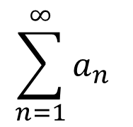
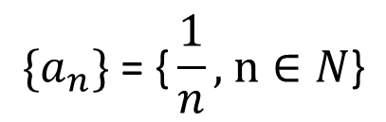
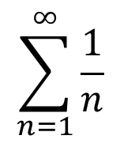
$$\sum_{n=1}^{∞}{a_{n}}$$
False
is divergent, then $\text{sequence} \{a_{n}\}$is divergent
$$\sum_{n=1}^{∞}{\frac{1}{n}}$$
is divergent
but
$$\{a_{n}\} \text{= \{}\frac{1}{n}\text{, }\text{n}∈N\text{\}}$$
is convergent

