Slide 1
1090521演練課

Slide 2
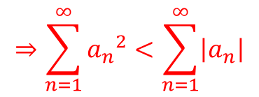


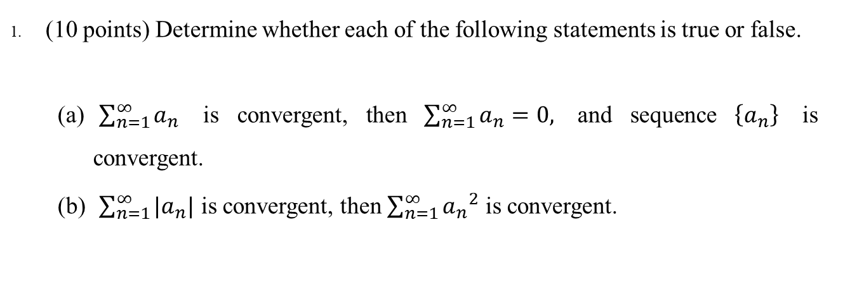



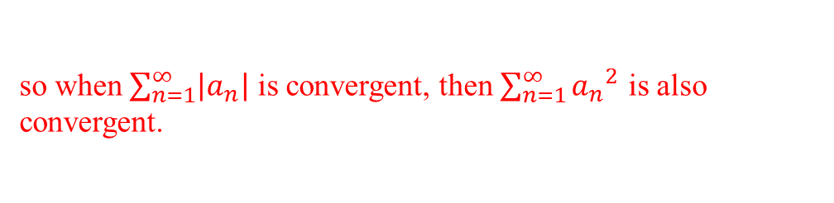
(10 points) Determine whether each of the following statements is true or false.
$\sum_{n=1}^{∞}{a_{n}}$ is convergent, then $\sum_{n=1}^{∞}{a_{n}}=0,$ and sequence $\left\{a_{n}\right\}$ is convergent.
$\sum_{n=1}^{∞}{|a_{n}|}$ is convergent, then $\sum_{n=1}^{∞}{{a_{n}}^{2}}$ is convergent.
FALSE
TRUE
$$⇒ \lim_{n→0}{a_{n}}=0$$
Pf. (b) If $\sum_{n=1}^{∞}{a_{n}}$ is convergent
$$⇒ \lim_{n→0}\left|a_{n}\right|=0$$
=> absolutely convergent
$$⇒\sum_{n=1}^{∞}{{a_{n}}^{2}}<\sum_{n=1}^{∞}{\left|a_{n}\right|}$$
$$0<\left|a_{n}\right|<1$$
, $0<{a_{n}}^{2}<\left|a_{n}\right|<1$
so when $\sum_{n=1}^{∞}{\left|a_{n}\right|}$ is convergent, then $\sum_{n=1}^{∞}{{a_{n}}^{2}}$ is also convergent.

Slide 3
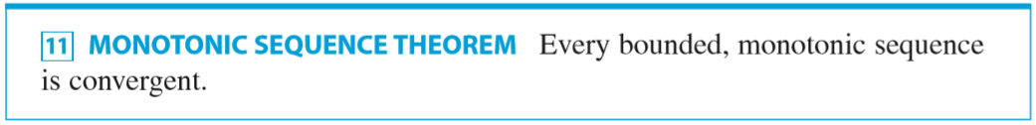










2. (10 points) There is a sequence $\left\{a_{n}\right\},$ $a_{n+1}=\sqrt{5a_{n}}, n=1, 2, 3, …,$and $a_{1}=1$.
(a) Find $\lim_{n→∞}{a_{n}=}$ ?
(b) Determine whether $\left\{a_{n}\right\}$ is convergent or divergent?
$$a_{1}=1$$
$a_{1}<a_{2}$< $a_{3}$<……
$a_{2}=$ $\sqrt{5a_{1}}=\sqrt{5}=5^{\frac{1}{2}}$
Monotonic increasing
$a_{3}=$ $\sqrt{5a_{2}}=5^{\frac{1}{2}+\frac{1}{4}}$
Bounded above?
.
.
.
$$=5^{\frac{\frac{1}{2}(1−{(\frac{1}{2})}^{n})}{1−\frac{1}{2}}}$$
$a_{n}=$ $5^{\frac{1}{2}+\frac{1}{4}+…+({\frac{1}{2})}^{n−1}}$
$$=5^{1−{(\frac{1}{2})}^{n}}$$
$$<5$$
Bounded above
By monotonic sequence theorem $\left\{a_{n}\right\}$ is convergent
$\lim_{n→∞}{a_{n}=} 5$

Slide 4
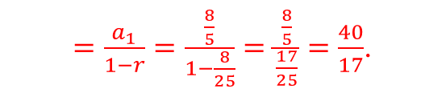

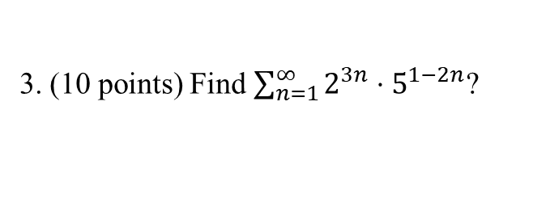



3. (10 points) Find $\sum_{n=1}^{∞}{2^{3n}⋅5^{1−2n}}$?
$$\sum_{n=1}^{∞}{2^{3n}⋅5^{1−2n}}$$
$$=\sum_{n=1}^{∞}{5⋅{\left(\frac{8}{25}\right)}^{n}}$$
$⇒\left|r\right|=\frac{8}{25}<1$.
$$=\sum_{n=1}^{∞}{{\left(2^{3}\right)}^{n}⋅5⋅{\left(5^{−2}\right)}^{n}}$$
By “the geometric series”
$$=\sum_{n=1}^{∞}{8^{n}⋅5⋅\frac{1}{{25}^{n}}}$$
$=\frac{a_{1}}{1−r}=\frac{\frac{8}{5}}{1−\frac{8}{25}}=\frac{\frac{8}{5}}{\frac{17}{25}}=\frac{40}{17}$.

Slide 5
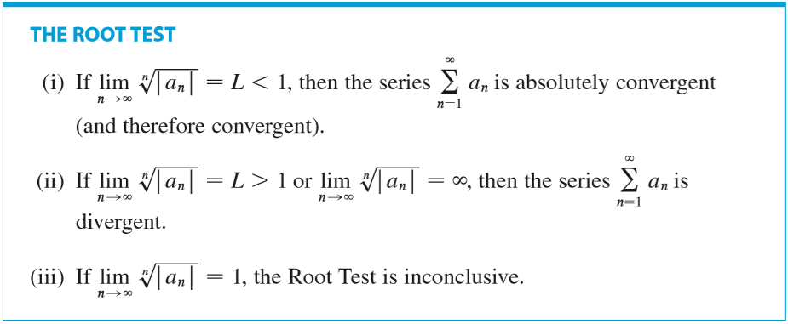
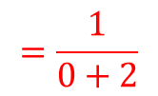
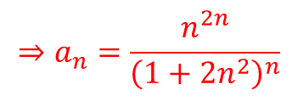


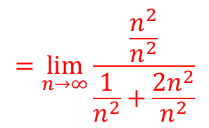
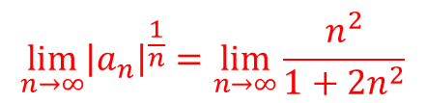



4. (18 points) Determine whether each of the following series is convergent or divergent.
(a) $\sum_{n=1}^{∞}{\frac{n^{2n}}{{\left(1+2n^{2}\right)}^{n}}}$
$$⇒a_{n}=\frac{n^{2n}}{{\left(1+2n^{2}\right)}^{n}}$$
$$={\left[\frac{n^{2}}{1+2n^{2}}\right]}^{n}$$
$$\lim_{n→∞}{{\left|a_{n}\right|}^{\frac{1}{n}}}=\lim_{n→∞}{\frac{n^{2}}{1+2n^{2}}}$$
$$=\lim_{n→∞}{\frac{1}{\frac{1}{n^{2}}+2}}$$
$$=\lim_{n→∞}{\frac{\frac{n^{2}}{n^{2}}}{\frac{1}{n^{2}}+\frac{2n^{2}}{n^{2}}}}$$
$$=\frac{1}{0+2}$$
$$=\frac{1}{2}$$
$$<1$$
convergent

Slide 6
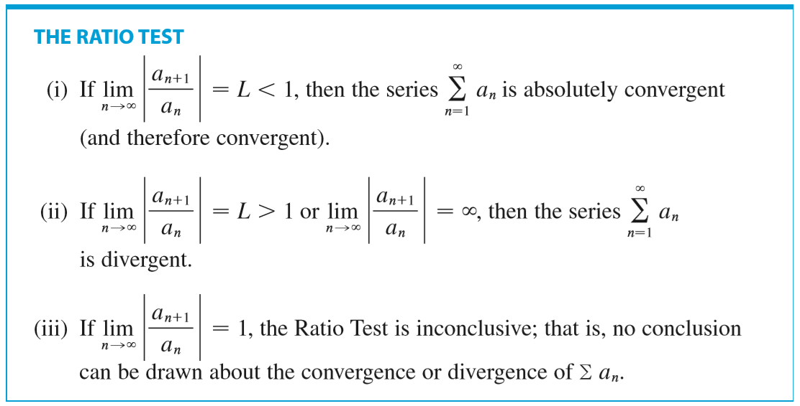



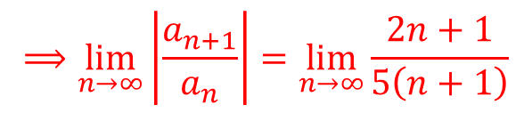



(b) $\sum_{n=1}^{∞}{\frac{1×3×5×…×\left(2n−1\right)}{5^{n}×n!}}$
$⇒a_{n}=\frac{1×3×5×…×\left(2n−1\right)}{5^{n}×n!}$, $a_{n+1}=\frac{1×3×5×…×\left(2n−1\right)\left(2n+1\right)}{5^{n+1}×\left(n+1\right)!}$
$a_{n+1}$ $=a_{n}×\frac{2n+1}{5\left(n+1\right)}$
$$\frac{a_{n+1}}{a_{n}}=\frac{2n+1}{5\left(n+1\right)}$$
$$⟹\lim_{n→∞}\left|\frac{a_{n+1}}{a_{n}}\right|=\lim_{n→∞}\frac{2n+1}{5\left(n+1\right)}$$
$$=\lim_{n→∞}\frac{2+\frac{1}{n}}{5\left(1+\frac{1}{n}\right)}$$
$$=\frac{2}{5}$$
convergent.
$$<1.$$

Slide 7

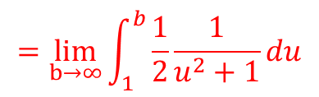


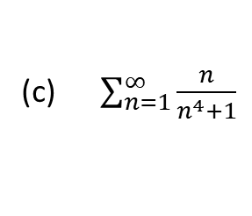
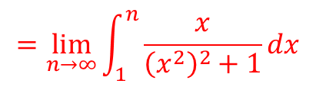
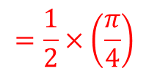
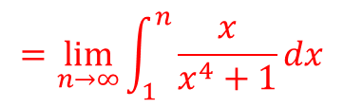
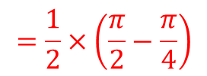
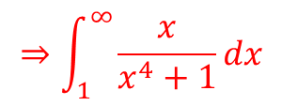
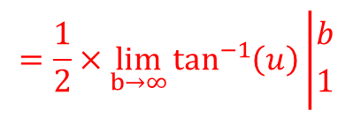
(c) $\sum_{n=1}^{∞}{\frac{n}{n^{4}+1}}$
positive
continuous
dicreasing
$$u=x^{2}$$
$$⇒\int_{1}^{∞}{\frac{x}{x^{4}+1}}dx$$
$$=\lim_{b→∞}\int_{1}^{b}{\frac{1}{2}\frac{1}{u^{2}+1}}du$$
$$=\lim_{n→∞}\int_{1}^{n}{\frac{x}{x^{4}+1}}dx$$
$$=\frac{1}{2}×\lim_{b→∞}\tan^{−1}\left(u\right)\left|{b \atop 1}\right.$$
$$=\lim_{n→∞}\int_{1}^{n}{\frac{x}{{\left(x^{2}\right)}^{2}+1}}dx$$
$$=\frac{1}{2}×\left(\frac{π}{2}−\frac{π}{4}\right)$$
$$=\frac{1}{2}×\left(\frac{π}{4}\right)$$
$$=\frac{π}{8}$$
convergent.

Slide 8
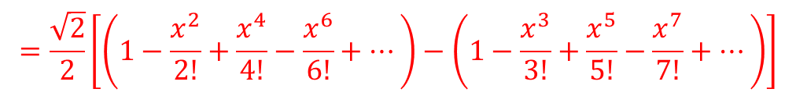

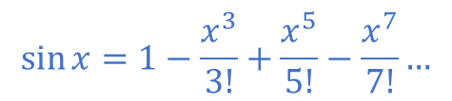
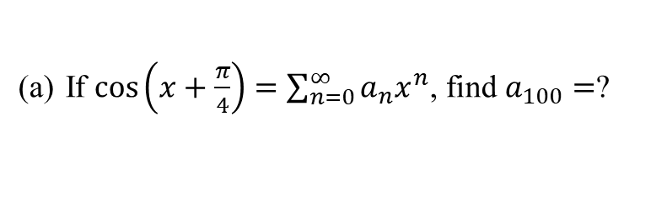

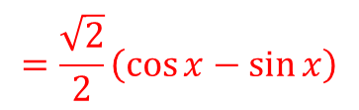
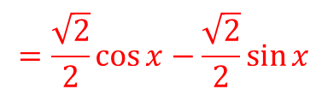
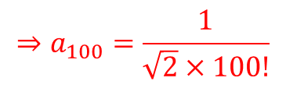
5. (14 points) Solve each of the following problems.
If $cos\left(x+\frac{π}{4}\right)=\sum_{n=0}^{∞}{a_{n}x^{n}}$, find $a_{100}=$?
$$⇒\cos\left(x+\frac{π}{4}\right)=\cos{x}\cos{\frac{π}{4}}−\sin{x}\sin{\frac{π}{4}}$$
$$=\frac{\sqrt{2}}{2}\cos{x}−\frac{\sqrt{2}}{2}\sin{x}$$
$$=\frac{\sqrt{2}}{2}\left(\cos{x}−\sin{x}\right)$$
$\cos{x}=1−\frac{x^{2}}{2!}+\frac{x^{4}}{4!}−\frac{x^{6}}{6!}…$
$$\sin{x}=1−\frac{x^{3}}{3!}+\frac{x^{5}}{5!}−\frac{x^{7}}{7!}…$$
$$=\frac{\sqrt{2}}{2}\left[\left(1−\frac{x^{2}}{2!}+\frac{x^{4}}{4!}−\frac{x^{6}}{6!}+…\right)−\left(1−\frac{x^{3}}{3!}+\frac{x^{5}}{5!}−\frac{x^{7}}{7!}+…\right)\right]$$
$$⇒a_{100}=\frac{1}{\sqrt{2}×100!}$$

Slide 9
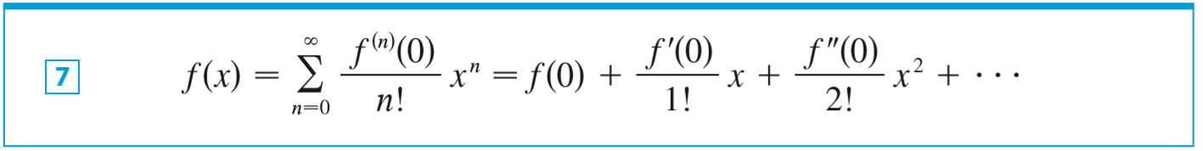



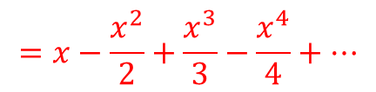
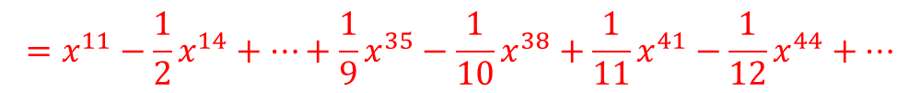
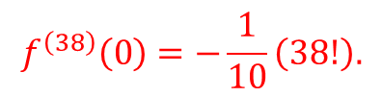
(b)$f\left(x\right)=x^{8}\ln\left(1+x^{3}\right),$ then $f^{(38)}\left(0\right)=$?
$$=x−\frac{x^{2}}{2}+\frac{x^{3}}{3}−\frac{x^{4}}{4}+…$$
$$\ln\left|1+x\right|$$
$$=x^{3}−\frac{1}{2}x^{6}+\frac{1}{3}x^{9}−\frac{1}{4}x^{12}+…+\frac{1}{9}x^{27}−\frac{1}{10}x^{30}+\frac{1}{11}x^{33}−…$$
$$\ln\left|1+x^{3}\right|$$
$$x^{8}⋅\ln\left(1+x^{3}\right)$$
$$=x^{11}−\frac{1}{2}x^{14}+…+\frac{1}{9}x^{35}−\frac{1}{10}x^{38}+\frac{1}{11}x^{41}−\frac{1}{12}x^{44}+…$$
$$f^{\left(38\right)}\left(0\right)=−\frac{1}{10}\left(38!\right).$$

Slide 10

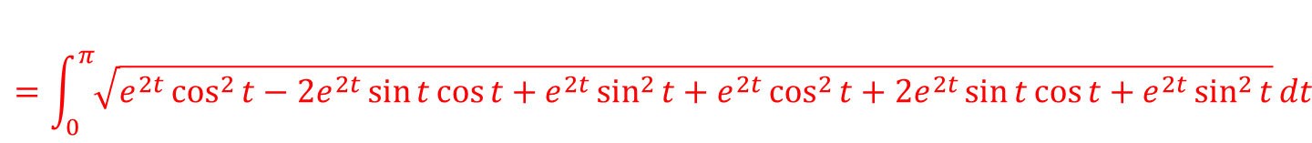
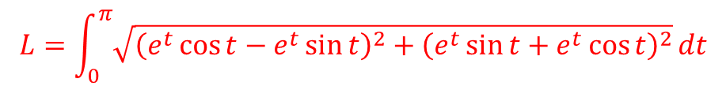

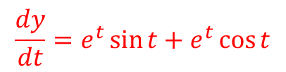

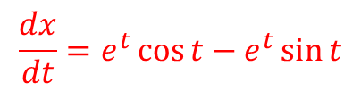

6. (10 points) Find the length of the curve $x=e^{t}\cos{t}, y=e^{t}\sin{t}, 0≤t≤π.$
$$⇒L=\int_{a}^{b}{\sqrt{{\left(\frac{dx}{dt}\right)}^{2}+{\left(\frac{dy}{dt}\right)}^{2}dt}}$$
$$\frac{dx}{dt}=e^{t}\cos{t}−e^{t}\sin{t}$$
$$\frac{dy}{dt}=e^{t}\sin{t}+e^{t}\cos{t}$$
$$L=\int_{0}^{π}{\sqrt{{\left(e^{t}\cos{t}−e^{t}\sin{t}\right)}^{2}+{\left(e^{t}\sin{t}+e^{t}\cos{t}\right)}^{2}}}dt$$
$$=\int_{0}^{π}{\sqrt{e^{2t}\cos^{2}{t}−2e^{2t}\sin{t}\cos{t}+e^{2t}\sin^{2}{t}+e^{2t}\cos^{2}{t}+2e^{2t}\sin{t}\cos{t}+e^{2t}\sin^{2}{t}}}dt$$
$$=\int_{0}^{π}{\sqrt{2e^{2t}}}dt$$
$$=\int_{0}^{π}{\sqrt{2}}e^{t}dt$$
$$=\int_{0}^{π}{\sqrt{2e^{2t}\cos^{2}{t}+2e^{2t}\sin^{2}{t}}}dt$$
$$=\sqrt{2}\left(e^{π}−1\right)$$

Slide 11
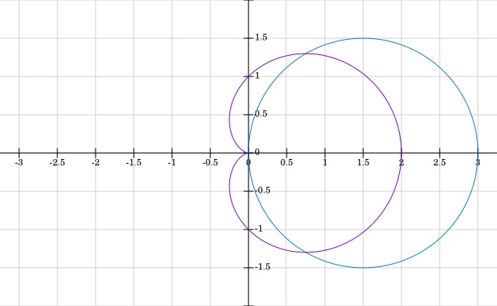
7. (10 points) Find the area of the region that lies inside $r=3\cos{θ}$ and outside $r=1+\cos{θ}$.

Slide 12
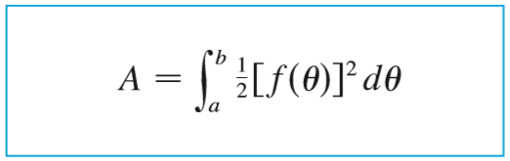
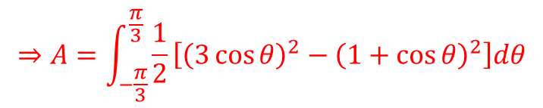
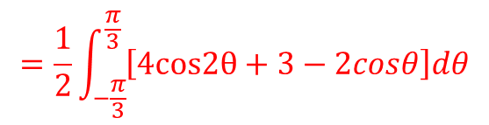



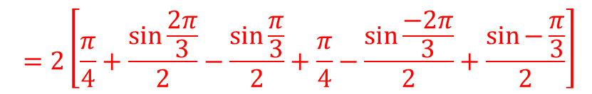



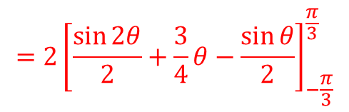
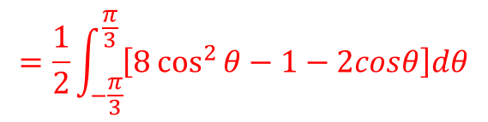


7. (10 points) Find the area of the region that lies inside $r=3\cos{θ}$ and outside $r=1+\cos{θ}$.
$$=\frac{1}{2}∙4\int_{−\frac{π}{3}}^{\frac{π}{3}}{\left[cos2θ+\frac{3}{4}−\frac{cosθ}{2}\right]dθ}$$
$$=\frac{1}{2}\int_{−\frac{π}{3}}^{\frac{π}{3}}{\left[9\cos^{2}{θ}−\left(1+2\cos{θ}+\cos^{2}{θ}\right)\right]dθ}$$
$$=2{\left[\frac{\sin{2θ}}{2}+\frac{3}{4}θ−\frac{\sin{θ}}{2}\right]}_{−\frac{π}{3}}^{\frac{π}{3}}$$
$$⇒A=\int_{−\frac{π}{3}}^{\frac{π}{3}}{\frac{1}{2}}\left[{\left(3\cos{θ}\right)}^{2}−{\left(1+\cos{θ}\right)}^{2}\right]dθ$$
$$⇒3\cos{θ}=1+\cos{θ}$$
$$2\cos{θ}=1$$
$$=\frac{1}{2}\int_{−\frac{π}{3}}^{\frac{π}{3}}{\left[8\cos^{2}{θ}−1−2cosθ\right]dθ}$$
$$=2\left[\frac{π}{4}+\frac{\sin{\frac{2π}{3}}}{2}−\frac{\sin{\frac{π}{3}}}{2}+\frac{π}{4}−\frac{\sin{\frac{−2π}{3}}}{2}+\frac{\sin{−\frac{π}{3}}}{2}\right]$$
$\cos{θ}=\frac{1}{2}$
$$\cos{2θ=2\cos^{2}θ−1}$$
$θ=\frac{π}{3}$ , $−\frac{π}{3}$
$$→8\cos^{2}θ{=4cos2θ+4}$$
$$=π$$
$$=\frac{1}{2}\int_{−\frac{π}{3}}^{\frac{π}{3}}{\left[4cos2θ+3−2cosθ\right]dθ}$$

Slide 13

8.

Slide 14












9. Find the area of the region that is bounded by the polar curve 𝑟 = cos 𝜃, 0 ≤ 𝜃 ≤ $\frac{π}{6}$ .
$$A=\frac{1}{2}\int_{a}^{b}{r^{2}dθ}$$
$$\cos{2θ=2\cos^{2}θ−1}$$
$$=\frac{1}{2}\int_{0}^{\frac{π}{6}}{\cos^{2}θdθ}$$
$$→\cos^{2}θ{=\frac{cos2θ+1}{2}}$$
$$=\frac{1}{2}\int_{0}^{\frac{π}{6}}{\frac{cos2θ+1}{2}dθ}$$
$$=\frac{1}{4}\left(\frac{1}{2}sin\frac{π}{3}+\frac{π}{6}−0−0\right)$$
$$=\frac{1}{4}\int_{0}^{\frac{π}{6}}{\left(cos2θ+1\right) dθ}$$
$$=\frac{1}{4}\left(\frac{1}{2}×\frac{\sqrt{3}}{2}+\frac{π}{6}\right)$$
$$=\frac{1}{4}{\left(\frac{1}{2}sin2θ+θ\right)}_{0}^{\frac{π}{6}}$$
$$=\frac{\sqrt{3}}{16}+\frac{π}{24}$$
$$=\frac{2π+3\sqrt{3}}{48}$$

Slide 15










10. (10 points) Find $\frac{dy}{dx}$ and $\frac{d^{2}y}{dx^{2}}$ for $x=1+t^{2}, y=t−t^{3}.$
$$\frac{dy}{dx}=\frac{\frac{dy}{dt}}{\frac{dx}{dt}}$$
$$\frac{d}{dt}\left(\frac{dy}{dx}\right)=\frac{−6t\left(2t\right)−{\left(1−3t^{2}\right)}^{2}}{{\left(2t\right)}^{2}}$$
$$=\frac{−12t^{2}−2+6t^{2}}{4t^{2}}$$
If $\frac{dx}{dt}≠0$ , $\frac{dx}{dt}=2t\text{, }\frac{dy}{dt}=1−3t^{2}$
$$=\frac{−6t^{2}−2}{4t^{3}}$$
$$⇒\frac{dy}{dx}=\frac{1−3t^{2}}{2t}$$
$$=\frac{−2\left({3t}^{2}+1\right)}{4t^{2}}$$
$$\frac{d^{2}y}{dx^{2}}=\frac{\frac{d}{dt}\left(\frac{dy}{dx}\right)}{\frac{dx}{dt}}$$
$$=\frac{\frac{−2\left({3t}^{2}+1\right)}{4t^{2}}}{2t}$$
$$=\frac{−\left(3t^{2}+1\right)}{4t^{3}}$$

Slide 16

















11. (10 points) Use the parametric equations of an ellipse, $x=a\cos{θ}, y=b\sin{θ},0≤θ≤2π$, to find the area that is enclosed with the equations.
$$\frac{x}{a}=cosθ, \frac{y}{b}=sinθ$$
$$A=\int_{0}^{a}{ydx}$$
$$=b\int_{0}^{a}{\sqrt{ (1−\frac{x^{2}}{a^{2}})}dx}$$
$$\cos^{2}θ+\cos^{2}θ=1$$
$$y=∓\sqrt{b^{2}(1−\frac{x^{2}}{a^{2}})}$$
$${(\frac{x}{a})}^{2}+{(\frac{y}{b})}^{2}=1$$
$$x=acosθ$$
$dx=−asinθ$d$θ$
$$x=a$$
$$→acosθ=a$$
$$→θ=0$$
$$x=0$$
$$→acosθ=0$$
$$→θ=\frac{π}{2}$$
$$=b\int_{\frac{π}{2}}^{0}{\sqrt{ (1−\frac{{(acosθ)}^{2}}{a^{2}})}−asinθ\text{d}θ}$$
$$=−ab\int_{\frac{π}{2}}^{0}{\sin^{2}θ\text{d}θ}$$

Slide 17










$$\cos{2θ=1−2\sin^{2}θ}$$
$$=−ab\int_{\frac{π}{2}}^{0}{\sin^{2}θ\text{d}θ}$$
$$→\sin^{2}θ{=\frac{1−cos2θ}{2}}$$
$$=−\frac{1}{2}ab\int_{\frac{π}{2}}^{0}{(1−cos2θ)\text{d}θ}$$
$$=−\frac{1}{2}ab{(θ−\frac{1}{2}sin2θ)}_{\frac{π}{2}}^{0}$$
$$=−\frac{1}{2}ab(0−0−\frac{π}{2}+\frac{1}{2}sinπ)$$
$$=−\frac{1}{2}ab(−\frac{π}{2})$$
$$\frac{π}{4}ab×4$$
$$=\frac{π}{4}ab$$
$$=πab$$

