Slide 1

TCP 3-way handshake
client state
server state
LISTEN
LISTEN
choose init seq num, x
send TCP SYN msg
SYNSENT
SYNbit=1, Seq=x
choose init seq num, y
send TCP SYNACK
msg, acking SYN
SYN RCVD
SYNbit=1, Seq=y
ACKbit=1; ACKnum=x+1
received SYNACK(x)
indicates server is live;
send ACK for SYNACK;
this segment may contain
client-to-server data
ESTAB
ACKbit=1, ACKnum=y+1
received ACK(y)
indicates client is live
ESTAB

Slide 2
TCP: closing a connection
client state
server state
ESTAB
ESTAB
clientSocket.close()
FIN_WAIT_1
can no longer
send but can
receive data
FINbit=1, seq=x
CLOSE_WAIT
ACKbit=1; ACKnum=x+1
can still
send data
FIN_WAIT_2
wait for server
close
LAST_ACK
FINbit=1, seq=y
TIMED_WAIT
can no longer
send data
ACKbit=1; ACKnum=y+1
timed wait
for 2*max
segment lifetime
CLOSED
CLOSED

Slide 3
TCP congestion control: additive increase multiplicative decrease
approach: sender increases transmission rate (window size), probing for usable bandwidth, until loss occurs
additive increase: increase cwnd by 1 MSS every RTT until loss detected
multiplicative decrease: cut cwnd in half after loss
additively increase window size …
…. until loss occurs (then cut window in half)
AIMD saw tooth
behavior: probing
for bandwidth
cwnd: TCP sender
congestion window size
time

Slide 4
TCP Congestion Control: details
sender sequence number space
TCP sending rate:
roughly: send cwnd bytes, wait RTT for ACKS, then send more bytes
cwnd
last byte
ACKed
last byte sent
sent, not-yet ACKed
(“in-flight”)
rate
cwnd
sender limits transmission:
cwnd is dynamic, function of perceived network congestion
~
bytes/sec
~
RTT
LastByteSent-
LastByteAcked
cwnd
<

Slide 5
TCP: detecting, reacting to loss
loss indicated by timeout:
cwnd set to 1 MSS;
window then grows exponentially (as in slow start) to threshold, then grows linearly
loss indicated by 3 duplicate ACKs: TCP RENO
dup ACKs indicate network capable of delivering some segments
cwnd is cut in half window then grows linearly
TCP Tahoe always sets cwnd to 1 (timeout or 3 duplicate acks)

Slide 6
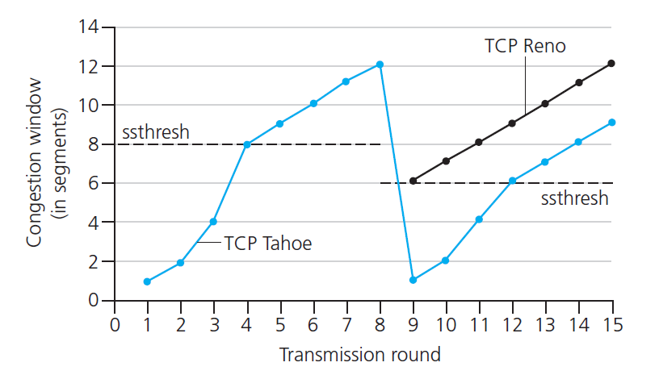
TCP: switching from slow start to CA
Q: when should the exponential increase switch to linear?
A: when cwnd gets to 1/2 of its value before timeout.
Implementation:
variable ssthresh
on loss event, ssthresh is set to 1/2 of cwnd just before loss event
* Check out the online interactive exercises for more examples: http://gaia.cs.umass.edu/kurose_ross/interactive/

Slide 7
Longest prefix matching
longest prefix matching
when looking for forwarding table entry for given destination address, use longest address prefix that matches destination address.
Destination Address Range
11001000 00010111 00010*** *********
11001000 00010111 00011000 *********
11001000 00010111 00011*** *********
otherwise
Link interface
0
1
2
3
examples:
DA: 11001000 00010111 00010110 10100001
which interface?
DA: 11001000 00010111 00011000 10101010
which interface?

Slide 8
Switching fabrics
transfer packet from input buffer to appropriate output buffer
switching rate: rate at which packets can be transfer from inputs to outputs
often measured as multiple of input/output line rate
N inputs: switching rate N times line rate desirable
three types of switching fabrics
memory
memory
bus
crossbar

Slide 9
Input port queuing
fabric slower than input ports combined -> queueing may occur at input queues
queueing delay and loss due to input buffer overflow!
Head-of-the-Line (HOL) blocking: queued datagram at front of queue prevents others in queue from moving forward
switch
fabric
switch
fabric
output port contention:
only one red datagram can be transferred. lower red packet is blocked
one packet time later: green packet experiences HOL blocking

Slide 10
Scheduling policies: priority
priority scheduling: send highest priority queued packet
multiple classes, with different priorities
class may depend on marking or other header info, e.g. IP source/dest, port numbers, etc.
real world example?
high priority queue
(waiting area)
arrivals
departures
classify
link
(server)
low priority queue
(waiting area)
2
1
3
4
5
arrivals
packet in service
1
3
2
4
5
departures
1
3
2
4
5

Slide 11
IP fragmentation, reassembly
network links have MTU (max.transfer size) - largest possible link-level frame
different link types, different MTUs
large IP datagram divided (“fragmented”) within net
one datagram becomes several datagrams
“reassembled” only at final destination
IP header bits used to identify, order related fragments
…
fragmentation:
in: one large datagram
out: 3 smaller datagrams
reassembly
…

Slide 12
IP fragmentation, reassembly
length
=4000
ID
=x
fragflag
=0
offset
=0
example:
4000 byte datagram
MTU = 1500 bytes
one large datagram becomes
several smaller datagrams
1480 bytes in data field
length
=1500
ID
=x
fragflag
=1
offset
=0
offset =
1480/8
length
=1500
ID
=x
fragflag
=1
offset
=185
length
=1040
ID
=x
fragflag
=0
offset
=370

Slide 13
IP addressing: CIDR
CIDR: Classless InterDomain Routing
subnet portion of address of arbitrary length
address format: a.b.c.d/x, where x is # bits in subnet portion of address
subnet
part
host
part
11001000 00010111 00010000 00000000
200.23.16.0/23

Slide 14
NAT: network address translation
NAT translation table
WAN side addr LAN side addr
2: NAT router
changes datagram
source addr from
10.0.0.1, 3345 to
138.76.29.7, 5001,
updates table
1: host 10.0.0.1
sends datagram to
128.119.40.186, 80
138.76.29.7, 5001 10.0.0.1, 3345
…… ……
S: 10.0.0.1, 3345
D: 128.119.40.186, 80
10.0.0.1
1
2
S: 138.76.29.7, 5001
D: 128.119.40.186, 80
10.0.0.4
10.0.0.2
138.76.29.7
S: 128.119.40.186, 80
D: 10.0.0.1, 3345
4
S: 128.119.40.186, 80
D: 138.76.29.7, 5001
3
10.0.0.3
4: NAT router
changes datagram
dest addr from
138.76.29.7, 5001 to 10.0.0.1, 3345
3: reply arrives
dest. address:
138.76.29.7, 5001
* Check out the online interactive exercises for more examples: http://gaia.cs.umass.edu/kurose_ross/interactive/

Slide 15
Dijkstra’s algorithm: another example
Step
0
1
2
3
4
5
N'
u
ux
uxy
uxyv
uxyvw
uxyvwz
D(v),p(v)
2,u
2,u
2,u
D(w),p(w)
5,u
4,x
3,y
3,y
D(x),p(x)
1,u
D(y),p(y)
∞
2,x
D(z),p(z)
∞
∞
4,y
4,y
4,y
5
v
3
w
2
5
u
2
1
z
3
1
2
x
y
1
* Check out the online interactive exercises for more examples: http://gaia.cs.umass.edu/kurose_ross/interactive/

Slide 16
D_{x}(z) = min{c(x,y) + D_{y}(z), c(x,z) + D_{z}(z)}
= min{2+1 , 7+0} = 3
D_{x}(y) = min{c(x,y) + D_{y}(y), c(x,z) + D_{z}(y)} = min{2+0 , 7+1} = 2
node x
table
cost to
cost to
x y z
x y z
x
0 2 7
x
0
2
3
y
y
2 0 1
from
∞
∞
∞
from
z
∞
∞
∞
z
7 1 0
node y
table
cost to
x y z
y
2
1
x
∞
∞
z
∞
2 0 1
x
from
y
7
z
∞
∞
∞
node z
table
cost to
x y z
x
∞ ∞ ∞
from
y
∞
∞
∞
z
7
1
0
time

Slide 17
D_{x}(z) = min{c(x,y) + D_{y}(z), c(x,z) + D_{z}(z)}
= min{2+1 , 7+0} = 3
D_{x}(y) = min{c(x,y) + D_{y}(y), c(x,z) + D_{z}(y)} = min{2+0 , 7+1} = 2
node x
table
cost to
cost to
cost to
x y z
x y z
x y z
x
0 2 7
x
0
2
3
x
0 2 3
y
y
2 0 1
from
∞
∞
∞
from
y
2 0 1
z
z
from
∞
∞
∞
7 1 0
z
3 1 0
node y
table
cost to
cost to
cost to
x y z
x y z
x y z
y
2
1
x
∞
∞
x
0 2 7
∞
2 0 1
x
0 2 3
x
z
from
y
y
2 0 1
y
7
from
from
2 0 1
z
∞
∞
∞
z
7 1 0
z
3 1 0
node z
table
cost to
cost to
cost to
x y z
x y z
x y z
x
∞ ∞ ∞
x
0 2 7
x
0 2 3
y
y
2 0 1
from
y
∞
∞
from
2 0 1
from
∞
z
z
3 1 0
z
3 1 0
7
1
0
time
time

Slide 18
BGP, OSPF, forwarding table entries
Q: how does router set forwarding table entry to distant prefix?
AS3
3b
AS1
1b
AS3,X
1
AS3,X
3a
3c
1a
2
1c
local link interfaces
at 1a, 1d
AS2
2b
3d
X
2
1d
1
AS3,X
AS2,AS3,X
2a
2c
physical link
2d
dest
interface
recall: 1a, 1b, 1d learn about dest X via iBGP from 1c: “path to X goes through 1c”
…
…
…
…
X
1
1d: OSPF intra-domain routing: to get to 1c, forward over outgoing local interface 1

