Slide 1
Transformers Networks applied to
Natural Language Processing (NLP)
Patricio Olivares R.

Slide 2
What is Natural Language Processing (NLP)?

Slide 3

What is Natural Language Processing (NLP)?
We referred to all processes that allow computers to understand human (written or spoken) language as Natural Language Processing (NLP).
For a computer, “understand” is a pretty big issue. Natural Language Processing has to deal with:
  Contextual word and phrases and homonyms: “I ran to the store because we ran out of milk”
  Synonyms: Small, little, tiny
  Irony and sarcasm: “Yeah, right…”
  Human errors: Misspelling, mispronunciation, etc.
  Colloquialism and slang: “You ain’t going to like this”
  Etc..
Source: "Words." by ninachildish is marked with CC BY-ND 2.0.

Slide 4
What is Natural Language Processing (NLP)?
Most of the first solutions on NLP were based on hand written rules
As Machine Learning (ML) models gained popularity, a few models were used on NLP
  Machine Learning (ML), is defined as the set of techniques used by a computer to learn from data
  Some popular ML models used on NLP
    Naive Bayes
    Support Vector Machines
    Maximum Entropy
    Neural Networks/Deep Neural Networks
Source: "Words." by ninachildish is marked with CC BY-ND 2.0.

Slide 5
Neural Networks/Deep Neural Networks

Slide 6
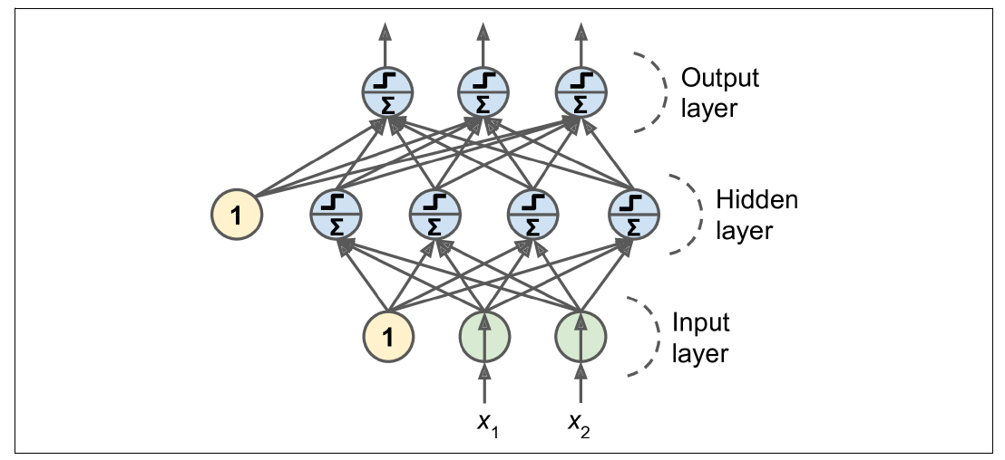
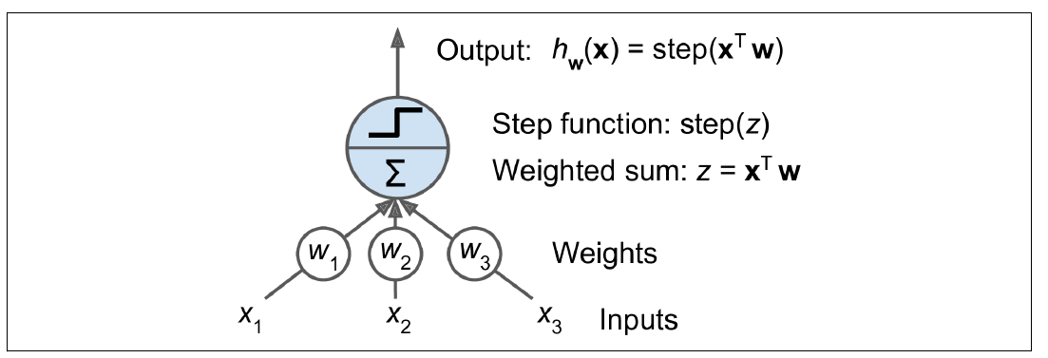
Neural Networks/Deep Neural Networks
Neural Networks (NN) are a set of Machine Learning models inspired on the human brain.
The building blocks of NN are the neurons. Neurons can be connected.
NN can be split in sub groups of neurons called layers.
A NN with a large number of layers is called a Deep Neural Network (DNN)
A single neuron. “Hands-on Machine Learning with Scikit-Learn, Keras & TensorFlow”
A Neural Network. “Hands-on Machine Learning with Scikit-Learn, Keras & TensorFlow”

Slide 7
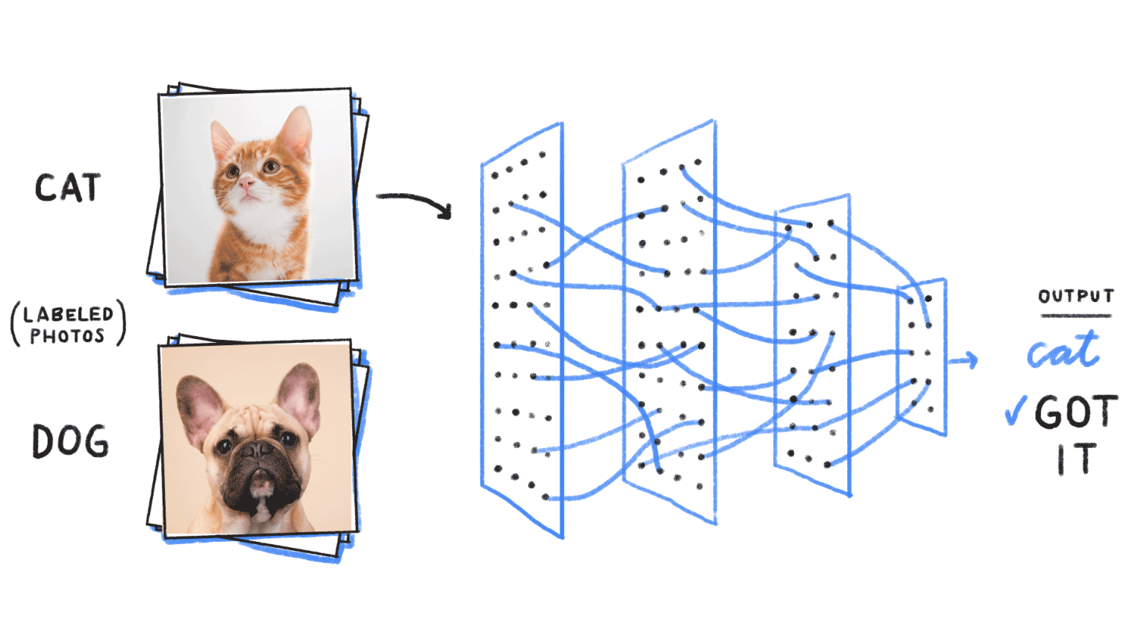
Neural Networks/Deep Neural Networks
Neural Networks can learn certain tasks by training.
  On each training step, you show an input and the expected result for that input.
  For each error, you have adjust the weights until you have the desired result.
Source: https://purnasaigudikandula.medium.com/recurrent-neural-networks-and-lstm-explained-7f51c7f6bbb9

Slide 8
Deep Learning on NLP

Slide 9
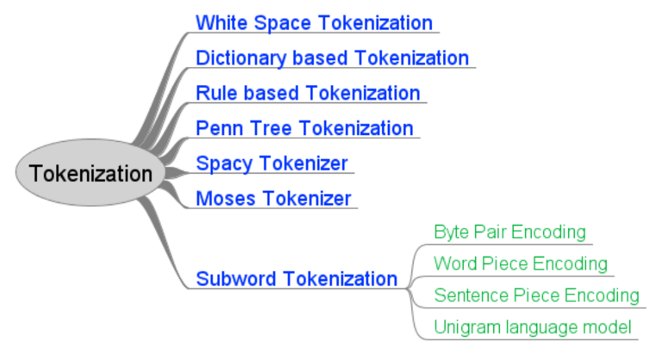
Deep Learning on NLP - Tokenization
First, we need to decide how we will divide our text to process it. This is called tokenization.
There are different kinds of tokenization
Source: https://towardsdatascience.com/tokenization-for-natural-language-processing-a179a891bad4

Slide 10
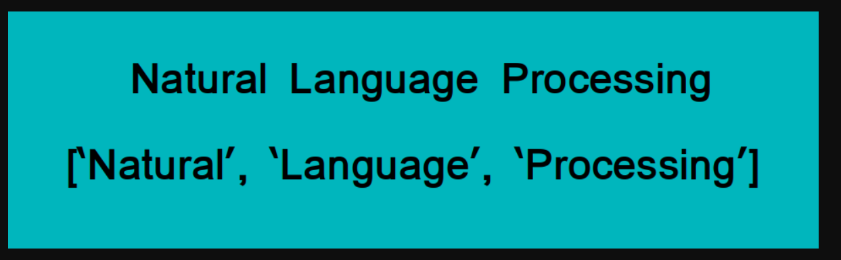
Deep Learning on NLP - Tokenization
Example: White Space Tokenization
Source: https://www.analyticsvidhya.com/blog/2019/07/how-get-started-nlp-6-unique-ways-perform-tokenization/

Slide 11

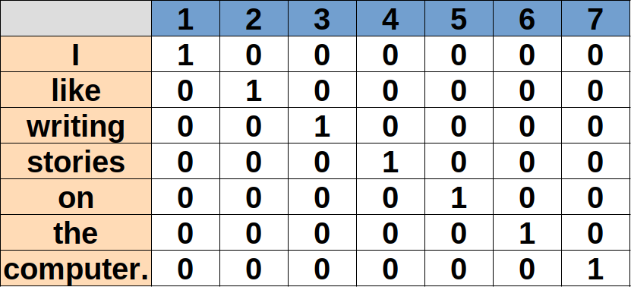
Deep Learning on NLP - Embedding
Deep Neural Networks are not compatible with “words”.
We need to translate words to numbers. Some techniques are:
  Replacement: Replace a word with a number
  One Hot Encoding: Replace a word with a vector. The vector contains information about word presence.

Slide 12
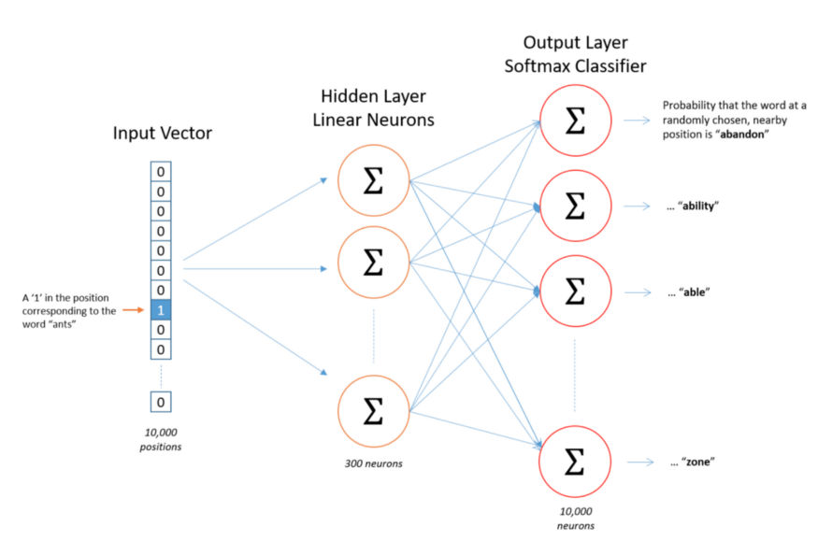
Deep Learning on NLP - Embedding
Deep Neural Networks are not compatible with “words”.
We need to translate words to numbers. Some techniques are:
  Embedding: Replace a word with a vector with information about the word and its relation with other words. (E.g. Word2Vec)
  Check https://projector.tensorflow.org/

Slide 13
Deep Learning on NLP – Processing
Now, with this new representation, we can start understanding each phrase.
The information from a phrase does not only rely on the individual meaning of each word, but also on its context.
The apple is red.
The apple is not red.
One approach is using Recurrent Neural Networks (RNN)

Slide 14
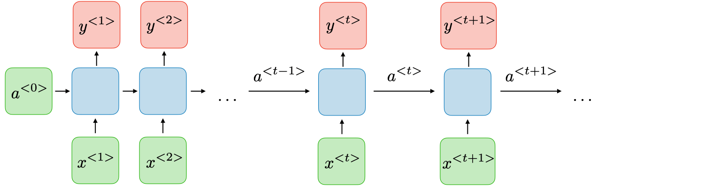
Deep Learning on NLP – RNN
A Recurrent Neural Network (RNN) are used mostly for sequential data.
Each output neuron depends not only on the present input, but also on what happened on the last training step.
Source: https://stanford.edu/~shervine/teaching/cs-230/cheatsheet-recurrent-neural-networks

Slide 15
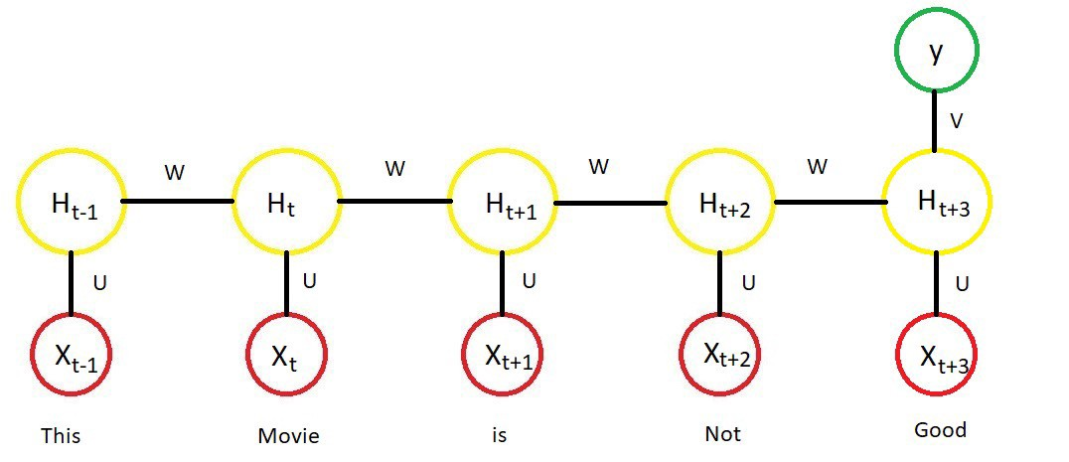
Deep Learning on NLP – RNN
Types of RNN architectures
  Many to One: Multiple inputs are used to obtain one output. E.g. classification
Source: https://medium.com/analytics-vidhya/natural-language-processing-from-basics-to-using-rnn-and-lstm-ef6779e4ae66

Slide 16
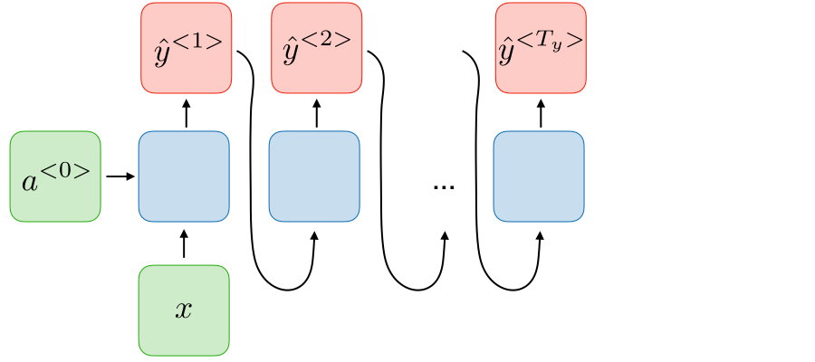
Deep Learning on NLP – RNN
Types of RNN architectures
  One to Many: A single input produces multiple outputs. E. g. Music generation
Source: https://medium.com/analytics-vidhya/natural-language-processing-from-basics-to-using-rnn-and-lstm-ef6779e4ae66

Slide 17
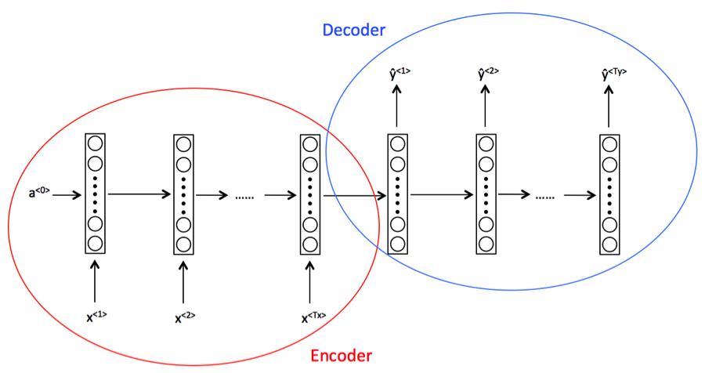
Deep Learning on NLP – RNN
Types of RNN architectures
  Many to Many: Multiple inputs produce multiple outputs. E. g. Translation
Source: https://medium.com/analytics-vidhya/natural-language-processing-from-basics-to-using-rnn-and-lstm-ef6779e4ae66

Slide 18
Deep Learning on NLP – RNN
Limitations of RNN:
  Dependency on data can be possible in only one direction: only data before can affect data later.
  RNN are not capable to capture long term dependencies.
In order to improve, we have to put more attention!

Slide 19
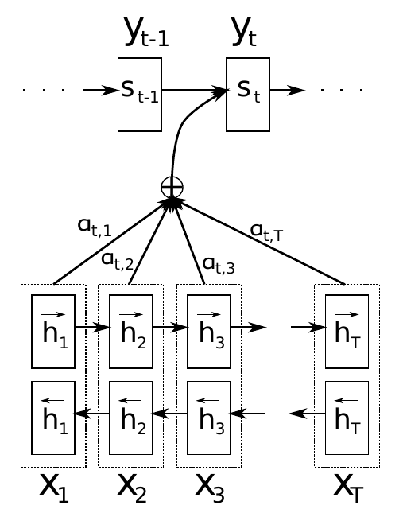
Deep Learning on NLP – RNN and Attention
Attention mechanisms are able to include information of the whole context to each iteration of RNN training process.
For including context, we have to learn the importance of each input on the whole context.
This importance is learned using a bidirectional RNN where the outputs are weights.
Source: Bahdanau, D., Cho, K., and Bengio, Y., “Neural Machine Translation by Jointly Learning to Align and Translate”, arXiv e-prints, 2014.

Slide 20
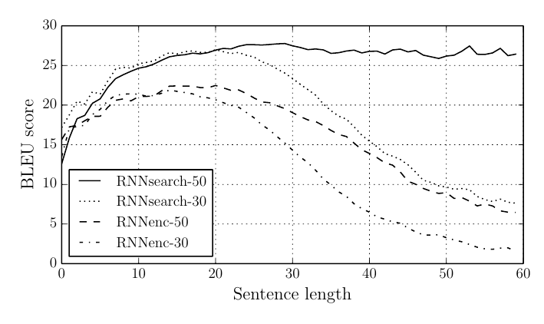
Deep Learning on NLP – RNN and Attention
Attention mechanism provided incredible results on NLP.
As you can see, Attention mechanism provides an incredible improvement on RNN scores, but… do we really need RNN? Attentions is all you need
Source: Bahdanau, D., Cho, K., and Bengio, Y., “Neural Machine Translation by Jointly Learning to Align and Translate”, arXiv e-prints, 2014.

Slide 21
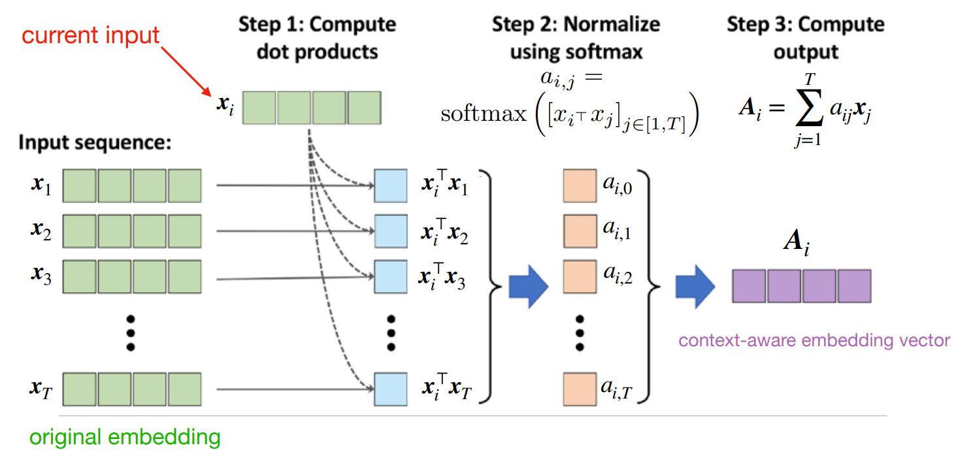
Deep Learning on NLP – Attention is all you need
Self-attention is an attention mechanism for finding relations between different input position data from a single sequence.
Problem: no trainable parameters
Source: Raschka & Mirjalili 2019. Python Machine Learning, 3rd edition

Slide 22
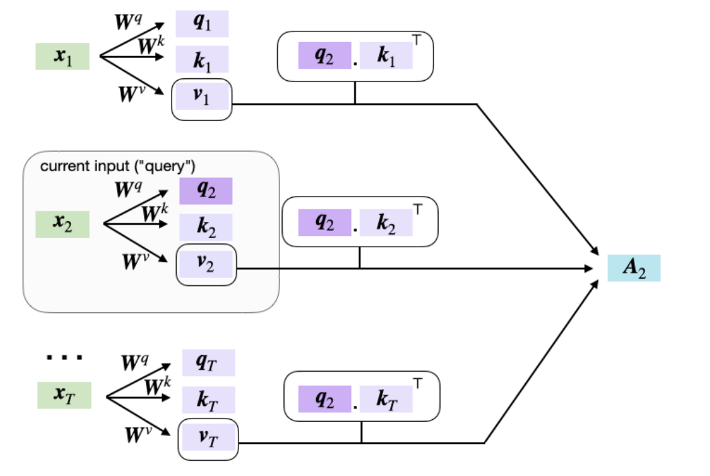
Deep Learning on NLP – Attention is all you need
Scale dot-product attention uses three different matrices called query, key and value. Those matrices can be trained
Source: https://sebastianraschka.com/pdf/lecture-notes/stat453ss21/L19_seq2seq_rnn-transformers__slides.pdf

Slide 23
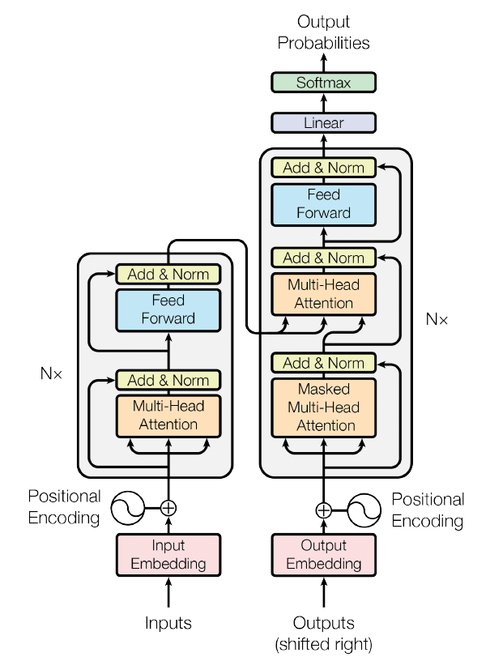
Deep Learning on NLP – Attention is all you need
Transformers are an architecture that use multi-head attention systems
Includes multiple layers of encoders and decoder.
A positional encoder is included in order to maintain information about position.
Source: Vaswani, A., “Attention Is All You Need”, arXiv e-prints, 2017.

Slide 24
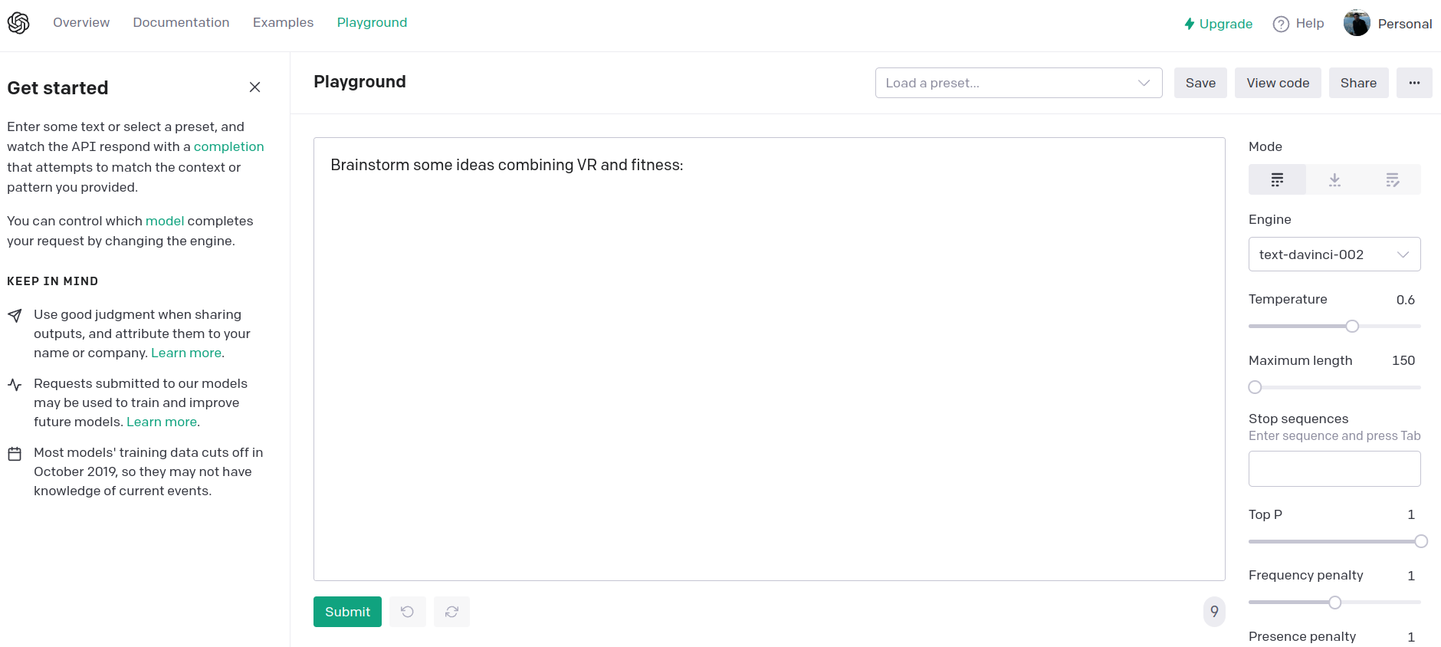
Deep Learning on NLP – Applications
Github copilot: https://copilot.github.com/
Compose.ai (writing extension): https://www.compose.ai/
Playground: https://beta.openai.com/playground/
Etc...

Slide 25
Thank you for your attention!

Slide 26
References
Aurélien Géron, “Hands on Machine Learning with Scikit-Learn, Keras & TensorFlow”
https://nogood.io/2021/06/25/gpt-3-tools/
Vaswani, A., “Attention Is All You Need”, arXiv e-prints, 2017.
Bahdanau, D., Cho, K., and Bengio, Y., “Neural Machine Translation by Jointly Learning to Align and Translate”, arXiv e-prints, 2014.
https://towardsdatascience.com/word-embedding-in-nlp-one-hot-encoding-and-skip-gram-neural-network-81b424da58f2
https://medium.com/analytics-vidhya/natural-language-processing-from-basics-to-using-rnn-and-lstm-ef6779e4ae66
https://purnasaigudikandula.medium.com/recurrent-neural-networks-and-lstm-explained-7f51c7f6bbb9
https://sebastianraschka.com/pdf/lecture-notes/stat453ss21/L19_seq2seq_rnn-transformers__slides.pdf

