Slide 1
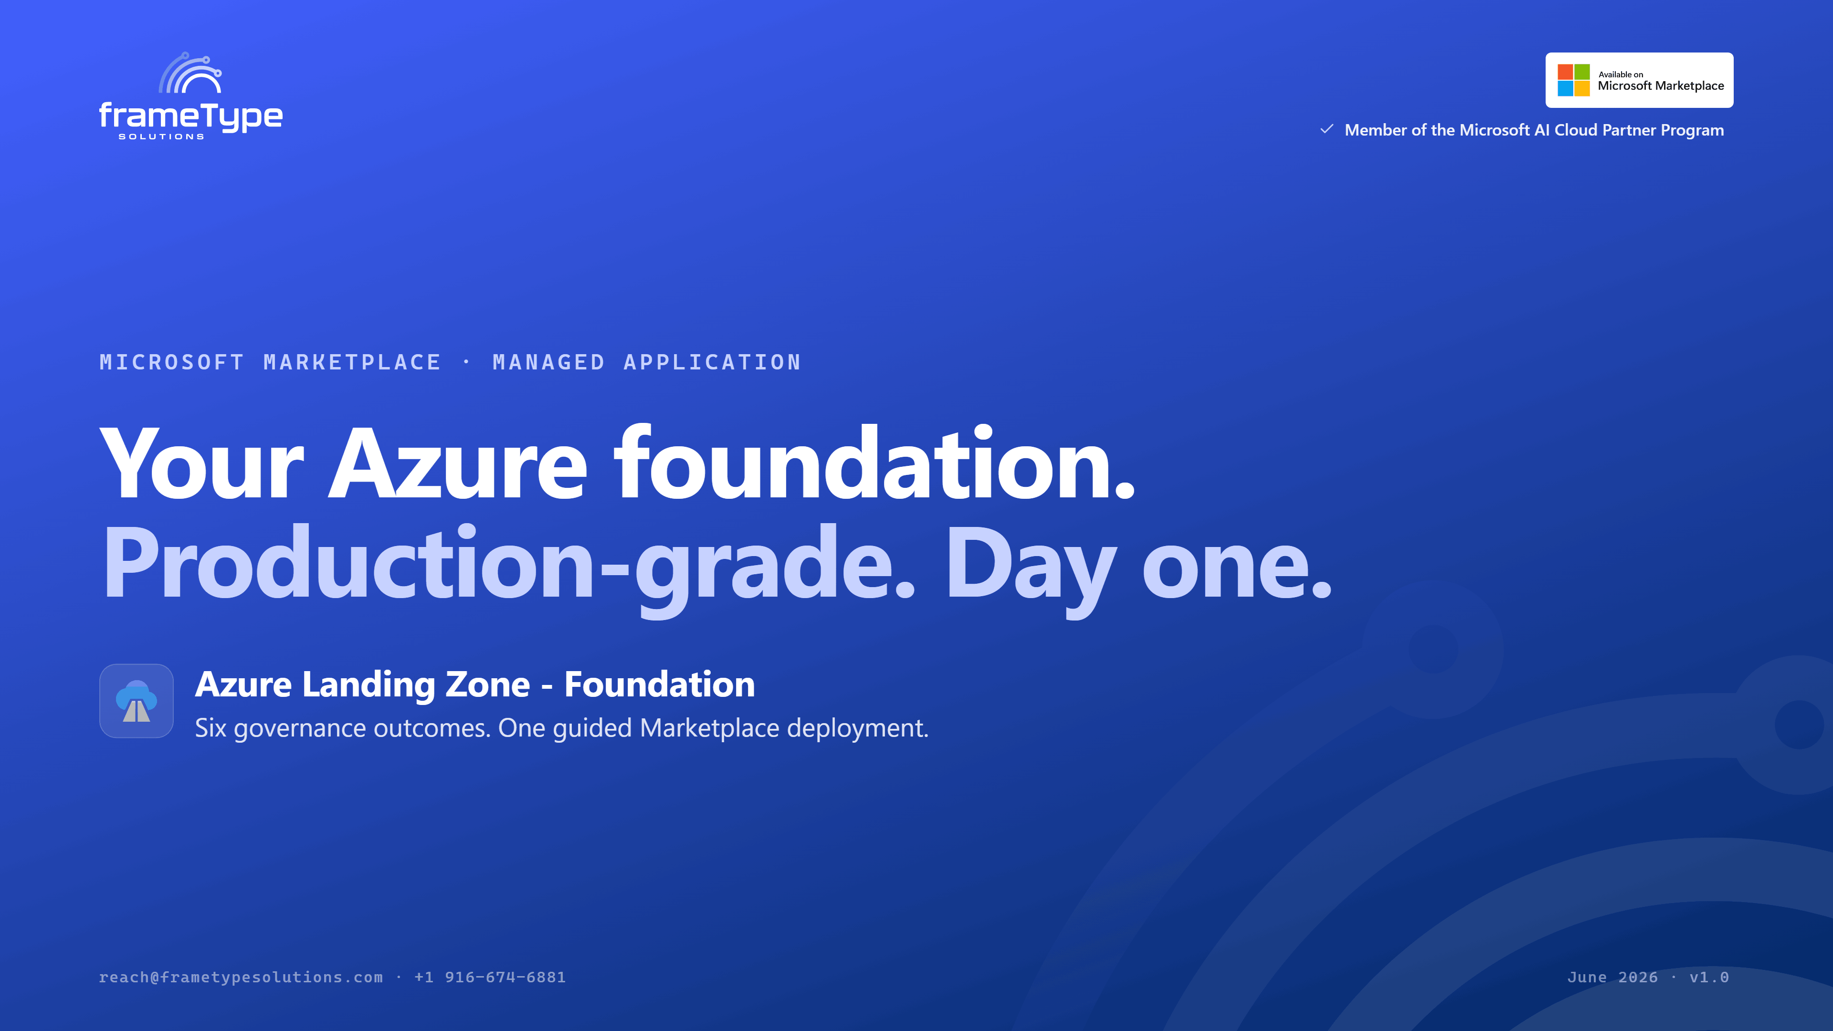
Notes:
Thanks for the time today. I want to walk you through Azure Landing Zone - Foundation. It's a frameType Solutions offer that's live on the Microsoft Marketplace, and in a nutshell it gives you a production-grade Azure foundation on day one. You get six governance outcomes from a single guided deployment — no platform engineering team required. Let me show you the problem it solves, then exactly what you get.

Slide 2
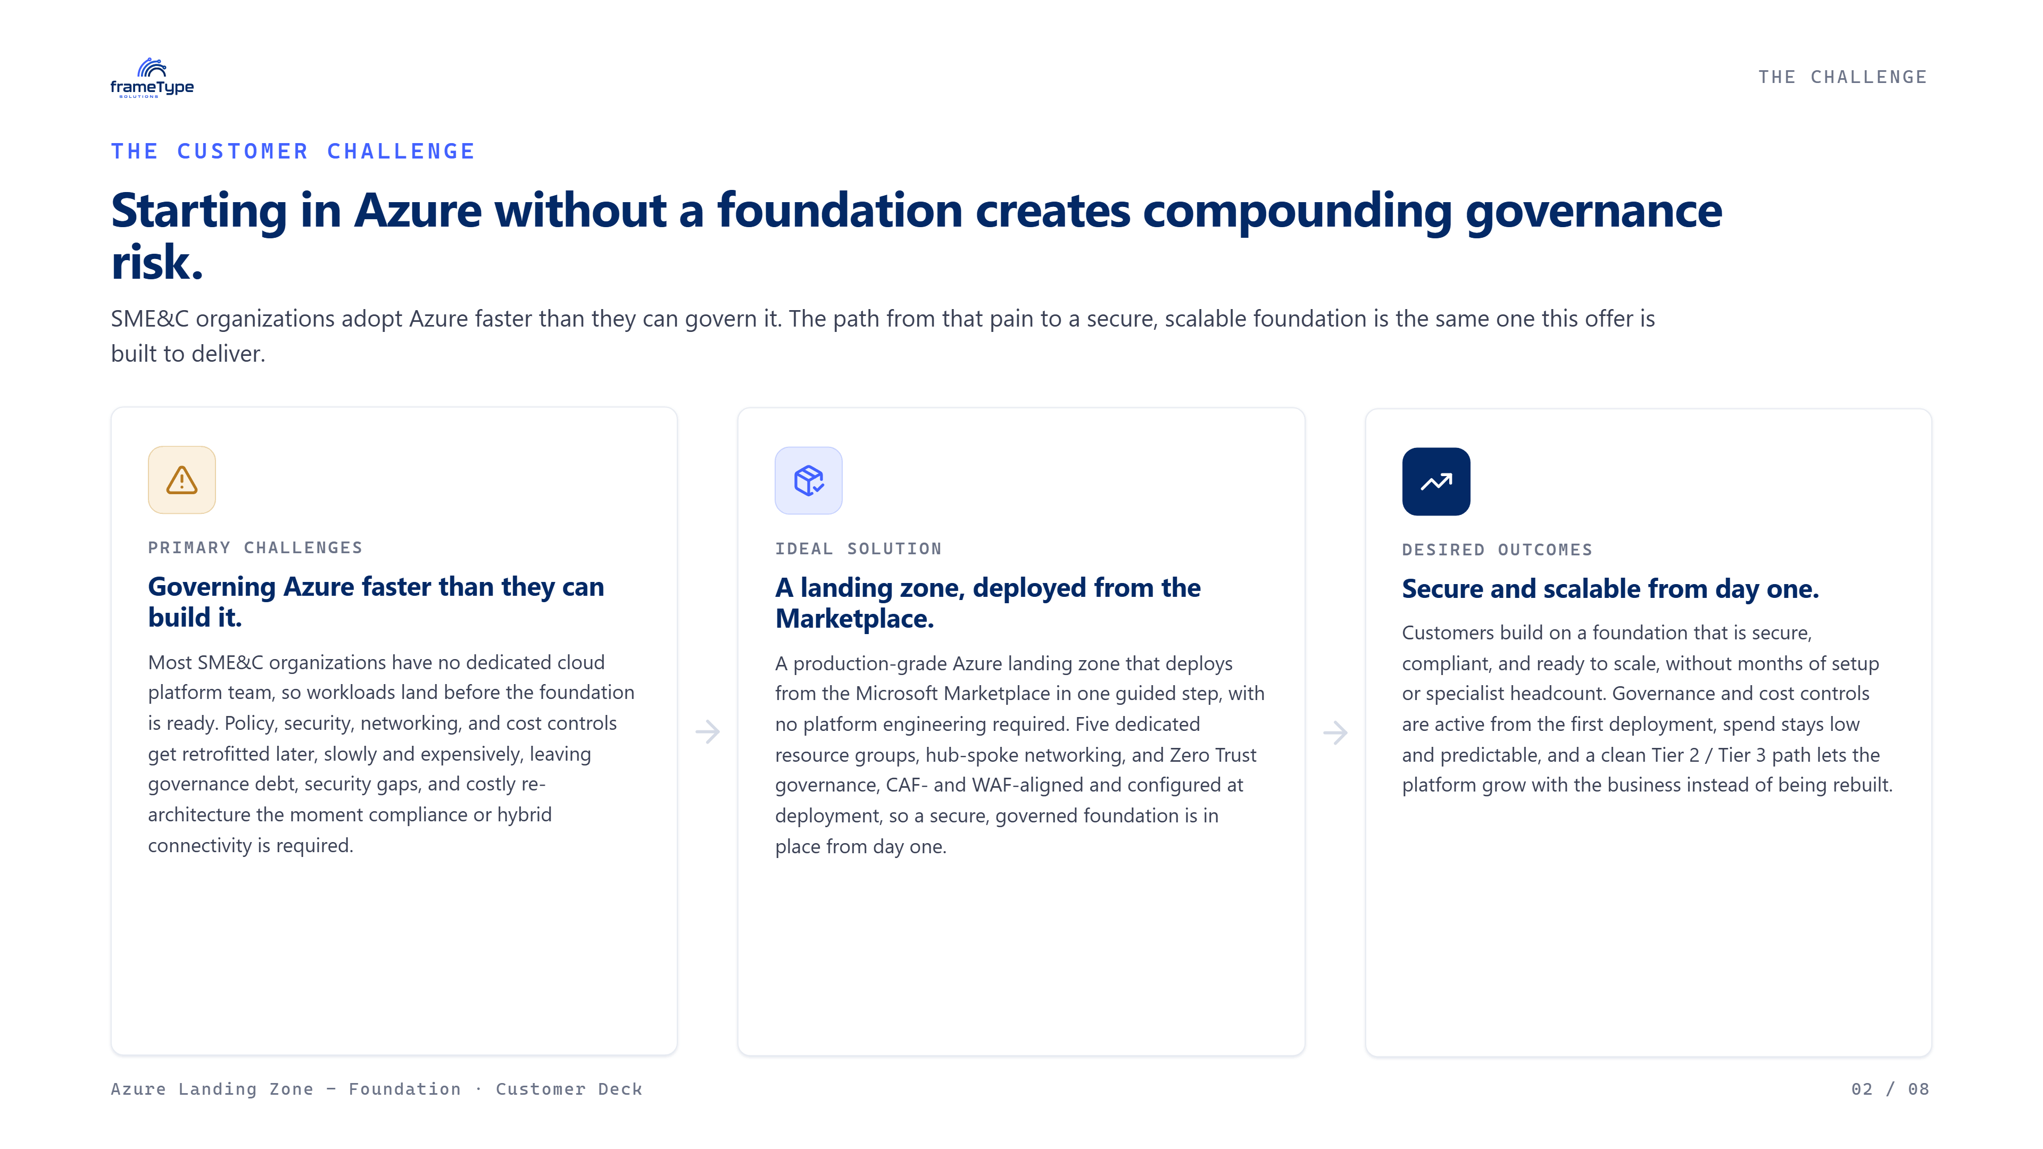
Notes:
Here's the pattern we see constantly with small and mid-sized organizations. Teams are eager to move, so they land workloads in Azure before the platform layer is ready. Then governance debt starts compounding — no policy enforcement, no central logging, no budget visibility until something breaks. Landing zones are genuinely hard to build from scratch, and most teams don't have a dedicated cloud platform engineer. Security gaps show up from day one. And the real sting comes later: when you need hybrid connectivity or a firewall, you're re-architecting. The point of this graphic is simple — deploy the foundation first, and that gap never opens.

Slide 3
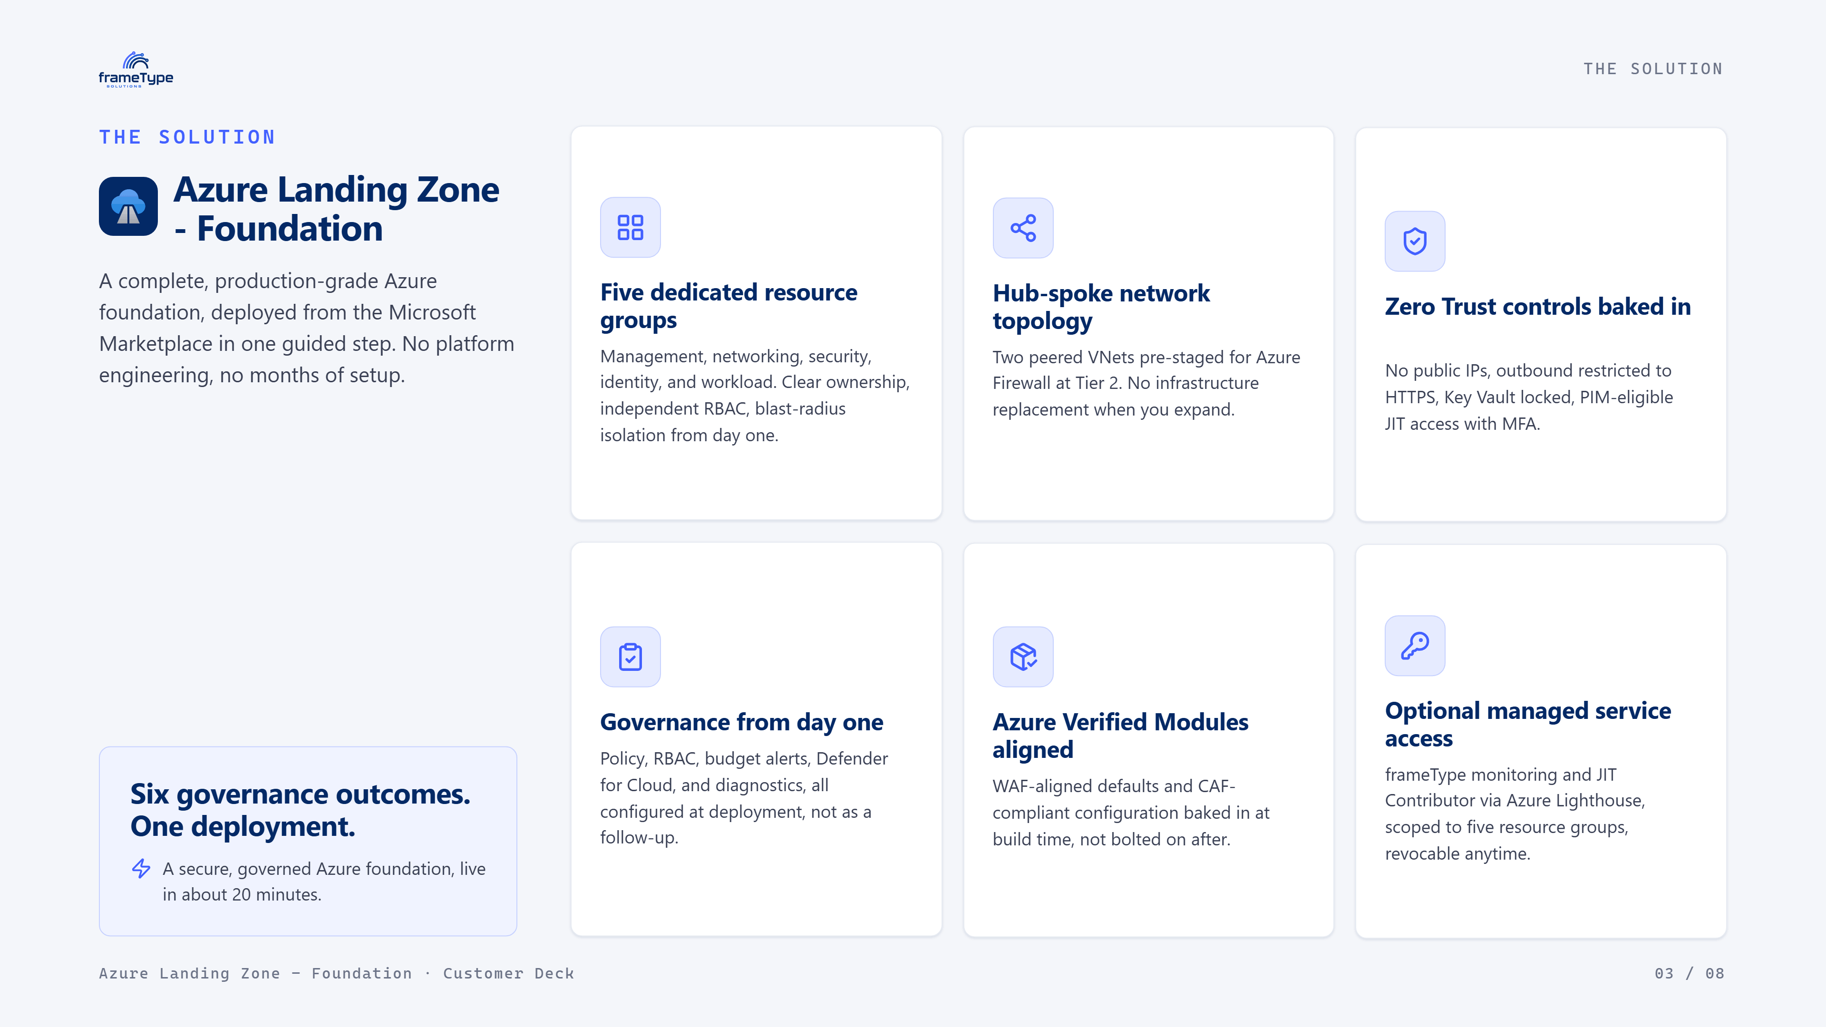
Notes:
So what do you actually get? Six concrete outcomes, configured at deployment, not as a follow-up project. Five dedicated resource groups for clean ownership and blast-radius isolation. A hub-spoke network already staged for Azure Firewall later. Zero Trust controls baked in. Governance — policy, RBAC, budget alerts, Defender — on from day one. Everything's aligned to Azure Verified Modules. And there's an optional managed-service option through Azure Lighthouse that you can revoke at any time. The deployment itself is about twenty minutes: run the script, deploy from the Marketplace, verify.

Slide 4
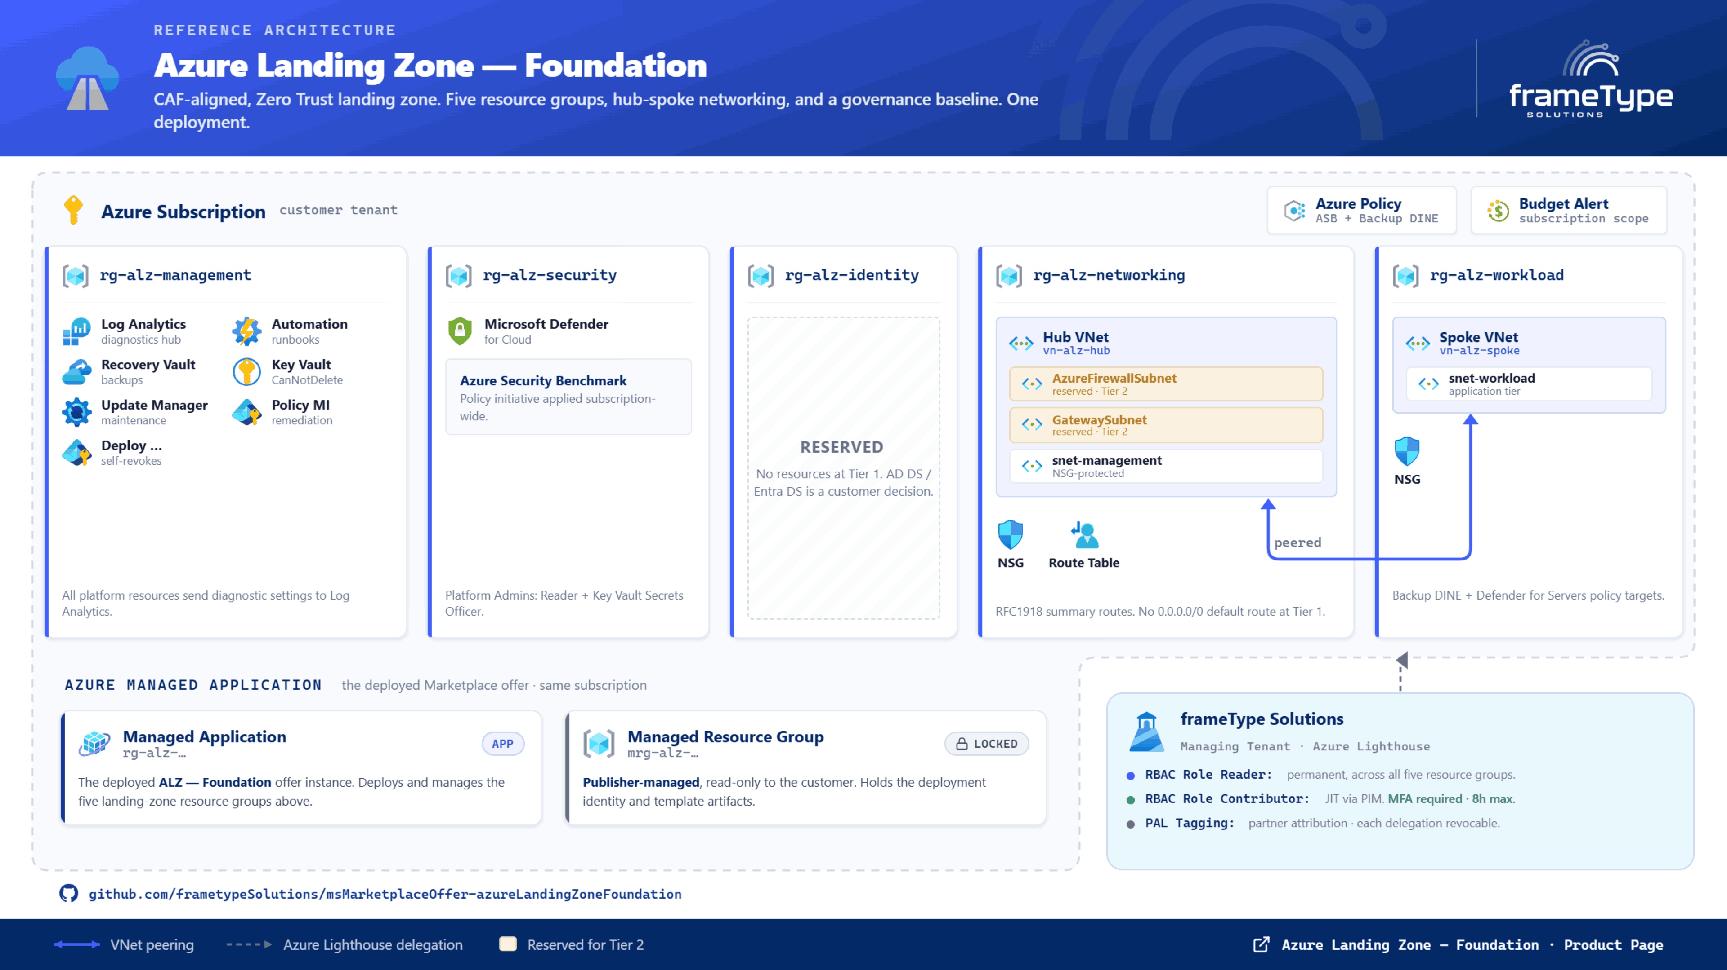
Notes:
This is what actually lands in your subscription. Five resource groups — management, security, identity, networking, and workload — all under your own tenant. You can see the governance baseline up top: Azure Policy and budget alerts at the subscription scope. Networking is hub-spoke, with subnets already reserved for Azure Firewall and a gateway at Tier 2, so nothing gets rebuilt when you expand. Identity is intentionally left reserved — that's your decision to make. And on the bottom right, if you opt into managed service, frameType connects through Azure Lighthouse: permanent Reader, just-in-time Contributor with MFA, every delegation revocable. No standing write access.

Slide 5
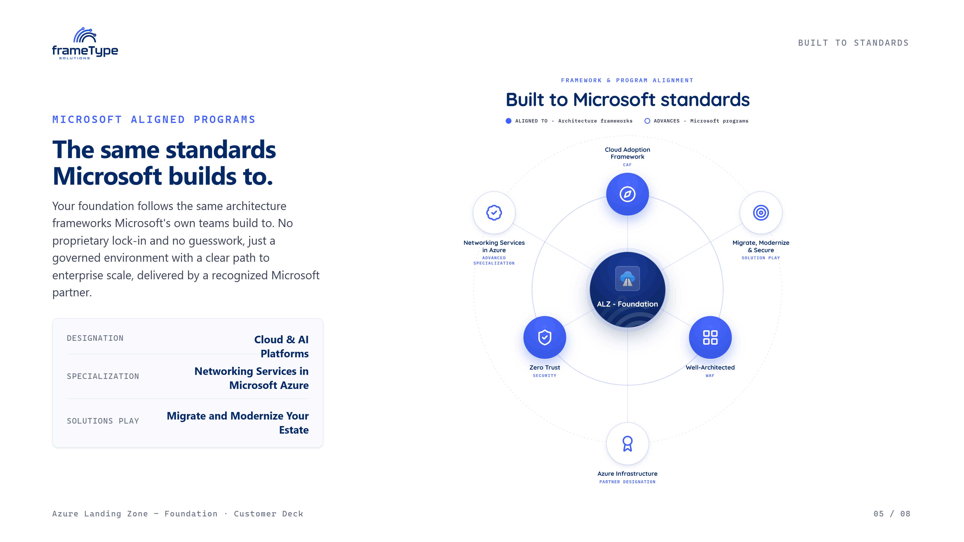
Notes:
None of this is bespoke. Every default maps to a Microsoft standard. The foundation is aligned to the Cloud Adoption Framework, the Well-Architected Framework, and Zero Trust principles. And on the program side, frameType carries the Microsoft designations that back this work — Cloud and AI Platforms, the Networking Services in Azure specialization, and the Migrate and Modernize solutions play. So when you deploy this, you're deploying to the same standards Microsoft itself recommends.

Slide 6
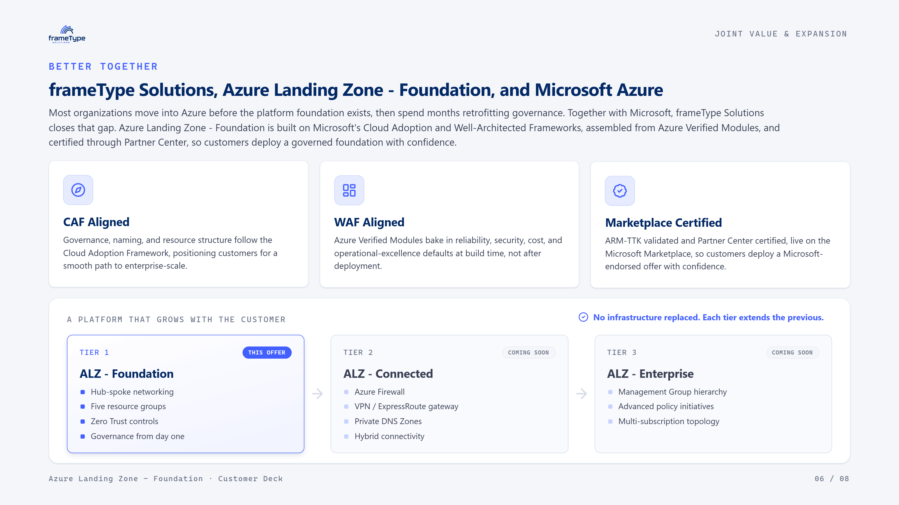
Notes:
This is genuinely better together. It's CAF-aligned for a clean path to enterprise scale, WAF-aligned through Azure Verified Modules, and Marketplace-certified — ARM-TTK validated and certified through Partner Center. The other thing I want to land is the expansion path. Foundation is Tier 1. When you're ready, Connected adds Azure Firewall, gateways, and hybrid connectivity. Enterprise adds management group hierarchy and policy at scale. The key promise: no infrastructure gets replaced. Each tier extends the last.

Slide 7
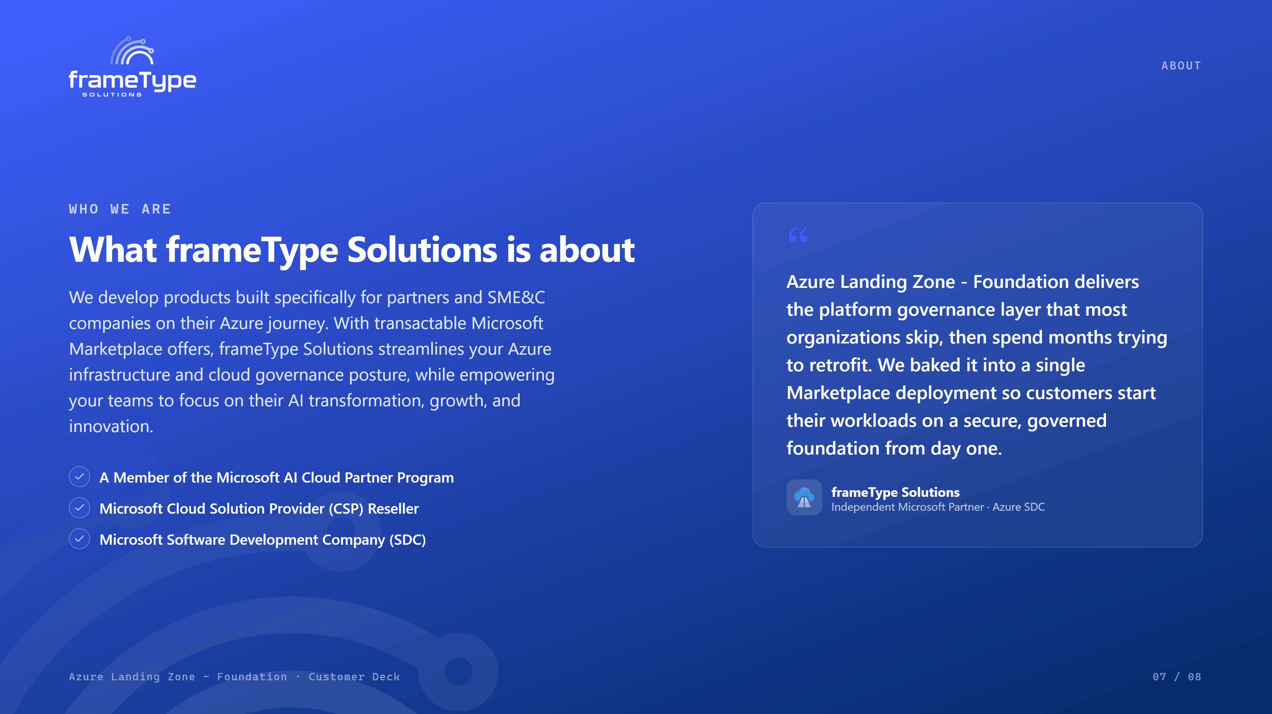
Notes:
A quick word on who we are. frameType Solutions builds products specifically for partners and small-to-mid-sized organizations on their Azure journey. Everything we ship is a transactable Marketplace offer, so you get a governed, secure foundation without months of custom work — and your team stays focused on growth and AI adoption instead of infrastructure plumbing. The philosophy is simple: we baked the governance layer most teams skip into a single deployment.

Slide 8
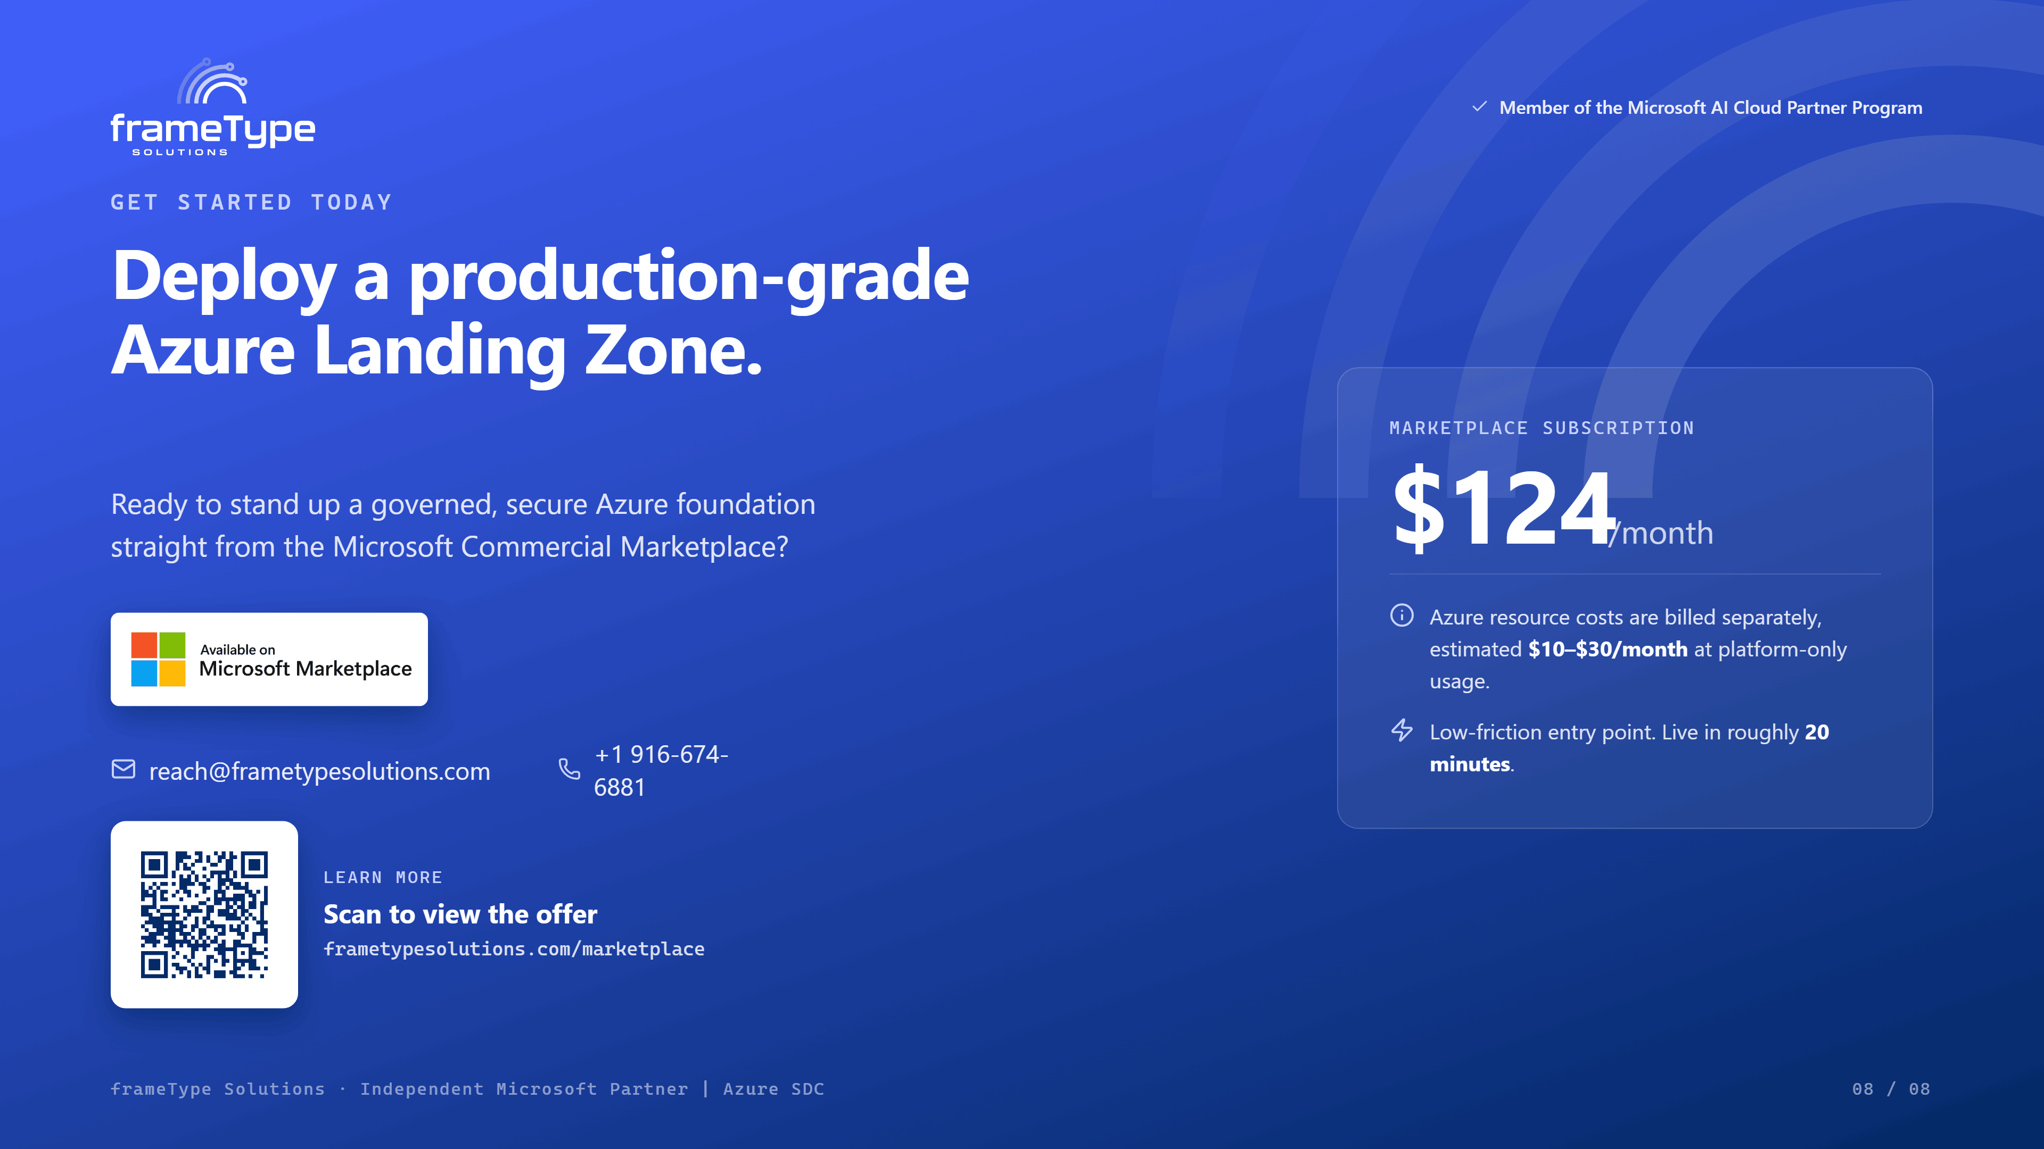
Notes:
That's the offer. It's live on the Microsoft Commercial Marketplace at a hundred and twenty-four dollars a month — a deliberately low-friction entry point. Azure resource costs are separate and minimal at platform-only usage, roughly ten to thirty dollars a month. You can be live in about twenty minutes. I'd suggest the next step is a quick look at the listing together, and I'm happy to walk your team through a deployment. Here's my contact — let's get you started.

