Slide 1


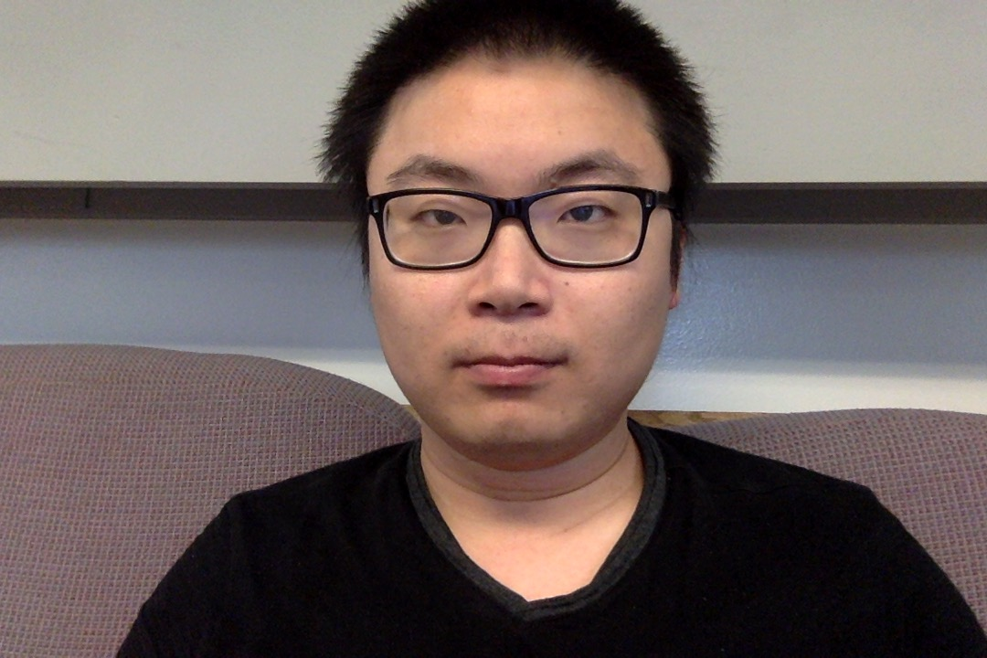
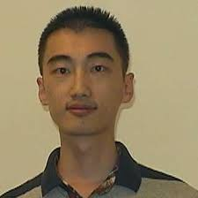
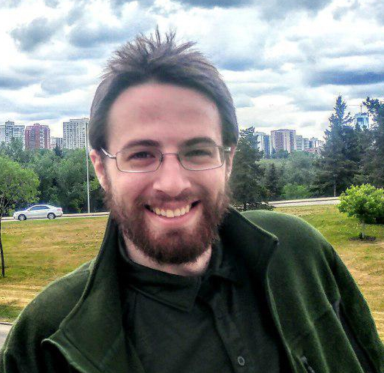



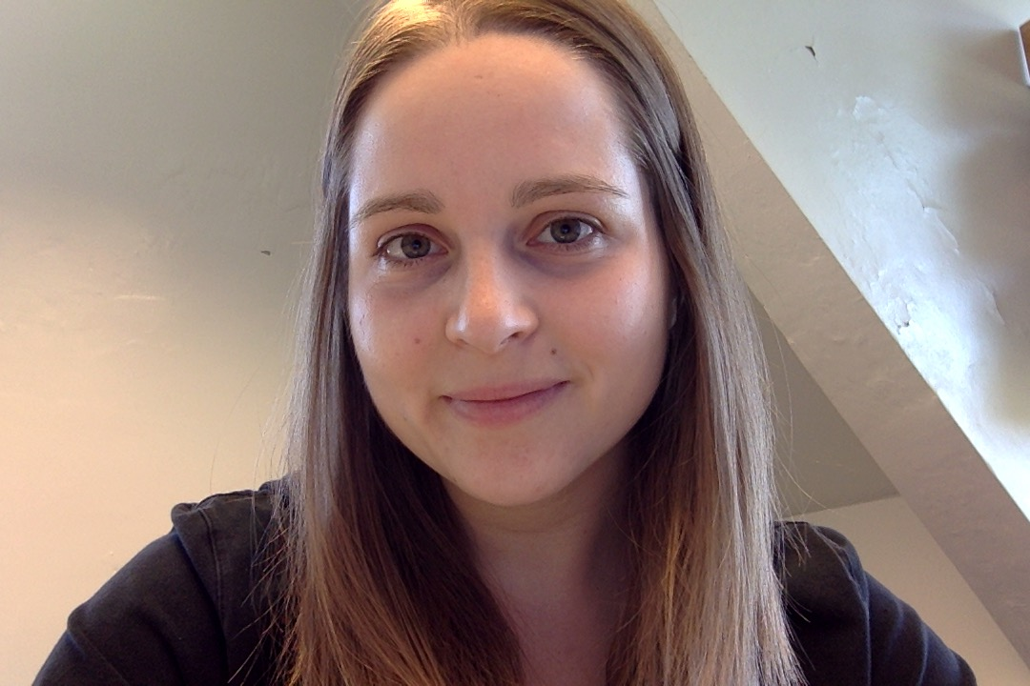




Learning Macroscopic Brain Connectomes via Group-Sparse Factorization
Farzane Aminmansour¹, Andrew Patterson¹, Lei Le², Yisu Peng³, Daniel Mitchell¹, Franco Pestilli², Cesar Caiafa⁴, Russell Greiner¹, Martha White¹
University of Alberta¹, Indiana University², Northeastern University³, Instituto Argentino de Radioastronom⁴
^{NeurIPS 2019}

Slide 2
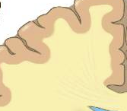
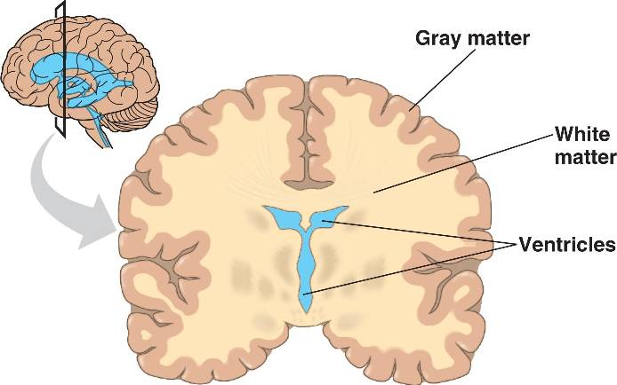
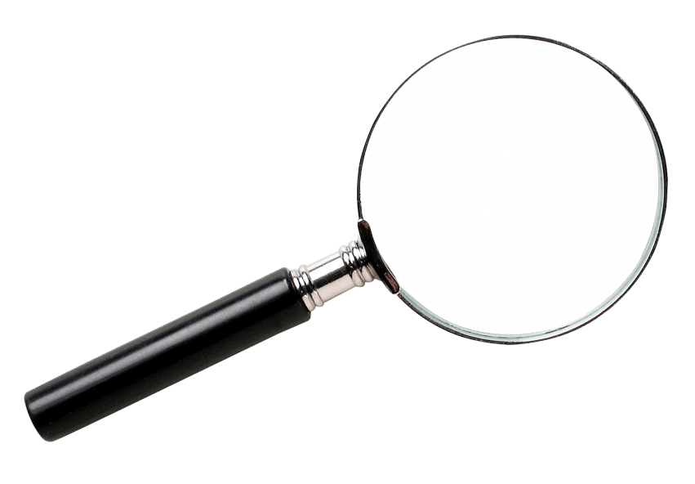
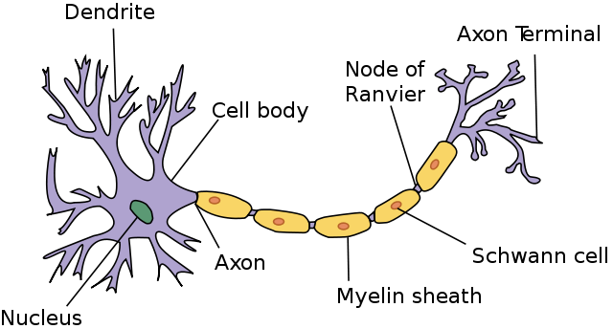
Goal: Identify the wiring of the brain
Notes:
The goal of this presentation is to introduce a fully unsupervised learning method to identify the wiring of the brain. Our brain is made of white and grey matter. Taking a closer look at white matter reveals that it consists of neuronal axons covered with myelin sheaths.

Slide 3
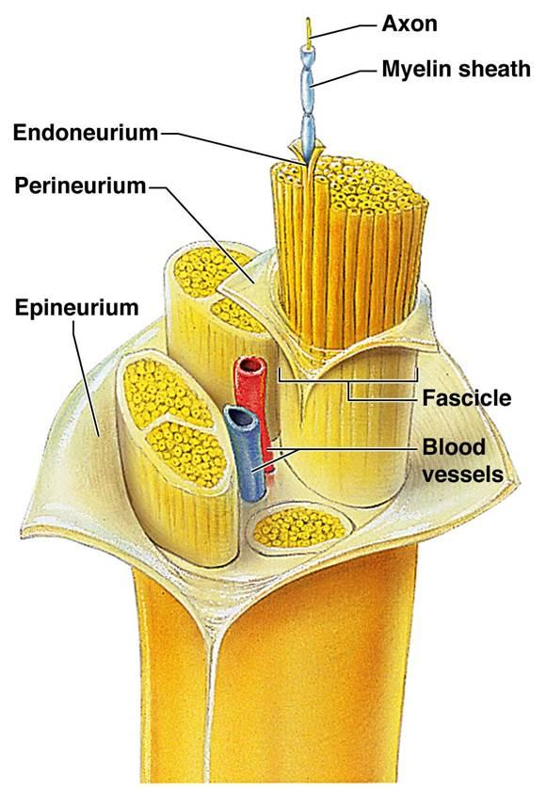
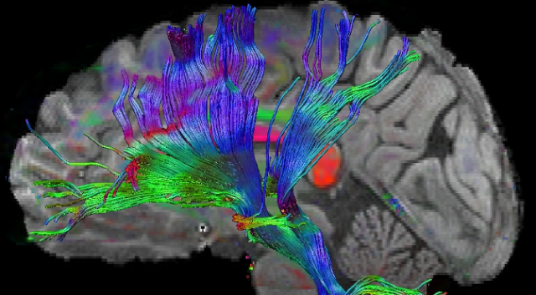
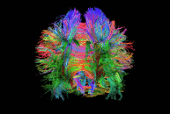
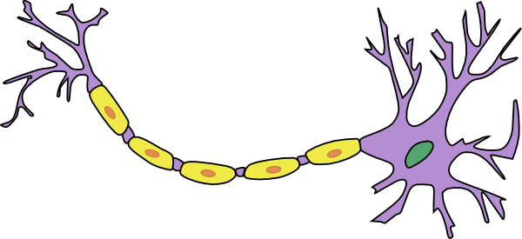
Fascicles & Connectomes
Connectome:
comprehensive map
of neural connections
Notes:
bundle of these axons together makes fascicles that connect different areas of the brain. Our goal is to learn a comprehensive map of these connections called connectomes.

Slide 4
Applications
Normal brain development and aging
Congenital anomalies, leukodystrophies
Demyelinating and neurodegenerative diseases
Tumors and preoperative planning
Epilepsy
Ischemia and stroke
Encephalopathies (toxic, metabolic, infectious)
Traumatic brain injury
Psychiatric disorders, dementia, depression
Functional connectivity mapping, cognitive neuroscience
Spinal cord evaluation
Notes:
There are several applications for this purpose: from preoperative planning to diagnosing psychiatric disorders or to identifying brain development and aging procedure.

Slide 5
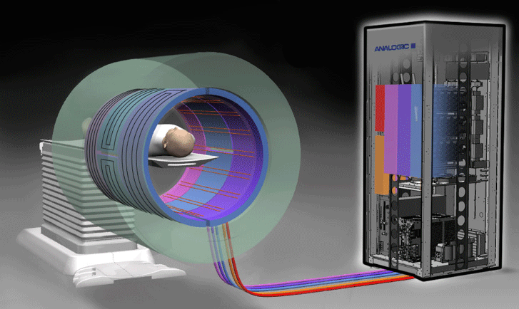
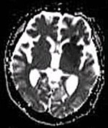
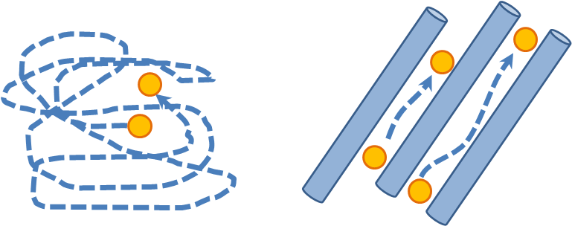
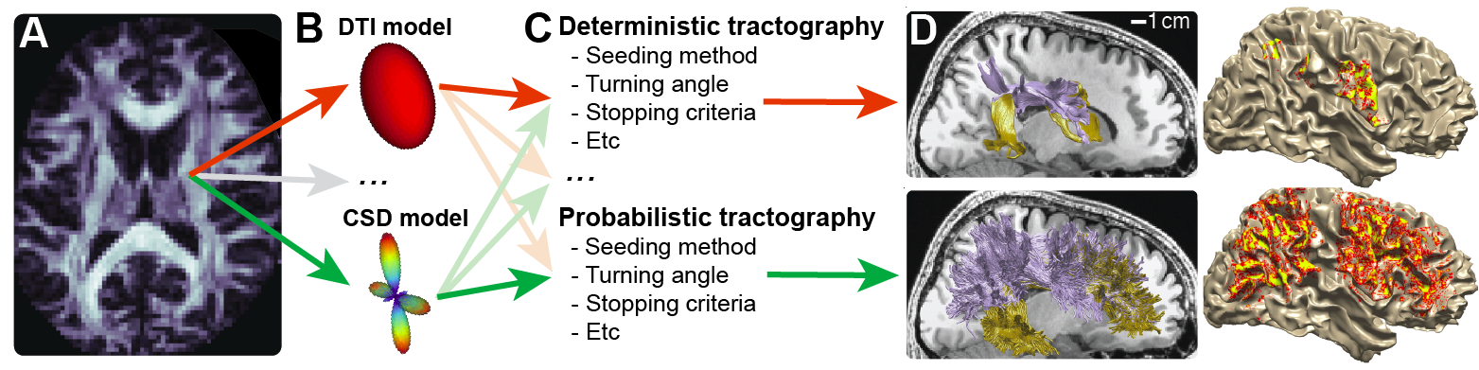
Problem statement
Notes:
Acquiring information about brain tissue is possible by measuring the diffusion of water molecules at different gradient directions of the magnetic field. Then a tractography model is employed to infer fascicles’ structures by calculating mathematical models from the diffusion-weighted signal. However, different combinations of models such as DTI or CSD, different tractography algorithms such as deterministic or probabilistic, and different parameter sets generate different solutions. Therefore, we intend to introduce a data-driven approach instead of available rule-based methods.

Slide 6
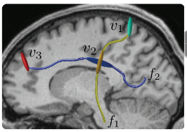
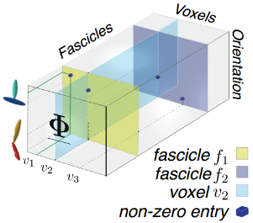
ENCODE – Natural Brain Space
v₂
v₄
v₆
v₈
6
7
8
5
v₁
v₃
v₅
v₇
4
3
1
2
Z
V
Encodes natural brain space → 3D sparse tensor
Tensor of brain structure, 𝚽 ⋸ R ^{Na × Nv × Nf}
N_{a}: #orientations, fascicles orientation at each position
N_{v}: #voxels, fascicles spatial position
N_{f}: #fascicles, indices of each fascicle
a₁
a₃
a₂
X
Y
f₂
f₁
Notes:
Imagine we have a fascicle passing through some voxels. We can break it down to the small chunks or nodes so that there might be more than one node in each voxel. We discretize the spatial space into the predefined vectors of orientations with size 3 (X,Y, Z) and assign the closest orientation vector to each of these nodes. By defining orientations, now, we can encode the whole natural brain space into a tensor of three dimensions like Phi so that the first dimension encodes orientations, the second dimension encodes voxels which have the positional information, and the third dimension encodes fascicle indices.

Slide 7
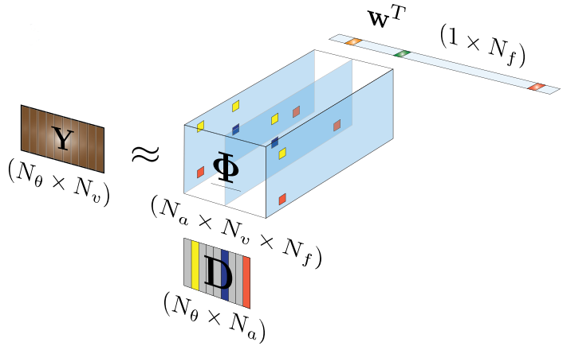
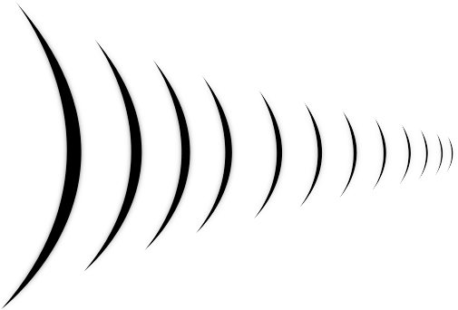
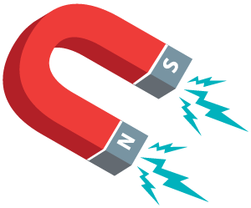
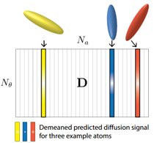
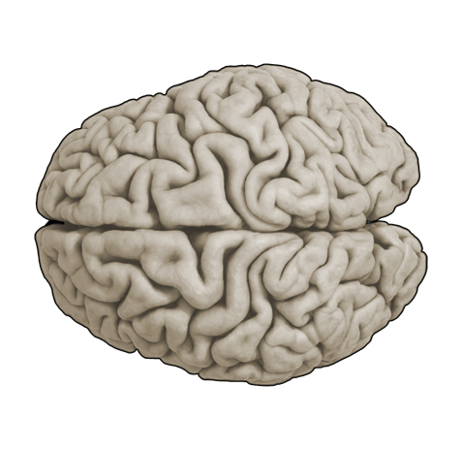
ENCODE – Input Data & Dictionary
Matrix of dMRI signal Y ⋸ R ^{Nθ × Nv}, θ is gradient direction
Factorizing Y into 𝚽 and dictionary D
D ⋸ R ^{Nθ × Na}
Q_{a} is the diffusion prediction for an a
Y ≈ 𝚽 ×₁ D ×₃ W, where W⋸ R ^{Nf}
θ₂
θ₃
v₂
v₄
v₆
v₈
v₁
v₃
v₅
v₇
θ₄
θ₁
θ₆
θ₅
Notes:
The dMRI data is also encoded into a matrix of N_theta by N_v, which intuitively shows what signal we received from each voxel after applying each gradient direction of the magnetic field. ENCODE enables us to factorize matrix of dMRI signal Y into the tensor of Phi and a dictionary D, calculated as follows and shows the expected diffusion prediction for each orientation after applying a gradient direction. So Y would be approximately equal to Phi by D by a vector of weights w that demonstrates the contribution of each fascicle in regenerating the diffusion signal.

Slide 8
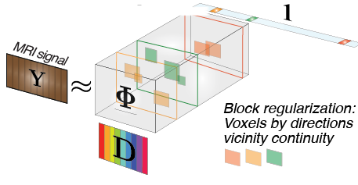
Objective Function & Group Regularizer
𝚽 = argmin ∥Y - 𝚽 ×₁ D ×₃ 1∥² , where 1⋸ R ^{Nf}
A group regularizer to enforce continuity and smoothness of fascicles
Neighbouring voxels are more likely to share similar orientations
  𝓖_{v} ⋸ 𝑽, group of neighbouring voxels
  𝓖_{A} ⋸ 𝓐, group of similar orientations
  We want either all-zero or more than one
  none-zero entries in (𝓖_{v}, 𝓖_{A}, f)
Constrained objective to learn :
min ∥Y - 𝚽 ×₁ D ×₃ 1∥² + 𝜆R(𝚽) ,
Notes:
We can fold W into Phi and try to define an appropriate objective function to learn Phi. A simple maximum likelihood can be employed to define an unconstrained objective which simply tries to minimize the residual error of constructing diffusion signal. To guarantee the uniqueness of the solution, we define a group regularizer that enforces the biological plausibility of fascicles which are continuity and smoothness. We expect neighboring voxels to share similar orientations. So we defined groups of neighboring voxels g_v and groups of similar orientations g_a. Based on the group regularizer we want either the entire block of g_a by g_v by f to be zero, meaning that the fascicle is not active for neighboring voxels g_v and similar orientations g_a. Or we want more than one non-zero entries in this block meaning multiple nearby voxels and orientations share the same fascicle.

Slide 9
Optimizing Objective Function
Challenge:
  Number of optimization parameters is large: N_{f} × N_{v} × N_{a}
Solution:
Screening Algorithms:
Orthogonal Matching Pursuit (OMP)
  A standard greedy forward selection algorithm
  Issue: it selects orthogonal or dissimilar orientations for the fascicles in an individual voxel!
Notes:
A major challenge with optimizing this objective function is the very large optimization parameters that prevent us from using standard gradient descent algorithms directly.
A solution could be to prune entries of the sparse problem by applying a screening algorithm. Orientations can largely be selected independently for each voxel based solely on diffusion information. One standard greedy strategy is to use orthogonal matching pursuit (OMP), which starts from an empty set and adds the next best orientation greedily based on how much it reduces the residual error for the diffusion signal. However, the criterion of OMP is not suitable since it prefers orthogonal or dissimilar orientations.

Slide 10
GreedyOrientation Algorithm
Goal: Select similar orientations to reconstruct diffusion information, Y.
Selection criterion:
is squared multiple correlation
prefers S with high multiple correlation ( ) & ensures usefulness of each orientation ( ) itself.
Notes:
We proposed a greedy algorithm with a new criterion so that it selects similar orientations to reconstruct diffusion information. The new objective balances between preferring a set S with high multiple correlations, and ensuring that each orientation itself is useful to regenerate the diffusion signal of a voxel.

Slide 11
Full Algorithm & Dataset
Full algorithm steps:
Screen the orientations using GreedyOrientation, |S| ≤ k
Optimize the tractography objective using subgradient descent
Evaluated the results on two datasets:
Arcuate:
N_{a} = 1057, N_{v} = 11823, N_{f} = 868
ARC-SLF:
N_{a} = 1057, N_{v} = 15033, N_{f} = 1100
Notes:
Therefore, the full algorithm consists of two steps: In the first step, we prune down the number of orientations by using a screening algorithm and then we optimize the objective function using subgradient descent.
We evaluated each of these steps on two data sets: Arcuate and ARC-SLF.

Slide 12
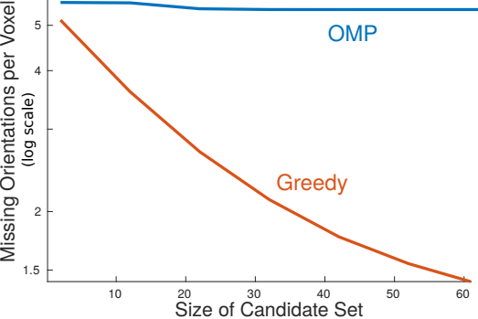
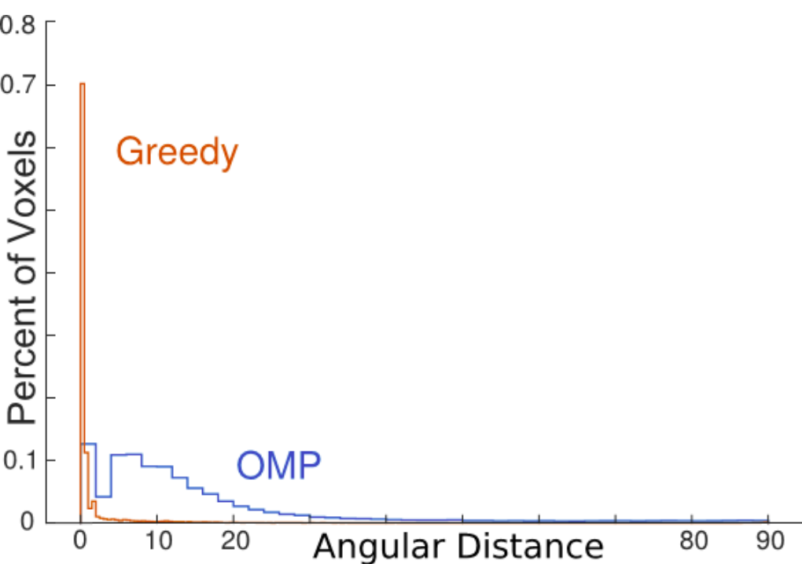
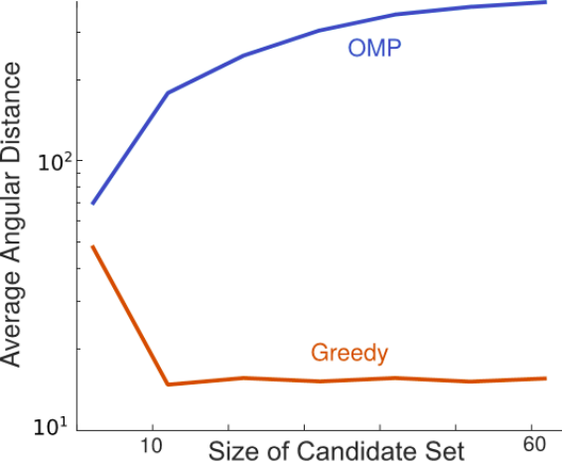
Screening evaluation (Arcuate)
A.
Missing orientations by increasing size of candidate set
B.
PDF of voxels’ angular distance
C.
Average angular distance by increasing size of candidate set
Notes:
Figure A demonstrates the results of OMP vs GreedyOrientation on the number of missing orientations compared to the ground truth, while increasing the size of the orientation candidate set. GreedyOrientation's advantage is likely because OMP continuously adds dissimilar orientations. Thus it is unlikely to add the exactly correct orientation. Figure B shows the distribution of voxels based on their orientations angular distances compared to the corresponding voxels and orientations in the ground truth. GreedyOrientation has a high probability mass near zero showing that it generates appropriate candidate sets. Figure C shows how the average angular distance compared to the ground truth changes for OMP and GreedyOrientation when we increase the size of the orientation candidate set. Increasing the size of orientation set in OMP results in a larger angular distance since more dissimilar orientations are included.

Slide 13
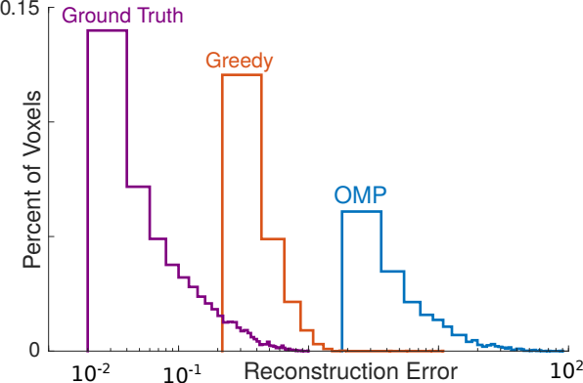
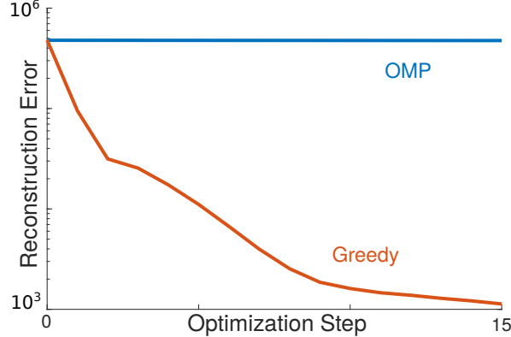
Screening evaluation (Arcuate) cont.
D.
PDF of reconstruction error
E.
Reconstruction error improvement
Notes:
Figure D demonstrates the distribution of reconstruction error over voxels after optimization. Starting the optimization with GreedyOrientation leads to much lower bias in the final optimization results rather than OMP, comparing to the distance from the distribution of ground truth. Figure E depicts that the reconstruction error of GreedyOrientation decreases at a rate several faster than OMP since the choices of orientations selected by OMP were not appropriate to enforce the plausible structure of Phi.

Slide 14
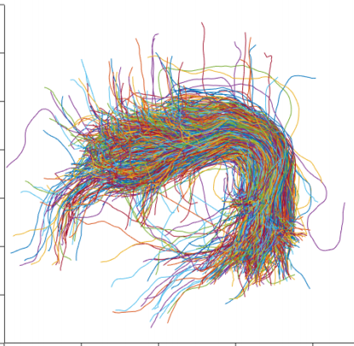
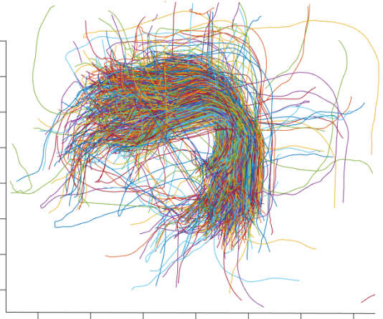
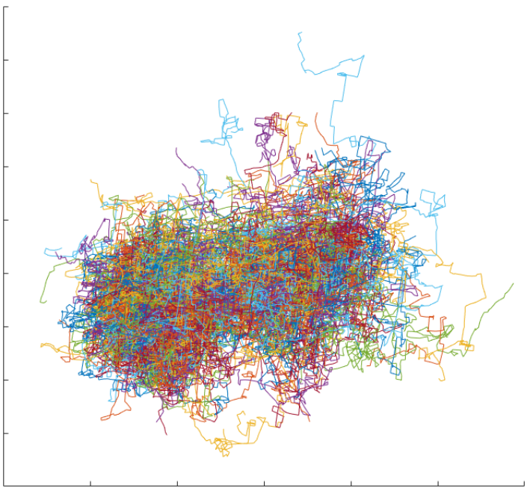
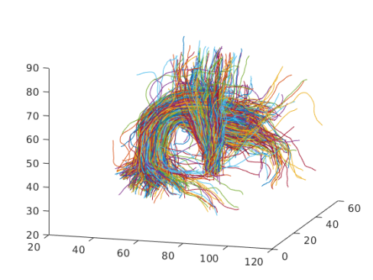
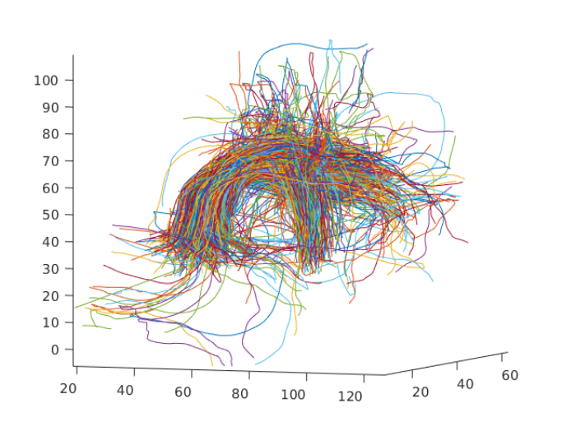
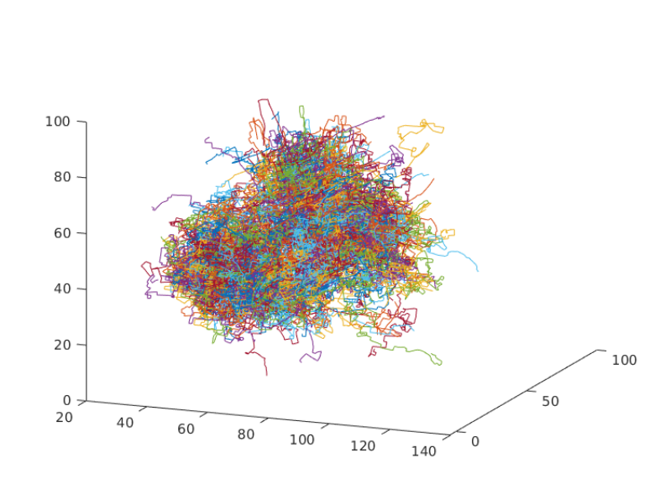
Optimization:Visualizing Learned
Arcuate
ARC-SLF
Ground Truth
GreedyOrientation
OMP
Notes:
From the visualization of Phi, we can see that our results for Phi are similar to the ground truth while OMP’s are not. This indicates that group regularizer performed well in regenerating macrostructure of connectomes, however, OMP initialized candidate sets with inappropriate orientations.

Slide 15
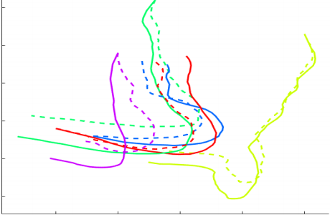
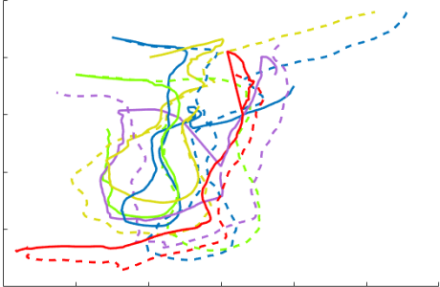
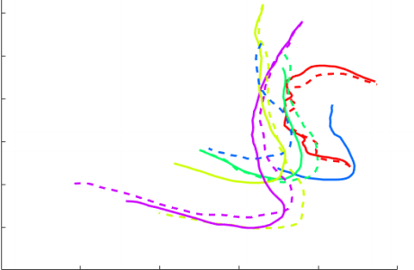
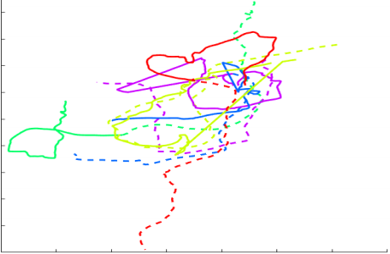
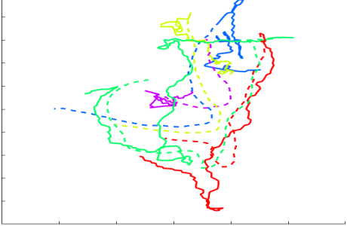
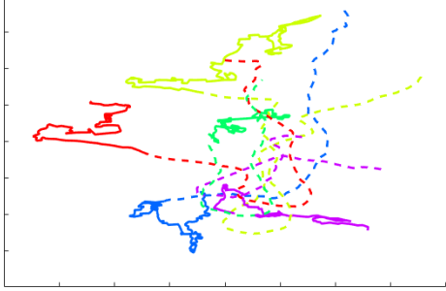
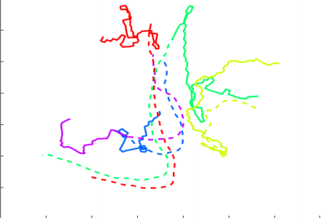
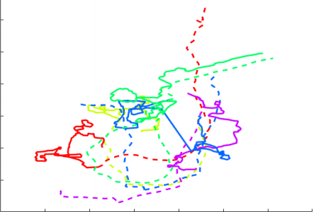
Optimization: best & worst fascicles
Arcuate
ARC-SLF
Greedy
OMP
5 best
5 worst
5 best
5 worst
Notes:
We also visualize the five best and worst fascicles for both OMP and GreedyOrientation. Solid lines show the predicted tracts while dashed lines show the ground truth. We can see that GreedyOrientation produces plausible fascicles in terms of orientation, in some cases seemingly even more so than the ground truth, which was obtained with a tractography algorithm. Since the objective attempts to minimize winding fascicles with abrupt direction changes it's difficult to reconstruct those five worst unlikely fascicles in the ground truth. The solution for OMP is generally poor.

Slide 16
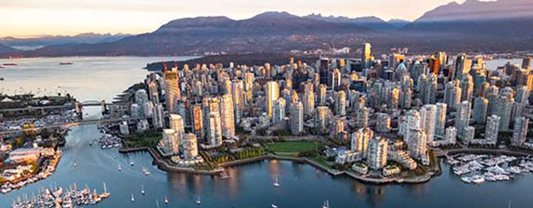
NeurIPS 2019, Vancouver, B.C., Canada
https://github.com/framinmansour/Learning-Macroscopic-Brain-Connectomes-via-Group-Sparse-Factorization
Full paper
Poster
Video
Demo of the code
Notes:
By visiting the link of the GitHub provided here, you can get access to the code, full version of the paper, and its poster. To find out more details about our work, please join us at NeurIPS 2019, this December at Vancouver, British Columbia.

