Slide 1

Graph Music
By Francisco Ramirez
Advisor: Dr. Randy Davila

Slide 2
Overview
In spectral graph theory, we study the properties of the Laplacian matrix, adjacency matrix , eigenvectors and eigenvalues associated with a graph.
We take a look at properties of different graphs and see see if there is any underlying pattens among them and how they correlate between any of them.
With the eigen values, we map them to frequencies to produce music.
We want to answer what properties graph are important in shaping the sound produced by the eigenvalues of the graph.

Slide 3

Julia, a new player on the field.
Julia is a program designed in 2017 by a team at MIT proferssors. It was meant to solve computational problems.
1
While there are a great a many similarities between python and Julia, Julia provides a higher computational power and
2
Julia is still a relatively new programing language but with time it can develop into a more robust surpassing even python.
3

Slide 4

Working with VS Code
Vs code is an idle that works extensively with many languages.
Its versatility with working with multiple third parties makes it a perfect IDLE for working with others.
Vs code is capable of downloading multiple plugins designed to help code

Slide 5
Library used
We needed the following libraries to create the project:
Data Analysis
CSV – to read the csv files
Data Frames – to create dataframes out of the csv
Plots – used for create plots of our data
Ggplot2 - used for style of the plot (not required
Creating the music
LinearAlgebra as LinAlg
SparseArrays
Graphs
WAV
GraphIO

Slide 6
Under the hood: Graph theory.
The primary drive for this paper was spectral graph theory. We look as to whether we can distinguish a graph by their eigenvalues that are associated with the graph.
Values between 0 and 2 are place on two octaves starting at A (440 Hz). Thus a value of 1 corresponds to A (880 Hz), a value of 2 corresponds to A (1760 Hz), a value of 1.5 corresponds to D# (660 Hz), and so forth. All the notes are played simultaneously in a chord. If a graph has a multiple eigenvalue, the corresponding note is played louder.
Take a graph an get the normalized Laplacian Matrix.
Normalized Laplacian matrix has a property that guarantees that their eigenvalues are between 0 and 2. You map them to frequencies.

Slide 7
Graph properties
Chromatic number – the smallest number o colors needed to color graph G
Independence number – the cardinality of a largest independent of G. as degrees increase, independence number increases.
Domination number – the cardinality of a smallest set of vertices such that every vertex no in the set is adjacent to at least one vertices of the set.
Zero forcing number - the minimum cardinality of a set s of black vertices such that V(G) is turned black
Radius – the minimum graph eccentricity of any graph vertex
Diameter – largest number of vertices which must be transversed to travel from one vertex to another when paths excluded from consideration.
Order – number of vertices
Density – ratio between the edges present and the max number of edges that the graph can contain.
Estrada index – the trace of the adjacency matrix

Slide 8
Domination Number
In this analysis we will focus on Domination number. The domination number of a graph is the cardinality of a smallest set of vertices such that every vertex not in the set is adjacent to at least vertices of the set.
The dominating deals with with testing wether y(G) <= K for a given graph H and input K;

Slide 9
Part 1: Creating the music
One of the first things we needed to do was create the sound.
The took the eigenvalues of the normalized Laplacian graphs.
The values where then mapped to a frequency

Slide 10
Code
Normalized Laplacian matrix – takes in a graph g and returns the normalized Laplacian matrix of the graph
Normalize Laplacian Spectrum – takes in graph g and returns the eigenvalues of the normalized Laplacian matrix of the graph
Spectrum to frequencies – maps the eigenvalues of the normalized Laplacian matrix to frequencies
Sine wave – converts the frequencies to sine waves
Square wave – converts the frequencies to square waves
Frequencies to tones – turns the waves (sine/square) to tones

Slide 11
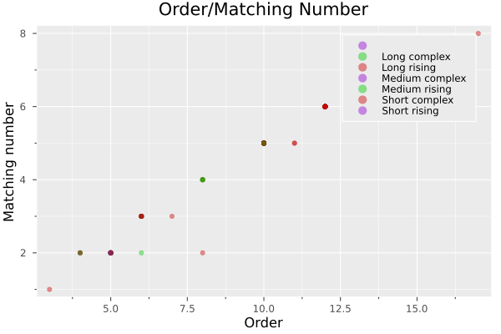
Order and Matching Number

Slide 12
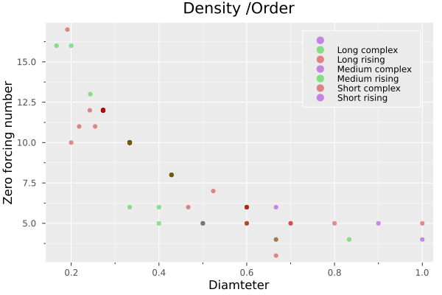
Density/Order

Slide 13
Part 2: Data Analysis
The higher the density the lower the order.
The higher algebraic connectivity the lower annihilation
The the higher the domination number the higher the independence number
No correlation between domination and zero forcing number
The higher the domination number the higher the order
The higher the domination the higher the matching number
The higher the domination number the higher the vertex cover number
The higher the domination number the lower the density

Slide 15
Conclusion

Slide 16
References
https://www.jasondavies.com/graph-music/
https://web.archive.org/web/20141114091039/http://math.iit.edu/~rellis/comb/graph.html
https://gist.github.com/somacdivad/fdcb59f52037269472804d1b5a08cab7
https://gist.github.com/somacdivad/fd9daff3a4aff1d649330e011d7aec6e

