Slide 1
Formal Methods for Partial Differential Equations
Francisco Penedo (franp@bu.edu)

Slide 2
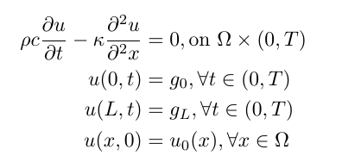
Heat Equation
Temperature evolution (u(x,t)) on a 1D rod (Ω = (0, L)):
We denote this system by Σ.

Slide 3




LTL for PDEs
We include the spatial information in the atomic propositions
Informally,
Example:

Slide 4

Verification Problem
Given a system Σ, specification φ and initial region Θ ∈ 2^{Π} check whether the trajectories of Σ satisfy φ for all initial values u₀ ∈ [[Θ]]

Slide 5


Finite Element Analysis
Partition Ω into a finite set of “elements” with endpoints
Approximate the solution of Σ by interpolating the solution of
Where A and b are computed from the parameters of Σ. The A matrix is banded.
We call this system Σ_{FEM}

Slide 6


LTL for FEM System
Only change atomic propositions:
Problem is now:
Given a system Σ_{FEM}, specification φ_{FEM} and initial region Θ ∈ 2^{Π} check whether the trajectories of Σ_{FEM} satisfy φ_{FEM} for all initial values corresponding to u₀ ∈ [[Θ]]
Issue: Σ_{FEM} is an approximation! We need a priori error bounds

Slide 7
Transition System and Quotients
Usual approach:
Partition state space of
Compute quotient TS with respect to the partition
Check satisfaction in the TS
Issue: is very high dimensional! (100 – 10000)
Idea: Make smaller quotients to check subformulas

Slide 8




TS and Quotients
For a formula in the form
We only need to check each individually.
Consider the full quotient TS, K, based on a rectangular partition of the state space:
And the equivalence relationships

Slide 9
TS and Quotients
We can check the satisfaction of a subformula using the quotient TS K/S_{I}, where I contains all indices of d_{i} that appear in

Slide 10

Subsystems
How do we compute those quotients? Not from the full TS K, but from the subsystem corresponding to the equivalence relation:
The TS corresponding to this system is an overapproximation of the quotient K/S_{I}
Regular
term
Polyhedral
disturbance

Slide 11


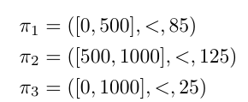
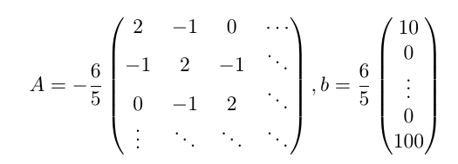
Example
Rod with L = 1000, g₀ = 10, g_{L} = 100. We want to check the spec with initial region
The FEM system for a norm 1 partition is given by the following matrices:

Slide 12



Example (cont)
A direct translation of the spec gives:
Each subformula has too many d_{i}, but we can rearrange it:
Now each subformula has only one d_{i} and we can check the corresponding quotient TS

Slide 13
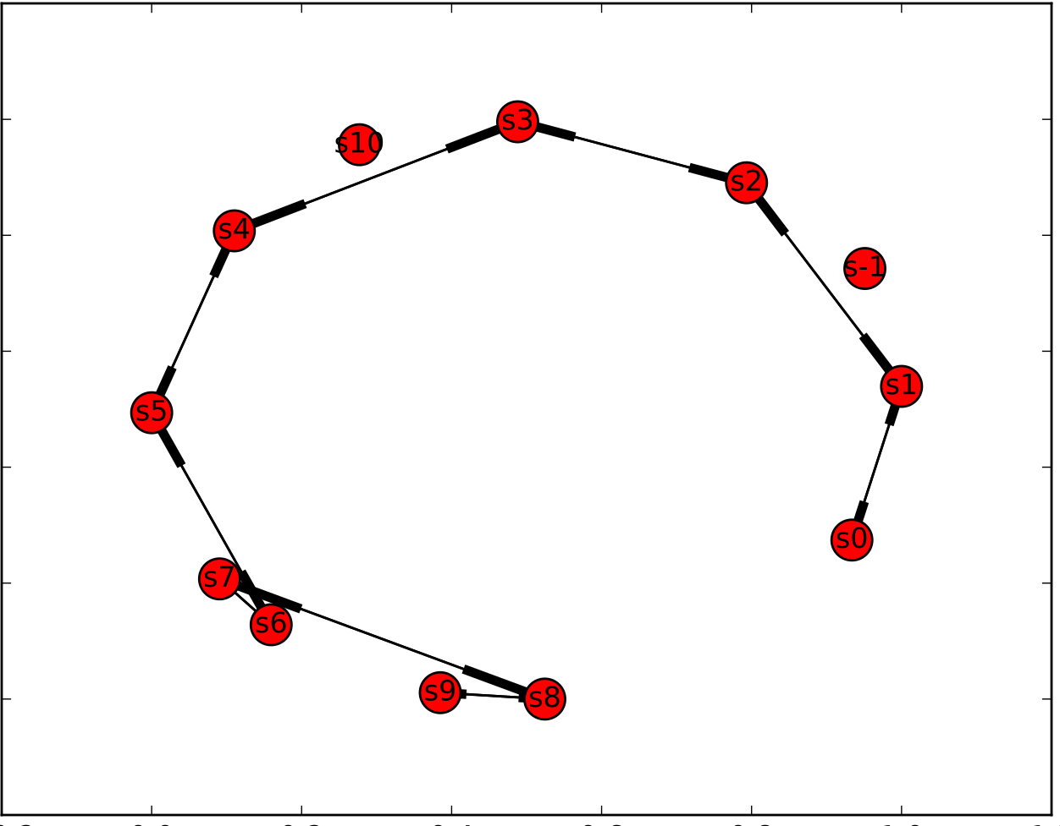

Example (cont)
This TS doesn’t satisfy
All transitions are enabled!
Only trivial formulas will be satisfied for this TS
TS for d₅₀₀ subsystem

Slide 14

STL for PDEs
Similar to LTL, we only need to define appropriate atomic propositions:
Example:

Slide 15

STL for FEM System
Same as LTL
In this formulation, we can translate the problem directly into a feasibility check for a Mixed Integer Linear Program

Slide 16


Example
Rod with L = 100, g₀ = 10, g_{L} = 100. We want to check the spec with initial value u₀ = 20
The corresponding FEM system for a size 1 partition is similar to the previous example
We use Gurobi to check the feasibility of the MILP
It takes 437 seconds to solve the problem

Slide 17
Conclusions
We can formulate verification problems for PDEs using temporal logics
We can translate the problem into a verification problem for ODEs
An abstraction based approach is not powerful enough for the high dimensional system
MILP based approach is promising for extension to control problems
A priori error bound still needed to connect PDE and ODE problems

