Slide 1



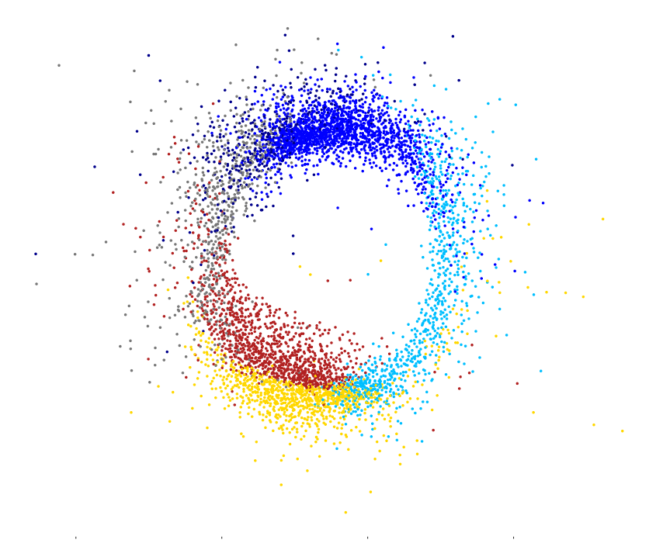

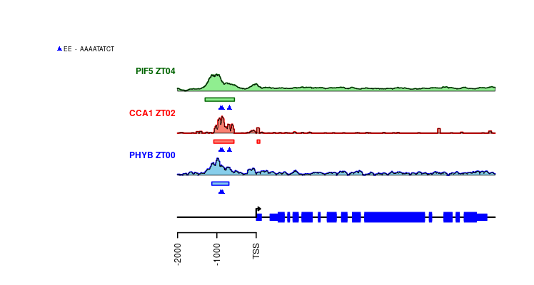

ATTRACTOR, a circadian clock transcriptional network based on ChIP-seq data unveils potential gene modules for crop improvement
Plant Development Unit
Dpt. Computer Science and Artificial Intelligence
Institute for Plant Biochemistry and Photosynthesis
University of Sevilla - CSIC

Slide 2
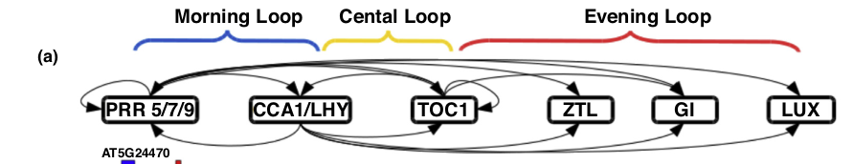
Circadian Clock is central to Plant Development and Physiology
1/15
Serrano-Bueno, Romero-Campero, et al (2017) Current Opinion in Plant Biology

Slide 3

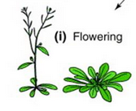
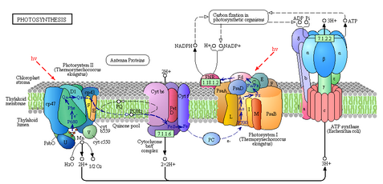
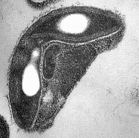
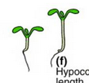

Circadian Clock is central to Plant Development and Physiology
Cotyledon/leaf
movement
Hypocotyl
length
Starch/sugar
metabolism
Stoma opening/closing
Flowering transition
Photosynthesis
1/15
Serrano-Bueno, Romero-Campero, et al (2017) Current Opinion in Plant Biology

Slide 4

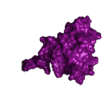
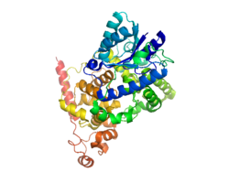
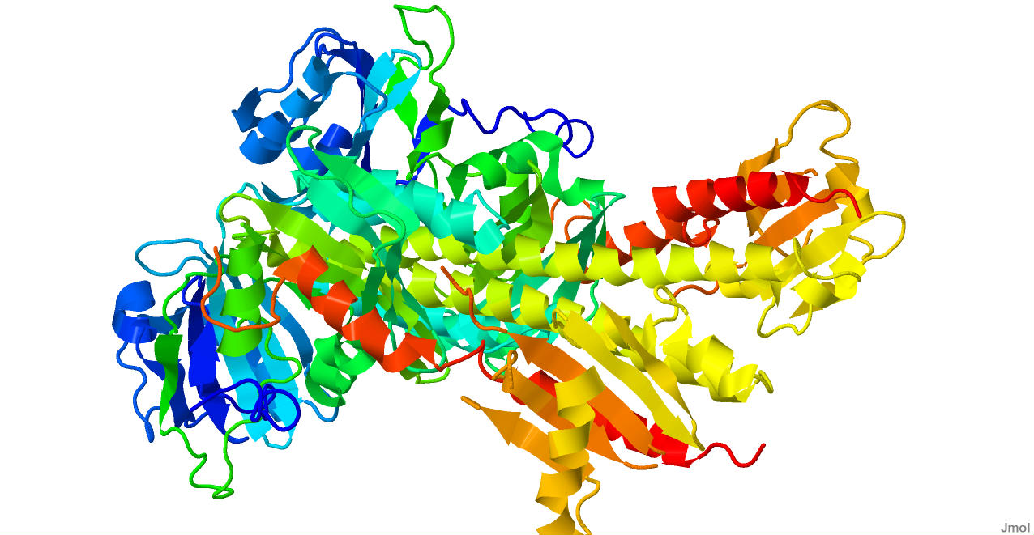
Circadian Clock is central to Plant Development and Physiology
Phytochromes
Phytochrome
Interacting Factors
Cryptochromes
Cotyledon/leaf
movement
Hypocotyl
length
Starch/sugar
metabolism
Stoma opening/closing
Flowering transition
Photosynthesis
1/15
Serrano-Bueno, Romero-Campero, et al (2017) Current Opinion in Plant Biology

Slide 5
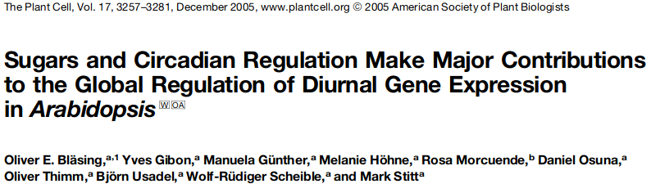
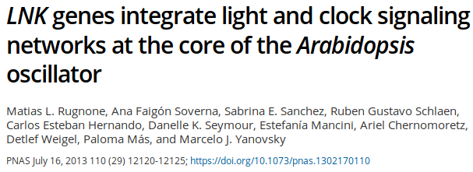

Transcriptomics and Cistromics data accumulate in Data Bases for key regulators in the Circadian Clock
RNA-seq / Microarray Data
2/15

Slide 6
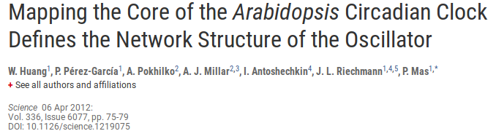


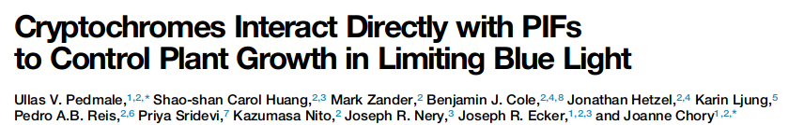

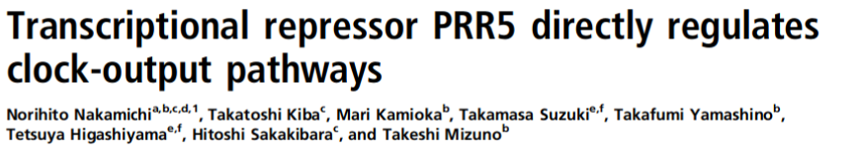
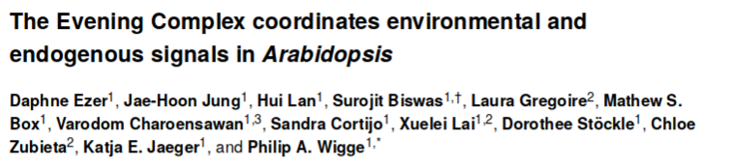
Transcriptomics and Cistromics data accumulate in Data Bases for key regulators in the Circadian Clock
RNA-seq / Microarray Data
… … …
ChIP-seq Data
2/15

Slide 7
Transcriptomics and Cistromics data accumulate in Data Bases for key regulators in the Circadian Clock
RNA-seq / Microarray Data
… … …
ChIP-seq Data
2/15

Slide 8
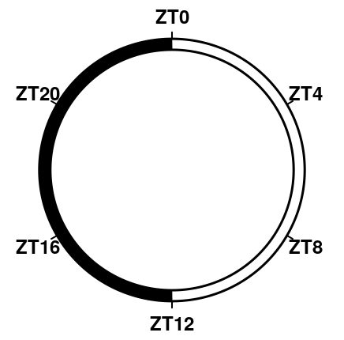
A Gene Co-expression Network shows that Genes Naturally Organize into a Cyclic Structure
3/15
de los Reyes, Romero-Campero, et al (2017) Frontiers in Plant Science

Slide 9
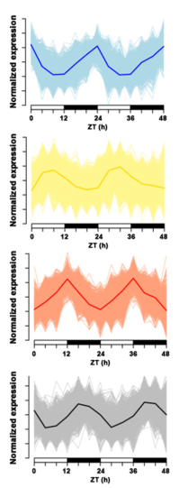
A Gene Co-expression Network shows that Genes Naturally Organize into a Cyclic Structure
3/15
de los Reyes, Romero-Campero, et al (2017) Frontiers in Plant Science

Slide 10

A Gene Co-expression Network shows that Genes Naturally Organize into a Cyclic Structure
3/15
de los Reyes, Romero-Campero, et al (2017) Frontiers in Plant Science

Slide 11
A Gene Co-expression Network shows that Genes Naturally Organize into a Cyclic Structure
GBSS1
3/15
de los Reyes, Romero-Campero, et al (2017) Frontiers in Plant Science

Slide 12
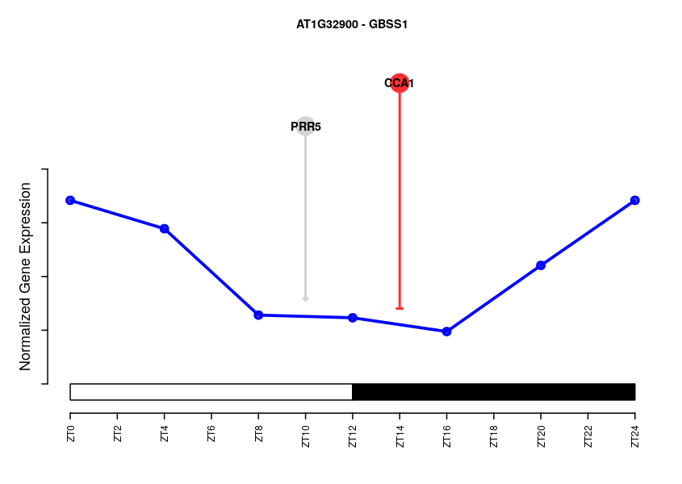
A Gene Co-expression Network shows that Genes Naturally Organize into a Cyclic Structure
GBSS1
3/15
de los Reyes, Romero-Campero, et al (2017) Frontiers in Plant Science

Slide 13
A Gene Co-expression Network shows that Genes Naturally Organize into a Cyclic Structure
GBSS1
3/15
de los Reyes, Romero-Campero, et al (2017) Frontiers in Plant Science

Slide 14
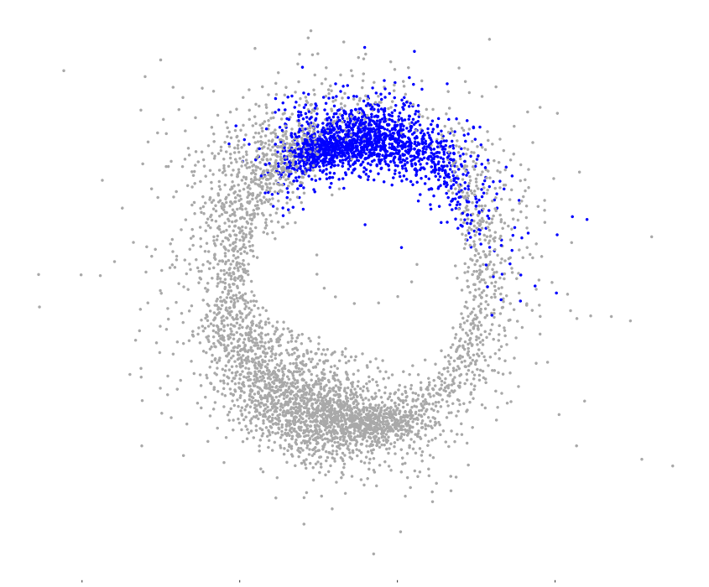
A Gene Co-expression Network shows that Genes Naturally Organize into a Cyclic Structure
ZT0
GBSS1
3/15
de los Reyes, Romero-Campero, et al (2017) Frontiers in Plant Science

Slide 15
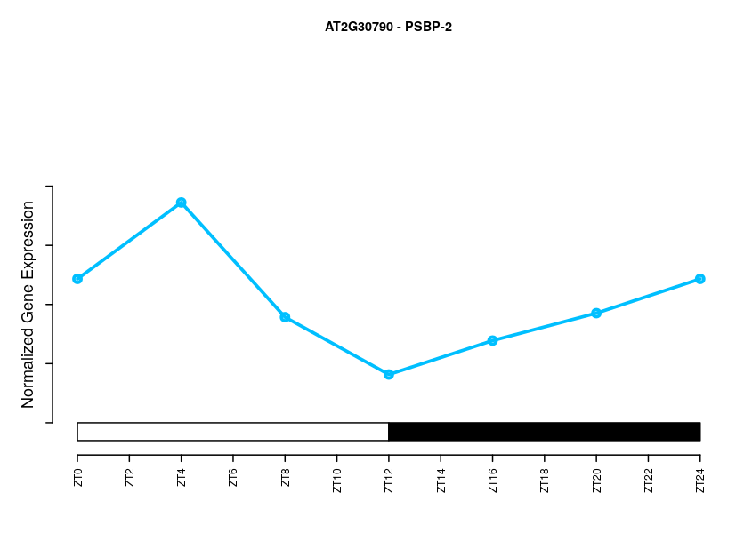
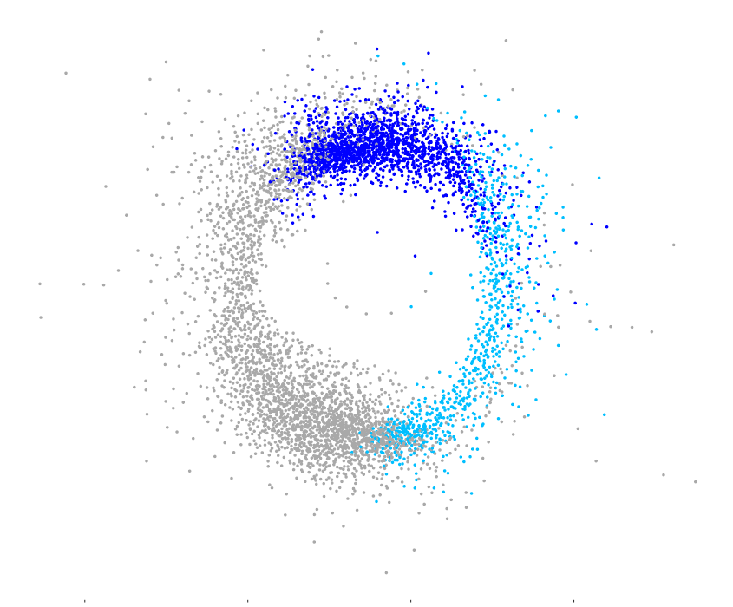
A Gene Co-expression Network shows that Genes Naturally Organize into a Cyclic Structure
ZT0
PSB27
ZT4
3/15
de los Reyes, Romero-Campero, et al (2017) Frontiers in Plant Science

Slide 16
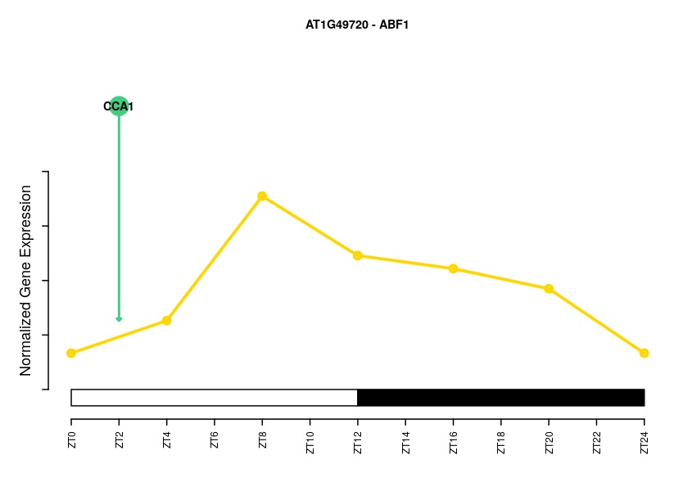
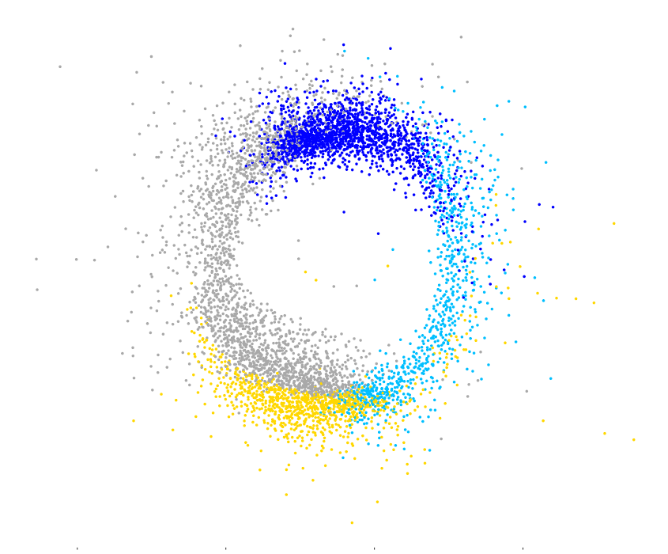
A Gene Co-expression Network shows that Genes Naturally Organize into a Cyclic Structure
ZT0
ABF1
ZT4
ZT8
3/15
de los Reyes, Romero-Campero, et al (2017) Frontiers in Plant Science

Slide 17
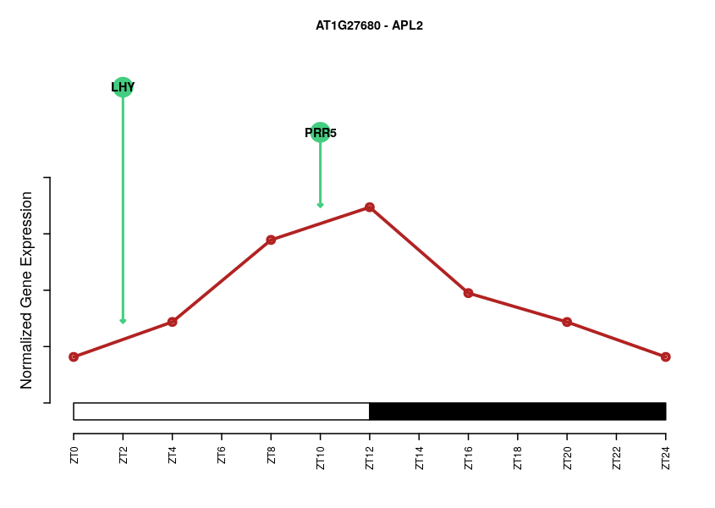
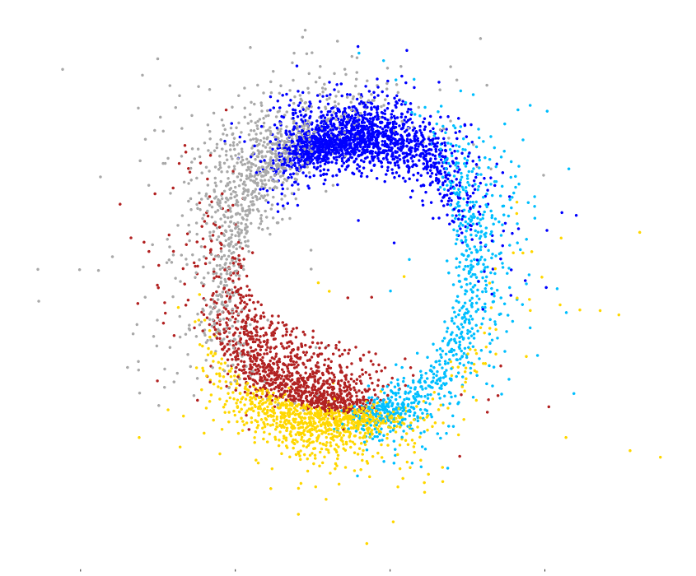
A Gene Co-expression Network shows that Genes Naturally Organize into a Cyclic Structure
ZT0
APL2
ZT4
ZT12
ZT8
3/15
de los Reyes, Romero-Campero, et al (2017) Frontiers in Plant Science

Slide 18
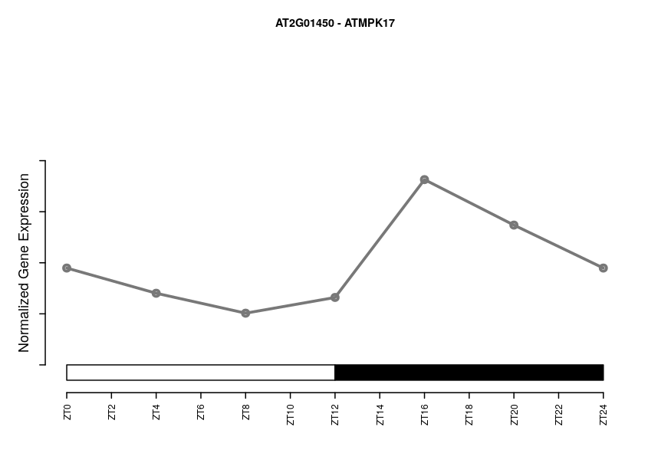
A Gene Co-expression Network shows that Genes Naturally Organize into a Cyclic Structure
ZT0
MPK17
ZT4
ZT12
ZT8
3/15
de los Reyes, Romero-Campero, et al (2017) Frontiers in Plant Science

Slide 19
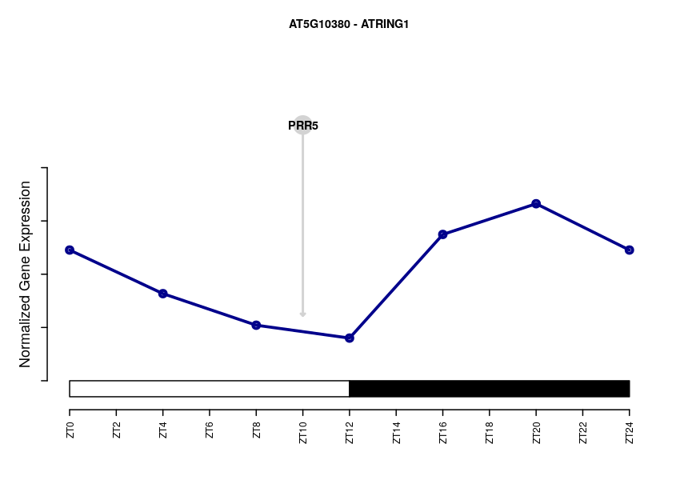
A Gene Co-expression Network shows that Genes Naturally Organize into a Cyclic Structure
ZT0
RING1
ZT20
ZT16
ZT4
ZT12
ZT8
3/15
de los Reyes, Romero-Campero, et al (2017) Frontiers in Plant Science

Slide 20
Transcriptomics and Cistromics data accumulate in Data Bases for key regulators in the Circadian Clock
RNA-seq / Microarray Data
… … …
ChIP-seq Data

Slide 21
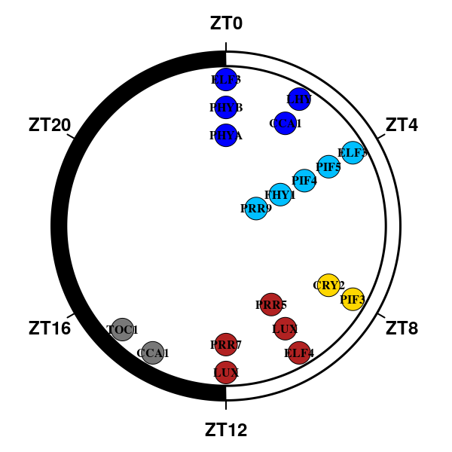
ATTRACTOR, a Transcriptional Network integrating key Circadian Regulators and Light Signaling
ZT0
ZT20
ZT16
ZT4
ZT12
ZT8
5/15

Slide 22
ATTRACTOR, a Transcriptional Network integrating key Circadian Regulators and Light Signaling
CCA1
LHY
PRR9
PRR7
PRR5
TOC1
LUX
ELF3
ELF4
PHYA
PHYB
PIF3
PIF4
PIF5
CRY2
FHY1
ZT0
ZT20
ZT16
ZT4
ZT12
ZT8
5/15

Slide 23
ATTRACTOR, a Transcriptional Network integrating key Circadian Regulators and Light Signaling
CCA1
LHY
PRR9
PRR7
PRR5
TOC1
LUX
ELF3
ELF4
PHYA
PHYB
PIF3
PIF4
PIF5
CRY2
FHY1
ZT0
Morning Loop
ZT20
ZT16
ZT4
ZT12
ZT8
5/15

Slide 24
ATTRACTOR, a Transcriptional Network integrating key Circadian Regulators and Light Signaling
CCA1
LHY
PRR9
PRR7
PRR5
TOC1
LUX
ELF3
ELF4
PHYA
PHYB
PIF3
PIF4
PIF5
CRY2
FHY1
ZT0
Morning Loop
ZT20
ZT16
ZT4
ZT12
ZT8
5/15

Slide 25
ATTRACTOR, a Transcriptional Network integrating key Circadian Regulators and Light Signaling
CCA1
LHY
PRR9
PRR7
PRR5
TOC1
LUX
ELF3
ELF4
PHYA
PHYB
PIF3
PIF4
PIF5
CRY2
FHY1
ZT0
Morning Loop
ZT20
Evening Loop
ZT16
ZT4
ZT12
ZT8
5/15

Slide 26
ATTRACTOR, a Transcriptional Network integrating key Circadian Regulators and Light Signaling
CCA1
LHY
PRR9
PRR7
PRR5
TOC1
LUX
ELF3
ELF4
PHYA
PHYB
PIF3
PIF4
PIF5
CRY2
FHY1
ZT0
Morning Loop
ZT20
Evening Loop
ZT16
ZT4
ZT12
ZT8
5/15

Slide 27
ATTRACTOR, a Transcriptional Network integrating key Circadian Regulators and Light Signaling
CCA1
LHY
PRR9
PRR7
PRR5
TOC1
LUX
ELF3
ELF4
PHYA
PHYB
PIF3
PIF4
PIF5
CRY2
FHY1
ZT0
Morning Loop
ZT20
Evening Loop
ZT16
ZT4
ZT12
ZT8
5/15

Slide 28
ATTRACTOR, a Transcriptional Network integrating key Circadian Regulators and Light Signaling
CCA1
LHY
PRR9
PRR7
PRR5
TOC1
LUX
ELF3
ELF4
PHYA
PHYB
PIF3
PIF4
PIF5
CRY2
FHY1
ZT0
Morning Loop
ZT20
Evening Loop
ZT16
ZT4
ZT12
Light Signalling
ZT8
5/15

Slide 29
ATTRACTOR, a Transcriptional Network integrating key Circadian Regulators and Light Signaling
CCA1
LHY
PRR9
PRR7
PRR5
TOC1
LUX
ELF3
ELF4
PHYA
PHYB
PIF3
PIF4
PIF5
CRY2
FHY1
ZT0
Morning Loop
ZT20
Evening Loop
ZT16
ZT4
ZT12
Light Signaling
ZT8
5/15

Slide 30
Transcriptional regulations are assigned a positive/negative/neutral effect depending on the target expression profile
ZT0
PRR5
PIF4
ZT20
ZT16
ZT4
ZT12
ZT8
6/15

Slide 31
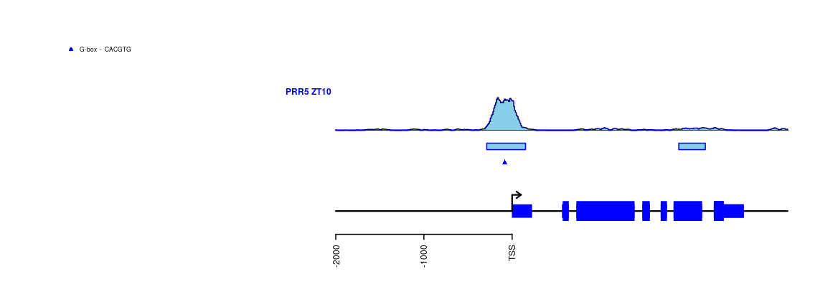
Transcriptional regulations are assigned a positive/negative/neutral effect depending on the target expression profile
ZT0
PRR5
PIF4
ZT20
PRR5
ZT16
ZT4
PIF4
ZT12
ZT8
6/15

Slide 32
Transcriptional regulations are assigned a positive/negative/neutral effect depending on the target expression profile
ZT0
PRR5
PIF4
ZT20
PRR5
ZT16
ZT4
PIF4
ZT12
ZT8
6/15

Slide 33
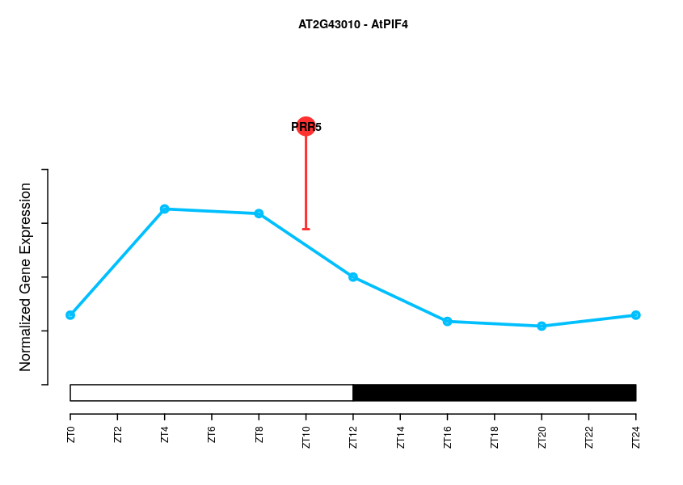
Transcriptional regulations are assigned a positive/negative/neutral effect depending on the target expression profile
ZT0
PRR5
PIF4
ZT20
PRR5
ZT16
ZT4
PIF4
ZT12
ZT8
6/15

Slide 34
Transcriptional regulations are assigned a positive/negative/neutral effect depending on the target expression profile
ZT0
PRR5
PIF4
ZT20
PRR5
ZT16
ZT4
PIF4
ZT12
ZT8
6/15

Slide 35
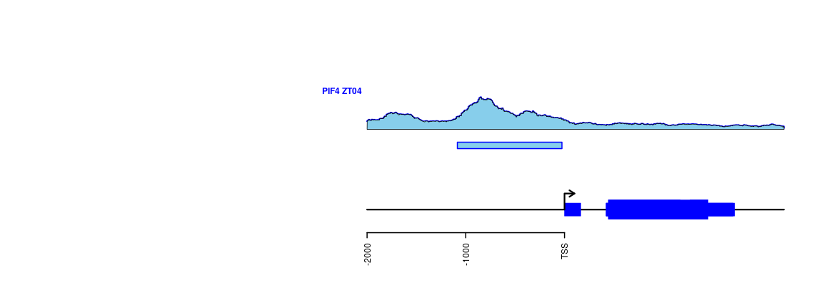
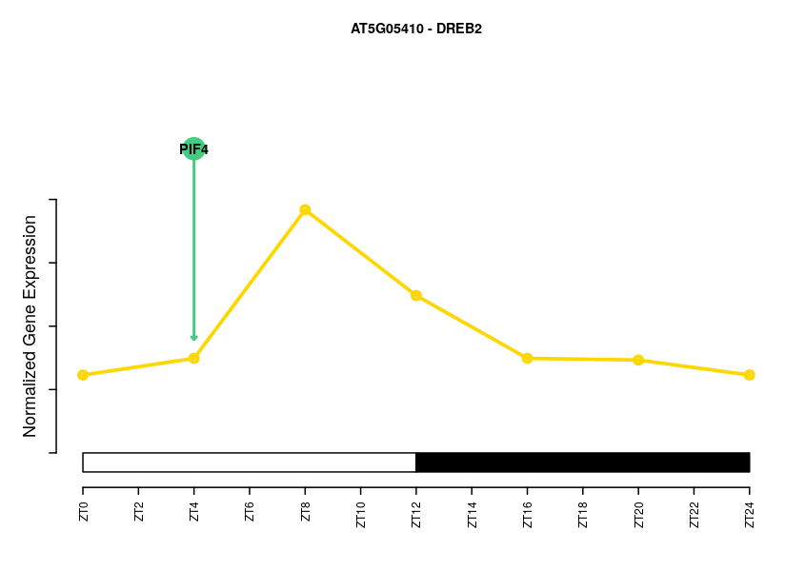
Transcriptional regulations are assigned a positive/negative/neutral effect depending on the target expression profile
ZT0
PIF4
DREB2A
ZT20
PIF4
ZT16
ZT4
ZT4
DREB2A
ZT12
ZT8
6/15

Slide 36
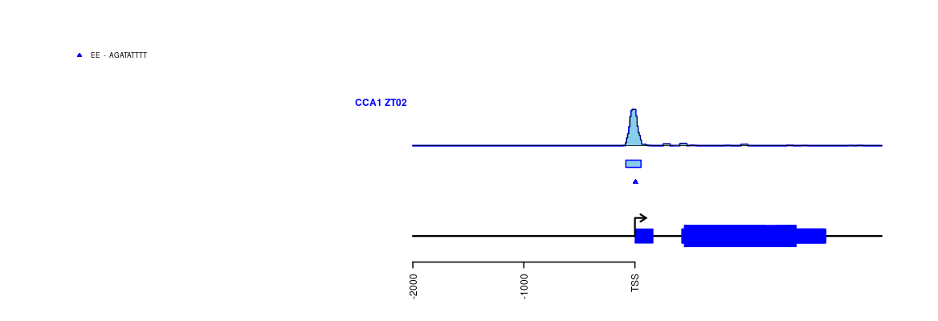
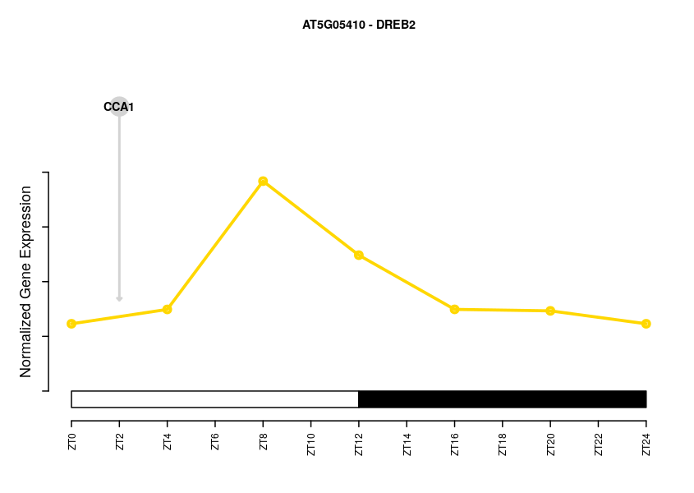
Transcriptional regulations are assigned a positive/negative/neutral effect depending on the target expression profile
ZT0
CCA1
DREB2A
ZT20
ZT16
ZT4
ZT4
DREB2A
ZT12
ZT8
6/15

Slide 37
Transcriptional regulations are assigned a positive/negative/neutral effect depending on the target expression profile
ZT0
ATTRACTOR is a gene transcriptional
network comprising:
  - 5778 nodes or genes with rythmic expression profiles
  - 14529 edges or transcriptional regulations
ZT20
ZT16
ZT4
ZT4
ZT12
ZT8
7/15

Slide 38



ATTRACTOR, a web based tool for the exploration of a transcriptional network integrating key regulators of the circadian clock and light signalling
ZT0
Completely developed using R packages.
Functionalities:
    Global properties analysis and visualization
    Analysis of the regulation of individual genes
    Analysis of coordinated regulation over set of genes including:
      - Significance enrichment in specific expression patterns
      - GO enrichment and TFBS overrepresentation
      - Significance of binding sites overlaps between different transcription factors
ZT20
ZT16
ZT4
ZT4
ZT12
ZT8
8/15
de los Reyes, Romero-Losada, in preparation

Slide 39
ATTRACTOR suggests that the Circadian Clock Transcriptional Program is simultaneously robust to random perturbations and sensitive to directed tuning
ZT0
ZT20
ZT16
In degree 3
Number of regulators
ZT4
ZT12
ZT8
9/15

Slide 40
ATTRACTOR suggests that the Circadian Clock Transcriptional Program is simultaneously robust to random perturbations and sensitive to directed tuning
ZT0
ZT20
ZT16
In degree 3
Number of regulators
ZT4
ZT12
ZT8
9/15

Slide 41
ATTRACTOR suggests that the Circadian Clock Transcriptional Program is simultaneously robust to random perturbations and sensitive to directed tuning
ZT0
ZT20
ZT16
In degree 3
Number of regulators
ZT4
ZT12
ZT8
9/15

Slide 42
ATTRACTOR suggests that the Circadian Clock Transcriptional Program is simultaneously robust to random perturbations and sensitive to directed tuning
ZT0
ZT20
HUBS
ZT16
In degree 3
Number of regulators
ZT4
ZT12
ZT8
9/15

Slide 43
ATTRACTOR suggests that the Circadian Clock Transcriptional Program is simultaneously robust to random perturbations and sensitive to directed tuning
ZT0
ZT20
HUBS
ZT16
In degree 3
Number of regulators
ZT4
An ultra-small world network
ZT12
ZT8
9/15

Slide 44
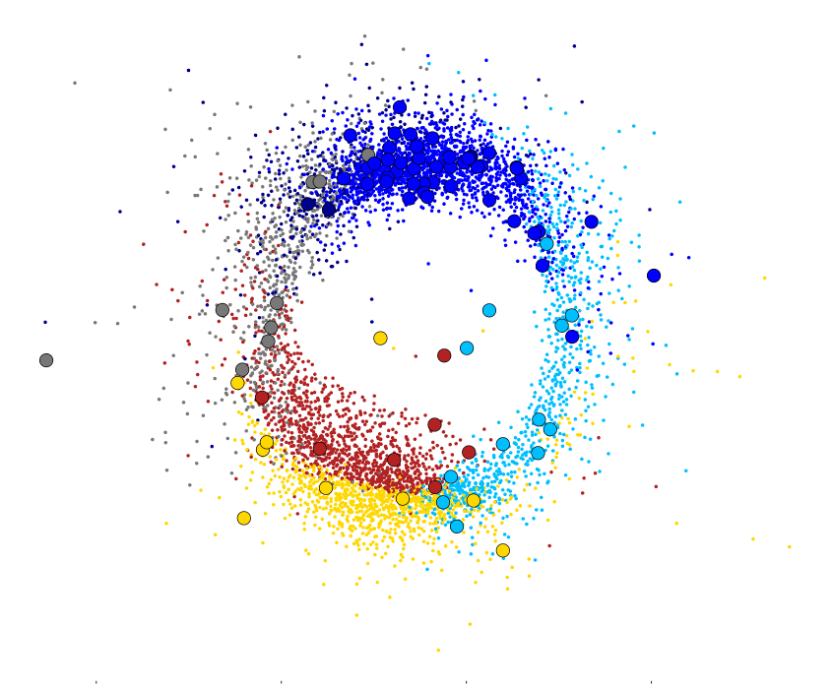
ATTRACTOR suggests that the Circadian Clock Transcriptional Program is simultaneously robust to random perturbations and sensitive to directed tuning
ZT0
ZT20
HUBS
ZT16
In degree 3
Number of regulators
ZT4
An ultra-small world network
ZT12
ZT8
9/15
Hubs genes significantly enriched in genes peaking at the dark/light transition (p-value = 1.16x10⁻⁸)

Slide 45
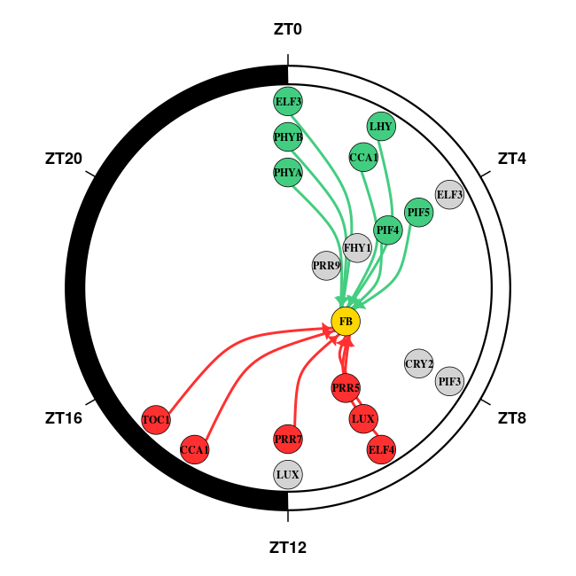
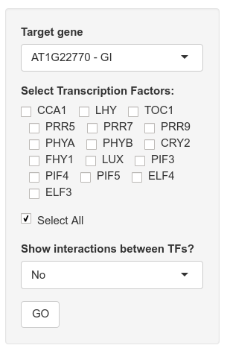
ATTRACTOR enables researchers to explore the expression profile, potential regulators and their binding sites of individual genes
10/15

Slide 46
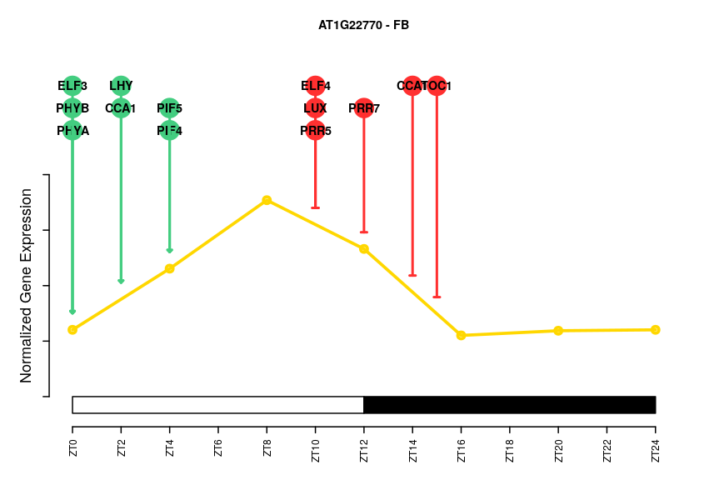
ATTRACTOR enables researchers to explore the expression profile, potential regulators and their binding sites of individual genes
GIGANTEA
10/15

Slide 47
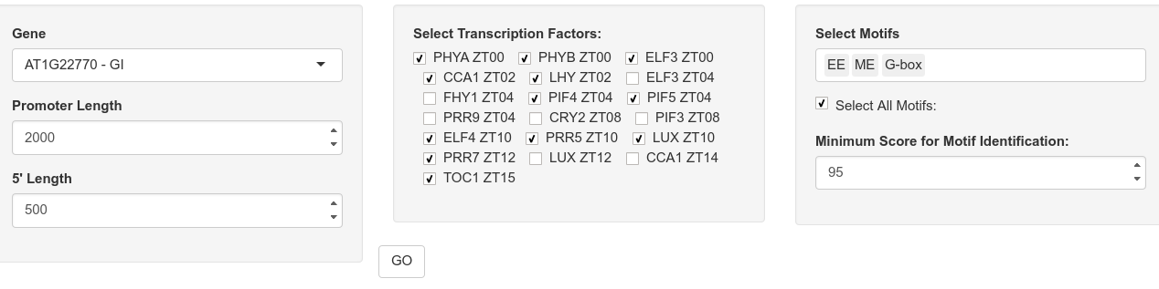
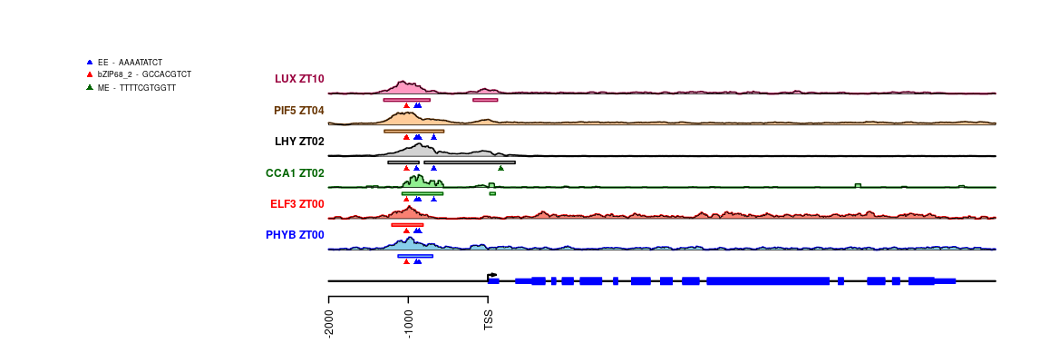
ATTRACTOR enables researchers to explore the expression profile, potential regulators and their binding sites of individual genes
10/15
GIGANTEA

Slide 48
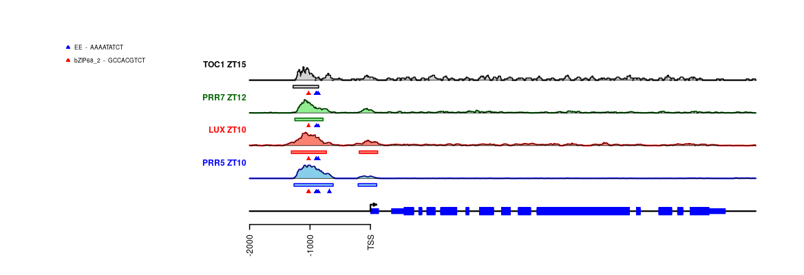
ATTRACTOR enables researchers to explore the expression profile, potential regulators and their binding sites of individual genes
10/15
GIGANTEA

Slide 49
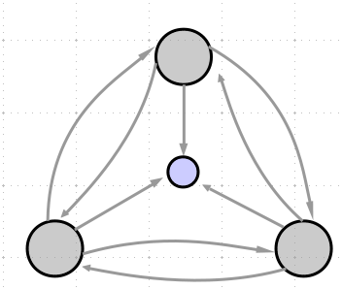
ATTRACTOR is constituted by non-random subgraphs called network motives
ZT0
ZT20
ZT16
ZT4
ZT12
ZT8
11/15

Slide 50
ATTRACTOR is constituted by non-random subgraphs called network motives
ZT0
ZT20
ZT16
1042
ZT4
ZT12
ZT8
11/15

Slide 51
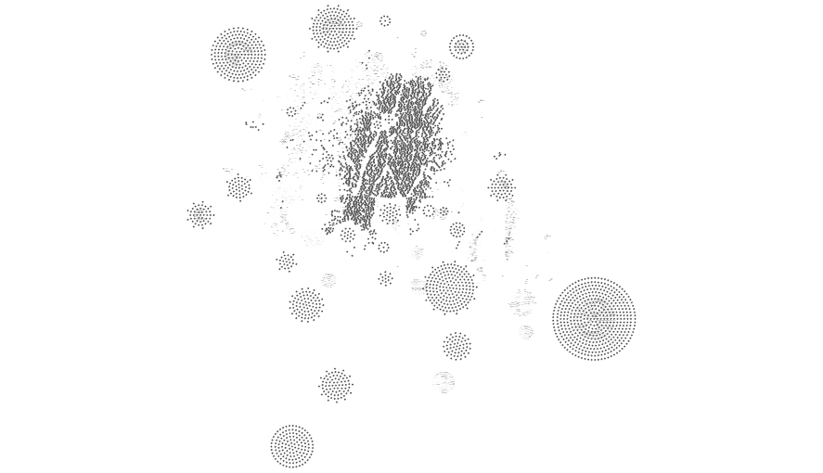
ATTRACTOR is constituted by non-random subgraphs called network motives
ZT0
ZT20
ZT16
1042
ZT4
ZT12
ZT8
11/15

Slide 52
ATTRACTOR is constituted by non-random subgraphs called network motives
ZT0
6
ZT20
ZT16
1042
ZT4
ZT12
ZT8
11/15

Slide 53
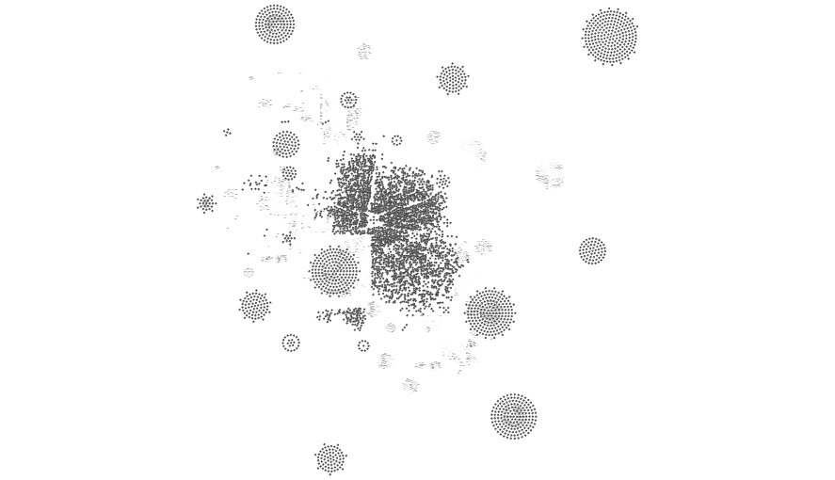
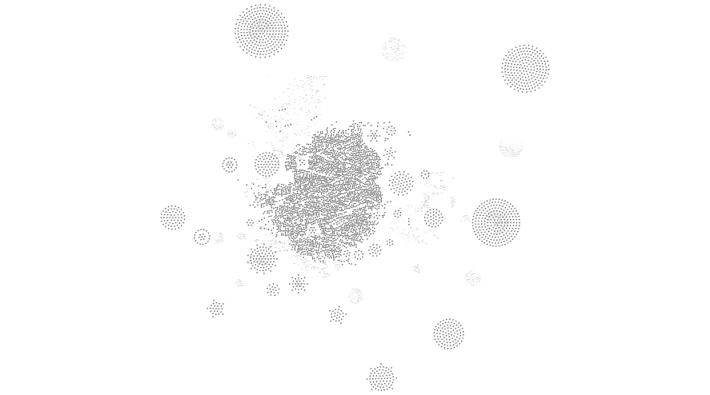
ATTRACTOR is constituted by non-random subgraphs called network motives
ZT0
6
ZT20
ZT16
1042
ZT4
.
.
.
ZT12
ZT8
11/15

Slide 54
ATTRACTOR is constituted by non-random subgraphs called network motives
ZT0
6
ZT20
ZT16
1042
0
ZT4
.
.
.
ZT12
ZT8
4
11/15

Slide 55
ATTRACTOR is constituted by non-random subgraphs called network motives
ZT0
6
ZT20
ZT16
1042
0
ZT4
.
.
.
ZT12
ZT8
4
11/15
The triple linked feedback loops with multiple output is a network motif with p-value < 10⁻⁶

Slide 56
PIFs establish multiple output linked feedback loops with PRRs and CCA1/LHY producing specific expression patterns involved in drought response
12/15

Slide 57
PIFs establish multiple output linked feedback loops with PRRs and CCA1/LHY producing specific expression patterns involved in drought response
PIF5
ERD7
DREB2A
GRP7
CCA1
PRR5
12/15

Slide 58
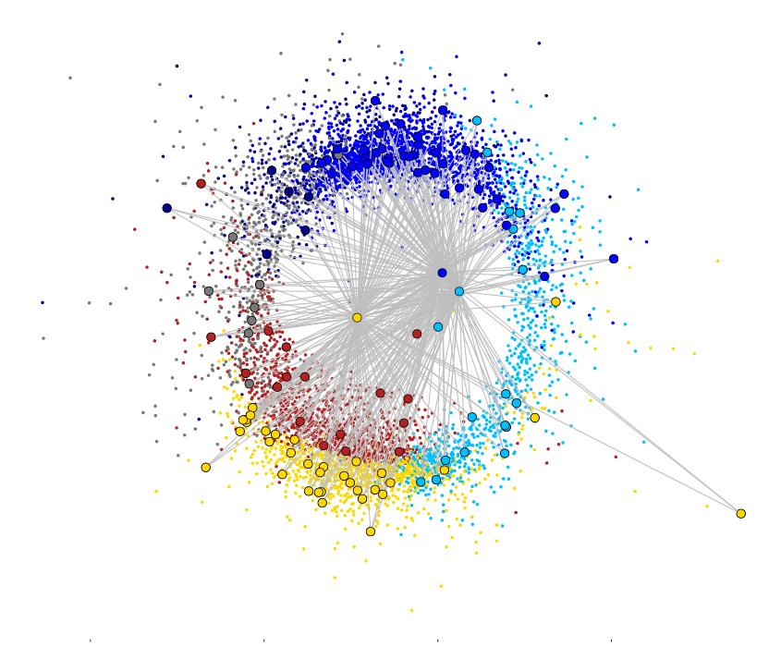
PIFs establish multiple output linked feedback loops with PRRs and CCA1/LHY producing specific expression patterns involved in drought response
ZT0
PIF5
ZT20
ZT16
ERD7
ZT4
DREB2A
GRP7
ZT12
CCA1
PRR5
ZT8
The common targets are not uniformly distributed but they are enriched in genes peaking at ZT8.
12/15

Slide 59
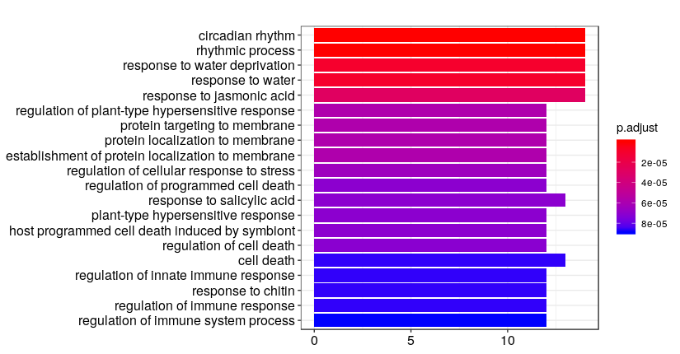
PIFs establish multiple output linked feedback loops with PRRs and CCA1/LHY producing specific expression patterns involved in drought response
PIF5
ERD7
DREB2A
GRP7
CCA1
PRR5
13/15

Slide 60
PIFs establish multiple output linked feedback loops with PRRs and CCA1/LHY producing specific expression patterns involved in drought response
PIF5
ERD7
DREB2A
GRP7
CCA1
PRR5
13/15

Slide 61
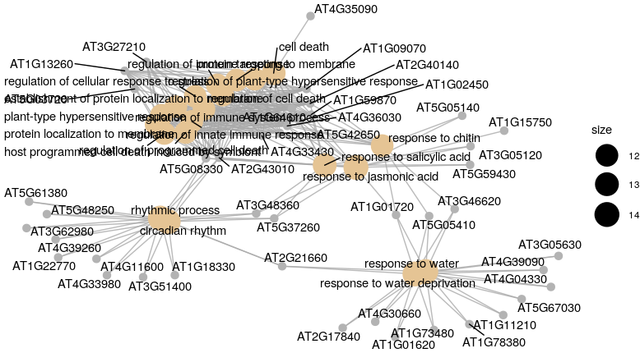
PIFs establish multiple output linked feedback loops with PRRs and CCA1/LHY producing specific expression patterns involved in drought response
PIF5
ERD7
DREB2A
GRP7
CCA1
PRR5
13/15

Slide 62
PIFs establish multiple output linked feedback loops with PRRs and CCA1/LHY producing specific expression patterns involved in drought response
PIF5
ERD7
DREB2A
GRP7
CCA1
PRR5
13/15

Slide 63
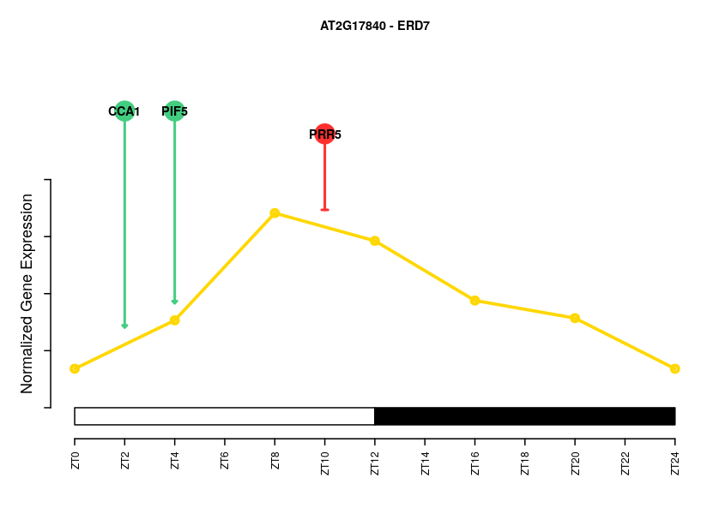
PIFs establish multiple output linked feedback loops with PRRs and CCA1/LHY producing specific expression patterns involved in drought response
ERD7
PIF5
ERD7
DREB2A
GRP7
CCA1
PRR5
14/15

Slide 64


PIFs establish multiple output linked feedback loops with PRRs and CCA1/LHY producing specific expression patterns involved in drought response
PIF5
ERD7
DREB2A
GRP7
CCA1
PRR5
DREB2A
14/15

Slide 65
PIFs establish multiple output linked feedback loops with PRRs and CCA1/LHY producing specific expression patterns involved in drought response
PIF5
p-value = 0.0012
ERD7
DREB2A
GRP7
CCA1
PRR5
DREB2A
14/15

Slide 66
PIFs establish multiple output linked feedback loops with PRRs and CCA1/LHY producing specific expression patterns involved in drought response
p-value = 2.35 x 10⁻⁵
PIF5
p-value = 0.0012
ERD7
DREB2A
GRP7
CCA1
PRR5
DREB2A
14/15

Slide 67


Summary
ATTRACTOR is a transcriptional network capturing the synergistic regulation exerted by the circadian clock and light signaling that unveils a system simultaneously robust to random perturbations and sensitive to directed tuning.
ATTRACTOR is a web based tool that enables researchers to explore the expression profile, regulators and their binding sites of individual genes as well as the coordinated regulation of multiple transcription factors over common target genes.
Network motive analysis reveals that PIFs, PRRs and CCA1/LHY form linked controlling response to drought.
15/15

Slide 68






Acknowledgments
Members:
Myriam Calonje
Federico Valverde
Jose M. Romero
Teresa Ruiz
Gloria Serrano
Isabel Jiménez
Pedro de los Reyes
Ana Belén Romero

