Slide 1
Over 50M tablet computers and over 420M smart phones
(higher than projections of 385 M PCs) are expected to
be purchased by consumers in 2011[1]

Slide 2
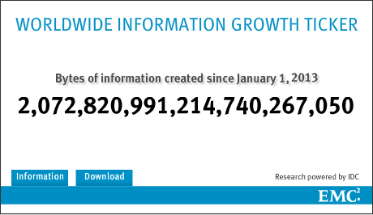
http://www.emc.com/leadership/digital-universe/index.htm
1885219709.2335157394 Terabytes
1.76 Zettabytes

Slide 3
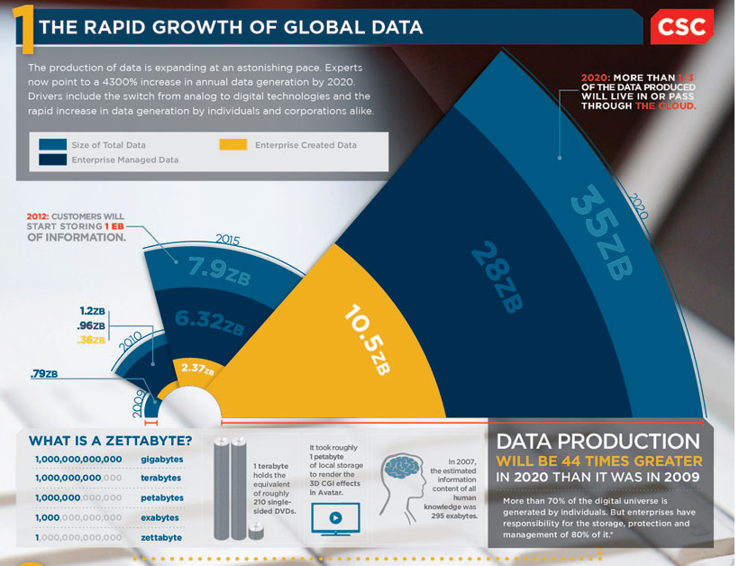
http://www.csc.com/insights/flxwd/78931-big_data_universe_beginning_to_explode

Slide 4
1. DeDu: Building a Deduplication Storage System over Cloud Computing

Slide 5
What is DeDu?
manages cloud storage with data deduplication
Goal: To remove redundant data and reduce cloud storage with a system.

Slide 6
Main idea:
Linking of files
Database (HBase)
File reuse

Slide 7
Approaches
File comparison
File level
Hash values
Combination of md5 and sha-1

Slide 8
Storage mechanism
Mass data
Indexing
Sparse indexing and bloom filters
deduplicates, and calculates hash values at the client before data transmission

Slide 9
Results
“In our experiment, we uploaded 110,000 files, amounting to 475.2 GB, into DeDu”
A perfect deduplication would result to 37GB
Achieved 38.1GB
1.1GB from link files

Slide 10
2. Deduplication and Compression Techniques in Cloud Design

Slide 11
System Architecture and Development
Local block level deduplication
better storage efficiency and lesser bandwidth consumption
Bandwidth as a vital source of users

Slide 12
System Architecture and Development
Segmentation
Compression
Binning
restricts the number of segments and their sizes so that it is optimum for each file size.

Slide 13
Bin1 – contains files of size < 10 MB.
Bin2 – contains files of size 10 MB to 1 GB.
Bin3 – contains files of size > 1 GB.

Slide 14
File Upload
File Download

Slide 15
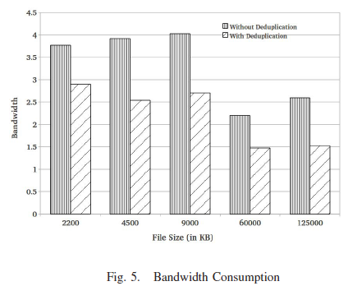

Slide 16
3. SAM: A Semantic-Aware Multi-Tiered Source De-duplication Framework for Cloud Backup

Slide 17
Focus
Trade-offs
High compression ratios vs...
At the cost of heavy overheads
Small overheads
at the cost of high data transmission
global ﬁle-level deduplication vs chunk-level deduplication

Slide 18
Observations
it is observed that the redundant data across different clients is dominated largely by duplicate ﬁles
many ﬁle-level semantic attributes can be exploited to narrow the search space of redundant data

Slide 19
Exploited file semantics
File Locality
File Size
63.8% of the identical ﬁles are smaller than 8KB, accounting for only 0.53% of the redundant data
File Type
File Timestamp

Slide 20
Results
Compared to
L-CDS (source local chunklevel de-duplication scheme) and
G-CDS (source global chunk-level deduplication scheme) with real-world datasets,
SAM achieves the compression ratio approaching to G-CDS by a margin of 1.35% while incurring the overhead close to that of the L-CDS method
Achieving a higher de-duplication efﬁciency/overhead ratio than existing solutions and shortens the backup window by an average of 38.7%

