Slide 1
THESIS PROPOSAL
Semantic Data Deduplication?
8, 15, 25, 29
July 2013
TEAM O U
Cordevilla, Chynna Julia
Formes, Rafael Gerard
Viernes, Francis Bien Jan

Slide 2
PROPOSAL
Thesis Statement

Slide 3
MOTIVATION: Problem
Problem
Cloud computing is catching on fast, and people are becoming more and more reliant on storing and processing their data on the cloud. The continuous barrage of data (meaning, both the addition, deletion, and updating of data) on cloud servers creates a problem that database designers are familiar with: data duplication, or the presence of data duplicates.

Slide 4
MOTIVATION: PROBLEM
Data duplication is a problem, most especially in the cloud, for the following reasons:
1. Wasted storage space; redundant storage means more storage space is used up. This is going to be a problem if the space being used or allotted for various users is/are limited.
2. Data inconsistency; it is highly likely that a file update will get lost among the redundant data, because various links still point to all the previous version/s of said file. This is going to be a huge problem most especially if the cloud server is shared among different users.
3. Slow data searches; redundant storage would mean that the system would have to go through a lot more data than it should to be able to find a single file. This is going to be a huge problem if the cloud holds a lot of data.

Slide 5
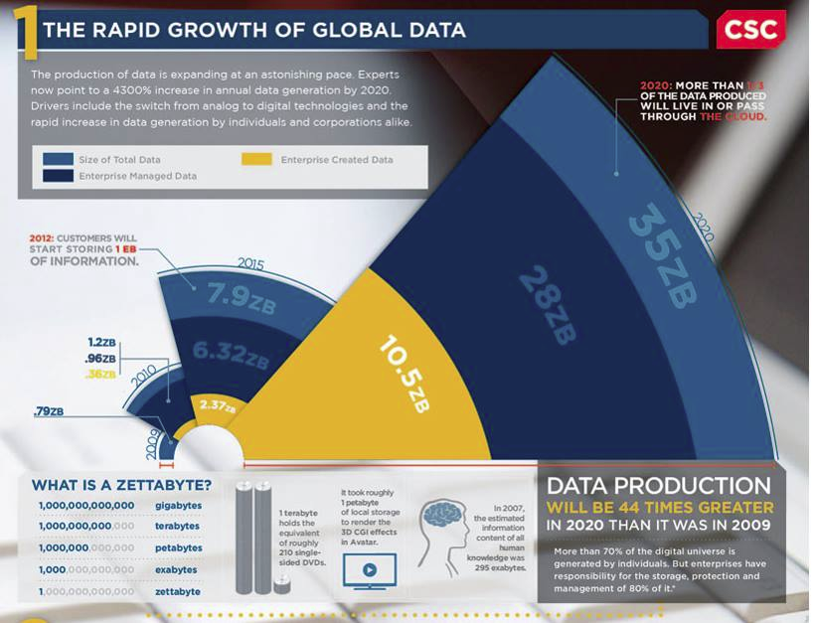
MOTIVATION: PROBLEM

Slide 6
MOTIVATION: PROBLEM
"An explosion in the volume of online digital content has resulted in enormous strain on storage systems.
The study by IDC estimates that in year 2007 about 255 Exabyte of information are created and replicated.
It predicts that the information added annually will increase more than six fold from 161 Exabyte to 988 Exabyte between 2006 and 2010, growing by 57% a year.“
Source: Semantic Data De-duplication for Archival Storage Systems (2008)

Slide 7
MOTIVATION: PROBLEM
This is why data duplication must be addressed, and data deduplication (as the name implies), does exactly that.

Slide 8
MOTIVATION: solution
“Data deduplication refers to a kind of approach that uses Lossless Data Compression Algorithms to minimize duplicate data at the inter-file level.”

Slide 9
MOTIVATION: BASELINE
SAM
UVLe without dedup

Slide 10
THESIS STATEMENT
In a cloud wherein the continual storing of data in a local area share the same context, duplicate data becomes a prevalent problem, hence the need for a system that makes use of cloud deduplication and context-processing.

Slide 11
APPLICATION
1. UVLE
2. Google Sites

Slide 12
REFERENCES
DeDu: Building a Deduplication Storage System over Cloud Computing
Deduplication and Compression Techniques in Cloud Design
SAM: A Semantic-Aware Multi-Tiered Source De-duplication Framework for Cloud Backup
AA-Dedupe: An Application-Aware Source Deduplication Approach for Cloud
Backup Services in the Personal Computing Environment
Analysis of Data Fragments in Deduplication System
Reducing The De-linearization of Data Placement to Improve Deduplication Performance
Chunk and Object Level Deduplication for Web Optimization: A Hybrid Approach
End-to-end data deduplication for the mobile Web (06038628)
Estimation of Deduplication Ratios in Large Data Sets (06232381)
Semantic Data De-duplication for Archival Storage Systems (04625441)
Large-Scale Deduplication with Constraints Using Dedupalog (04812468)

Slide 13
mindmap
w/ Papers

Slide 14
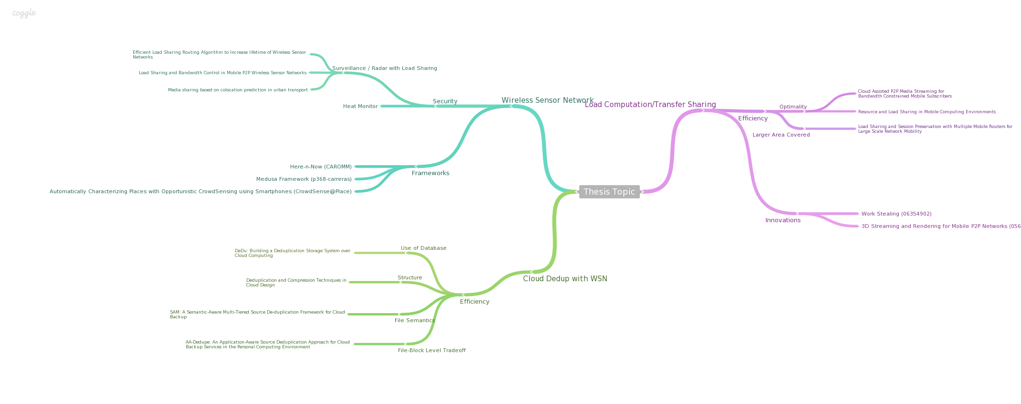
Mindmap
https://coggle.it/diagram/51d7c2b7e53ab1ac0500da57

Slide 15
Other proposals
PROPOSAL 1: Storing Files in Cloud for Deduplication Checking: Files or Blocks?
PROPOSAL 2: Load Share/Transfer in Mobile (Android) Phones
PROPOSAL 3: Torrent Seeding Incentive
PROPOSAL 4: Wireless Sensor Networks

