Slide 1
THESIS PROPOSAL
8 & 15 July 2013
Context-Aware Data Deduplication
TEAM O U
Cordevilla, Chynna Julia
Formes, Rafael Gerard
Viernes, Francis Bien Jan

Slide 2
PROPOSAL
Thesis Statement

Slide 3
MOTIVATION
Since there is a rapid growth of data due to innovations in computers and mobile technologies, the cloud has become a viable option for users to store their data in.
However, this would mean that the cloud systems must be able to keep up with data growth and deal with possible issues, specifically data redundancy.
We hope to find more efficient methods that will contribute to solving the problem. One such method that we can experiment with involves context-processing / approximating.

Slide 4
THESIS STATEMENT
In a cloud wherein the continual storing of data in a local area share the same context, duplicate data becomes a prevalent problem, hence the need for a system that makes use of cloud deduplication and context-processing.

Slide 5
APPLICATION
Given a University setup, we can attain information pertaining to the files the students upload. With this information, we can categorise files based on location and other context so that we can cut down search time for files instead of searching for duplicate data sequentially, making this method dynamic.

Slide 6
REFERENCES
DeDu: Building a Deduplication Storage System over Cloud Computing
Deduplication and Compression Techniques in Cloud Design
SAM: A Semantic-Aware Multi-Tiered Source De-duplication Framework for Cloud Backup
AA-Dedupe: An Application-Aware Source Deduplication Approach for Cloud
Backup Services in the Personal Computing Environment

Slide 7
mindmap
w/ Papers

Slide 8
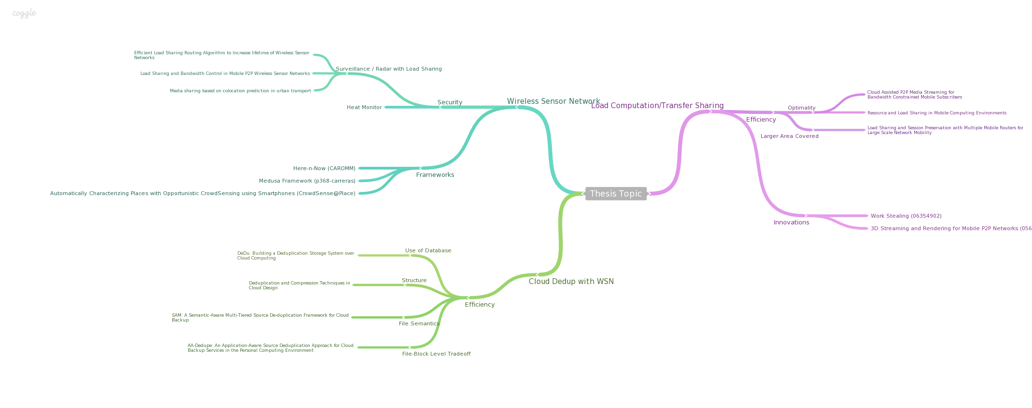
Mindmap
https://coggle.it/diagram/51d7c2b7e53ab1ac0500da57

Slide 9
Other proposals
PROPOSAL 1: Storing Files in Cloud for Deduplication Checking: Files or Blocks?
PROPOSAL 2: Load Share/Transfer in Mobile (Android) Phones
PROPOSAL 3: Torrent Seeding Incentive
PROPOSAL 4: Wireless Sensor Networks

