Slide 1
NDSG THESIS
7 October 2013
SAM Deduplication Framework for Cloud Backup
TEAM O U
Cordevilla, Chynna Julia
Formes, Rafael Gerard
Viernes, Francis Bien Jan

Slide 2
INTRODUCTION
SAM: Semantic-Aware Multi-tiered Source De-duplication Framework for Cloud Backup

Slide 3
INTRODUCTION
SAM: Semantic-Aware Multi-tiered Source De-duplication Framework for Cloud Backup

Slide 4
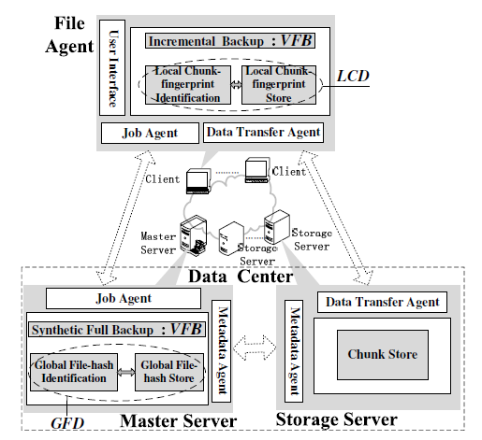
focus. Believe. aCHIEVE.
Three parts:
File Agent
Master Server
Storage Server
Three phases:
Virtual Full Backup
Global File-level Dedup
Local Chunk-level Dedup
SAM

Slide 5
focus. Believe. aCHIEVE.
VFB
GFD
LCD
Filter out the completely unchanged files using File Timestamps
Remove duplicate files across different clients in Master Server
Remove duplicate chunks across similar files within the same client

Slide 6
FOCUS. BELIEVE. ACHIEVE.
VFB
GFD
LCD
We tried to implement our own SAM using the paper as a guide.
Each of us took one phase and attempted to put it into action.

Slide 7
FOCUS. BELIEVE. ACHIEVE.
VFB
GFD
LCD

Slide 8
FOCUS. BELIEVE. ACHIEVE.
Virtual Full Backup tasks:
Identify changed files (using File Timestamp Semantic)
Hash these files using SHA-1
Retrieve metadata
Send a list of hashes and metadata to Master Server
VFB
GFD
LCD

Slide 9
FOCUS. BELIEVE. ACHIEVE.
Global File-Level Deduplication tasks:
Accept file hashes and metadata from File Agent
Use Bloom Filter to check if hash already exists
Stream-Informed System Layout
Locality-preserved Cache
Ignore Files with size smaller than 8 KB
VFB
GFD
LCD

Slide 10
FOCUS. BELIEVE. ACHIEVE.
Local Chunk-level Deduplication tasks:
Accept files from Master Server
Ignore multimedia, compressed, and small files
Split into variable-sized chunks
Get chunk hashes/id using SHA-1
Apply extreme-binning method
Compare chunk hashes.
VFB
GFD
LCD

Slide 11
FOCUS. BELIEVE. ACHIEVE.
VFB
GFD
Identify changed files (using File Timestamp Semantic)
Hash these files using SHA-1
Retrieve metadata
Send a list of hashes and metadata to Master Server
Accept file hashes and metadata from File Agent
Use Bloom Filter to check if hash already exists
Stream-Informed System Layout
Locality-preserved Cache
Ignore Files with size smaller than 8 KB
LCD
Accept files from Master Server
Ignore multimedia, compressed, and small files
Split into variable-sized chunks
Get chunk hashes/id using SHA-1
Apply extreme-binning method
Compare chunk hashes.

Slide 12
FOCUS. BELIEVE. ACHIEVE.
VFB
GFD
Identify changed files (using File Timestamp Semantic)
Hash these files using SHA-1
Retrieve metadata
Send a list of hashes and metadata to Master Server
Accept file hashes and metadata from File Agent
Use Bloom Filter to check if hash already exists
Stream-Informed File Layout
Locality-preserved Cache
Ignore Files with size smaller than 8 KB
LCD
Accept files from Master Server
Ignore multimedia, compressed, and small files
Split into variable-sized chunks
Get chunk hashes/id using SHA-1
Apply extreme-binning method
Compare chunk hashes.

