Slide 1
Identity Access Management (IAM) & SSM

Slide 2
Least Privilege Rule
Users
Groups
Roles
Today we’re creating an IAM role for an EC2 to access Session Manager – this way you don’t need to handle AWS credentials saved to your laptop

Slide 3
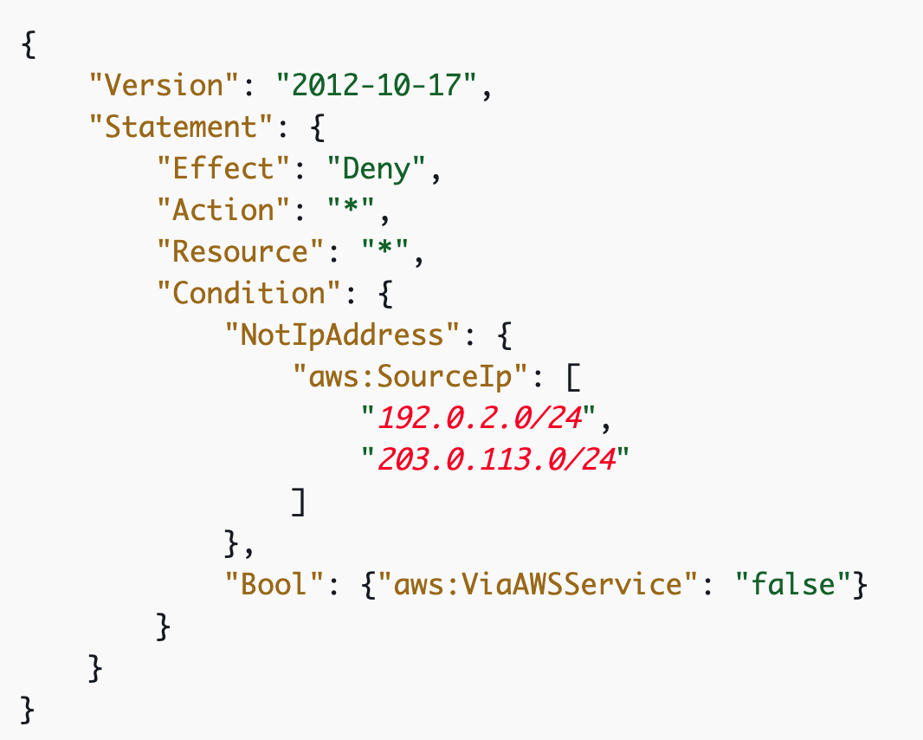
IAM Policies
Policies define the specifics of who/what can access AWS resource/s and how
AWS has predefined policies or you can make your own

Slide 4

Firstly, let’s refresh ourselves on IAM with an activity!!

Slide 5
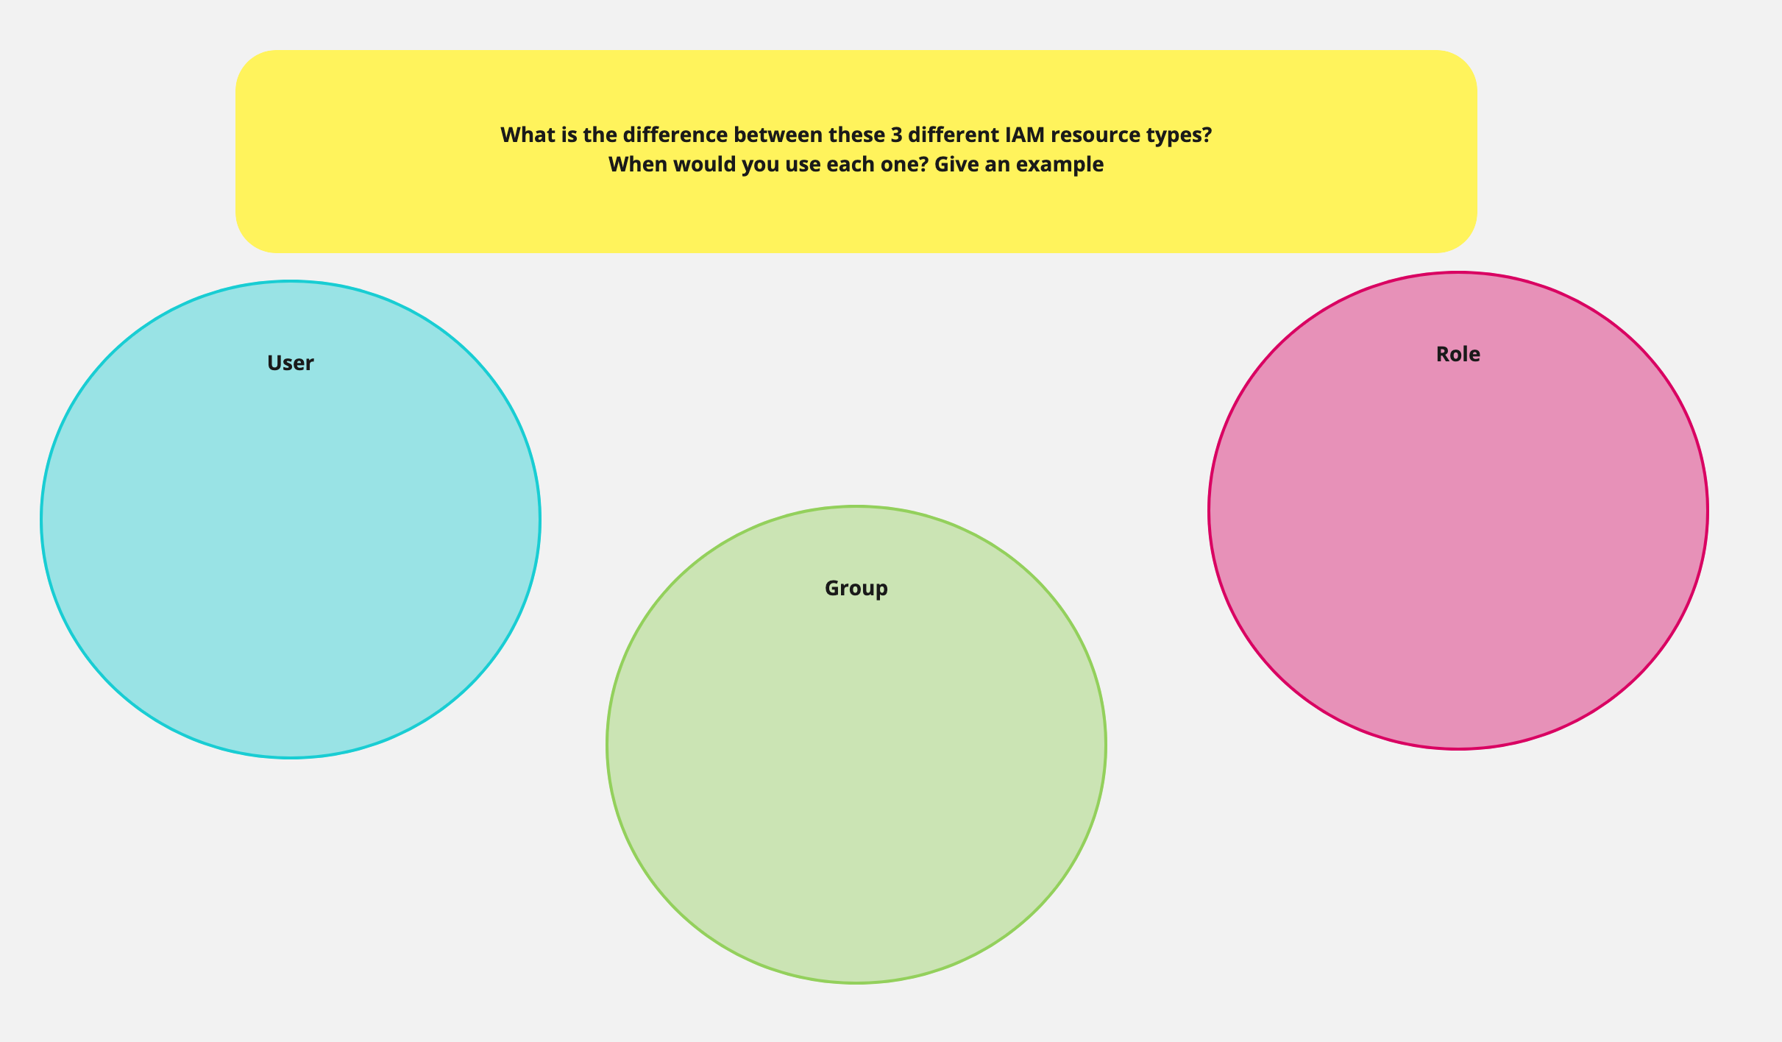
Notes:
User
Probably shouldn’t be using this in an organization as it requires individuals to manage and maintain their own credentials.
Some 3rd party tools may require a user to be able to interact with the API (Team City for example)
Group
More likely used in organizations and at larger scale –
A team might be part of a group with administrator access for their aws accounts only
A Devops/sys admin might be part of a group that has administrator access to all aws accounts as they play a support role
Role
Can be associated with resources. Build agent to deploy an application or maybe a lambda function that needs to upload objects to an s3 bucket

Slide 6
SSH (Secure Shell)
Using an AWS key pair you can log onto an EC2 instance from the command line
Requires you to have the AWS CLI installed
You’ll be handling a private key saved to your computer
There are ‘best practices’ around managing SSH usage including secure storage and rotation of keys – we won’t be going into this

Slide 7
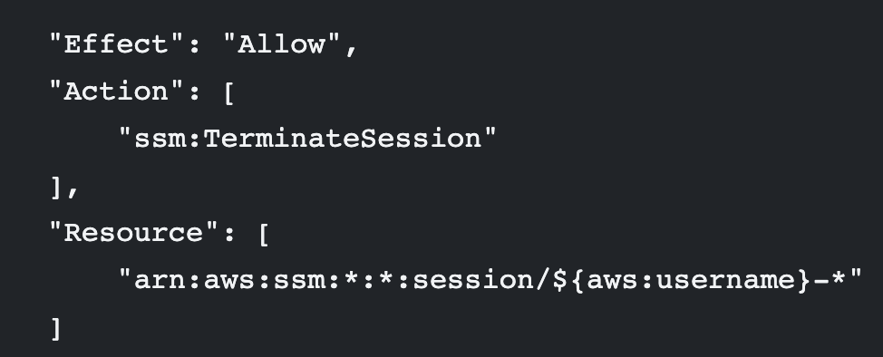
SSM’s Session Manager
SSM manager is not SSH, it is making requests using HTTPS.
Can be used via console or AWS CLI.
Here’s some tips I’ve found in this handy Hackernoon article for people who want a deep dive:
Enable WHO can use this feature via ssm:enabled in IAM policies
Ensure people can only terminate their own sessions using:
Hackernoon Article: https://hackernoon.com/ditch-your-ssh-keys-and-enable-aws-ssm-ec1c2b27350c
Notes:
Note, you’d need to auth via the command line using aws config (or something similar) to do this via the command line

Slide 8
We’re going to use SSM Session Manager
Most people have experience with SSH, so this is something new
We don’t have to troubleshoot machine-specific CLI issues – we’ll be using the console
As we move towards ‘servers as cattle, not pets’ means we have less reasons to log onto individual servers
I haven’t worked directly with an SSH key management process, don’t want to give wrong advice

