Slide 1



GeoNode
Joint Code Sprint 2021
Overview
2021-02-17

Slide 2


Sponsors
Gold Sponsor:
Silver Sponsor:

Slide 3
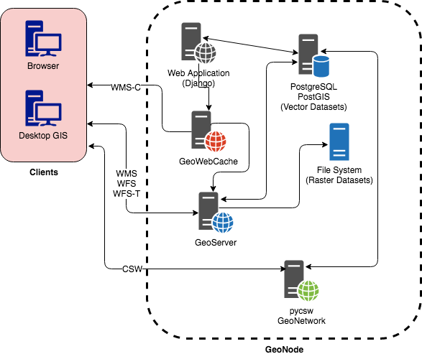
GeoNode at glance
A web frameworks to build geospatial CMS, open data geoportals and SDI
Started by Global Facility for Disaster Reduction and Recovery (GFDRR) in 2009
Adopted by a large number of organizations
Built with open source software (PostGIS, GeoServer, pycsw, Django, etc)
Official OSGeo project since August 2016

Slide 4
Sprint planning
Add support for OGC API – Features
More details and community discussion under this issue https://github.com/GeoNode/geonode/issues/6706
GeoNode has already a REST API for the resource base model under the route /v2 (i.e.
Build the new OGC APIs on top of pygeoapi core API as a new optional django application
pygeoapi configuration loaded from a new setting (i.e. PYGEOAPI_CONFIGURATION)
Challenge:
native Django template for HTML vs Jinja2 through pygeoapi
Django Rest Framework vs Django with external JSON serializer (Pydantic, etc)

Slide 5
Dependencies
pygeoapi
Django framework support need to be added
Issue: https://github.com/geopython/pygeoapi/issues/586
Sprint room for GeoNode: https://meet.jit.si/GeoNode

