Slide 1
Machine Learning Driven Soil Fertility Analysis and Crop recommendation
Frances Ayango 136046 ICS 4C
Supervisor : Dr. Joseph Orero

Slide 2
CONTENTS
Project Title
Background/Problem Statement
Motivation
Related Works
Designed Solution

Slide 3
Introduction
WHAT IS PRECISION AGRICULTURE ?
Precision agriculture is a modern farming technique that uses research data of soil characteristics, soil types, crop yield data collection.

Slide 4
Problem Statement
The common problem existing among the Indian farmers are they don’t choose the right crop based on their soil requirements and also which fertilizer to be used for their crop.
This problem of farmers has been addressed through precision agriculture.

Slide 5
Objective
General
To develop and implement a machine learning based soil fertility analysis and crop recommendation system that uses available soil nutrients to analyze soil fertility and crop selection for sustainable agricultural practices.
Specific
To Investigate factors influencing soil fertility and suitable crop selection.
To examine the existing techniques and approaches that have been used for soil fertility analysis and crop recommendation.
To train and validate the model for soil fertility analysis and crop recommendation.
To test the trained model.

Slide 6
Related Works
Ref. no. | Year | Paper name | Feature Selection | Highest Accuracy
1 | 2021 | Intelligent Crop Recommendation System using Machine Learning | Decision Tree, KNN, Logistic Regression, SVM, Naive Bayes, Neural network | 95.00%
2 | 2020 | Classification of Soil and Crop Suggestion using Machine Learning Techniques. | KNN, Logistic Regression, Bagged tree, SVM | 91.09%
3 | 2020 | Crop Prediction Method to Maximize Crop Yield Rate Using Machine Learning Techniques | KNN, Naïve Bayes, Random Forest, K-star | 97.00%
4 | 2020 | Soil Analysis and Crop prediction | Naïve Bayes, Logistic Regression, Decision Tree | 89.00%
5 | 2019 | Crop Recommendation System for Precision Agriculture | SVM, Random Forest, KNN, Bagging Technique And Naïve Bayes | 90.75%
6 | 2018 | Soil Classification Using Machine Learning Methods and Crop Suggestion Based on Soil Series | Gaussian SVM, Weighted KNN, Bagged trees | 91.16%
7 | 2018 | A Review on Data Mining Techniques for Fertilizer Recommendation | Clustering, Decision Tree, SVM | 87.86%

Slide 7
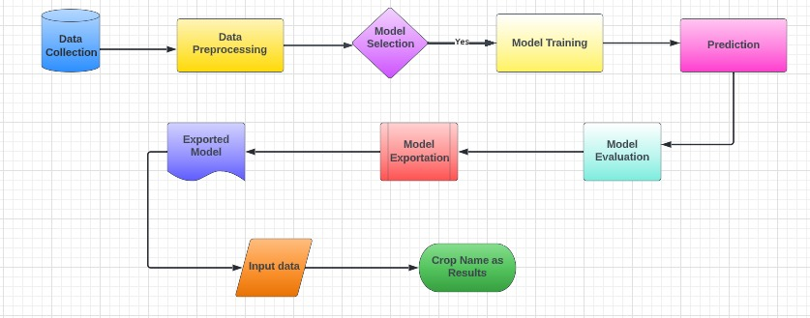
Conceptual Framework

Slide 8
Methodologies
This system architecture involves in series steps given below :
* Data Collection using IOT
* Data Preprocessing
* Train/Test Split
* Model Selection
* Model Training
* Prediction
* Model Evaluation
* Model Exportation/Deployment

Slide 9
Software & Hardware Requirements
Hardware System Configuration:
Processor: 2 gigahertz (GHz) or faster processor.
RAM: 4 gigabyte (GB) for 32-bit or 4 GB for 64-bit.
Hard disk space: =>16GB.
Software Configuration:
Operating System: Windows XP/7/8/8.1/10, Linux and Mac
Coding Language: Python
Tools: Pandas, Numpy ,Seaborn , Pickle,Scikit-learn, Pytorch & ResNet
Framework: Flask
Other Tools : HTML, CSS, Bootstrap

Slide 10
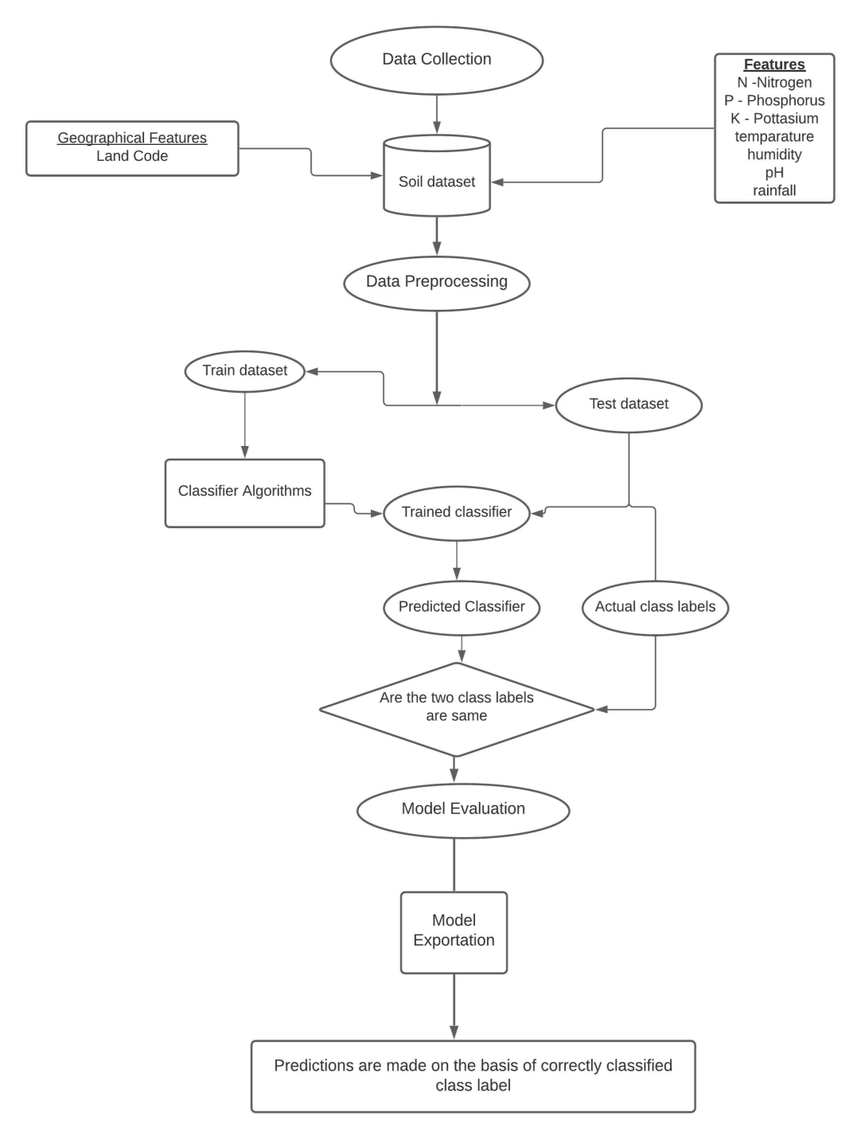
Data Flow Diagram

Slide 11
Algorithms & Accuracy
We used a series of ML algorithms such as
Algorithm | Accuracy (%)
Decision Tree | 90%
SVM | 97%
Logistic Regression | 95%
Random Forest | 99%

Slide 12
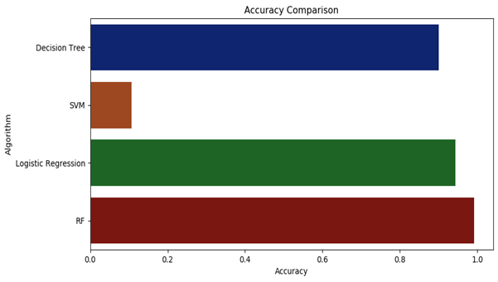
Accuracy Comparison
Hence, Random Forest is our Final efficient model

Slide 13
Advantages
Improve farm management efficiency by adjusting field/crop treatments
Ensure profitability, sustainability and protection of the environment.
Optimise efforts and resources, reduce consumption and waste, and boost land productivity.

Slide 14
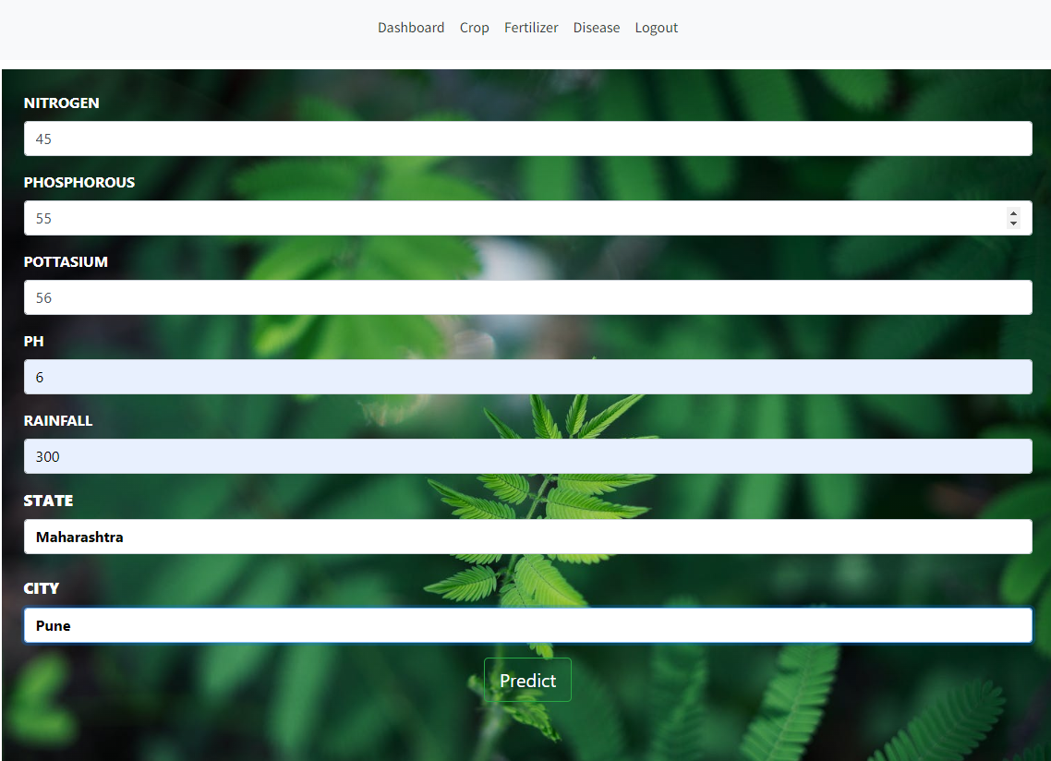
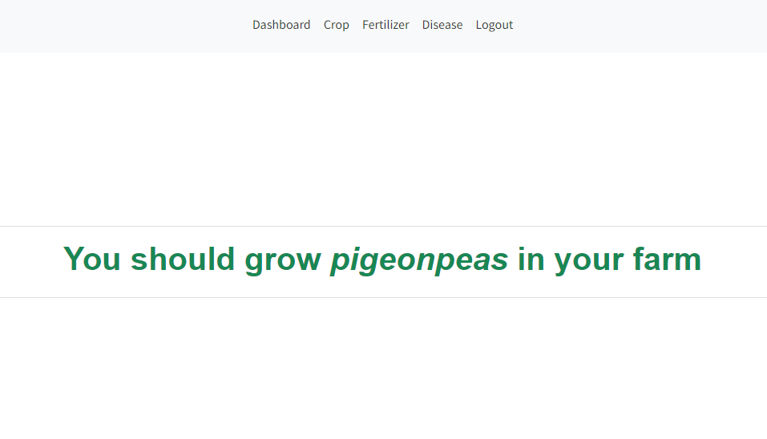
Results
According to nutrients of Soil you will get output as best crop that
you should grow on your farm

Slide 15
References
[1] 2019, 10th International Conference on Computing, Communication and Networking Technologies, “Low-cost IOT+ML design for smart farming with multiple applications”, Fahad Kamraan Syed, Agniswar Paul, Ajay Kumar, Jaideep Cherukuri.
[2] 2019 IEEE “ Smart Management of Crop Cultivation using IoT and Machine Learning” Archana Gupta, Dharmil Nagda, Pratiksha Nikhare, Atharva Sandbhor
[3] Radhika, Narendiran, “Kind of Crops and Small Plants Prediction using IoT with Machine Learning,” International Journal of Computer & Mathematical Sciences, 2018.
[4] “Crop Recommendation on Analyzing Soil Using Machine Learning” Anguraj.Ka, Thiyaneswaran.Bb, Megashree.Gc, Preetha Shri.J.Gd, Navya.Se, Jayanthi. Jf, 2020.
[5] “Classification of Soil and Crop Suggestion using Machine Learning Techniques”, A. Mythili , IEEE 2019.
[6] Mehta, P., Shah, H., Kori, V., Vikani, V., Shukla, S., & Shenoy, M.,2018. “Survey of unsupervised machine learning algorithms on precision agricultural data”, IEEE
[7] “IOT based Crop Recommendation, Crop Disease Prediction and Its Solution” Rani Holambe, Pooja Patil, Padmaja Pawar, Saurabh Salunkhe , Mr. Hrushikesh Joshi, 2019 IRJET

Slide 16
THANK YOU

