Slide 1
Machine Learning Driven Soil Fertility Analysis and Crop recommendation
Frances Ayango 136046 ICS 4C
Supervisor : Dr. Joseph Orero

Slide 2
Introduction
Agriculture remains a cornerstone of the global economy, particularly in regions where it is the primary livelihood for a substantial portion of the population
Soil Fertility is a critical factor influencing crop yield and quality.
Decline in soil Health: Monocropping, climate change, excessive use of chemical fertilizers have led to degraded soil quality.
Traditional Methods like soil sampling and testing are expensive and time consuming.
Farmers often use generalized agricultural practices based on past experiences, leading to overuse or misuse of fertilizers and other inputs, further degrading soil health.
Limited access to real-time soil data: Most small-scale farmers lack the resources and tools to analyze soil properties, leading to uninformed decision-making.
Machine learning to empower farmers with precise soil analysis, enabling informed decisions on crop suitability and fertility management.

Slide 3
Motivation
Need to enhance agricultural productivity by using machine learning techniques.
Need to support sustainable farming practices by providing data-driven insights to farmers.
Technological advancements pave way for innovations demonstrating the potential of combining ML with agronomy.
Justification
Proper soil fertility analysis and crop recommendation can significantly boost agricultural productivity.
Improved crop yield can lead to increased income for farmers and contribute to the economy.

Slide 4
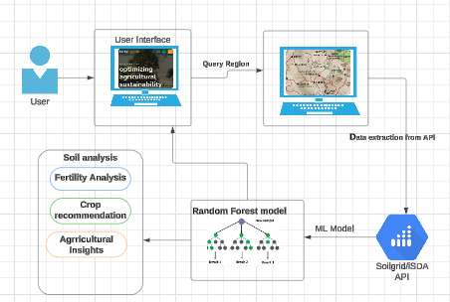
Designed Solution: System Architecture

Slide 5
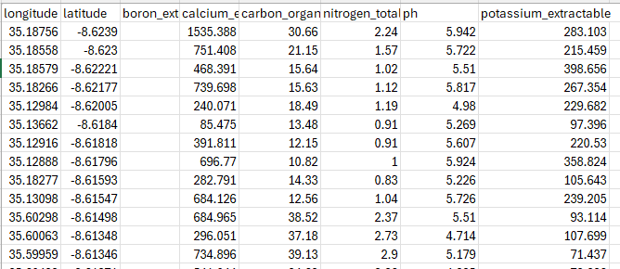
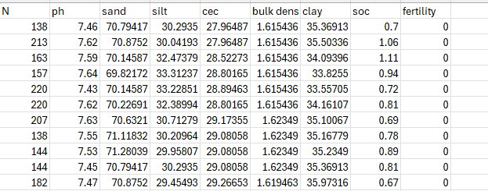
Dataset
Source: Soilgrids, iSDA
Characteristics: depth 0f 0-5cm
Properties: Bulk Density, soc, ph, Nitrogen, clay, silt, sand, cec.
Format: Geotiff and csv
Dataset was divided in the ratio of 80:20
5-fold cross validation
Model trained on 4 folds, remaining 1 used for validation

Slide 6
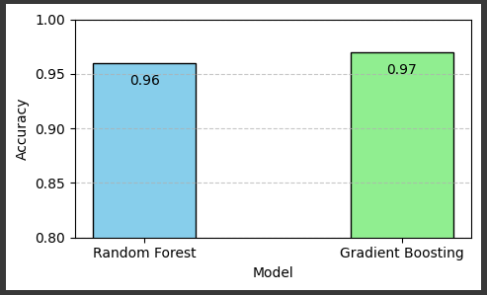
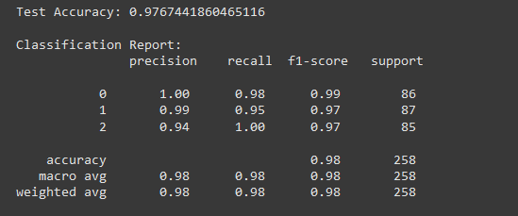
Algorithms & Accuracy
Two ensemble models were used: Evaluation Metric:
Algorithm | Accuracy (%)
Ran Forest | 96%

Slide 7

THANK YOU

