Slide 1

The presentation title goes here
Organisational unit, can be spread over 2 lines
Remove rr_z from ecoregions_data
Check the files in the folder to_check on the server
Separate bs from no bs (e.g. median in bs = 0)
Professor John Doe
Role of person giving presentation
dd Month yyyy, Location

Slide 2
GitHub/forest-management
Main folders:
data
2) scripts
3)
4) results
5) aggregation_plotting
Other folders
7) RR-distributions
8) R-files
9) additional_analyses
10) temporary_old
Data on land use (areas) and on ecoregions (e.g., original species number) used in the model. Two subfolders: model_parameters and land_use_data
Scripts used to prepare the areas and the z values before being used in the biodiversity model
Scripts used to build and apply the model to quantify species loss.
.csv files containing the land use areas and the calculated species loss.
Aggregated results, scripts to do the aggregation and to plot the results.
PDF with the histograms of the RR raw values.
Random R files used in the past which might be useful again but not currently used.
Supplementary analyses not included in the main manuscript (e.g. comparison with other models)
Files which will be most probably thrown away.

Slide 3
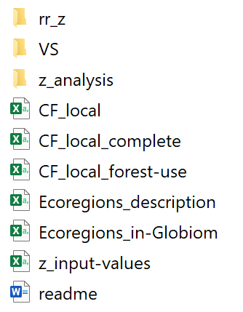
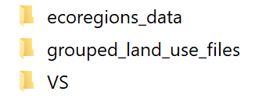


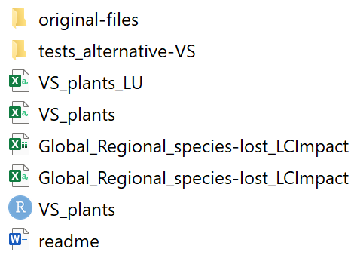
1a – data/model_parameters
.csv files providing i) the description of the ecoregions and the relative data, ii) the local CF iii) the z values.
A readme.doc file with a further detailed description of the .csv files.
Table with the z values sent by the corresponding author of Drakare et al. (2005) - z_SAR_data_full-table.csv
Table available in the SI of Drakare et al. (2005) - z_originals_Drakare _2005_SITable1.csv
Raw z values prepared to be used in the model - z_raw_values
An .xlxs file with some tests on z - z_analysis.xlxs
Some plots.
.Rdata files containing the results of the calculation of rr and z values with both approaches: static (no bootstrapping) and bootstrapping (bs). There is a subfolder (morethan10^5), which contains the same results but with a sample of 10^5 values
.csv with the global and regional CFs of LC-Impact.
.csv files with the VS as ratio between global CFs and regional CFs (VS_plants_LU.csv) and the average of VS per land use (VS_plants.csv).
Script to obtain VS_plants.csv.
A folder original-files containing the excel worksheets of the LC-Impact methodology.
A folder tests_alternative-VS containing excel files with multiple versions of the VS.
A readme.doc file describing the folder content in further detail.

Slide 4
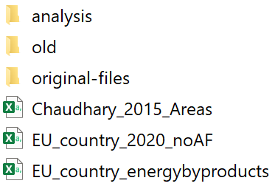

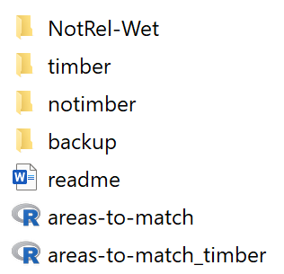


1b – data/land_use_data
.csv files resulting from the application of scripts_preparation/do_tidy_match.
.csv files containing the land use areas sent by Fulvio di Fulvio (IIASA) which were obtained with the GLOBIOM model.
analysis – folder containing files where some data have been looked at in more detail.
original-files – folder containing the excel worksheets sent by Fulvio di Fulvio.
readme.txt - file providing an overview of the scenarios and the acronyms used in GLOBIOM
…
readme.doc – document which describes the content of the sub-folders
notimber – folder with .csv files resulting from the application of scripts_preparation/ do_tidy_match.R (default setting)
timber – folder with .csv files resulting from the application of scripts_preparation/ do_tidy_match.R (“timber” setting)
NotRel-Wet – Folder containing the areas prepared with do_tidy_match.R without excluding Not relevant land and Wetland from the classification, grouped in subfolders.
areas-to-match.Rdata – output file of tidy_areas.R and input of match_areas.R (default setting).
areas-to-match_timber.Rdata - output file of tidy_areas.R and input of match_areas.R (“timber” setting).
This folder contains a subfolder (aggregated) where there is a .csv file. External users can fill out the .csv file with their global land use data. This file can then be used as input in the model to estimate the impacts on biodiversity.

Slide 5






2 – scripts
Scripts used to prepare the areas and the model parameters used as input in the model.
Scripts used to calculate the species loss .
Scripts for the aggregation of the raw results from /forest-managemement/results.
Scripts for plotting maps and barplots.
Additional scripts used to perform analysis not included in the manuscript: calculation of the area converted to energy plantation, calculation of the impacts using the CFs, comparison between the linear and non-linear approach.
Script that creates variables containing the paths to folders/files (e.g. the path to the results, to the plots, to the aggregated data, etc).
Script that creates directories if they do not exist already.

Slide 6
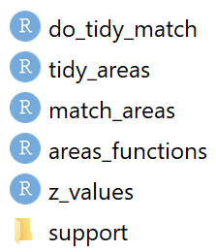

2a – scripts/data_preparation
The scripts in this folder are used to prepare the land use areas from GLOBIOM and the z values from Drakare et al. (2005) to be used in the species loss model. The other parameters needed in the model are already available in the .csv files in input/data (ecoregions_data.csv, CF_local.csv, CF_local_forest-use.csv) and do not need and additional manipulation.
Preparation of land use data to be used as input in the species loss model. This script calls the function tidy.areas from tidy_areas.R and match.areas from match_areas.R. Used in main.R.
It cleans the original areas and convert them in a .Rdata file to be used as input for match_areas.R. Used in tidy_match_areas.R.
It uses the .Rdata file produced in tidy.areas as input and matches the areas of the two GLOBIOM models (global and EU-forest-energy). The output of this script are .csv files containing the areas per land use type per year (each year is a separate file). Used in tidy_match_areas.R.
Functions used in match.areas.
Script that explores and selects the z values from Drakare et al. (2005) to make them ready to be used in the specie loss model. The output of this script is z_input-values.csv.
Script that calculates the VS for plants from the global and regional CFs of LCImpact, as explained in data/model_parameters/ecoregions_data/VS.
Folder containing R files used to do tests on the data.

Slide 7












2b – scripts/model
As bootstrapping can take quite some time to run, this function is not called in calculate.slost. Its results are already stored in two .Rdata files (one for RR and one for z) in the folder rr_z so that calculate.slost can directly load the .Rdata files.
For the sake of clarity, also RR and z output of parameters_calculation.R and resulting for the static approach are stored as additional .Rdata files available in the same folder and then loaded in calculate.slost if needed (the results of the montecarlo simulation have not been prepared as finally this approach was not used, though it is possible to use the function calculate.RR and prepare.zvalues in parameters_calculation.R to calculate them).
main function of the model calculation (calculate.slost) and calls functions defined in the R files connected to it by an entering arrow in the flowchart here above.
many functions used to build the model.
functions which prepare or calculate the parameters needed in the model (e.g., the response ratios, the z values, the weighting factors).
functions needed to perform the computation of confidence intervals with bootstrapping. Some functions used in this R file are defined in parameters_calculation.R.
function used to test the distributions of the response ratios and define the parametrization.
function name.landuse (it creates a character vector with the names of the columns of the different land use types) and function allocate.impacts (it allocates the species loss calculated with the model to the disaggregated land use classification).
main script, which calls all the other functions and is the only one to be ran.
same as impacts_calculation.R but with a parallelization procedure implemented

Slide 8

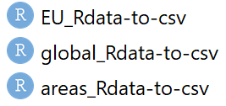



2c – scripts/aggregation
Scripts which sums the results and the areas per ecoregion, scenario and land uses at different level. The output are .Rdata files saved in the folder aggregation_plotting. Used in main.R.
Scripts which convert the .Rdata files created using aggregate_areas.R and aggregate_results.R to separate .csv files and save them in aggregation_plotting. Used in main.R.
Script to convert the results expressed as PDF to PDF per Mm3 of roundwood equivalent. The input data for this script are the .csv files in forest_management/results. Used in main.R.
Script to convert the results expressed as PDF to PDF per hectare. The input data for this script are the .csv files in forest_management/results. Used in main.R.
Script to convert the results at ecoregion resolution to GLOBIOM resolution. Used in main.R.

Slide 9
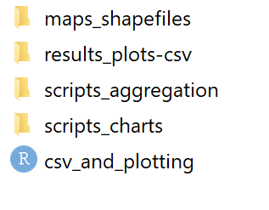
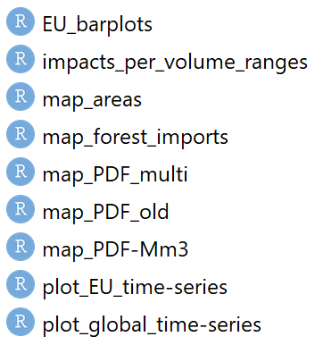
2d – scripts/plotting
Maps of the world ecoregions, the GLOBIOM regions and the EU28 border.
Scripts for the aggregation of the raw results from /forest_managemement/results.

Slide 10
5 - aggregation/
Maps of the world ecoregions, the GLOBIOM regions and the EU28 border.
Scripts for the aggregation of the raw results from /forest_managemement/results.
Each sub-folder in this folder contains
The aggregated data as .Rdata files resulted from the functions in aggregate_results.R, aggregate_results_CI.R or aggregate_areas.R available in /scripts_aggregation.
A sub-sub-folder csv with the .csv files needed for the plotting obtained using the functions in areas_Rdata-to-csv.R, global_Rdata-to-csv.R, EU_Rdata-to-csv.R, slost_Globiom.R, slost_ha.R, wood.R.
A sub-sub-folder plots with the plots obtained using the scripts in /scripts_charts.
Scripts that plot the results.
Script which sets the working directory and the saving directories for the scripts in scripts_aggregation and scripts_charts. It also calls the functions used to aggregate and plot.

Slide 11
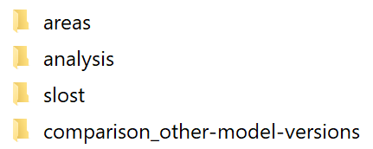
4 - results
This folder contains the areas resulting from the matching of the two GLOBIOM land use models and the species loss resulting from the application of the species loss model.
It contains multiple folders with all the results for species loss from the application of the model. Meaning of the words in the names: timber = EU timber plantations have been included; cutoff = response ratios larger than 1 converted to 1; nocutoff = cutoff not applied; bs = confidence interval calculated with bootstrapping; nobs = no confidence intervals. The folder species-lost_cutoff contains a .csv files where the median values come from the nobs results and the confidence intervals from the bs results and these are the values used in the paper. All the results have been calculated using the areas of the marginal approach (mg). A readme.doc file is provided.
Additional files where some data have been looked at in more detail.
It contains the input data, the script and the results of tests performed using the CF from other versions of the model (for further details, see the script calculate_impacts_withCF.R)

