Slide 1
Spotify recommendation algorithm
Francesca Beller
MSDS 696 – Data Science Practicum II

Slide 2
Motivation
As an avid music listener, I'm constantly looking for new songs and artists
The Spotify ‘Discover Weekly’ playlist is one of the many ways I find new music
My ‘Discover Weekly’ playlists have a terrible hit rate in terms of including songs I end up liking/saving
I decided I wanted to try to make an algorithm that takes into account two 1000+ song self-made playlists - one consisting of songs I like, one with songs I don't like
I could develop my own sort of Discover Weekly playlist generator that would perform better than Spotify's proprietary algorithm (at least for me personally)

Slide 3
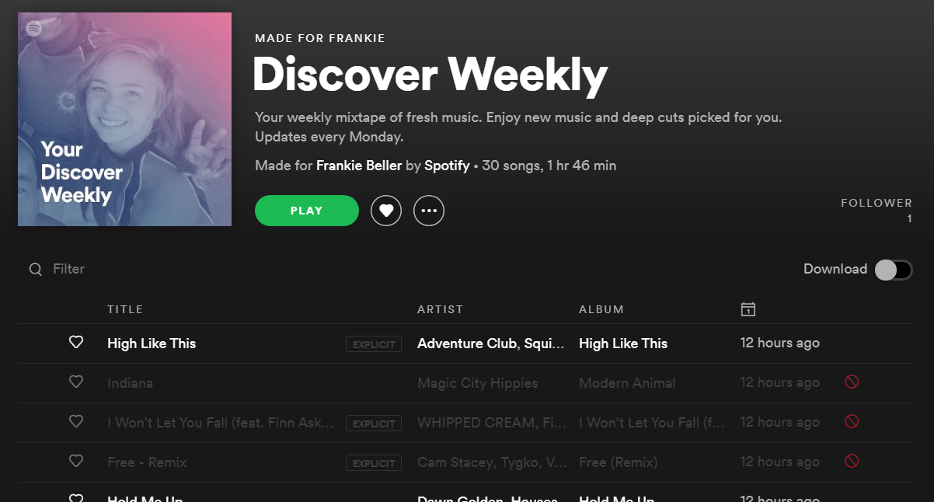

Slide 4
Spotify api & “spotipy”
Spotify has a developer API that can return information for a user’s account, including:
Top songs
Track audio features
Playlists
The Python library “Spotipy” acts as a connector to access the Spotify API

Slide 5
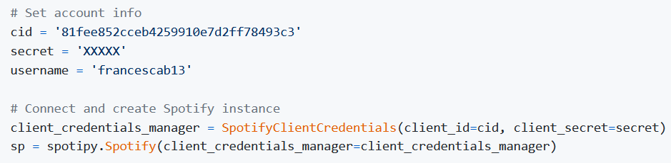
Connecting to spotify

Slide 6
Data gathering

Slide 7
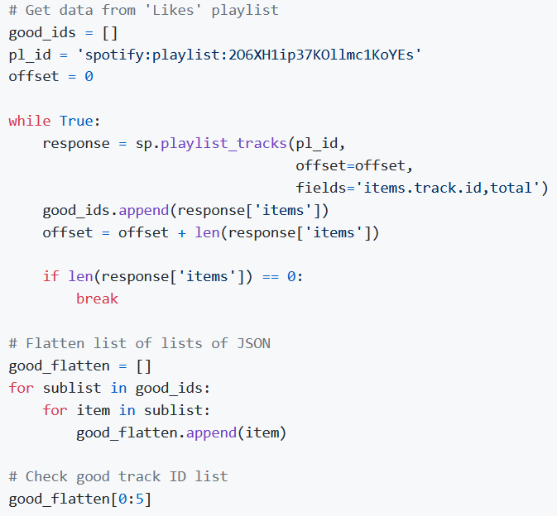
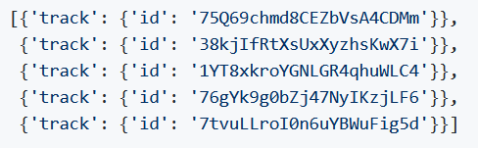
Extract track id’s from playlist

Slide 8
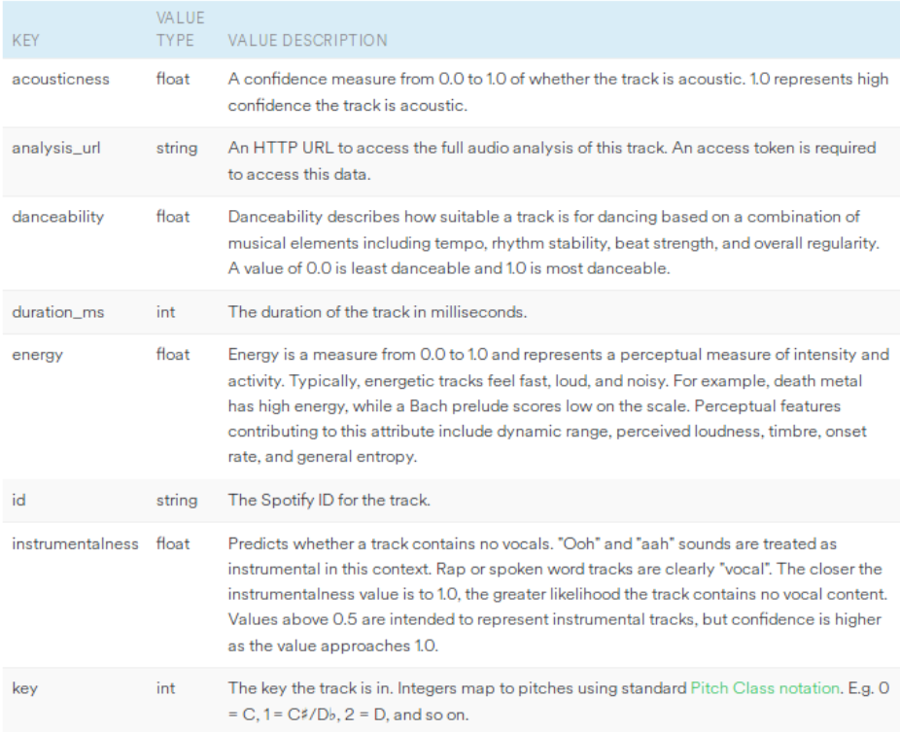
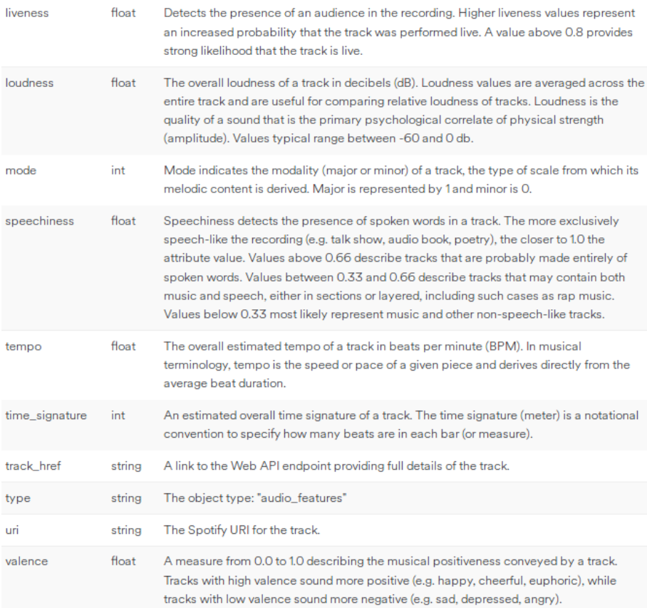
Track audio features

Slide 9
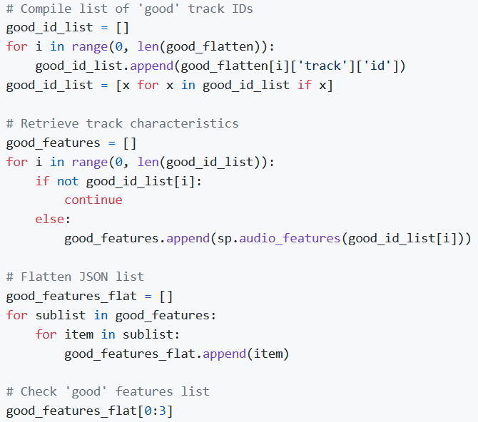
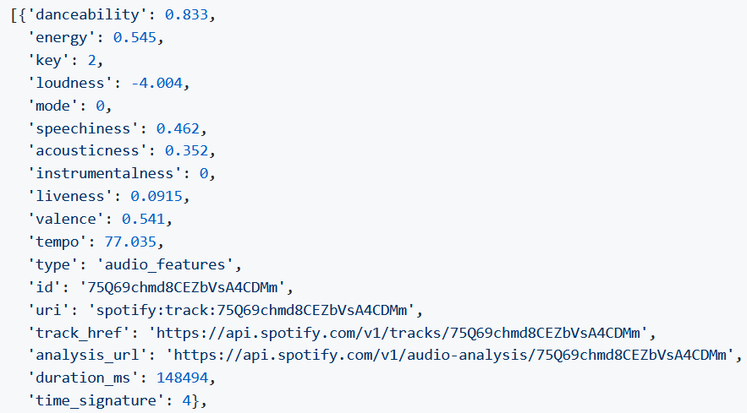
Retrieve track audio features

Slide 10
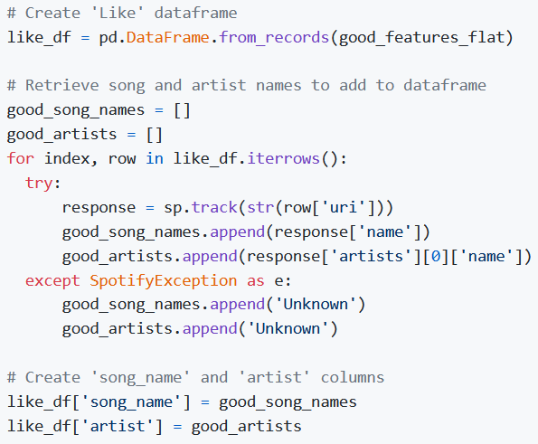
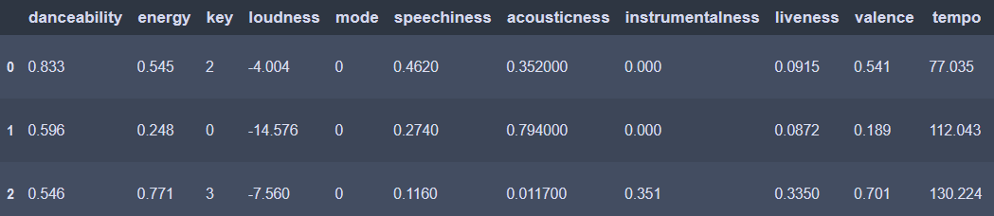

Slide 11
Exploratory data analysis

Slide 12

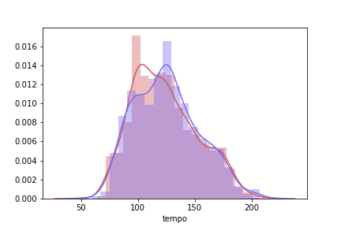
tempo
We can see for the tempo plot that, while similar, my liked playlist seems to lean more to the slower tempo side than my disliked songs.

Slide 13
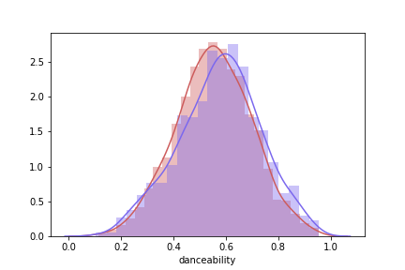
danceability
The distribution plots of danceability appear to be extremely similar, with my disliked songs leaning only slightly on the more danceable side. This makes sense as I am not a huge fan of super upbeat club/dance type music.

Slide 14

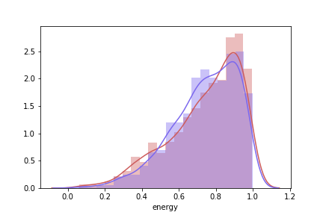
energy
Again, we see that my liked and disliked playlists share a lot of overlap in this energy plot, with both being highly skewed to the left. For my liked songs, I appear to like a bit more energy, peaking at around 0.9. For my disliked songs, while there is also a peak around 0.9, the peak is smaller and counteracted by a peak at around 0.7.

Slide 15

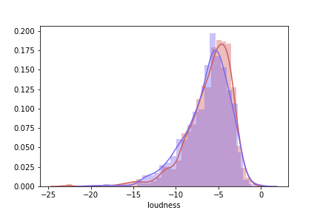
loudness
A recurring theme in the distribution plots so far has been massive overlap, and the plot for loudness is no exception. The disliked songs peak slightly lower than the liked songs, at around -6, whereas the liekd songs peak at about -3 or -4. Both plots are slightly left-skewed.

Slide 16

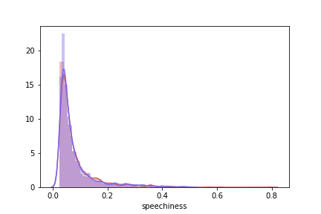
speechiness
The plot for speechiness seems to indicate that I have a strong aversion to speechy songs, with both plots being highly right-skewed and peaking around 0.

Slide 17

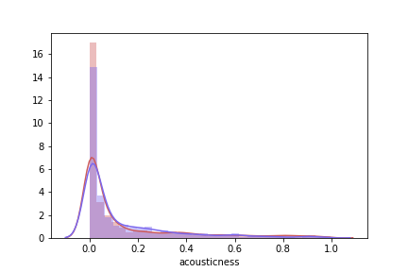
acousticness
A similar plot to the previous speechiness distribution plot, we can see that my liked songs have a slightly higher peak around 0, with my disliked songs only being marginally more acoustic.

Slide 18
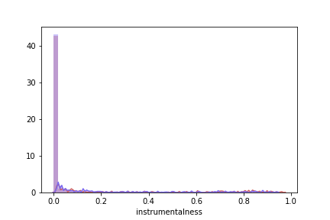
instrumentalness
Another plot in the same vein as speechiness and acousticness. My tastes between liked and disliked songs do not seem to be distinguishable based on this feature, with the peak bars at 0 being nearly identical between the two playlists.

Slide 19

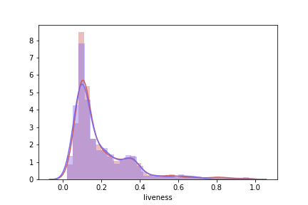
liveness
In this liveness plot, we get back to seeing a bit more separation between the two playlsits. While both peak at around 0.1, the peak is higher for the liked playlist, and the dislike playlist leaning slightly lower. Both hold a similar right skew and minor peak around 0.35.

Slide 20

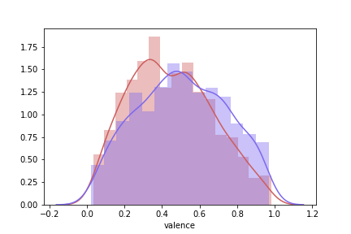
valence
My liked songs tend to lean lower in valence. We see the peak for the liked playlist at around 0.3, with a sub-peak at about 0.5. The disliked playlist plot is a bit more normal, with its primary peak being a little over 0.4 and tending to range higher than the liked playlist.

Slide 21

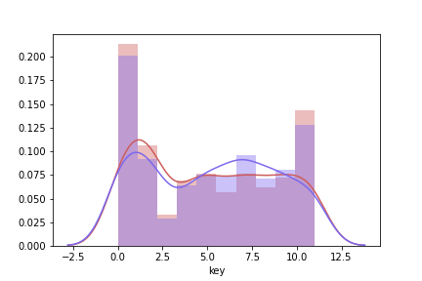
key
There do not appear to be major differences between the liked and disliked playlists for key. The only somewhat standout disparity is at around 7.5, meaning that I dislike songs in the G family of keys a bit more.

Slide 22
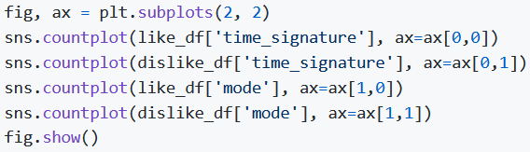
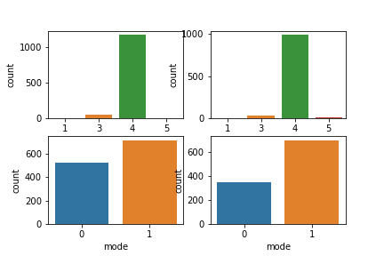
Time signature & mode
Our frequency plots for mode and time signature do not seem to provide any noticeable insight, as the plots are incredibly similar. As is characteristic of most songs, a majority of both the liked and disliked songs fell in 4/4 time, and were in a major key as opposed to a minor key.

Slide 23
Model creation & training

Slide 24
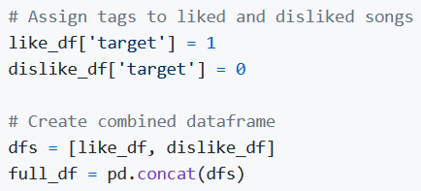
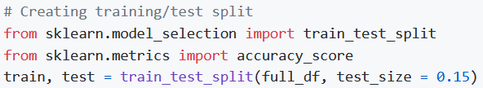
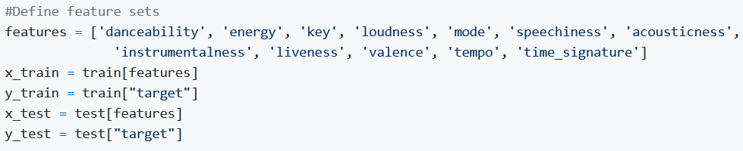
preparation

Slide 25
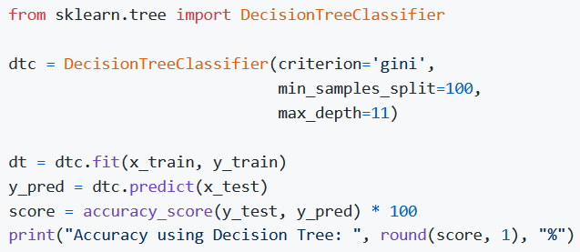
Decision tree

Slide 26
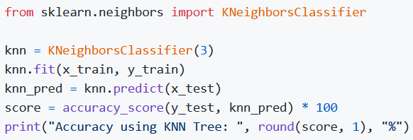

K-nearest neighbors

Slide 27
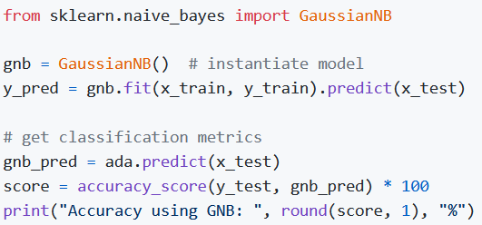
Naïve bayes

Slide 28
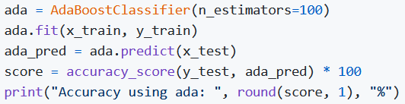

adaboost

Slide 29
Model tuning

Slide 30
gridsearchcv
GridSearchCV is a module that takes in specified lists of parameters and runs through them to try to determine the best combination of parameters for a model. KFold is used for cross-validation purposes.
GridSearchCV is a module that takes in specified lists of parameters and runs through them to try to determine the best combination of parameters for a model
KFold is used for cross-validation purposes

Slide 31
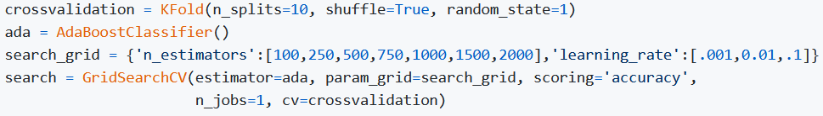

Gridsearchcv (cont.)

Slide 32
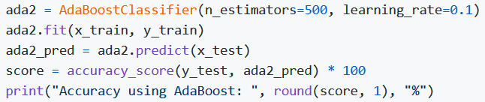

Adaboost tuned testing

Slide 33
Model re-testing

Slide 34
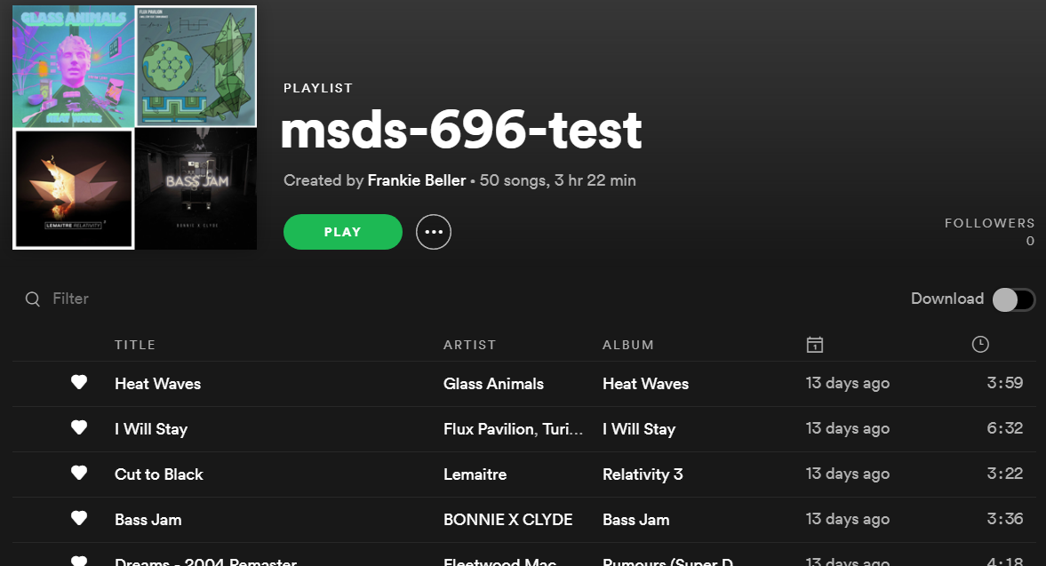

Slide 35
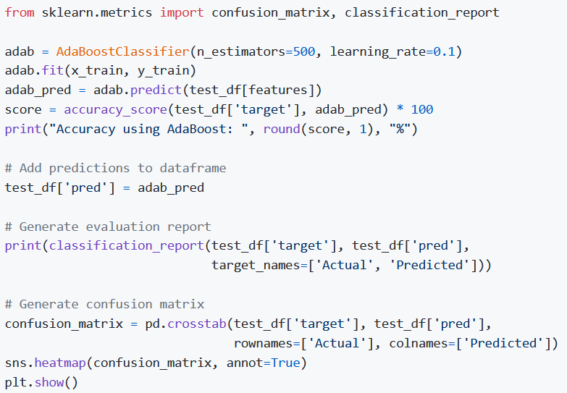
Adaboost test playlist evaluation

Slide 36
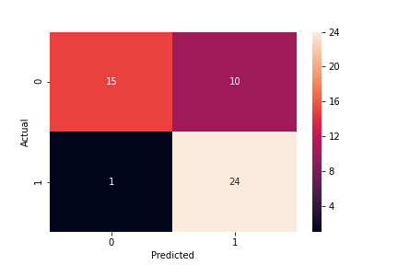
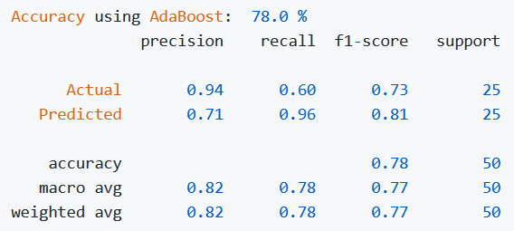
Adaboost test playlist evaluation

Slide 37
Adaboost playlist generator

Slide 38
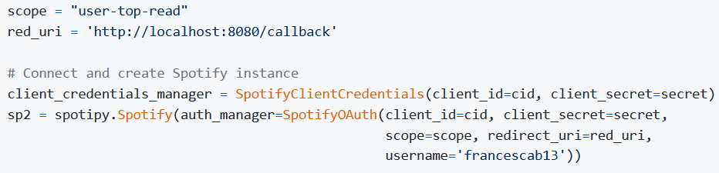
Spotipy instantation
We need to create a new Spotipy instance because we need to user the ‘user-top-read’ function to retrieve a user’s top tracks

Slide 39
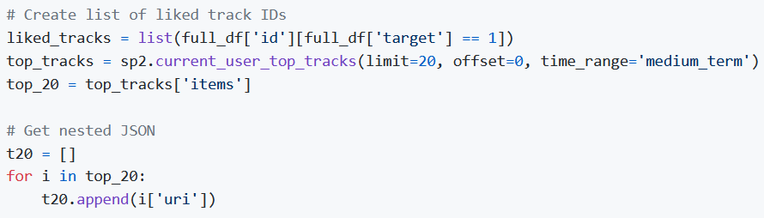
Retrieve top 20 tracks
We will pull the top 20 tracks from my account for the past week and extract the URI’s for each.

Slide 40
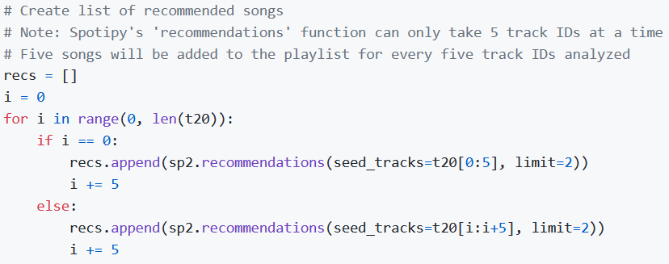
Recommended song data (pt. 1)
We will start by using the top track URI’s extracted in the previous step to obtain recommended songs
The recommendations function can only accept five tracks at a time
We will return 2 recommended songs per input track, giving us 40 total

Slide 41
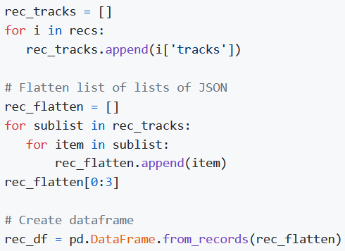
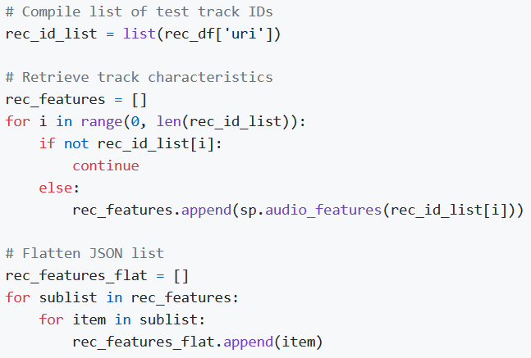
Recommended song data (pt. 2)
Next, we will extract the track information and retrieve audio features for the recommended tracks

Slide 42
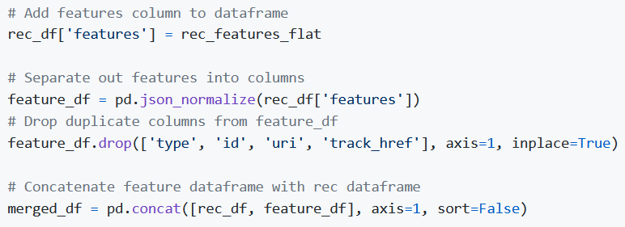
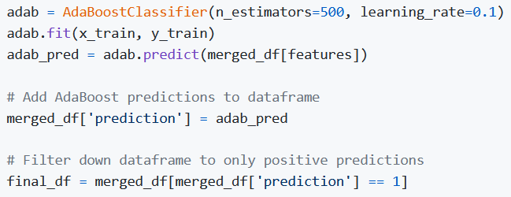
Recommended song data (pt. 3)
The last step for the recommended song data is to add the audio features to the dataframe, run the songs through the AdaBoost function, and extract only those recommended songs that AdaBoost predicts I will like

Slide 43
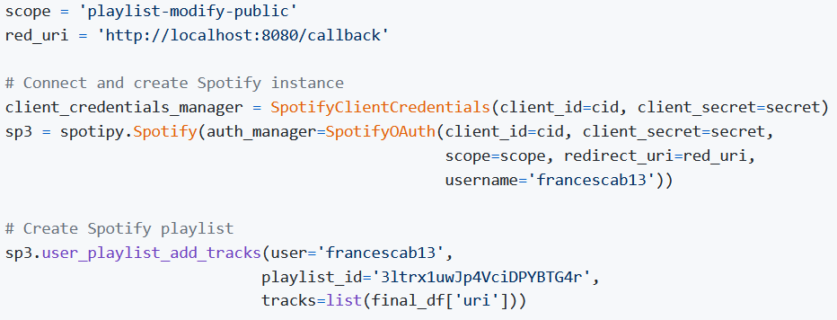
Add recommended songs to playlist
To add the songs to the placeholder playlist, we need to create a new Spotipy instance to use the ‘playlist-modify-public’ scope
Lastly, we use the user_playlist_add_tracks function to push songs to the playlist

Slide 44
