Slide 1
Static Code
Analysis Lab
SAST & SCA
Francesca Craievich | IN2300026
Lab 07 | [505MI] Cybersecurity Lab | A.Y. 2025/2026
Notes:
Title slide for Lab 07 - Static Code Analysis using SAST (SonarCloud) and SCA (Trivy). Comparing a vulnerable repository (Cacti) against a secure personal Python project.

Slide 2
Tools & Repositories
Tools:
SonarCloud - analyzes source code for vulnerabilities,
bugs, and code smells without executing the program
SAST: SonarCloud (Online)
SCA: Trivy by Aqua Security (CLI)
SCA: OWASP Dependency Check v13 (Docker)
Trivy - scans project dependencies (lock files) for
known CVEs in third-party libraries
Repositories:
VULNERABLE
SECURE
Cacti
service-points-location-capacity
PHP - 714k LOC github.com/Cacti/cacti
Python - 2.2k LOC github.com/francescacraievich/service-points-location-capacity
Notes:
Tools and repos overview. SonarCloud for SAST, Trivy for SCA. Cacti is the vulnerable target, service-points-location-capacity is the secure baseline.

Slide 3
Cacti Repository
Description:
Open-source network monitoring and graphing platform built on RRDtool
Scalable framework to collect, store, and visualize time-series data from network devices, servers, and applications
Why Selected:
Known issues: large real-world codebase with documented security flaws, serves as a benchmark for SAST/SCA detection
Multiple languages: PHP backend with JavaScript frontend (yarn + composer), enabling both SAST and SCA analysis
Expectation: high detection rates and critical severity alerts
Notes:
Cacti is an open-source network monitoring and graphing platform built on RRDtool. Chosen as the vulnerable repo because its large codebase and documented flaws make it an excellent benchmark for SAST/SCA tools.

Slide 4
service-points-location-capacity
Description:
Implementation of the mixed-integer linear programming (MILP) model from Raviv, T. (2023)
Optimization model for locating and sizing automatic parcel lockers (APLs) in urban delivery networks
Why Selected:
Baseline comparison: verifies how SAST/SCA tools handle a clean, well-structured codebase
Personal project: full knowledge of the code allows accurate evaluation of tool findings
Expectation: clean results with minimal findings
Notes:
Personal Python project implementing a MILP optimization model for automatic parcel locker placement. Selected as a baseline with full code knowledge for accurate evaluation of findings.

Slide 5
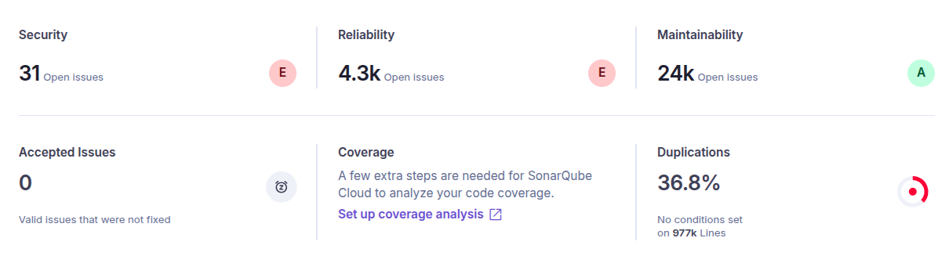
Cacti - SAST
SonarCloud Findings:
Insight:
Security: E - 31 issues
Reliability: E - 4.3k issues
Maintainability: A - 24k code smells
714k LOC, 36.8% code duplication
The project "Passed" the Quality Gate despite having E ratings in Security and Reliability. This is because the Quality Gate often applies only to new code, leaving legacy vulnerabilities hidden unless manually inspected.
Notes:
SonarCloud summary for Cacti: Security E (31 issues), Reliability E (4.3k issues), Maintainability A. The project Passed the Quality Gate despite critical issues because the gate only checks new code by default.

Slide 6
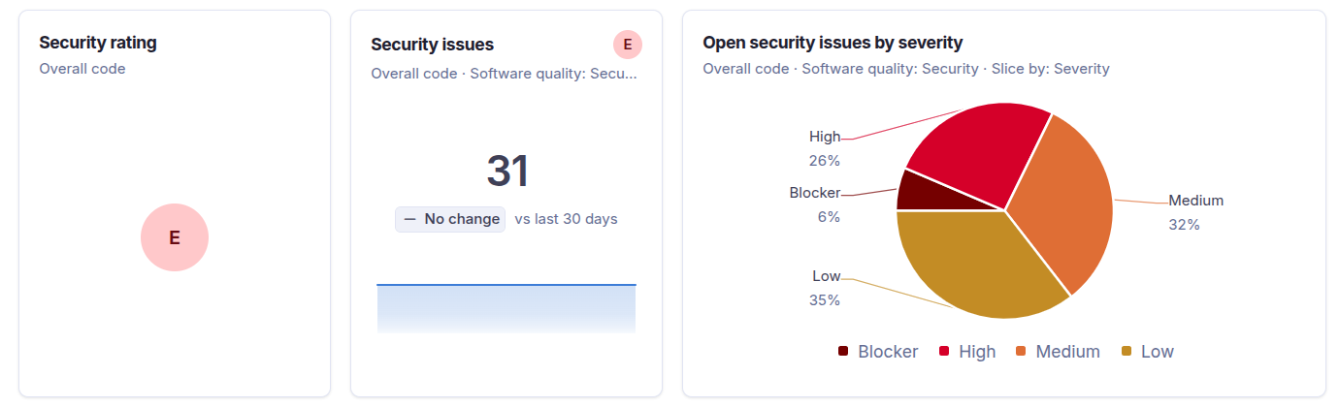
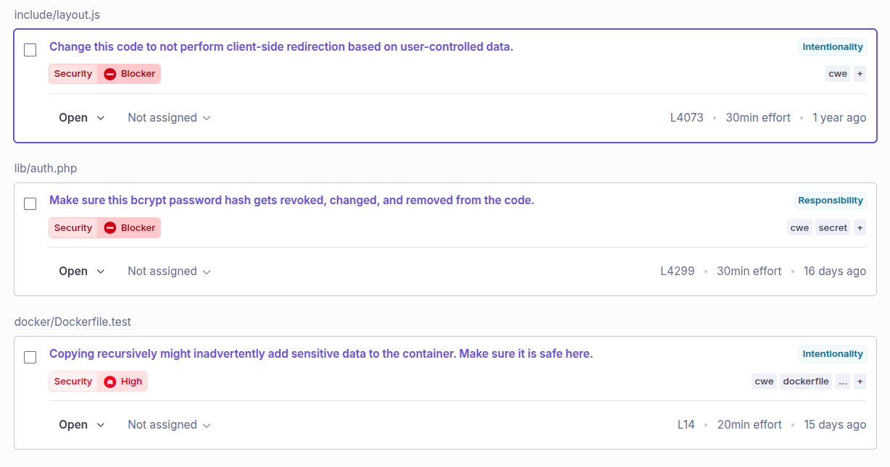
Cacti - Security Issues
31 Security Issues
2 Blocker
8 High
10 Medium
11 Low
Key Finding:
Bcrypt password hash exposed
in server responses
(Blocker severity).
Combined with client-side open
redirect vulnerabilities, this
creates a critical attack surface
for credential theft and phishing.
Notes:
Security E rating with 31 issues. Key findings: bcrypt password hash exposed in responses (Blocker), client-side open redirect (Blocker), sensitive data copied to container (High).

Slide 7
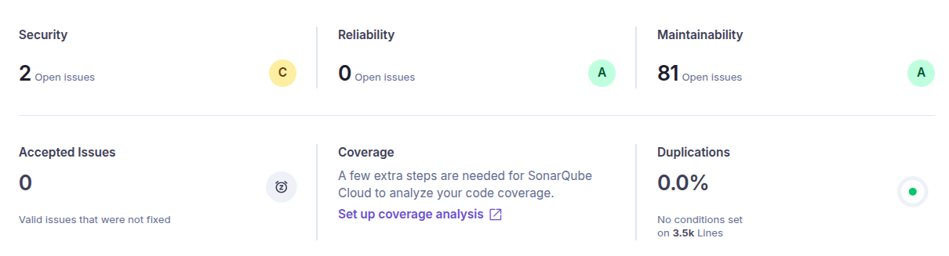
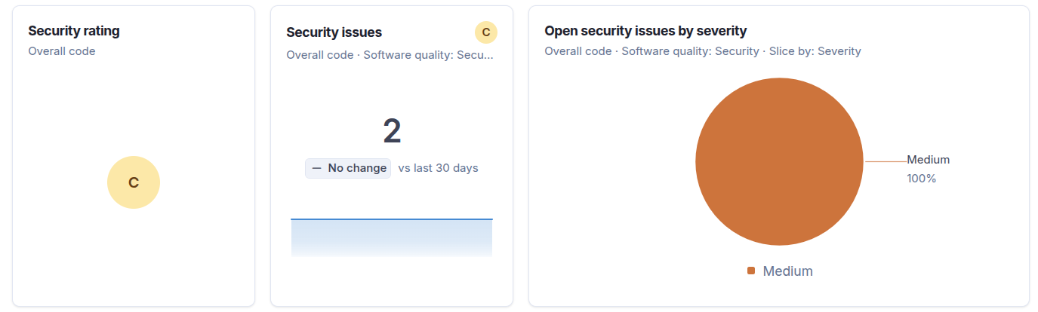
service-points-location-capacity - SAST
SonarCloud Findings:
Security: C - 2 issues
Reliability: A - 0 issues
Maintainability: A - 81 code smells
Duplications: 0.0%
Analysis:
Both security findings are
false positives (next slide).
The 81 code smells are minor
improvements: naming
conventions and cognitive
complexity refactoring.
2.2k Lines of Code | 0% duplication | well-structured codebase
Notes:
The secure repo scores Security C (2 false positives), Reliability A, Maintainability A. The 81 code smells are minor: naming conventions and cognitive complexity.

Slide 8
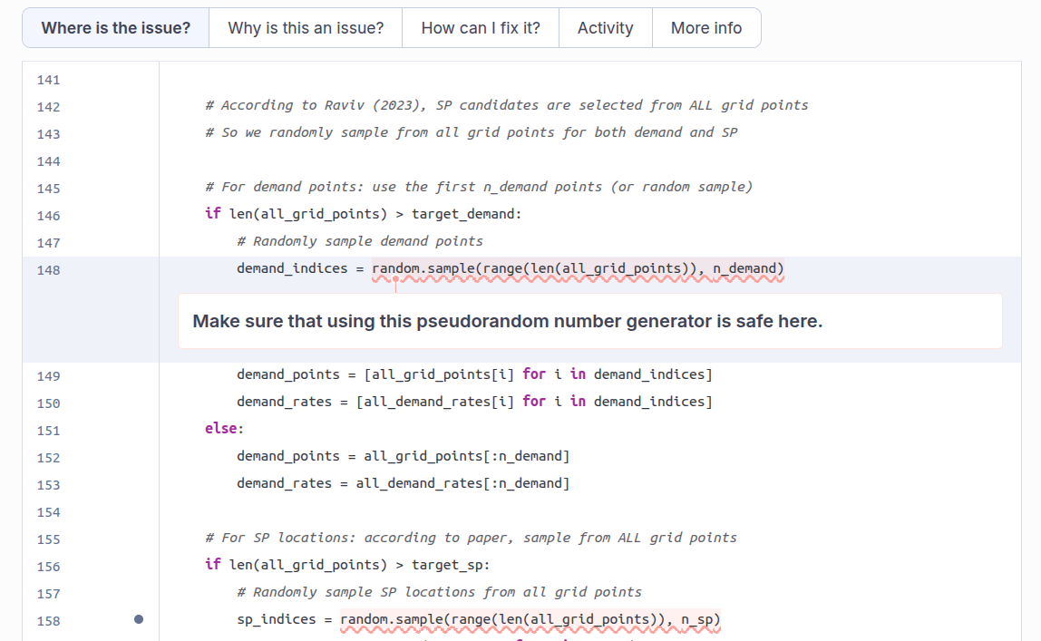
SAST - False Positive Analysis
Why False
Positive?
SonarCloud flagged
random.sample() as
an insecure Pseudo-
Random Number
Generator (PRNG).
But the function is
used for geographic
coordinate sampling,
not cryptography.
Lesson:
SAST tools cannot
understand business
logic context.
Notes:
SonarCloud flagged random.sample() as using an insecure Pseudo-Random Number Generator (PRNG). The code is actually doing geographic coordinate sampling, not cryptography. This demonstrates the key limitation of SAST tools: they cannot understand business logic context.

Slide 9
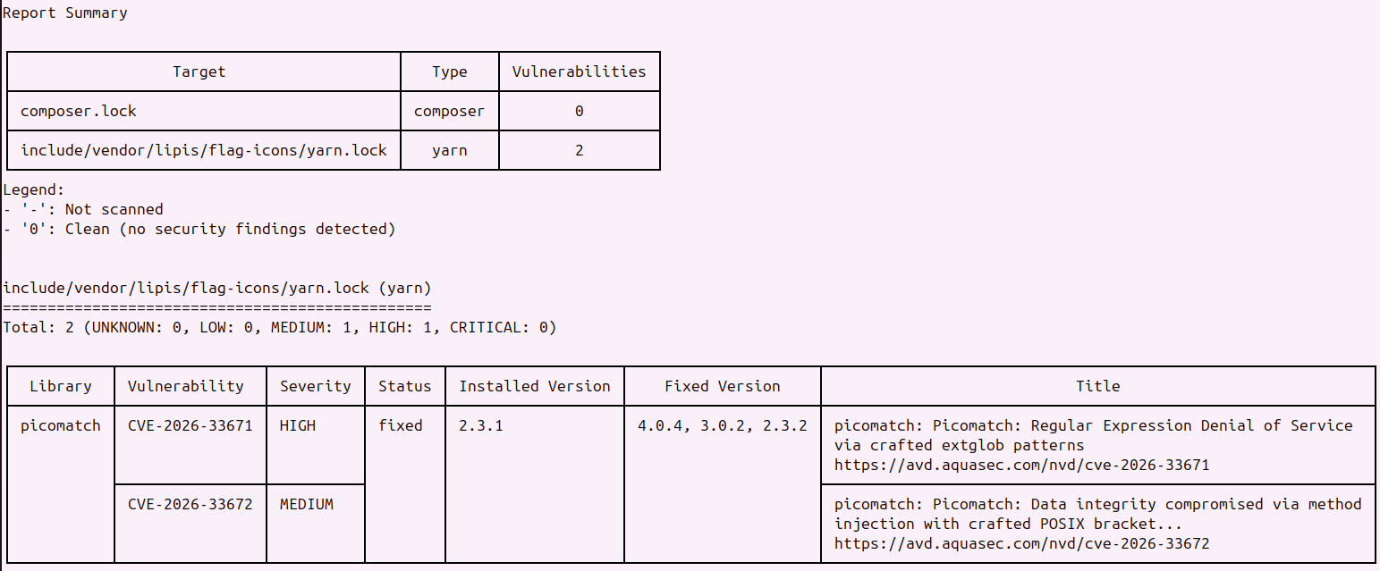
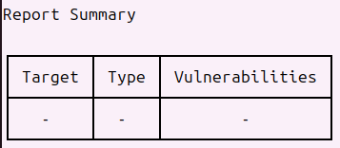
SCA Results - Trivy
Cacti
2 CVEs Found
picomatch (yarn.lock)
CVE-2026-33671
HIGH - ReDoS via
crafted extglob patterns
CVE-2026-33672
MEDIUM - Data integrity
compromised via POSIX
bracket injection
service-points-location-capacity
0 vulnerabilities found
No dependencies with known CVEs
Notes:
Trivy scanned dependency lock files. Cacti: yarn.lock contained 2 CVEs in picomatch. The secure repo has no dependencies with known CVEs.

Slide 10
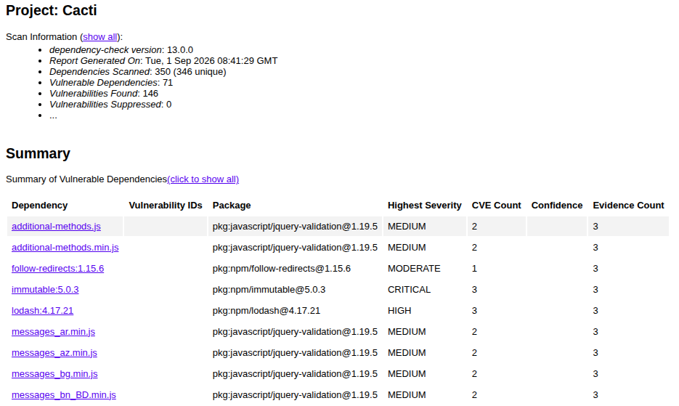
SCA Results - OWASP Dependency Check
Cacti
146 CVEs Found
350 dependencies scanned, 71 vulnerable
CRITICAL: immutable (prototype pollution, CVSS 9.8)
HIGH: lodash (code injection)
Comparison: Trivy vs OWASP DC
service-points-location-capacity
Trivy scans only lock files (yarn.lock): found 2 CVEs
OWASP DC also scans .js files on disk: found 146 CVEs
More data sources (NVD, RetireJS, NPM Audit) = wider coverage
0 dependencies scanned, 0 vulnerabilities
Notes:
OWASP Dependency Check v13 found 146 CVEs across 71 dependencies in Cacti (vs Trivy: only 2 in picomatch). OWASP DC uses more data sources: NVD, RetireJS, NPM Audit, Yarn Audit. It also scans JS files directly, finding jquery-validation XSS, immutable prototype pollution (CRITICAL CVSS 9.8), and lodash code injection. service-points-location-capacity: 0 dependencies (Python only), 0 CVEs — confirms Trivy. picomatch HIGH found by both tools (cross-validation).

