Slide 1
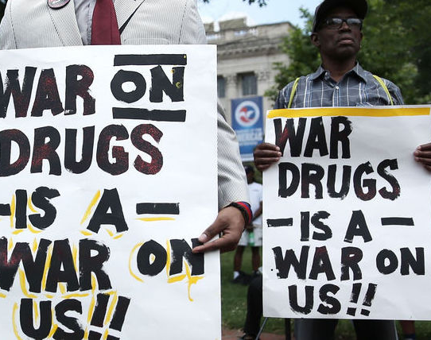
Ineffective Drug Policies
Source: https://nodrugwar.org/about/

Slide 2
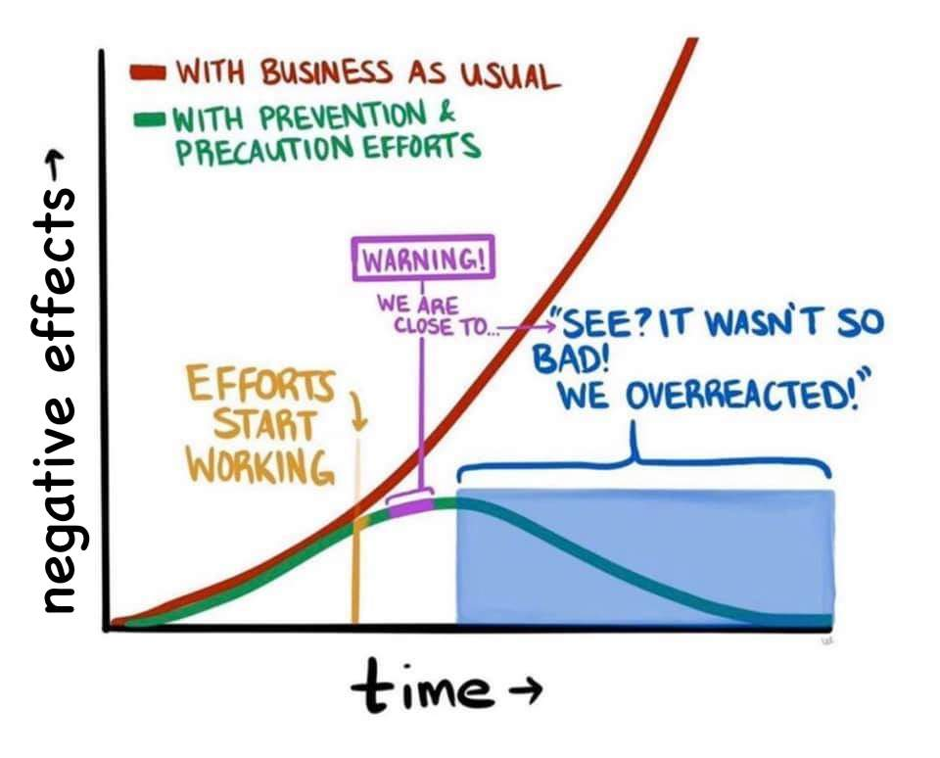
The Prevention Paradox
Source: https://twitter.com/bverheggen/status/1362799317510197258

Slide 3
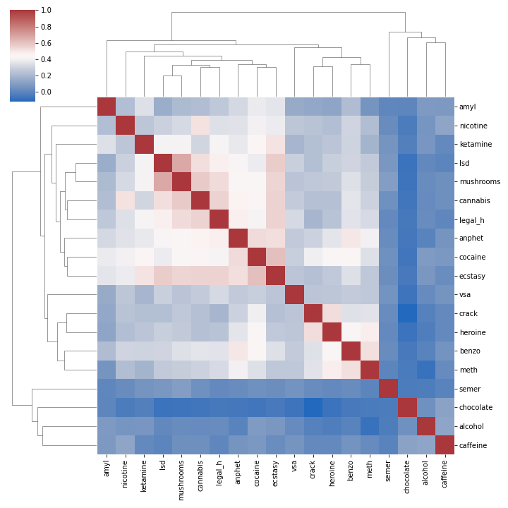
Correlation between substances

Slide 4
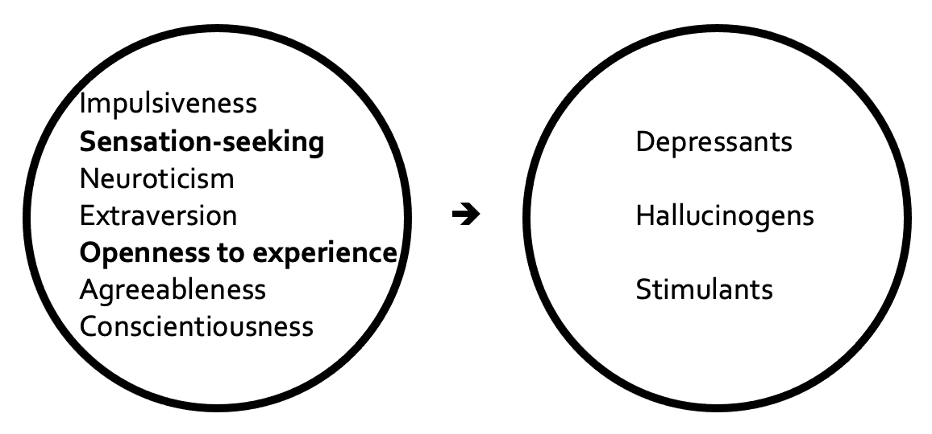
Methodology

Slide 5
References
Fehrman, Elaine, et al. "The five factor model of personality and evaluation of drug consumption risk." Data science. Springer, Cham, 2017. 231-242.
Fehrman, Elaine, et al. “Drug consumption (quantified) Data Set” https://archive.ics.uci.edu/ml/datasets/Drug+consumption+(quantified)

