Slide 1
Convergent Media: From Radio
to Podcasting
Erinna, Emily, Franki & Sara

Slide 2

Our podcast
Audience: UAL Community
Brand: University based podcast that brings young individuals together by discussing love, sex, fashion, politics and lifestyle. A place to share and listen without judgement or stigma
Idea: An entertaining podcast that explores love and relationships within the UAL community

Slide 3
HOW?
The podcast out of the series “ALL TALK” will be focused on love and dating within the UAL community – “Billy No Dates”
Presenters introducing podcast
Voxpops – getting other UAL students experiences with dating in university
Sara before going on date
'Vlog’ style – follow as if we are filming it
Interview – guest that can share their advice with love/dating
Catch up with Sara and how the date went

Slide 4
Planning

Slide 5
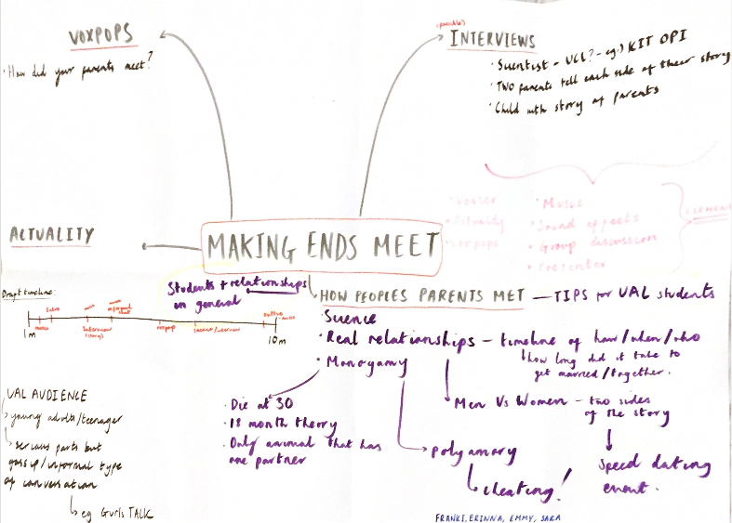
First Idea:
How peoples parents met
Why: Interesting to us, lighthearted, good information and stories
How: podcast of story telling –documentary - series of different ways individuals met
Issues: not relatable to UAL audience and not interesting enough for some to stay tuned in for whole 10 minutes

Slide 6
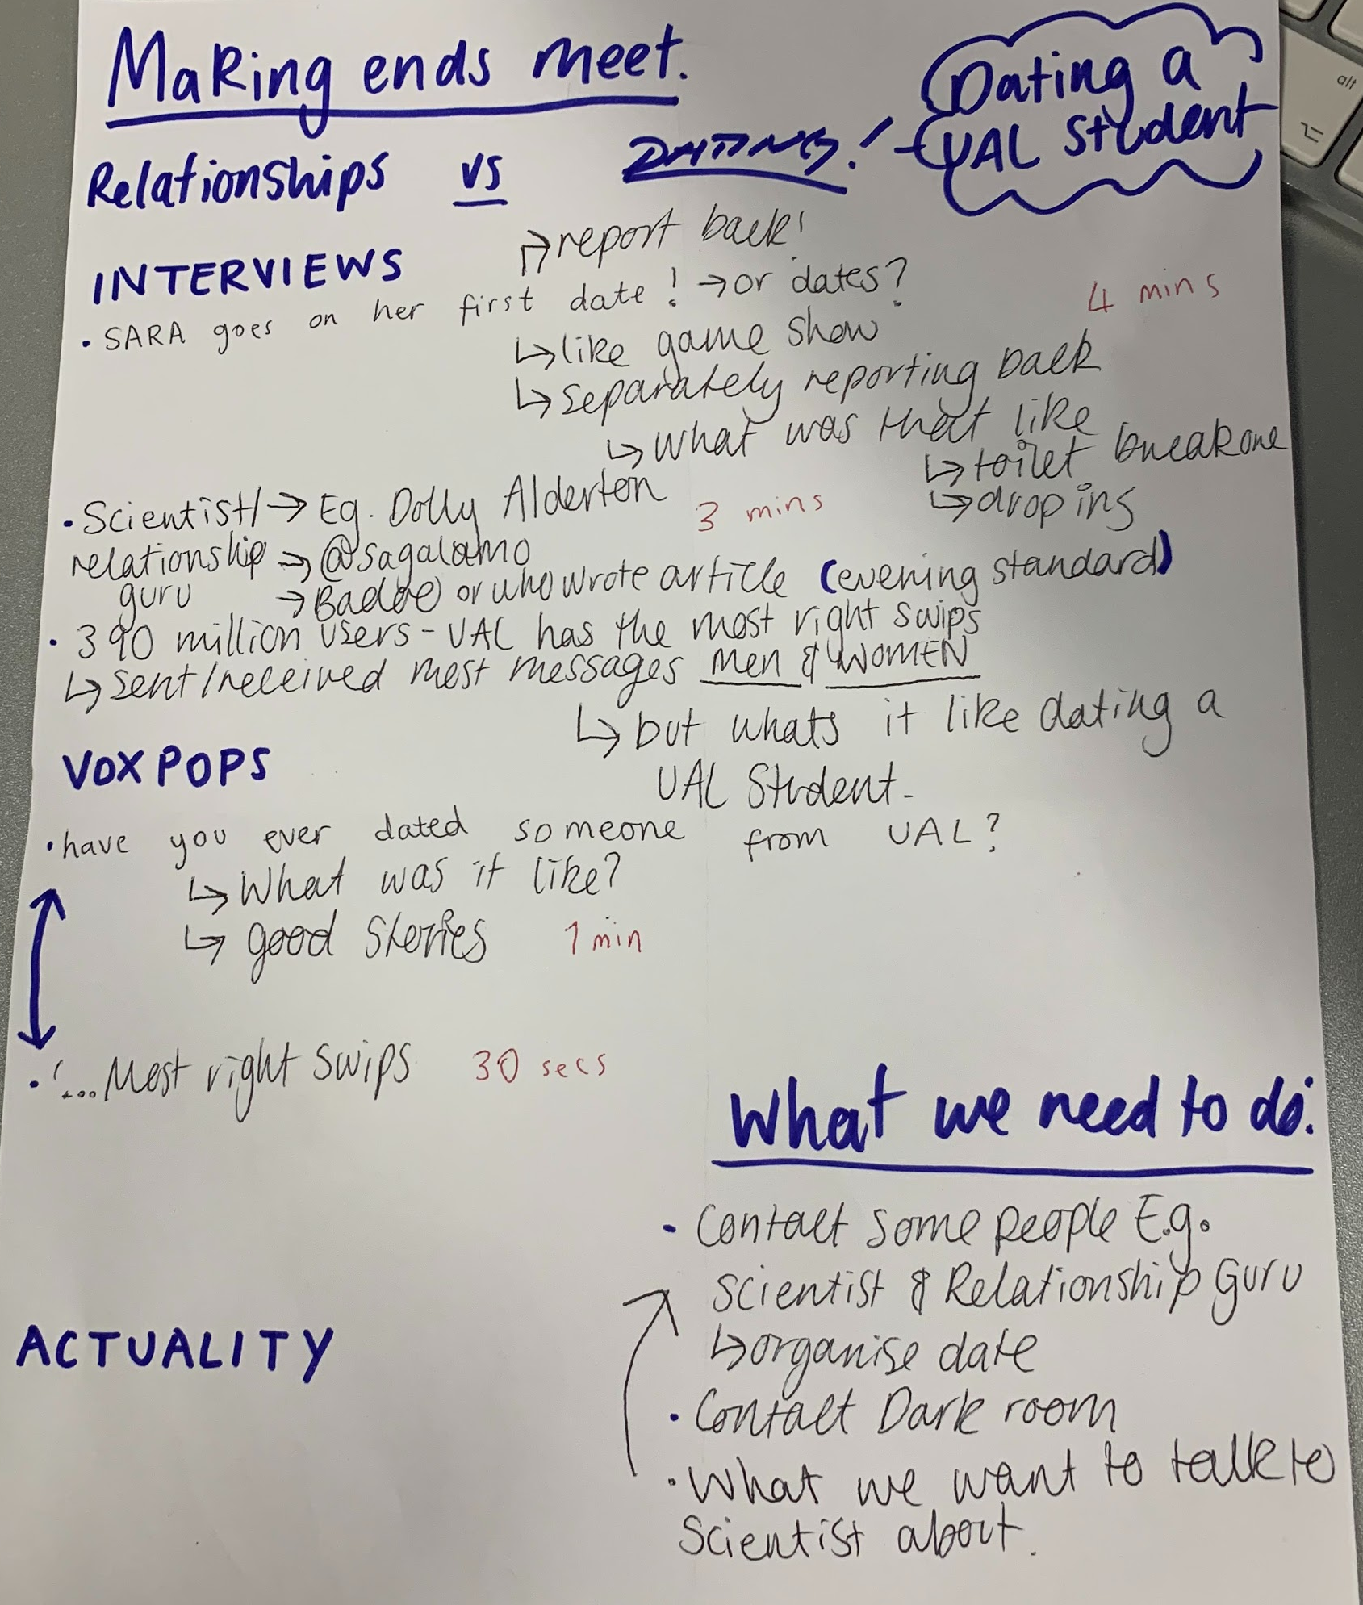

Slide 7
Timelines & how they’ve changed

Slide 8
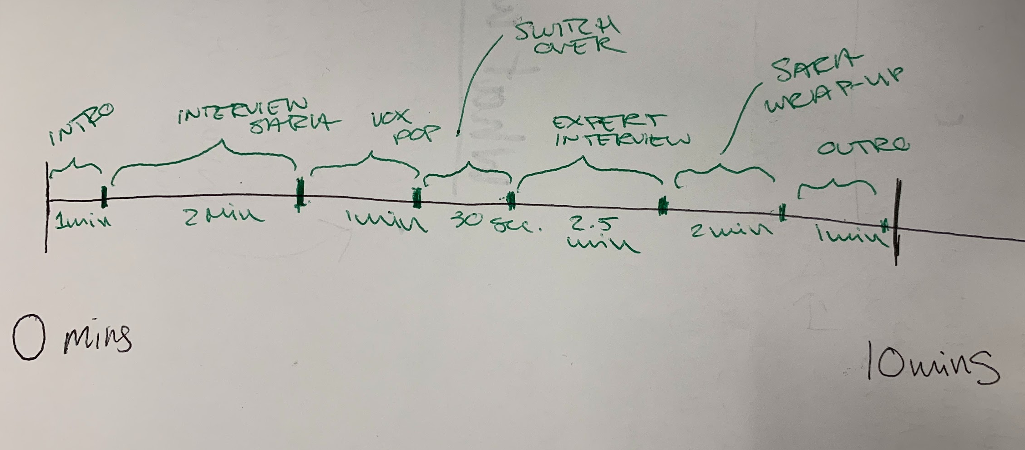
Timeline #1 :

Slide 9
Script and Timeline
Jingle - 5 seconds
Intro in studio - 1.5 minutes
Hello, and welcome back to ‘ALL TALK’ with your hosts Franki
and Em.
On today’s show we will be discussing dating at university
We are also going to interview an industry professional
Ask the students themselves, gather their stories and opinion
So Franki, - Most swiped rights
https://www.standard.co.uk/lifestyle/the-most-right-swiped-universities-badoo-dating-app-a3907211.htm
We sent Sara on a date with a Ual student to see if she could find what all the hype was about
Sara’s date - 1.5 minutes
Actuality - in restaurant or bar
How she feels etc
Leave her on the date
We’ll catch up with Sara later in the show
Studio - Introducing Vox pops - 20 seconds

Slide 10
Erinna went out on the street to see what LCC students had to say about dating
Vox Pops - 2 mins
Whilst Sara’s on her date
See what other people feel about dating a UAL Student
Any opinions or stories
Think of question
Studio - 30 seconds
Switching over
Discussion - our own funny stories?
Introducing our expert
Now we know what the students think so now we are going to here from the expert
Olivia Petter is the host of the independent’s Millennial Love podcast and an expert on the intricacies of modern dating. Erinna spoke to her about dating at uni, the apps and her nightmare date.
Expert Interview - 2.5 minutes
Dating tips etc
Either Rume Ugen or Olivia Peter
Organise when and questions we want to ask
Studio - 30 seconds
Catch up
It’s time to talk to Sara about her date with a Ual student
Studio - 1.5 mins
Sara comes in to talk about her date
Outro - 1 mins
Jingle - 5 seconds

Slide 11
Timeline #2 :
Back to studio- 10sec
Back to studio- 10sec
Back to studio- 10sec
Sara before date- 1min30
Sara date catch up- 2min
Outro- 30 sec
Intro- 1min30
Voxpops- 1min
Interview- 3min
Music
Voice Over
Actuality- bar and bathroom sounds
Actuality- food hall sounds
Music
Voice Over

Slide 12
Presenters: Franki and Em
Interviewer : Erinna
On report : Sara
Introduction: Franki and Em open up with explaining what podcast will include
Voxpops: Get UAL students themselves to tell their own stories to do with dating at university
Date: Sara on date – talking through how she’s feeling and what the night will entail
Interview: Erinna interviewing guest who can give tips and advice
Wrap up: Catching up with Sara and how her date went

Slide 13
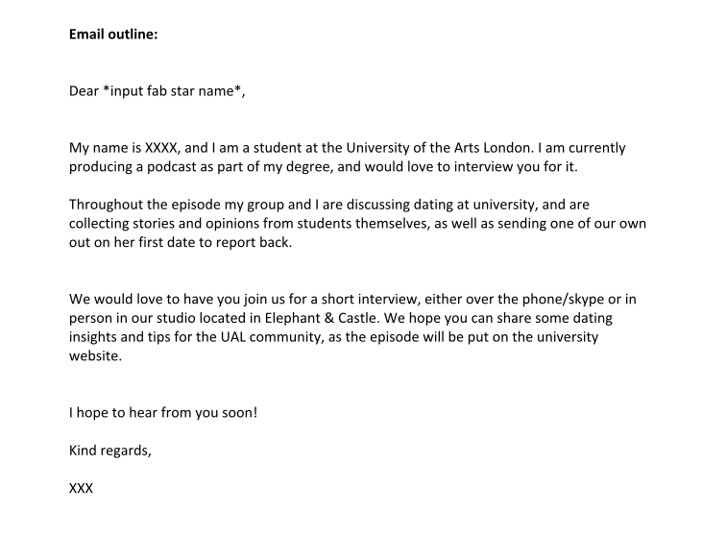

Slide 14
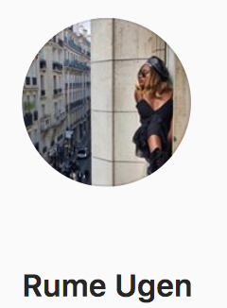
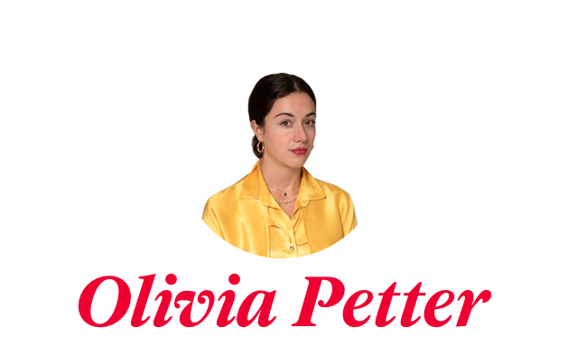

Slide 15
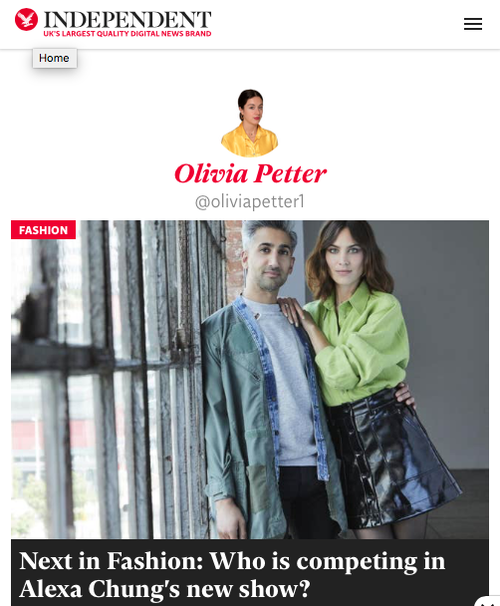
Went to Bristol University to study …
Twitter - @Oliviapetter1
Journalist for the Independent
Regular articles based on love, sex, fashion and lifestyle
Creator and producer of the chart-topping “Millennial Love” podcast

Slide 16
Interview Questions #1 :
Do you have any personal love story nightmares?
What’s the best piece of advice you’ve ever been told when it comes to dating?
What would you tell 18-year-old you about love if you could go back in time?
What is the most important thing you would say is in a relationship?
Why did you go into producing the ‘Millennial Love’ podcast for The Independent and why was that something that interested you?

Slide 17
Interview Questions #2:
What advice would you give uni students in the dating game?
What do you think of dating apps for our generation? Do you agree or disagree with the way they work? Have you ever used them and had bad/good experiences?
We know you went to university in Bristol, so how does the dating scene differ there to London?

Slide 18
Finished product
https://soundcloud.com/user-160870325/all-talk-billy-no-dates?fbclid=IwAR1uH2MDN31KuLBIhANW8OCWLBUJLEMAyKI1AYZUTVatobN3UoFTzlHYe1U

