Slide 1
BioTech 76 computing Plots, Gragph and Maps using R
Xin Tian, Ph.D., Mathematical Statistician
Office of Biostatistics Research National Heart, lung and Blood Institute, NIH Email: tianx@nhlbi.nih.gov
Github: https://github.com/npmldabook/rplots

Slide 2
Agenda (break 15 mins *2, lunch 12-1 PM)
A : R basics
B : Graphics systems in R
C : Using color in R
D : R Graphics Devices – Static display
E: R Graphics Devices – Interactive display
Q & A, hands on your own research data
F: Working with Maps
G: Network plots
H: Specialty Figures
Q & A, hands on your own research data

Slide 3
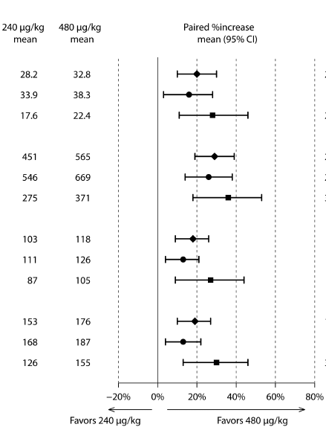
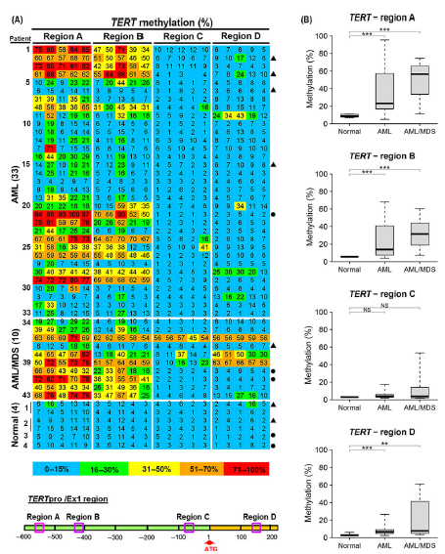
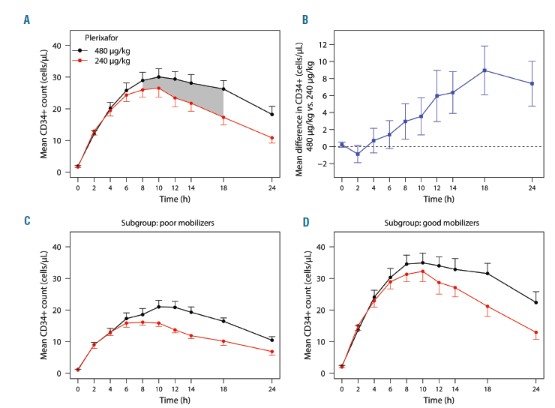
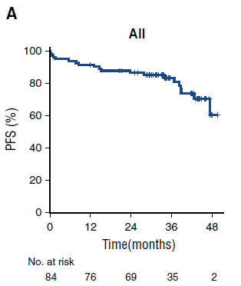
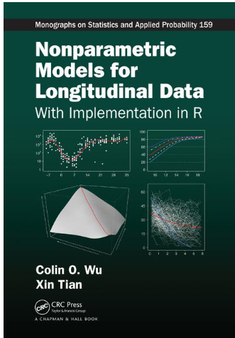
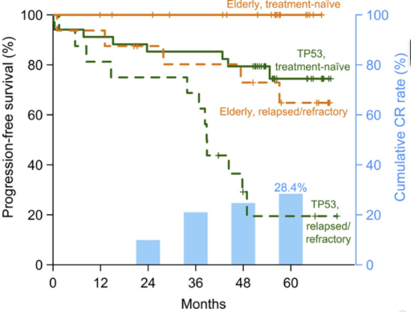
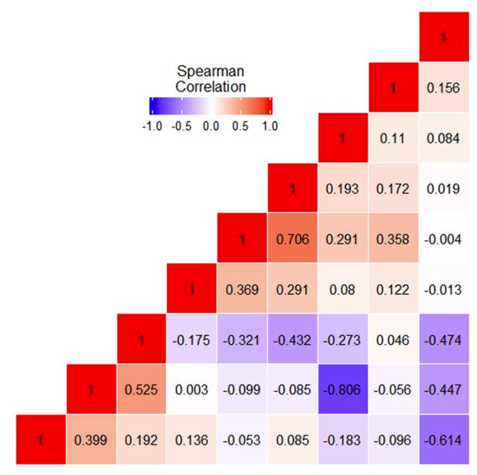
Data visualization in R for My research
Haematologica, 2017
Blood, 2017
British J. Haematology,
2016
CRC press, 2018
Blood, 2018
BMT 2018

Slide 4
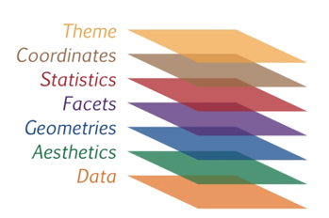
Grammar of R graphics= layers of elements/building blocks
Traditional R plots
plot(); hist(); boxplot() ; barplot()
lines(); abline();
points()
arrows(); segments()
axis(), title(), legend(),
text(), mtext()
grid(), box()
par(), layout(), grid.arrange()
GGPLOT2

Slide 5
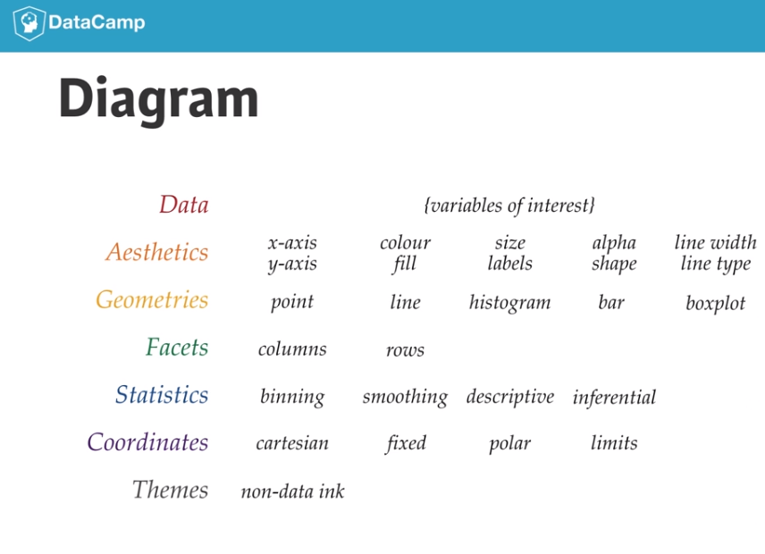

Slide 6
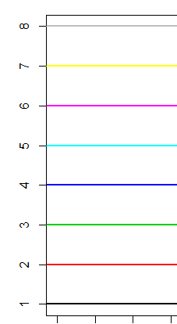
Sec C3 (p40): Using color in R- R can be colorful
Colors in R http://www.stat.columbia.edu/~tzheng/files/Rcolor.pdf
> par( ), arguments: col =“ color name” , col.axis=, col.lab=, col.main=, col.sub= .
> colors()
Use simple numbers: 1:8 Or use color names (657 build-in): check the cheat- sheet: “red”, “black”, “green”, “purple”, etc.
R color cheatsheet : https://www.nceas.ucsb.edu/~frazier/RSpatialGuides/colorPaletteCheatsheet.pdf
R palettes packaes: grDevices and colorRamps, RcolorBrewer, colorspace;
use help: >? rainbow_hcl ; use pal<- choose_palette() ; check on examples in R color cheatsheet

Slide 7
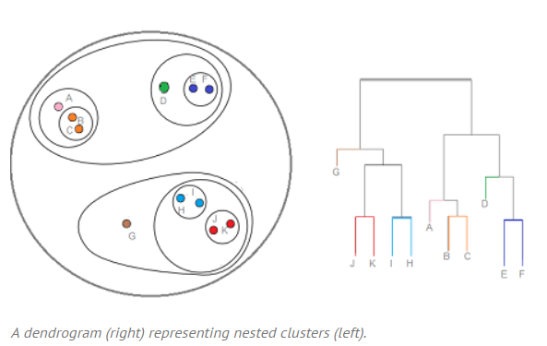
Sec 3.4 (p46): Plotting with Color
Hierarchical Clustering / Dendrogram: Definition, Examples
Hierarchical clustering is where you build a cluster tree (a dendrogram) to represent data, where each group (or “node”) links to two or more successor groups. The groups are nested and organized as a tree, which ideally ends up as a meaningful classification scheme. Each node in the cluster tree contains a group of similar data; Nodes group on the graph next to other, similar nodes. Clusters at one level join with clusters in the next level up, using a degree of similarity; The process carries on until all nodes are in the tree, which gives a visual snapshot of the data contained in the whole set. The total number of clusters is not predetermined before you start the tree creation.- Unsupervised Learning. https://www.statisticshowto.datasciencecentral.com/hierarchical-clustering

Slide 8
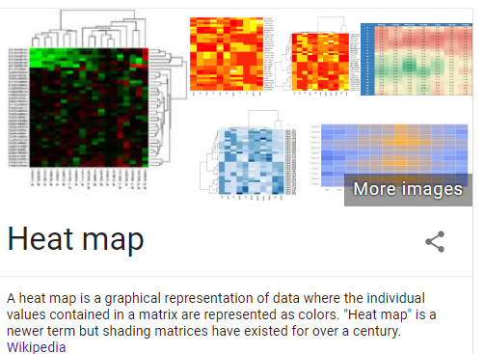
Sec C4.3.2 (p51) Heatmap (color-matrix)

Slide 9
Sec D (p55) R graphic Devices (static)
Graphic output in screen device or file device
The following graphics devices are currently available:
windows The graphics device for Windows (on screen, to printer and to Windows metafile).
pdf Write PDF graphics commands to a file
postscript Writes PostScript graphics commands to a file
xfig Device for XFIG graphics file format
bitmap bitmap pseudo-device via Ghostscript (if available).
pictex Writes TeX/PicTeX graphics commands to a file (of historical interest only)
The following devices will be functional if R was compiled to use them (they exist but will return with a warning on other systems):
cairo_pdf, cairo_ps PDF and PostScript devices based on cairo graphics.
svg SVG device based on cairo graphics.
png PNG bitmap device
jpeg JPEG bitmap device
bmp BMP bitmap device
tiff TIFF bitmap device

Slide 10

Sec E: Interactive Display (P60)
In R, the pipe operator is, as you have already seen, %>% : you can think of this operator as being similar to the + in a ggplot2 statement. Its function is very similar to that one that you have seen of the F# operator: it takes the output of one statement and makes it the input of the next statement. When describing it, you can think of it as a "THEN".
iris %>%
subset(Sepal.Length > 5) %>%
aggregate(. ~ Species, ., mean)
➔ Pipeline: you take the Iris data, then you subset the data and then you aggregate the data
➔ %>% used in ggvis

Slide 11
htmlwidgets for R
https://www.htmlwidgets.org/
Dygraphs: provides rich facilities for charting time-series data in R and includes support for many interactive features including series/point highlighting, zooming, etc.
Plotly: allows you to easily translate your ggplot2 graphics to an interactive web-based version:
https://images.plot.ly/plotly-documentation/images/r_cheat_sheet.pdf
Image can save as webpage- html file.

