Slide 1
BioTech 76 Creating Plots, Graph and Maps using R
Xin Tian, Ph.D., Mathematical Statistician
Office of Biostatistics Research National Heart, lung and Blood Institute, NIH Email: tianx@nhlbi.nih.gov
GitHub: https://github.com/npmldabook/rplots

Slide 2
Agenda (breaks: 2*15min @10a, 3p & lunch)
A : R basics
B : Graphics systems in R
C : Using color in R
D : R Graphics Devices – static plots
E: R Graphics Devices – interactive plots
Q & A, hands-on and discuss your own research data
F: Working with Maps
G: Network plots
H: Specialty Figures
Q & A, hands on your own research data

Slide 3
Why we need plots/figures?
“A picture is worth a thousand words.”
“Every picture tells a story.”
“The graphical display of data is among the most powerful tools available for communicating medical research findings, given the increasing complexity of study designs and the mind’s preference for information conveyed in pictorial format.” – Stuart Pocock in ‘How to interpret figures in reports of clinical trials’, BMJ, 2008

Slide 4
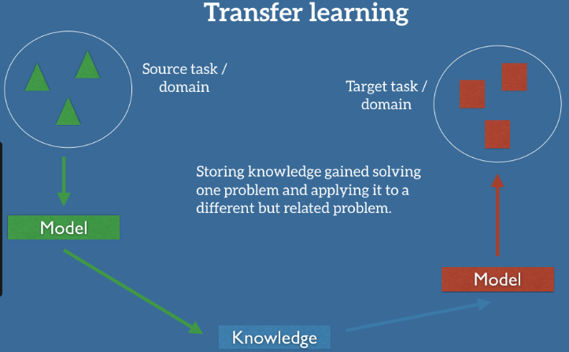
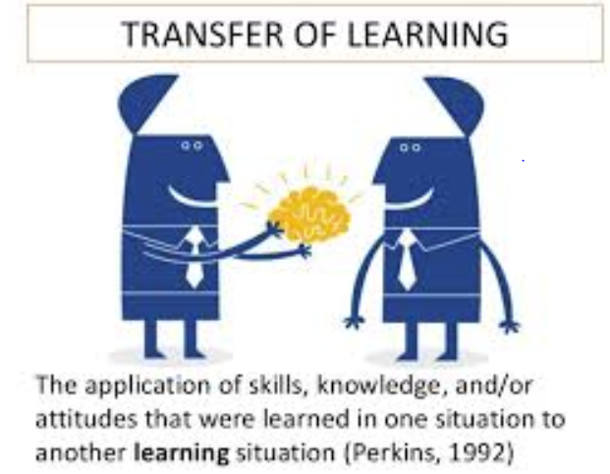

Slide 5
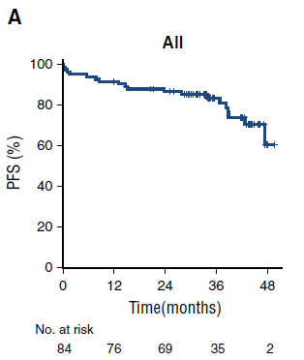
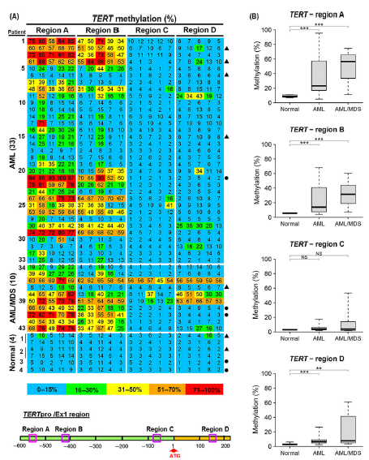
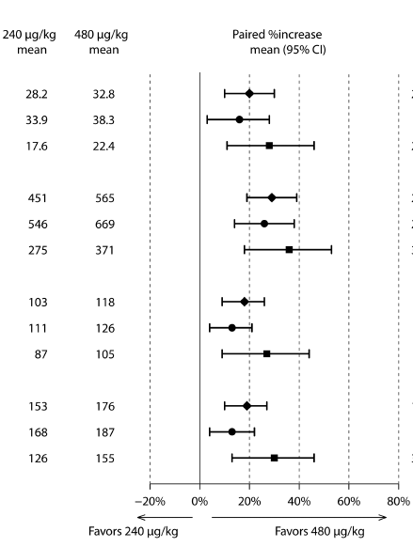
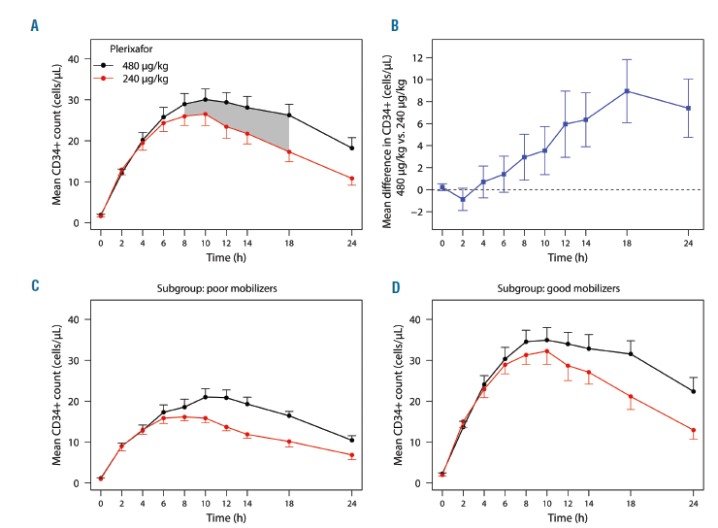
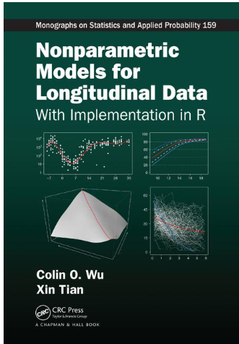
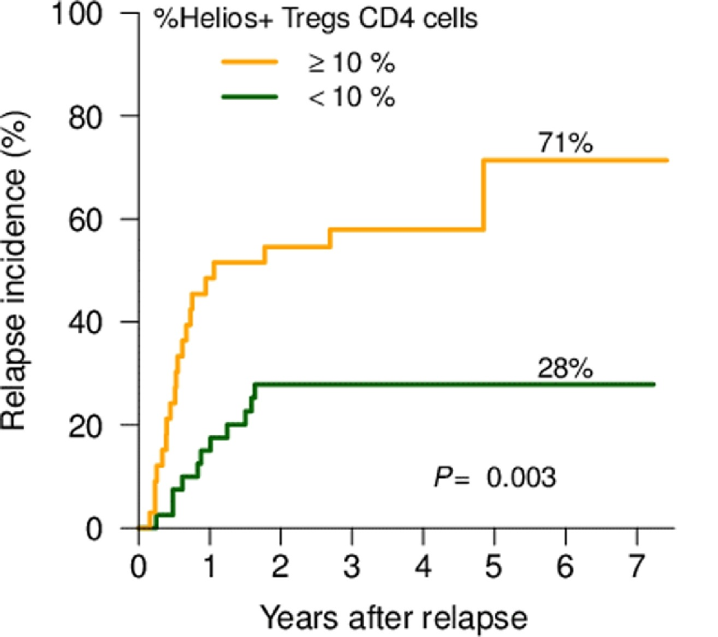
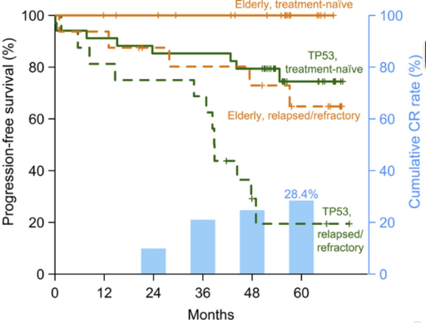
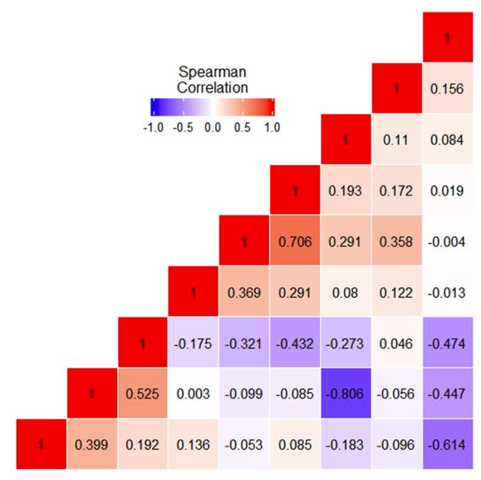
R Figures for My research
Blood, 2017
Haematologica, 2017
CRC press, 2018
British J.
Haematology 2016
Biology of Blood & Marrow Transplant 2019
Blood, 2018
BMT 2018

Slide 6
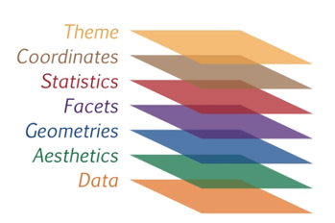
Grammar of R graphics = layers of elements/building blocks
Traditional R plots
plot(); hist(); boxplot() ; barplot()
lines(); abline(); points()
arrows(); segments()
axis(), title(), legend()
text(), mtext()
grid(), box()
par(), layout()
ggplot2 package

Slide 7
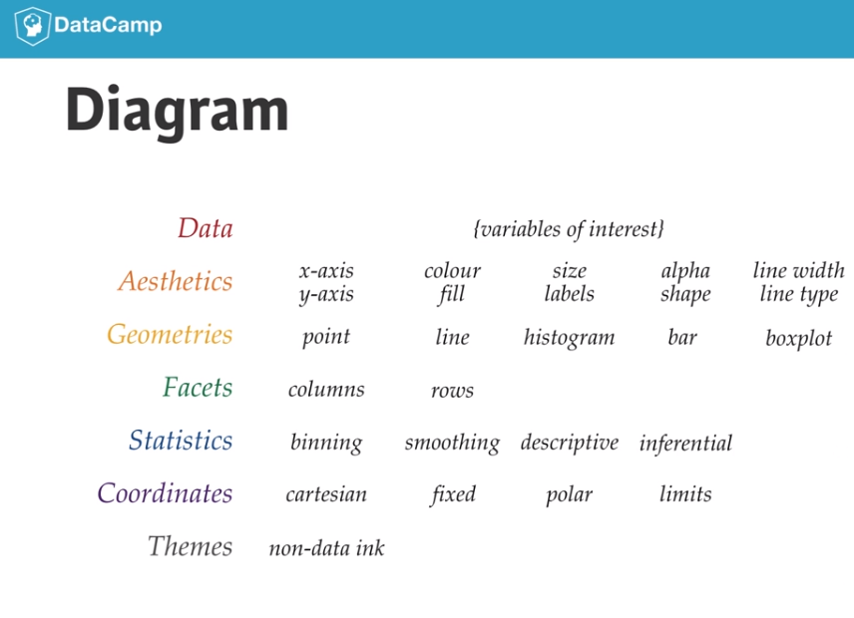

Slide 8

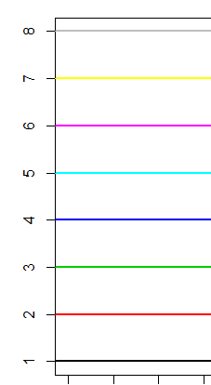
Sec C 1-3: Using color in R- R can be colorful
Colors in R : http://research.stowers−institute.org/efg/R/Color/Chart
> par( ), arguments: col =“name” or number , col.axis=, col.lab=, col.main=, col.sub = & color/fill in ggplot2
> colors() : 657 build in colors
Use simple numbers, co1=1 ~ 8 : default palette()
use color names (check the color-chart) ‘red’, “black”, “green”, “purple” or the Hex notation, “coral”== “#FF7F50”
R color cheatsheet : https://www.nceas.ucsb.edu/~frazier/RSpatialGuides/colorPaletteCheatsheet.pdf (w. examples)
R palettes packages: grDevices and colorRamps, RcolorBrewer, colorspace;
Interactive Tools: http://colorbrewer2.org ; use pal<- choose_palette ()

Slide 9
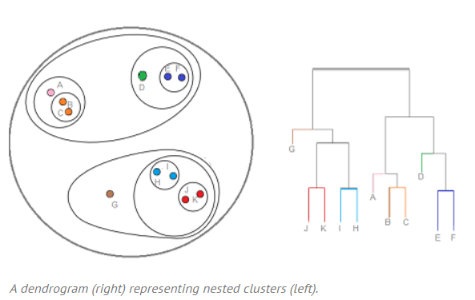
Sec 3.4: Plotting with Color
Hierarchical Clustering / Dendrogram: Definition, Examples
Hierarchical clustering is where you build a cluster tree (a dendrogram) to represent data, where each group (or “node”) links to two or more successor groups. The groups are nested and organized as a tree, which ideally ends up as a meaningful classification scheme. Each node in the cluster tree contains a group of similar data; Initially, each object is assigned to its own cluster and then the algorithm proceeds iteratively, at each stage joining the two most similar clusters, continuing until there is just a single cluster. The tree gives a visual snapshot of the data contained in the whole set. The total number of clusters is not predetermined before you start the tree creation. Unsupervised Learning. https://www.statisticshowto.datasciencecentral.com/hierarchical-clustering

Slide 10
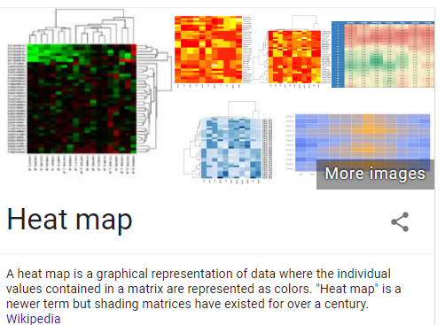
Sec C4.3.2 (p51) Heatmap (color-matrix)

Slide 11
Sec D: R graphic Devices (static)
Graphic output in screen device or file device: >? Devices
The following graphics devices are currently available:
windows The graphics device for Windows (on screen, to printer and to Windows metafile).
pdf Write PDF graphics commands to a file
postscript Writes PostScript graphics commands to a file
xfig Device for XFIG graphics file format
bitmap bitmap pseudo-device via Ghostscript (if available).
pictex Writes TeX/PicTeX graphics commands to a file (of historical interest only)
The following devices will be functional if R was compiled to use them (they exist but will return with a warning on other systems):
cairo_pdf, cairo_ps PDF and PostScript devices based on cairo graphics.
svg SVG device based on cairo graphics.
png PNG bitmap device
jpeg JPEG bitmap device
bmp BMP bitmap device
tiff TIFF bitmap device

Slide 12
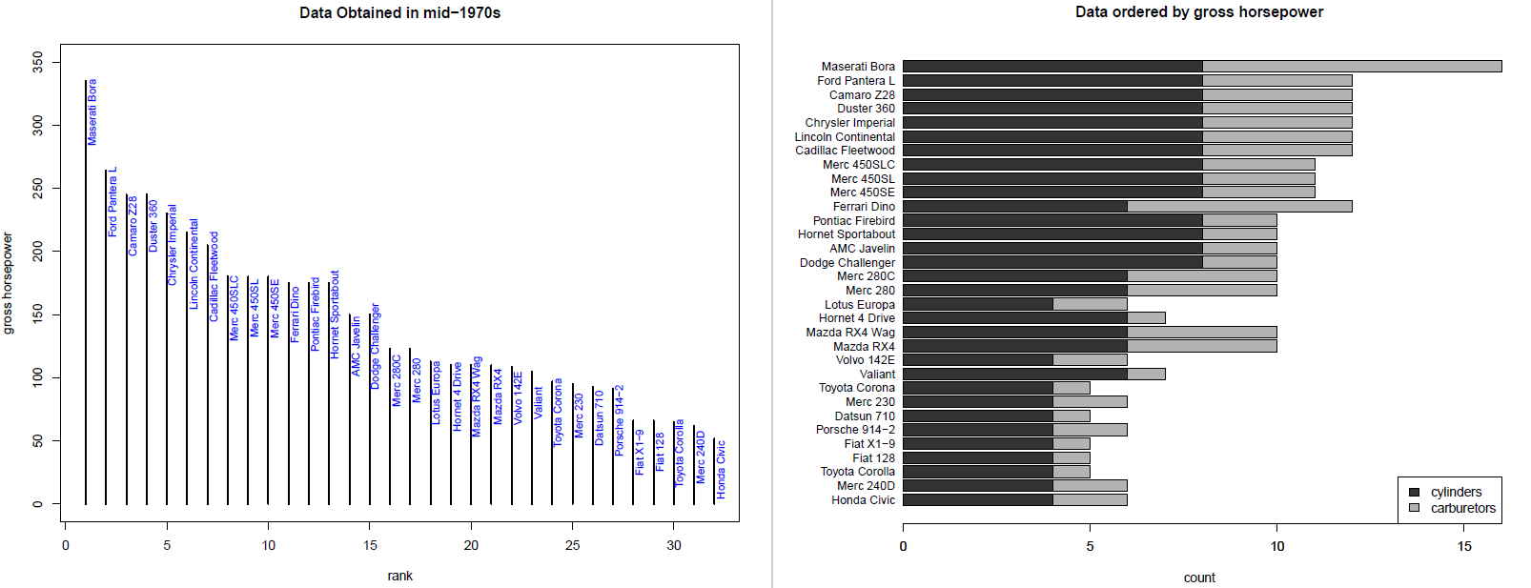
Ex3.3

Slide 13


Sec E: Interactive Display
In R, the pipe operator is, as you have already seen, %>% : you can think of this operator as being similar to the + in a ggplot2 statement. It takes the output of one statement and makes it the input of the next statement. When describing it, you can think of it as a "THEN".
iris %>%
subset(Sepal.Length > 5) %>%
aggregate(. ~ Species, ., mean)
➔ Pipeline: you take the Iris data, then you subset the data and then you aggregate the data
➔ %>% can be used in ggvis as well as data processing steps.

Slide 14
htmlwidgets for R
Interactivity: Any HTML format (document, notebook, presentation, or dashboard) can contain interactive components.
https://www.htmlwidgets.org/ (see showcase)
Dygraphs: provides rich facilities for charting time-series data in R and includes support for many interactive features including series/point highlighting, zooming, etc.
Plotly: allows you to easily translate your ggplot2 graphics to an interactive web-based version:
https://images.plot.ly/plotly-documentation/images/r_cheat_sheet.pdf
Image can save as webpage- html file and include in R markdown file
Other interesting ones: Highcharter; d3heatmap, threejs, etc

