Slide 1

Transport Equation Parallelization
Francesca Maria Palazzotto
Cloud and High-Performance Computing assignment
University of Palermo

Slide 2
Summary
Transport Equation:
Definition
Case study
Serial code:
Construction
Analysis
Graphical visualization
Parallel code:
Theoretical description
Code visualization
Results analysis
Graphical visualization
Transport Equation Parallelization - Summary

Slide 3
Transport Equation

Slide 4
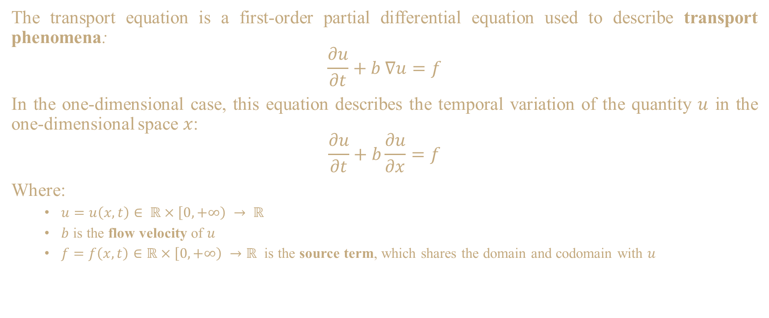
Transport Equation
The transport equation is a first-order partial differential equation used to describe transport phenomena:
$$\frac{∂u}{∂t}+b ∇u=f$$
In the one-dimensional case, this equation describes the temporal variation of the quantity $u$ in the one-dimensional space $x$:
$$\frac{∂u}{∂t}+b\frac{∂u}{∂x}=f$$
Where:
$u=u\left(x,t\right)∈ ℝ×\left[0, +∞\right) → ℝ$
$b$ is the flow velocity of $u$
$f=f\left(x,t\right)∈ℝ×\left[0, +∞\right) →ℝ$ is the source term, which shares the domain and codomain with $u$
Transport Equation Parallelization – Definition

Slide 5
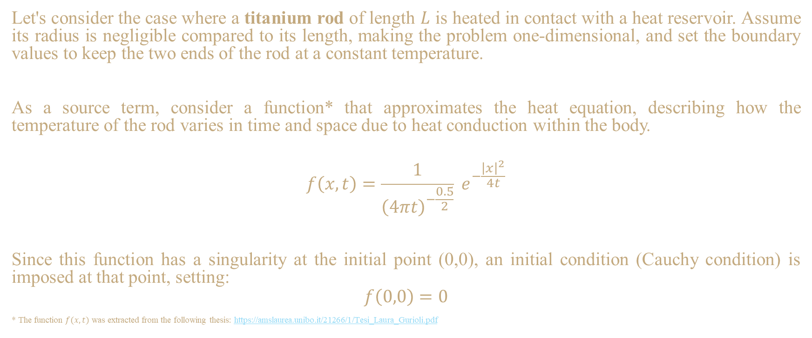
Transport Equation
Let's consider the case where a titanium rod of length $L$ is heated in contact with a heat reservoir. Assume its radius is negligible compared to its length, making the problem one-dimensional, and set the boundary values to keep the two ends of the rod at a constant temperature.
As a source term, consider a function* that approximates the heat equation, describing how the temperature of the rod varies in time and space due to heat conduction within the body.
$$f\left(x,t\right)=\frac{1}{{\left(4πt\right)}^{−\frac{0.5}{2}}} e^{−\frac{{\left|x\right|}^{2}}{4t}}$$
Since this function has a singularity at the initial point (0,0), an initial condition (Cauchy condition) is imposed at that point, setting:
$$f\left(0,0\right)=0$$
* The function $f(x,t)$ was extracted from the following thesis: https://amslaurea.unibo.it/21266/1/Tesi_Laura_Gurioli.pdf
Transport Equation Parallelization – Case study

Slide 6
Serial Code

Slide 7
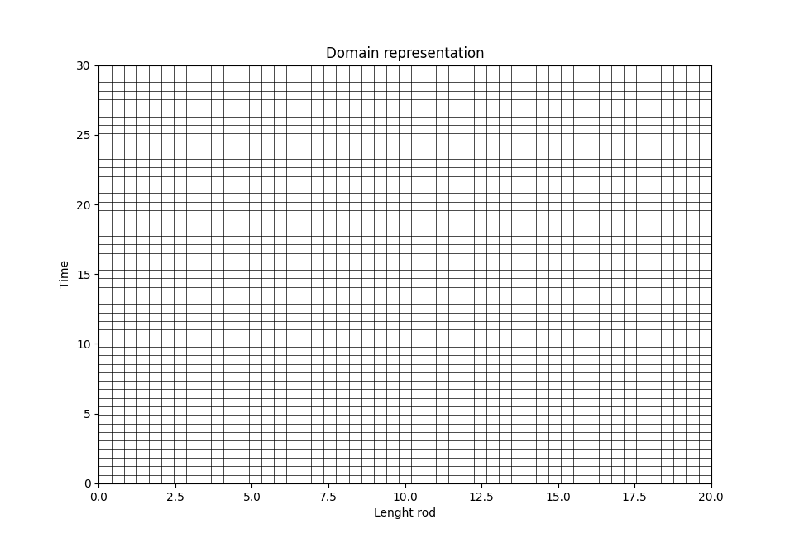
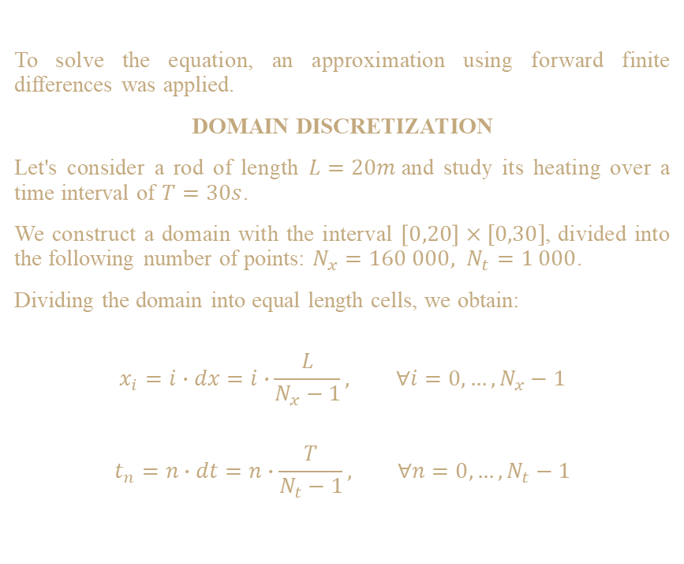
Serial Code
To solve the equation, an approximation using forward finite differences was applied.
DOMAIN DISCRETIZATION
Let's consider a rod of length $L=20m$and study its heating over a time interval of $T=30s$.
We construct a domain with the interval $\left[0,20\right]×[0,30]$, divided into the following number of points: $N_{x}=160 000, N_{t}=1 000$.
Dividing the domain into equal length cells, we obtain:
$$x_{i}=i∙dx=i∙\frac{L}{N_{x}−1}, ∀i=0, …, N_{x}−1$$
$$t_{n}=n∙dt=n∙\frac{T}{N_{t}−1}, ∀n=0, …, N_{t}−1$$
Sample of domain discretization
Transport Equation Parallelization – Construction

Slide 8
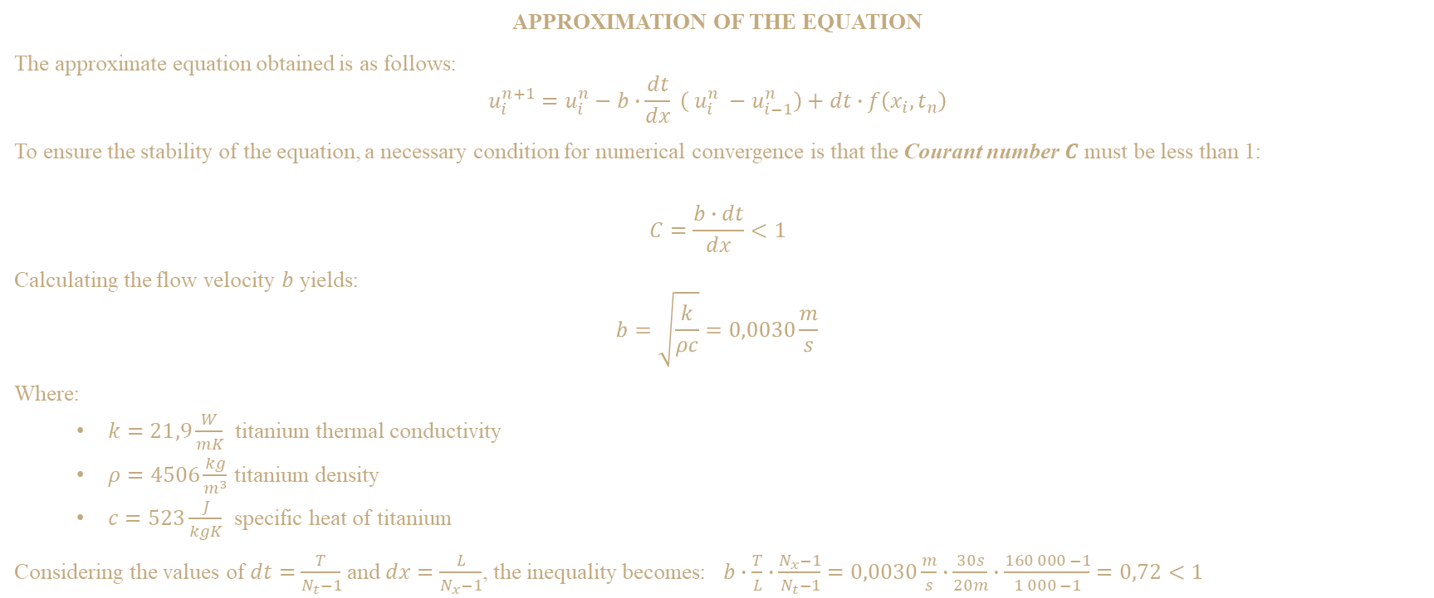
Serial Code
APPROXIMATION OF THE EQUATION
The approximate equation obtained is as follows:
$$u_{i}^{n+1}=u_{i}^{n}−b∙\frac{dt}{dx} \left( u_{i}^{n} −u_{i−1}^{n}\right)+dt∙f\left(x_{i}, t_{n}\right)$$
To ensure the stability of the equation, a necessary condition for numerical convergence is that the Courant number $C$ must be less than 1:
$$C=\frac{b∙dt}{dx}<1$$
Calculating the flow velocity $b$ yields:
$$b=\sqrt{\frac{k}{ρc}}=0,0030\frac{m}{s}$$
Where:
$k=21,9\frac{W}{mK}$ titanium thermal conductivity
$ρ=4506\frac{kg}{m^{3}}$ titanium density
$c=523\frac{J}{kgK}$ specific heat of titanium
Considering the values of $dt=\frac{T}{N_{t}−1}$ and $dx=\frac{L}{N_{x}−1}$, the inequality becomes: $b∙\frac{T}{L}∙\frac{N_{x}−1}{N_{t}−1}=0,0030\frac{m}{s}∙\frac{30s}{20m}∙\frac{160 000 −1}{1 000 −1}=0,72<1$
Transport Equation Parallelization – Construction

Slide 9
Serial Code
The programming language used for the implementation is Python.
The implementation of the serial code is as follows:
# Defining variables of the equation
L = 20 # Lenght of the rod - [0,L] x-domain
T = 30 # Time interval - [0,T] t-domain
N_x = 160000 # Points' number of x-domain
N_t = 1000 # Points' number of t-domain
b = 0.0030 # Speed of transport
# Spatial and temporal spacing
dx = L / (N_x - 1)
dt = T / (N_t - 1)
# Inizializing the space and time vectors - creates two vectors
# containing the number desidered of values in a given interval
x = np.linspace(0, L, N_x)
t = np.linspace(0, T, N_t)
# Creation of bidimensional array containing the information about
# the quantity u - initialized at 0
u = np.zeros( (N_t, N_x) )
# Inserting the initial condition - Cauchy condition
# At time 0, the rod is completely cold
u[0, :] = 0
# Inserting boundary conditions - Dirichlet conditions
# The ends of the rod are at a constant temperature: cold
u[:, 0] = 0
u[:, N_x-1] = 0
# Numeric schema finite differences forward
for n in range(1, N_t-1):
for i in range(1, N_x-1):
u[n+1, i] = u[n, i] \
- b * (dt/dx) * (u[n, i] - u[n, (i-1) % N_x]) \
+ dt * heat_function(x[i], t[n])
import numpy as np
import matplotlib.pyplot as plt
from datetime import datetime
from matplotlib import cm
# ---
# Non-homogeneous case
# Defining a Heat Function that represents the term function
def heat_function( space : np.ndarray,
time : np.ndarray ) -> np.ndarray:
'''
Using a fundamental solution of the heat equation.
'''
return ((np.pi*4*time)**(-0.5/2)) ** np.exp((-space**2)/(4*time))
Transport Equation Parallelization – Analysis

Slide 10
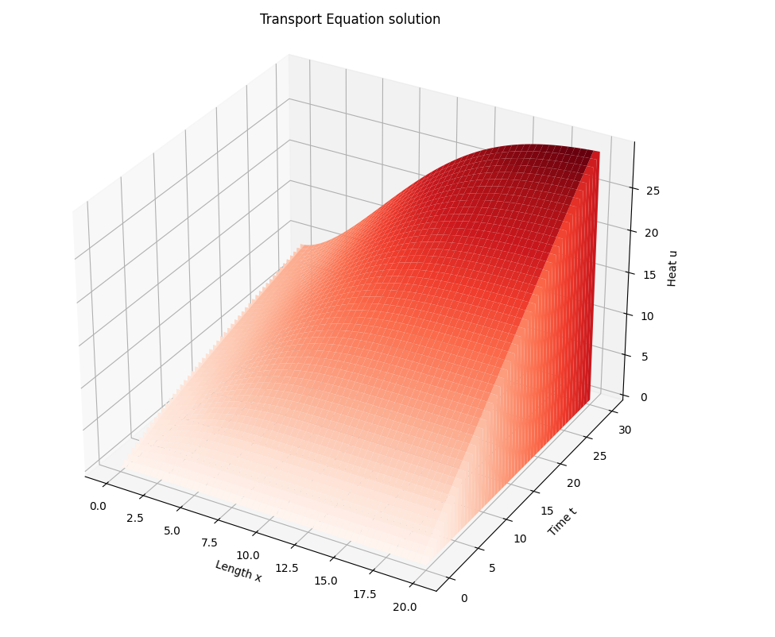
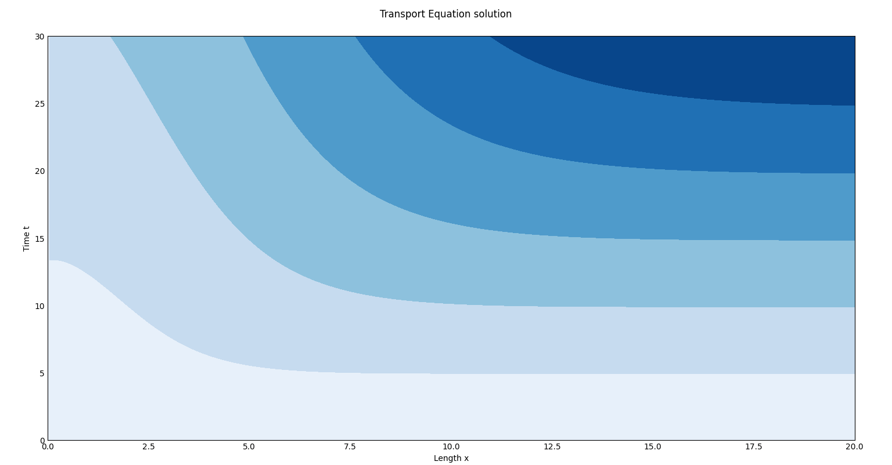
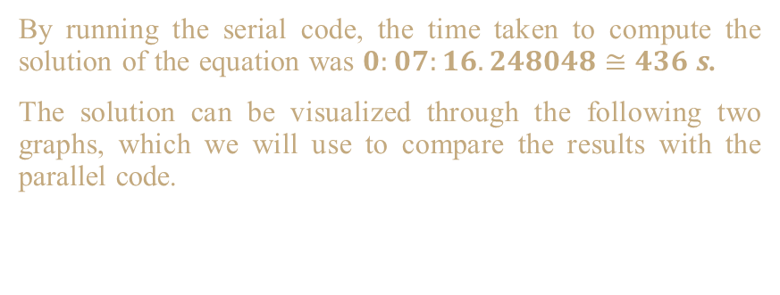
Serial Code
By running the serial code, the time taken to compute the solution of the equation was $0:07:16.248048≅436 s$.
The solution can be visualized through the following two graphs, which we will use to compare the results with the parallel code.
Transport Equation Parallelization – Graphical visualization
Levels visualization of solution
3D visualization of solution

Slide 11
Parallel Code

Slide 12
Parallel Code
The parallel code was constructed using the Message Passing model in which a set of tasks utilize their local memory during computation.
Tasks exchange data through communications by sending and receiving messages.
For the implementation of the parallel code, the mpi4py library was used.
The SPMD (Single Program Multiple Data) program has been constructed: all tasks execute their copy of the program simultaneously, working on their respective portions and processing different data.
DOMAIN DECOMPOSITION
Each parallel task works on a portion of the data which was decomposed in the figure.
Task 0
Task 1
Task 2
Task 3
Task 4
Sample of domain decomposition
Transport Equation Parallelization – Theoretical description

Slide 13
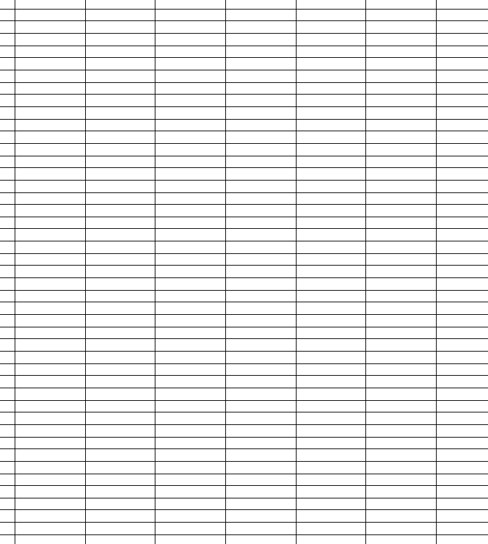
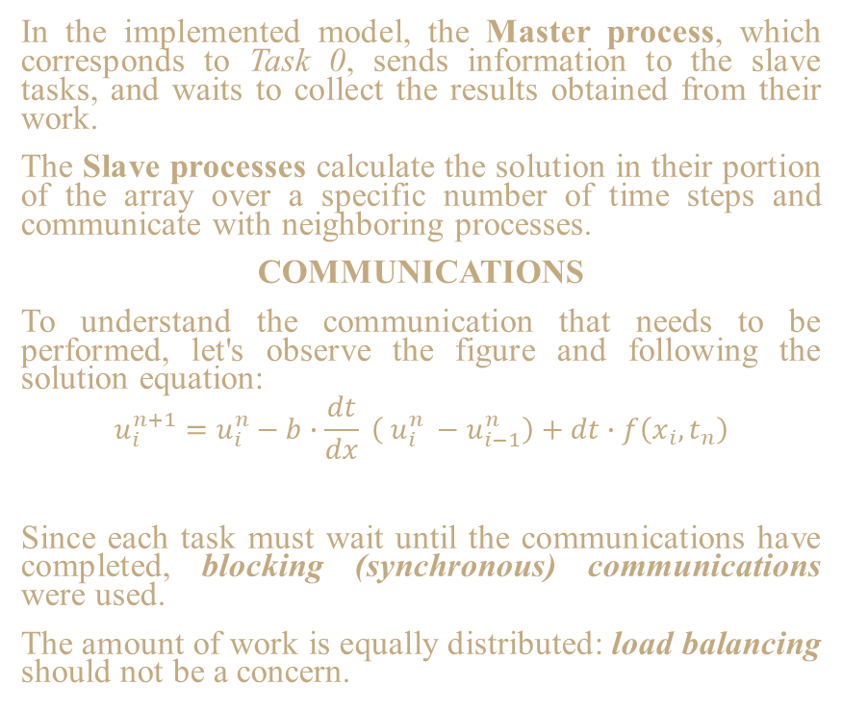
Parallel Code
Task_id
Task_id +1
In the implemented model, the Master process, which corresponds to Task 0, sends information to the slave tasks, and waits to collect the results obtained from their work.
The Slave processes calculate the solution in their portion of the array over a specific number of time steps and communicate with neighboring processes.
COMMUNICATIONS
To understand the communication that needs to be performed, let's observe the figure and following the solution equation:
$$u_{i}^{n+1}=u_{i}^{n}−b∙\frac{dt}{dx} \left( u_{i}^{n} −u_{i−1}^{n}\right)+dt∙f\left(x_{i}, t_{n}\right)$$
Since each task must wait until the communications have completed, blocking (synchronous) communications were used.
The amount of work is equally distributed: load balancing should not be a concern.
$$u_{i−1}^{n}$$
$$u_{i}^{n}$$
$$u_{i}^{n+1}$$
Transport Equation Parallelization – Theoretical description
Zoomed visualization of communication process between neighbours

Slide 14
Parallel Code
import numpy as np
import matplotlib.pyplot as plt
from mpi4py import MPI
from matplotlib import cm
# ---
# Defining a Heat Function that represents the term function
def heat_function( space : np.ndarray,
time : np.ndarray ) -> np.ndarray:
'''
Using a fundamental solution of the heat equation.
'''
return ((np.pi*4*time)**(-0.5/2)) ** np.exp((-space**2)/(4*time))
if __name__ == "__main__":
# Defining variables of the equation
L = int(20) # Lenght of the rod - [0,L] x-domain
T = int(30) # Time interval - [0,T] t-domain
N_x = int(160000) # Points' number of x-domain
N_t = int(1000) # Points' number of t-domain
b = float(0.0030) # Speed of transport
# Spatial and temporal spacing
dx = L / (N_x - 1)
dt = T / (N_t - 1)
''' Initialization MPI '''
array_size = N_x
master = 0
# Checking if MPI is already initialized
if not MPI.Is_initialized():
MPI.Init()
comm = MPI.COMM_WORLD
num_tasks = comm.Get_size()
task_id = comm.Get_rank()
print(f"MPI Task {task_id} has started...")
slaves = num_tasks - 1
chuncksize = int(array_size / slaves)
tag1 = 1 # Tag used to send the offset values of each task
tag2 = 2 # Tag used to send the decomposition of the array + neighbours
tag3 = 3 # Tag used to send message between tasks
Transport Equation Parallelization – Code visualization

Slide 15
Parallel Code
# ---
# MASTER CODE - domain's decomposition and distribution of work to processes
if task_id == master:
print("***** PARALLEL TRANSPORT EQUATION *****")
# Checking if the slaves is a divider of the array_size - quit if not
if array_size % slaves != 0:
print(f"Quitting. Number of MPI slaves must be a multiple of {array_size}")
comm.Abort(0)
print(f"Starting parallelization with {slaves} tasks.")
# Initializing bidimensional array containing the respective values of u
# Inizializing the space and time vectors - creates two vectors
# containing the number desidered of values in a given interval
x = np.linspace(0, L, N_x)
t = np.linspace(0, T, N_t)
# Creation of bidimensional array containing the information about
# the quantity u - initialized at 0
u = np.zeros( (N_t, N_x), dtype=np.float64, order='C' )
# Inserting the initial condition - Cauchy condition
# At time 0, the rod is completely cold
u[0, :] = 0
# Inserting boundary conditions - Dirichlet conditions
# The ends of the rod are at a constant temperature: cold
u[:, 0] = 0
u[:, N_x-1] = 0
print("Array initialized...")
start_time = MPI.Wtime()
# Sending each task its portion of the array
offset = 0
for id in range(1, slaves+1):
# Telling each slaves who its neighours are - communication needed
# Inserting value -1 if there is no neighbour
# Left-task - first task does not have a left-neighbour
left = np.array([id - 1], dtype=np.int64, order='C') if id != 1
else np.array([-1], dtype=np.int64, order='C')
# Right-task - last task does not have a right-neighbour
right = np.array([id + 1], dtype=np.int64, order='C') if id != slaves
else np.array([-1], dtype=np.int64, order='C')
offset = np.array([offset], dtype=np.int64, order='C')
# Sending startup information to each slave
comm.Send(offset, dest=id, tag=tag1)
comm.Send(left, dest=id, tag=tag2)
comm.Send(right, dest=id, tag=tag2)
offset = offset.item()
for row in range(1, N_t):
row_to_send = u[row, offset:offset+chuncksize]
comm.Send(row_to_send, dest=id, tag=tag2)
print(f"Sent to task {id} offset {offset}")
print(f"left={left} - right={right}")
offset += chuncksize
Transport Equation Parallelization – Code visualization

Slide 16
Parallel Code
# Waiting to receive results from each task
for id in range(1, slaves+1):
offset = np.array([0], dtype=np.int64, order='C')
comm.Recv(offset, source=id, tag=tag1)
offset = offset.item()
for row in range(1, N_t):
row_recv_slave = np.array([0]*chuncksize, dtype=np.float64, order='C')
comm.Recv(row_recv_slave, source=id, tag=tag2)
u[row, offset:offset+chuncksize] = row_recv_slave
# Final outputs and visualization of results
print("Parallelization done and generating rappresentations...")
end_time = MPI.Wtime()
elapsed_time = end_time - start_time
print(elapsed_time)
visualizations_u(x,t,u)
if not MPI.Is_finalized():
MPI.Finalize()
# END MASTER CODE
# SLAVES CODE
if task_id != master:
print(f"Task {task_id} working...")
# Receiving information sent by master
offset = np.array([0], dtype=np.int64, order='C')
left = np.array([0], dtype=np.int64, order='C')
right = np.array([0], dtype=np.int64, order='C')
comm.Recv(offset, source=master, tag=tag1)
comm.Recv(left, source=master, tag=tag2)
comm.Recv(right, source=master, tag=tag2)
print(f"Received: {offset} - {left} - {right}")
# Extracting the numeric value
offset = offset.item()
left = left.item()
right = right.item()
# Initializing everything - including borders conditions
u = np.zeros( (N_t, N_x), dtype=np.float64, order='C' )
# Receiving portion of the domain
for row in range(1, N_t):
row_recv = np.array([0]*chuncksize, dtype=np.float64, order='C')
comm.Recv(row_recv, source=master, tag=tag2)
u[row, offset:offset+chuncksize] = row_recv
print("Received rows...")
Transport Equation Parallelization – Code visualization

Slide 17
Parallel Code
# Checking if task operates over borders elements.
# If so, changing the variables: first and last columns must be
# equal to zero. It can cause raised value due to the calculation
# of solution.
start = offset if offset != 0 else 1
end = min( offset+chuncksize, N_x ) - 1
print(f"task={task_id} - start={start} - end={end}")
x = np.linspace(0, L, N_x)
t = np.linspace(0, T, N_t)
# Begin doing work. Must communicate border information with neighbours.
# If it is first or last task, it has only one neighbour.
print(f"Task {task_id} received work. Begin work...")
for n in range(1, N_t-1):
# Sending information to neighbours - checking if any
if right != -1:
el_send = u[n, end]
comm.Send(el_send, dest=right, tag=tag3)
if left != -1:
el_recv = np.array([0], dtype=np.float64, order='C')
comm.Recv(el_recv, source=left, tag=tag3)
u[n, start-1] = el_recv
for i in range(start, end+1):
u[n+1, i] = u[n, i] \
- b * (dt/dx) * (u[n, i]- u[n, (i-1) % N_x]) \
+ dt * heat_function( x[i], t[n] )
# Sendig to master the work done
offset = np.array([offset], dtype=np.int64, order='C')
comm.Send(offset, dest=master, tag=tag1)
for row in range(1, N_t):
row_to_master = u[row, start:end+1]
comm.Send(row_to_master, dest=master, tag=tag2)
if not MPI.Is_finalized():
MPI.Finalize()
# END SLAVES' WORK
Transport Equation Parallelization – Code visualization

Slide 18
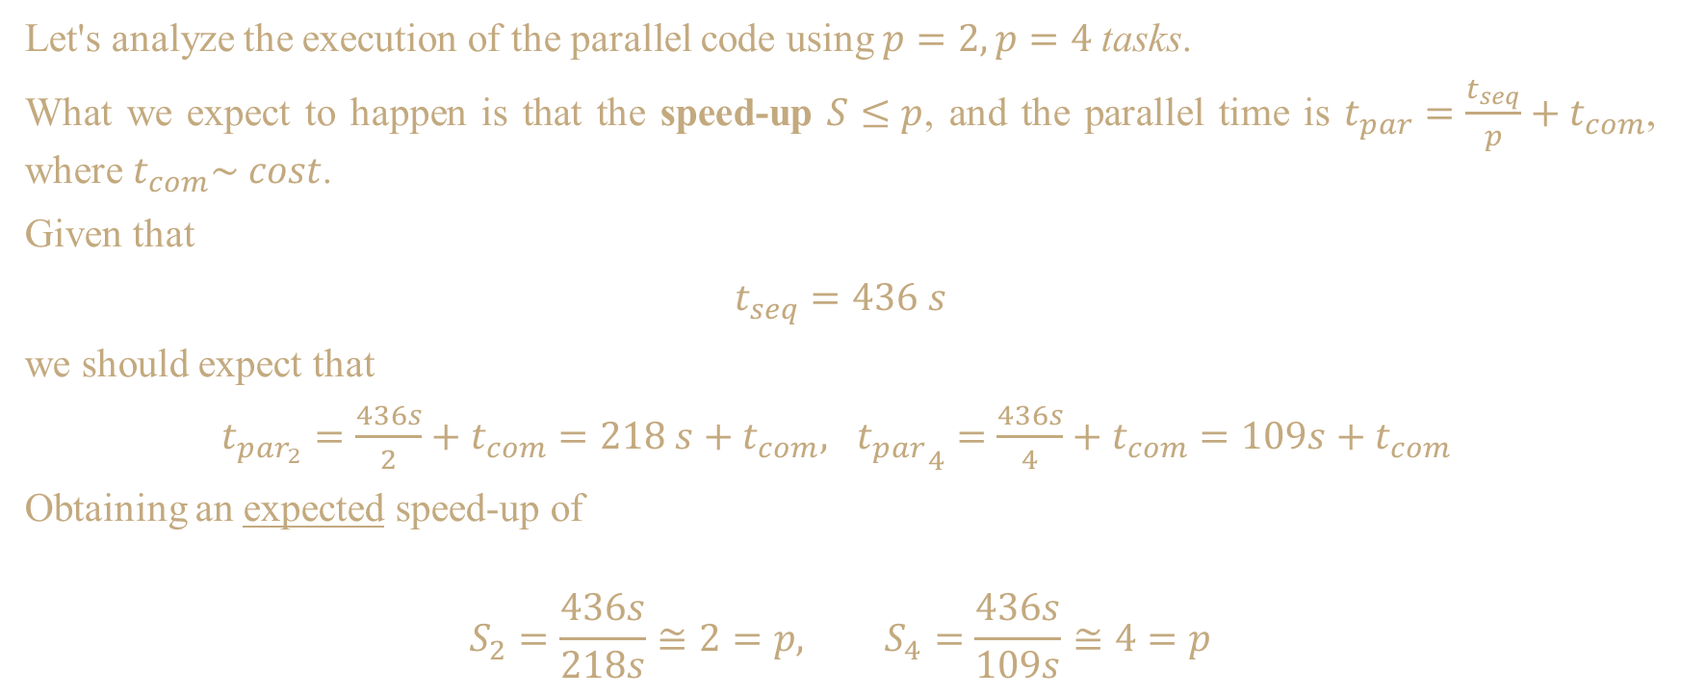
Parallel Code
Let's analyze the execution of the parallel code using $p=2, p=4$tasks.
What we expect to happen is that the speed-up $S≤p$, and the parallel time is $t_{par}=\frac{t_{seq}}{p}+t_{com}$, where $t_{com}\sim cost$.
Given that
$t_{seq}=436 s$
we should expect that
$t_{par_{2}}=\frac{436s}{2}+t_{com}=218 s+t_{com}, {t_{par}}_{4}=\frac{436s}{4}+t_{com}=109s+t_{com}$
Obtaining an expected speed-up of
$$S_{2}=\frac{436s}{218s}≅2=p, S_{4}=\frac{436s}{109s}≅4=p$$
Transport Equation Parallelization – Results analysis
Notes:
This represents a theoretical estimate of the parallel time if the work is evenly distributed among processes without significant overhead. Keep in mind that, in practice, factors such as communication between processes and load balancing can impact the actual time.

Slide 19
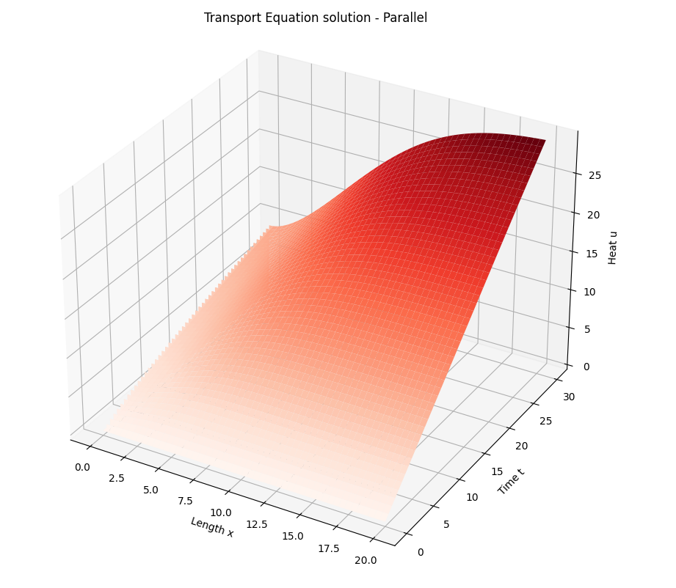
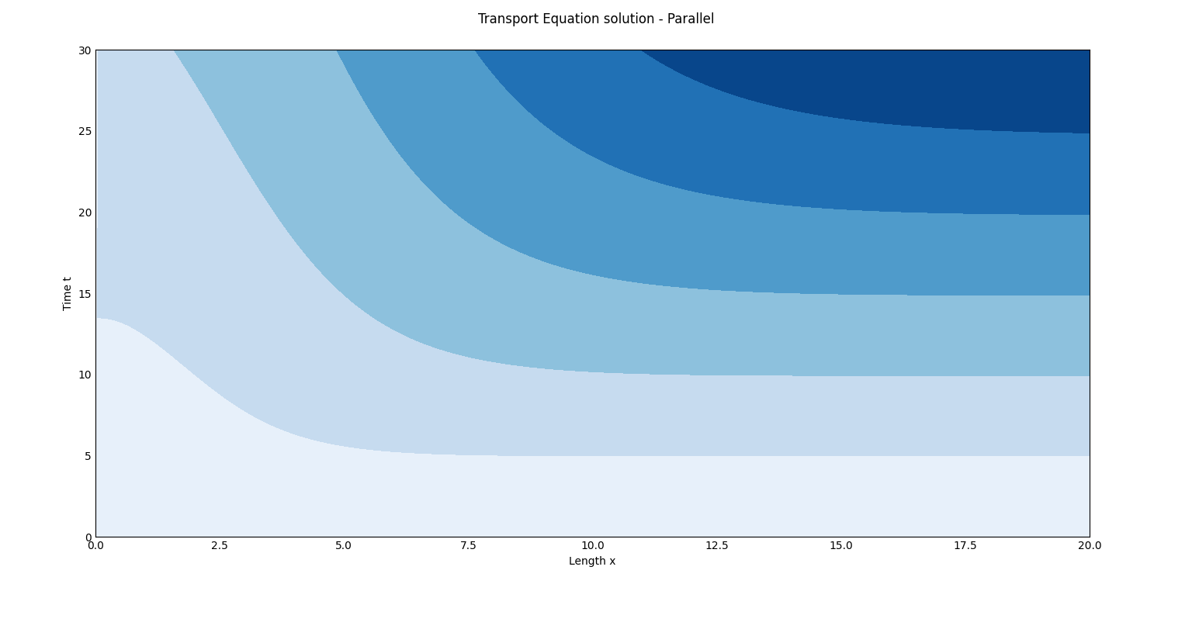
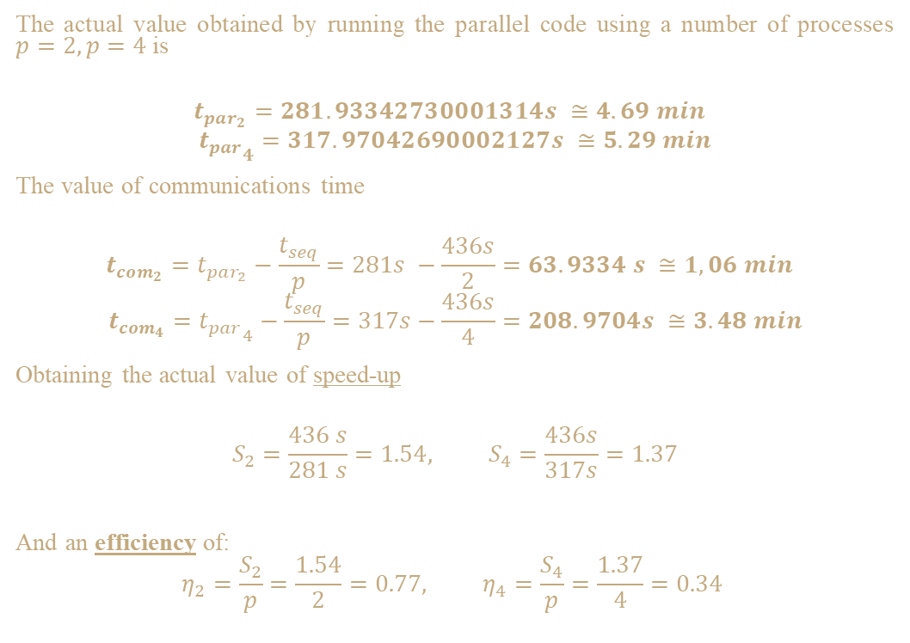
Parallel Code
The actual value obtained by running the parallel code using a number of processes $p=2, p=4$ is
$$t_{par_{2}}=281.93342730001314s ≅4.69 min$$
$${t_{par}}_{4}=317.97042690002127s ≅5.29 min$$
The value of communications time
$$t_{com_{2}}=t_{par_{2}}−\frac{t_{seq}}{p}=281s −\frac{436s}{2}=63.9334 s ≅1,06 min$$
$$t_{com_{4}}={t_{par}}_{4}−\frac{t_{seq}}{p}=317s−\frac{436s}{4}=208.9704s ≅3.48 min$$
Obtaining the actual value of speed-up
$$S_{2}=\frac{436 s}{281 s}=1.54, S_{4}=\frac{436s}{317s}=1.37$$
And an efficiency of:
$$η_{2}=\frac{S_{2}}{p}=\frac{1.54}{2}=0.77, η_{4}=\frac{S_{4}}{p}=\frac{1.37}{4}=0.34$$
Transport Equation Parallelization – Results analysis

Slide 20
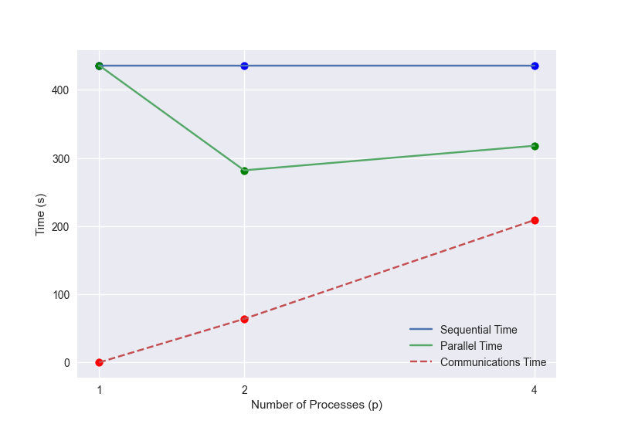
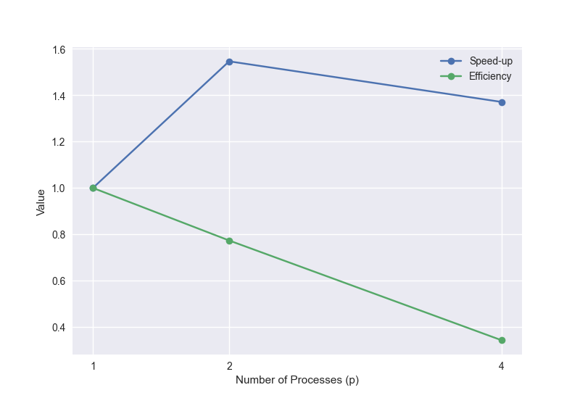
Parallel Code
Transport Equation Parallelization – Results analysis

Slide 21
Thank you

