Slide 1
Interpretation of AMR reports: case studies
Case study 1: Identifying linezolid-resistance point mutations from Enterococcus faecium genomes
Case study 2: Effect of duplicated and truncated AMR genes on genotypic AMR determination
Case study 3. Resolving AMR phenotype-genotype discrepancies from Salmonella enterica genomes

Slide 2
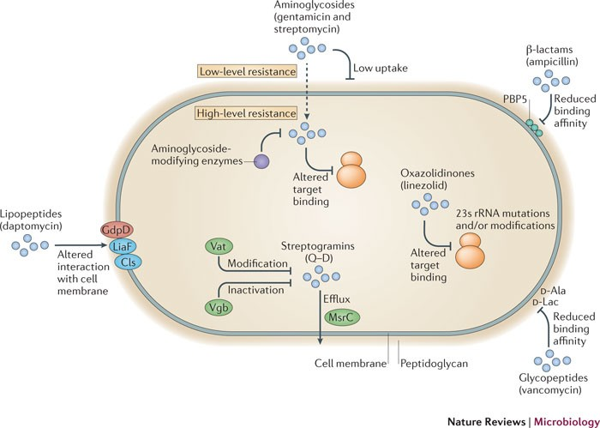
Case study 1: Identifying linezolid-resistance point mutations from Enterococcus faecium genomes
Source: Arias, C., Murray, B. The rise of the Enterococcus: beyond vancomycin resistance. Nat Rev Microbiol 10, 266–278 (2012). https://doi.org/10.1038/nrmicro2761
Notes:
Minor improvements: add better BMD image, add copyright to images

Slide 3
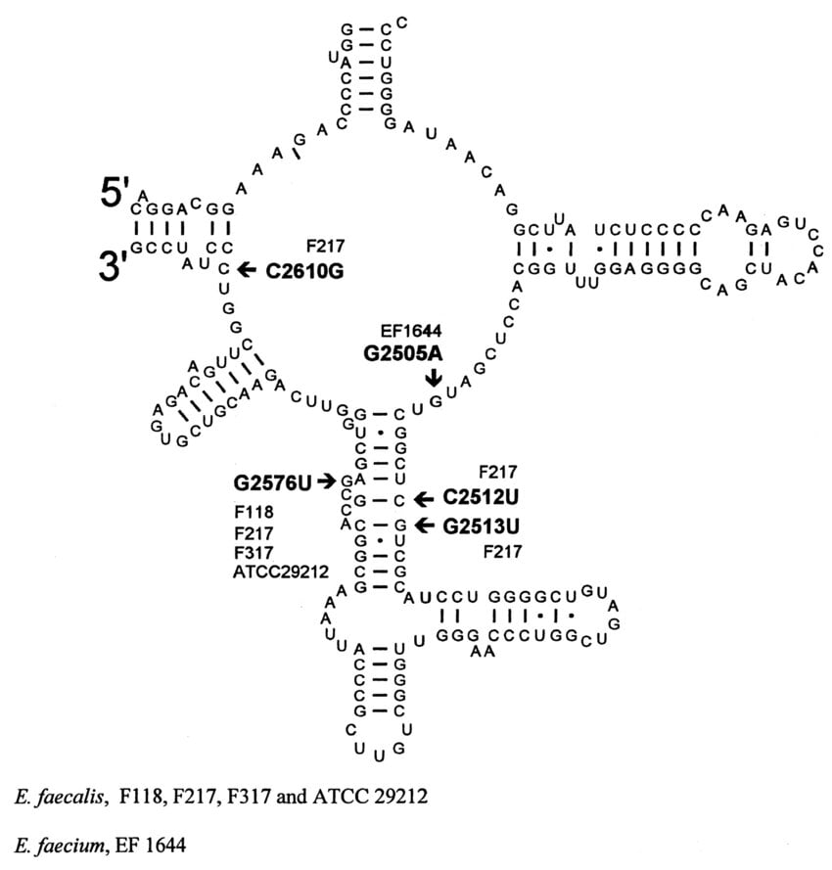
Case study 1: Identifying linezolid-resistance point mutations from Enterococcus faecium genomes
Enterococcus faecium typically 6 copies of the 23S rRNA gene.
23S rRNA mutations (e.g., G2576T and linezolid resistance) may occur in only a subset of these chromosomal 23S rRNA copies.
Source: Arias, C., Murray, B. The rise of the Enterococcus: beyond vancomycin resistance. Nat Rev Microbiol 10, 266–278 (2012). https://doi.org/10.1038/nrmicro2761
Notes:
Minor improvements: add better BMD image, add copyright to images

Slide 4
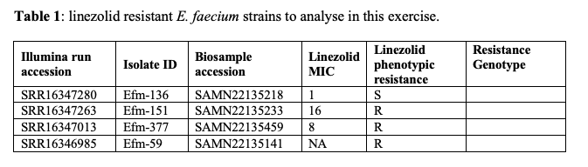
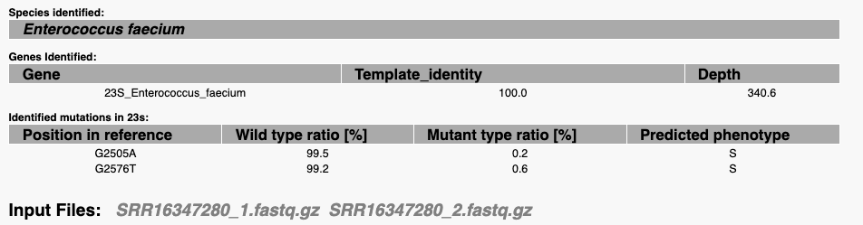
Case study 1: Identifying linezolid-resistance point mutations from Enterococcus faecium genomes
Notes:
Minor improvements: add better BMD image, add copyright to images

Slide 5
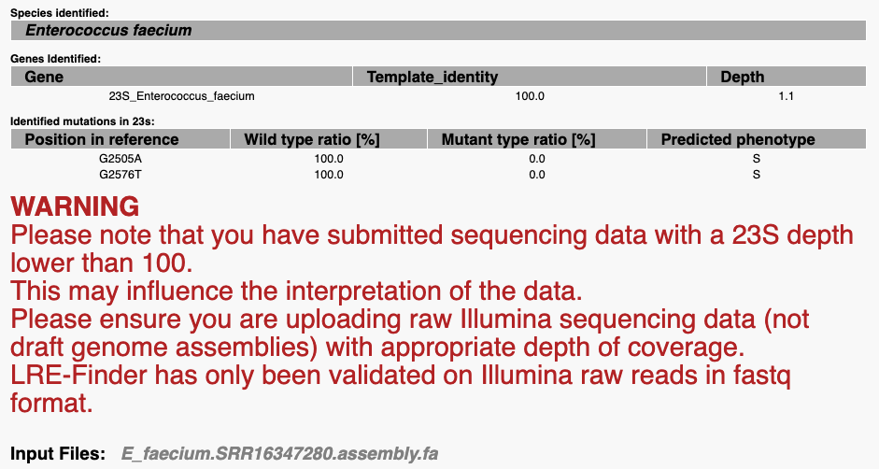
Case study 1: Identifying linezolid-resistance point mutations from Enterococcus faecium genomes
Notes:
Minor improvements: add better BMD image, add copyright to images

Slide 6

Case study 1: Identifying linezolid-resistance point mutations from Enterococcus faecium genomes
Notes:
Minor improvements: add better BMD image, add copyright to images

Slide 7
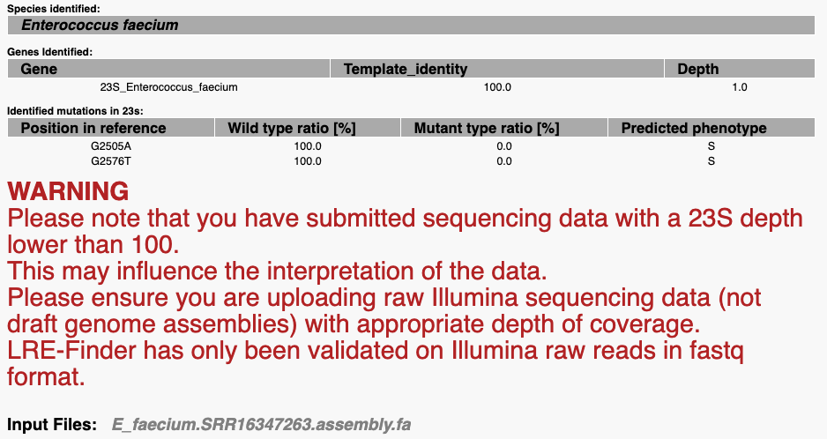
Case study 1: Identifying linezolid-resistance point mutations from Enterococcus faecium genomes
Notes:
Minor improvements: add better BMD image, add copyright to images

Slide 8

Case study 1: Identifying linezolid-resistance point mutations from Enterococcus faecium genomes
Notes:
Minor improvements: add better BMD image, add copyright to images

Slide 9
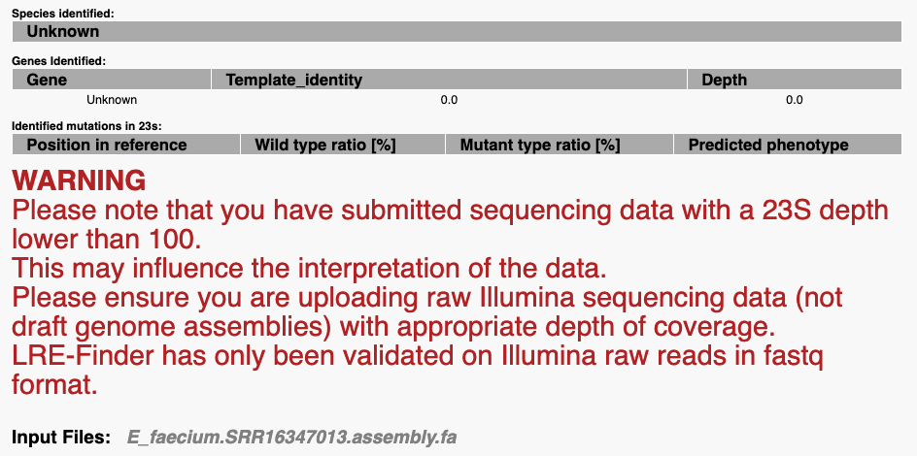
Case study 1: Identifying linezolid-resistance point mutations from Enterococcus faecium genomes
Notes:
Minor improvements: add better BMD image, add copyright to images

Slide 10

Case study 1: Identifying linezolid-resistance point mutations from Enterococcus faecium genomes
Notes:
Minor improvements: add better BMD image, add copyright to images

Slide 11

Case study 1: Identifying linezolid-resistance point mutations from Enterococcus faecium genomes
Notes:
Minor improvements: add better BMD image, add copyright to images

Slide 12
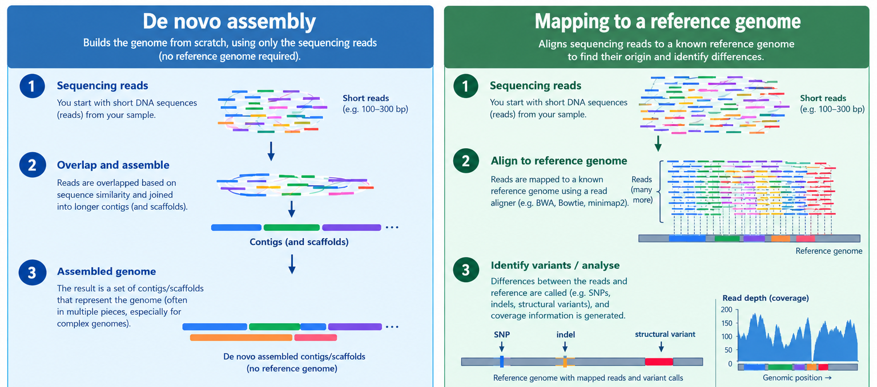
Case study 1: Identifying linezolid-resistance point mutations from Enterococcus faecium genomes
Notes:
Minor improvements: add better BMD image, add copyright to images

Slide 13
Case study 2: Effect of duplicated and truncated AMR genes on genotypic AMR determination
Lab number | Tetracycline Phenotype | AMRFinder detection (Illumina assemblies) – default settings
IVR212 | R | No tet gene found
VREN1631 | R | No tet gene found
VREN0576 | R | No tet gene found
→ False negatives
→ Question Has AMRFinder identified any tet genes that could explain phenotypic tetracycline resistance of these strains?
Source: García-González et al. 2026. BioRxiv. https://doi.org/10.64898/2026.06.08.729070
Notes:
Minor improvements: add better BMD image, add copyright to images

Slide 14
Case study 2: Effect of duplicated and truncated AMR genes on genotypic AMR determination
Lab number | Tetracycline Phenotype | AMRFinder detection (Hybrid assemblies)
IVR212 | R | 2 tet(M) copies (100.00%, 58.69%)
VREN1631 | R | 2 tet(M) copies (100.00%, 58.69%)
VREN0576 | R | 2 tet(M) copies (100.00%, 58.69%)
→ Question Has AMRFinder identified any tet genes in the hybrid assemblies? How many copies and in what coverage?
Source: García-González et al. 2026. BioRxiv. https://doi.org/10.64898/2026.06.08.729070
Notes:
Minor improvements: add better BMD image, add copyright to images

Slide 15
Case study 2: Effect of duplicated and truncated AMR genes on genotypic AMR determination
Lab number | Tetracycline Phenotype | AMRFinder detection (Illumina assemblies) | AMRFinder detection (Hybrid assemblies)
IVR212 | R | 4 tet(M) copies/contigs (31.92%, 31.92%, 41.78%, 32.39%) | 2 tet(M) copies (100.00%, 58.69%)
VREN1631 | R | 2 tet(M) copies/contigs (41.78%, 32.39%) | 2 tet(M) copies (100.00%, 58.69%)
VREN0576 | R | 4 tet(M) copies/contigs (30.20%, 30.20%, 41.78%, 32.39%) | 2 tet(M) copies (100.00%, 58.69%)
→ Question Based on the results of AMRFinder from Illumina and hybrid assemblies, which results would you trust more? what could explain the lack of full tet(M) detection in the Illumina assemblies?
Source: García-González et al. 2026. BioRxiv. https://doi.org/10.64898/2026.06.08.729070
Notes:
Minor improvements: add better BMD image, add copyright to images

Slide 16
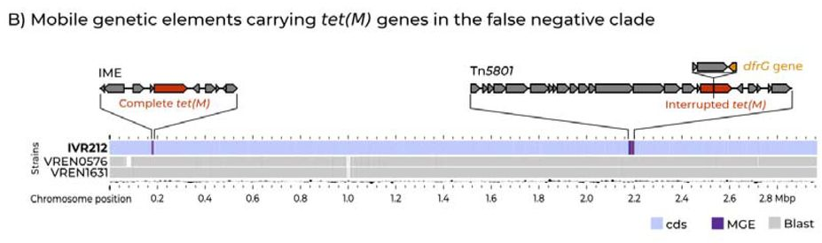
Case study 2: Effect of duplicated and truncated AMR genes on genotypic AMR determination
Source: García-González et al. 2026. BioRxiv. https://doi.org/10.64898/2026.06.08.729070
Notes:
Minor improvements: add better BMD image, add copyright to images

Slide 17
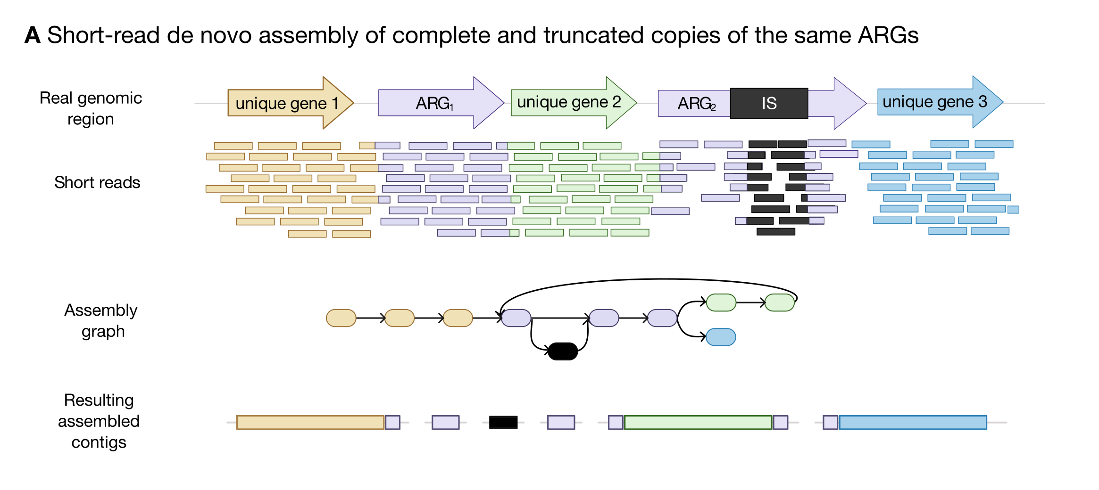
Case study 2: Effect of duplicated and truncated AMR genes on genotypic AMR determination
Source: Diricks et al. 2026. Sources of Genotype–Phenotype Discrepancies when Predicting Antibiotic Resistance from Bacterial Genome Sequences. Under review.
Notes:
Minor improvements: add better BMD image, add copyright to images

Slide 18
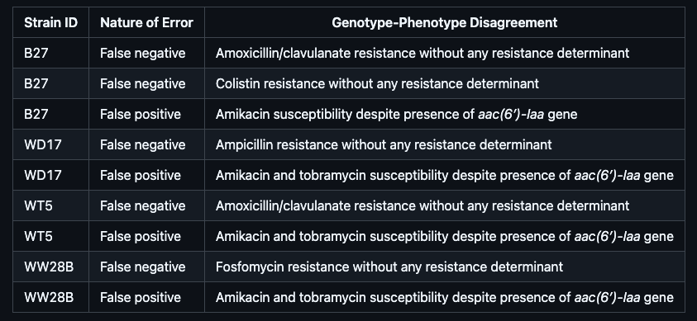
Case study 3: Resolving AMR phenotype-genotype discrepancies from Salmonella enterica genomes
Notes:
Minor improvements: add better BMD image, add copyright to images

Slide 19
Case study 3: Resolving AMR phenotype-genotype discrepancies from Salmonella enterica genomes
→ source of false-positives: amikacin and tobramycin susceptibility despite presence of aac(6′)-Iaa gene
Notes:
Minor improvements: add better BMD image, add copyright to images

Slide 20
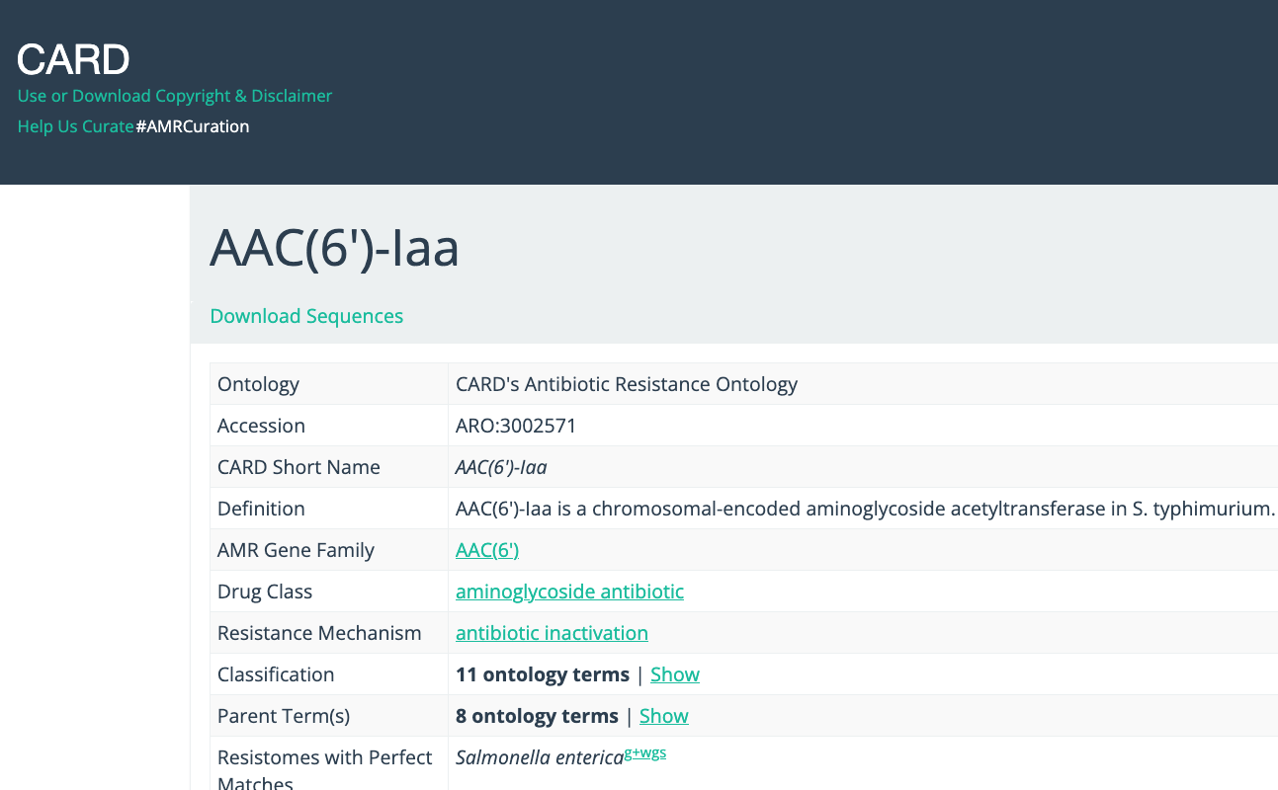
Case study 3: Resolving AMR phenotype-genotype discrepancies from Salmonella enterica genomes
→ source of false-positives: amikacin and tobramycin susceptibility despite presence of aac(6′)-Iaa gene
Notes:
Minor improvements: add better BMD image, add copyright to images

Slide 21
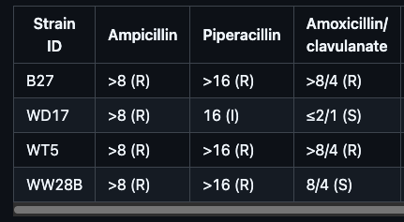
Case study 3: Resolving AMR phenotype-genotype discrepancies from Salmonella enterica genomes
→ Question All four Salmonella strains are resistant to ampicillin according to phenotypic testing. Can you identify which resistance determinant(s) are responsible for phenotypic resistance to ampicillin in each strain? Do all four strains carry at least one resistance determinant that could explain ampicillin resistance?
Notes:
Minor improvements: add better BMD image, add copyright to images

Slide 22
Case study 3: Resolving AMR phenotype-genotype discrepancies from Salmonella enterica genomes
→ blaTEM-1
→ ???
→ blaCARB-2
→ blaTEM-1
→ Question All four Salmonella strains are resistant to ampicillin according to phenotypic testing. Can you identify which resistance determinant(s) are responsible for phenotypic resistance to ampicillin in each strain? Do all four strains carry at least one resistance determinant that could explain ampicillin resistance?
Notes:
Minor improvements: add better BMD image, add copyright to images

Slide 23
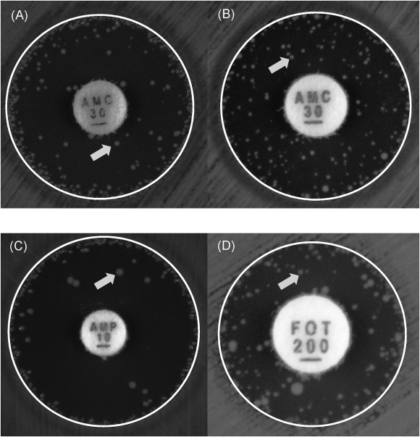
Case study 3: Resolving AMR phenotype-genotype discrepancies from Salmonella enterica genomes
WD17
→ blaTEM-1
→ ???
→ blaCARB-2
→ blaTEM-1
→ Question All four Salmonella strains are resistant to ampicillin according to phenotypic testing. Can you identify which resistance determinant(s) are responsible for phenotypic resistance to ampicillin in each strain? Do all four strains carry at least one resistance determinant that could explain ampicillin resistance?
Notes:
Minor improvements: add better BMD image, add copyright to images

Slide 24
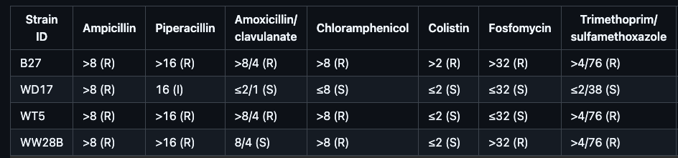
Case study 3: Resolving AMR phenotype-genotype discrepancies from Salmonella enterica genomes
→ Question Three Salmonella strains are resistant to trimethoprim/sulfamethoxazole. Can you identify the AMR genes responsible for resistance to this antibiotic combination?
Notes:
Minor improvements: add better BMD image, add copyright to images

Slide 25
Case study 3: Resolving AMR phenotype-genotype discrepancies from Salmonella enterica genomes
dfrA genes (trimethoprim-resistant dihydrofolate reductase)
+
sul1 or sul3 (sulfonamide-resistant dihydropteroate synthase)
→ Question Three Salmonella strains are resistant to trimethoprim/sulfamethoxazole. Can you identify the AMR genes responsible for resistance to this antibiotic combination?
Notes:
Minor improvements: add better BMD image, add copyright to images

Slide 26
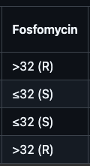
Case study 3: Resolving AMR phenotype-genotype discrepancies from Salmonella enterica genomes
→ Question Two Salmonella strains (B27 and WW28B) are resistant to fosfomycin. Can you identify the AMR gene(s) responsible for resistance to this antibiotic?
Notes:
Minor improvements: add better BMD image, add copyright to images

Slide 27
Case study 3: Resolving AMR phenotype-genotype discrepancies from Salmonella enterica genomes
→ fosA4 fosfomycin resistance glutathione transferase
→ ?
→ Question Two Salmonella strains (B27 and WW28B) are resistant to fosfomycin. Can you identify the AMR gene(s) responsible for resistance to this antibiotic?
Notes:
Minor improvements: add better BMD image, add copyright to images

Slide 28
Case study 3: Resolving AMR phenotype-genotype discrepancies from Salmonella enterica genomes
→ fosA4 fosfomycin resistance glutathione transferase
→ ?
→ Question Two Salmonella strains (B27 and WW28B) are resistant to fosfomycin. Can you identify the AMR gene(s) responsible for resistance to this antibiotic?
Notes:
Minor improvements: add better BMD image, add copyright to images

