Slide 1
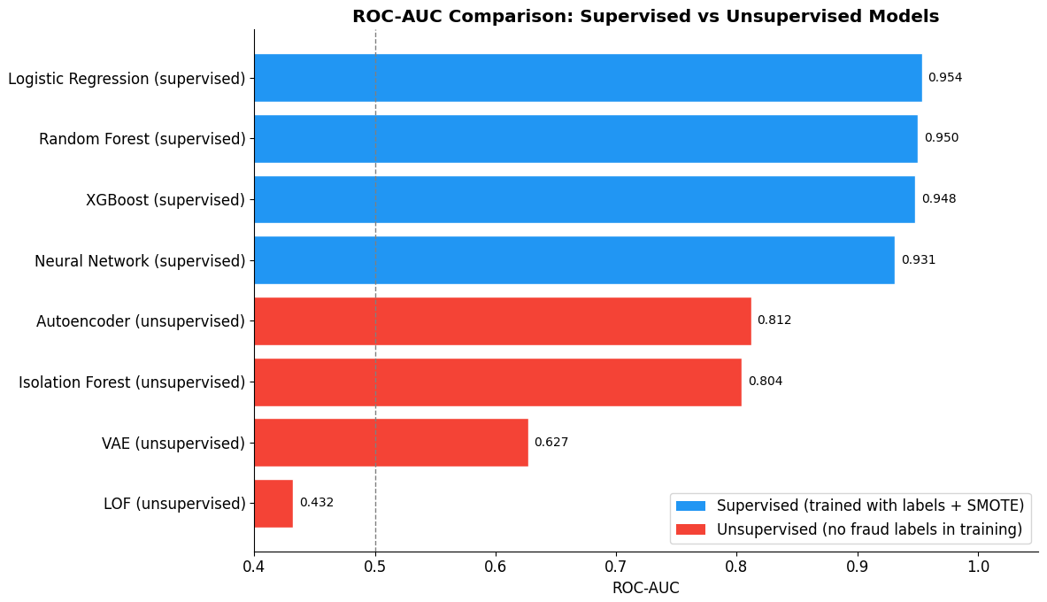
HUNTER COLLEGE
Comparing Anomaly Detection Methods
for Medicare Provider Fraud
STAT 790 — Final Project Presentation
Main thesis: use unsupervised methods to solve the cold start; use supervised models once labels accumulate.
Student: Francesco Pecora
Advisor: Dr. Iordan Slavov
Hunter College | STAT 790 | Francesco Pecora
1
Notes:
Open with the research question: how should a payer rank suspicious Medicare providers when confirmed fraud labels may or may not exist? The presentation follows the final report: first the data and why it is difficult, then the unsupervised cold-start setting, then the supervised setting, then the operational tradeoffs and financial implications. The headline is not that one model is universally best. It is that model choice depends on where the fraud unit is in its lifecycle and on the cost of investigations.

Slide 2
15-minute roadmap
The story moves from messy claims data to deployment decisions.
1
2
3
4
Data state
Unsupervised
Supervised
Decision layer
Claims, labels, imbalance, mixed features
Useful before confirmed fraud labels exist
Useful after investigations create labels
Investigation budget, precision, recall, ROI
Core comparison: same 30% test set, same provider-level features, same seed.
Hunter College | STAT 790 | Francesco Pecora
2
Notes:
Set expectations for the audience. I will spend the first few minutes on the dataset because the model results only make sense after understanding the data. Then I will separate the two practical scenarios: one where labels are not available, which is the unsupervised cold-start problem, and one where labels are available, which is the supervised setting. Finally, I translate performance into an investigation queue and financial impact.

Slide 3
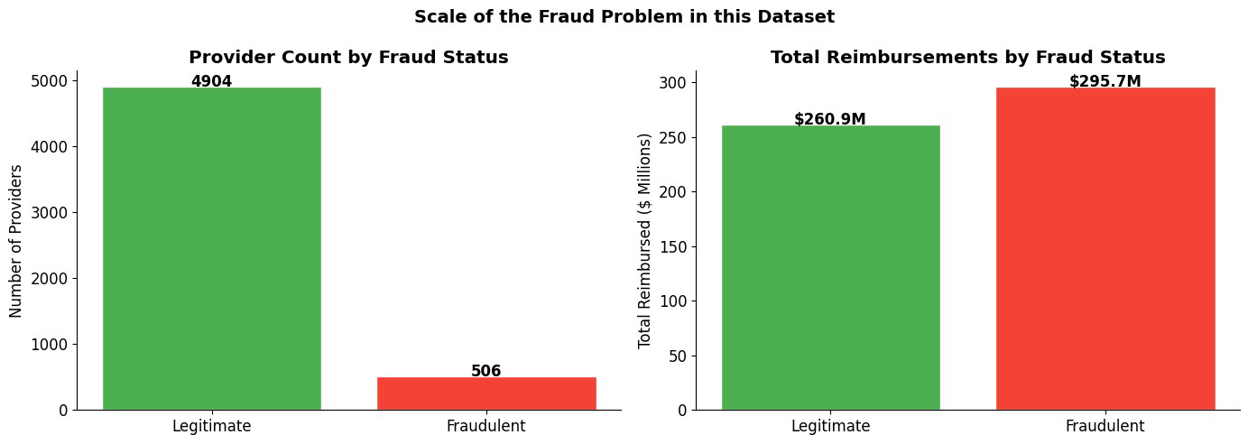
Problem scale: rare providers, large dollars
Fraud labels are rare at the provider level, but the dollars are concentrated.
558,211
5,410
combined inpatient + outpatient claims
providers modeled
9.4%
$295.7M
PotentialFraud provider rate
reimbursement tied to fraud-labeled providers
The label exists at the provider level, not at the individual claim level.
A claim-level model would be dominated by high-volume providers; the operational decision is who to investigate.
PotentialFraud is a screening label — the model ranks risk; humans still investigate.
Hunter College | STAT 790 | Francesco Pecora
3
Notes:
Explain the state of the data. The raw data is claims, but the decision unit is the provider. There are more than half a million claims, but 5,410 providers. Only 506 are labeled potentially fraudulent, so the positive class is rare. However, the reimbursement chart shows that those fraud-labeled providers account for a very large dollar amount. This is why the problem is not just classification accuracy; it is prioritizing limited investigative capacity toward high-impact providers.

Slide 4
Data assembly: from four tables to provider-level modeling
The raw claims data is joined and aggregated into 40 provider features.
Labels
Claims
Beneficiaries
Provider matrix
PotentialFraud
by Provider
Inpatient +
Outpatient
Demographics +
chronic flags
40 engineered
features
Object
Count / Value
Why it matters
Combined claims
558,211
Raw events after stacking inpatient/outpatient
Provider labels
5,410
Final unit of prediction
Fraud providers
506 (9.4%)
Rare positive class
Test set
1,623 providers
Same held-out comparison set
Test fraud count
152 providers
Small enough to need uncertainty estimates
Hunter College | STAT 790 | Francesco Pecora
4
Notes:
Walk through how the data becomes model-ready. I stack the inpatient and outpatient claims into a single claim table, join beneficiary information, and attach provider-level labels. Since the label is at the provider level, I aggregate from claims to providers. The final matrix has 5,410 rows and 40 features. The same stratified 70/30 split is used everywhere, so all model comparisons are apples-to-apples.

Slide 5
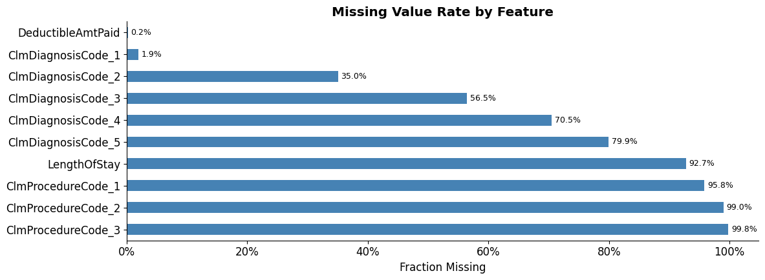
Why the data is hard: mixed, sparse, and high-cardinality
Raw diagnosis/procedure codes cannot be treated as ordinary continuous variables.
Field
Unique values
Modeling issue
Primary diagnosis
10,450
Sparse if one-hot encoded
Secondary diagnosis
5,300
Adds mixed-data dimensionality
Procedure code 1
1,117
Large and heavily missing
State / County
52 / 314
Geography proxies practice mix
Key modeling decision: compress raw codes into provider behavior summaries, not thousands of sparse indicators.
Procedure-code missingness is structural: many claims simply do not have procedure slots filled.
Classical distance and local-density methods struggle when scale, counts, proportions, and sparse code behavior are mixed.
Provider-level aggregation turns messy categorical fields into interpretable signals: diversity, concentration, entropy, and volatility.
Hunter College | STAT 790 | Francesco Pecora
5
Notes:
This slide explains the data analysis piece that motivates the methods. The primary diagnosis field alone has 10,450 unique values. If we one-hot encode all of these raw fields, the feature space becomes very sparse. At the same time, missingness in procedure fields is not just bad data; it reflects the structure of claims. The solution was to summarize behavior at the provider level rather than directly model every raw code.

Slide 6
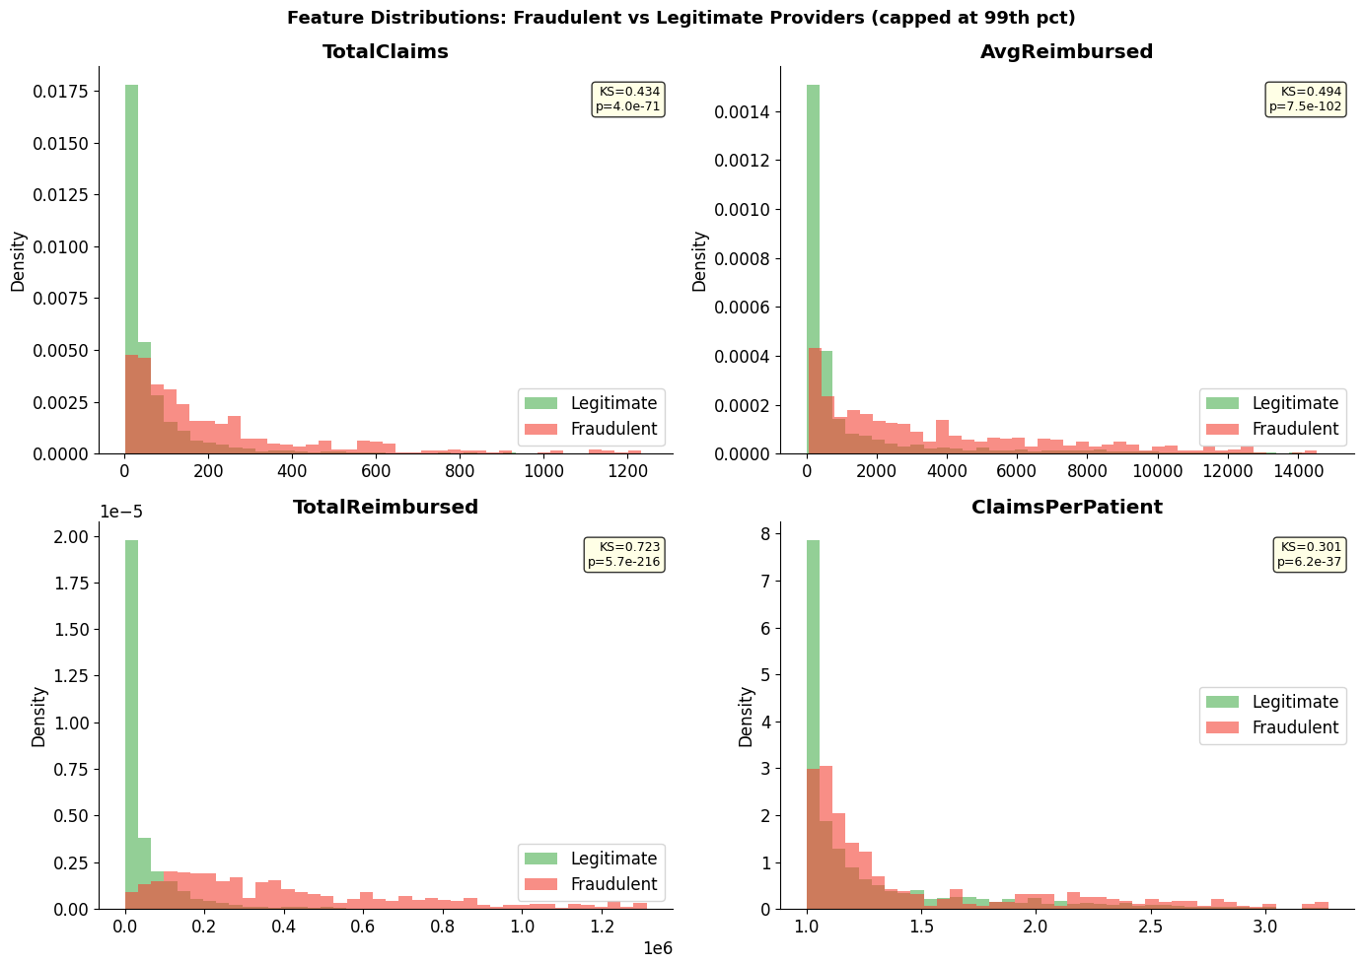
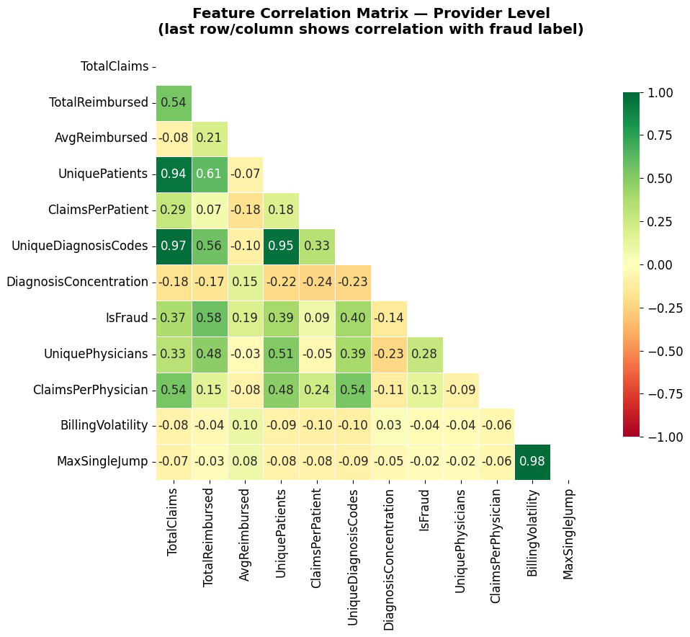
EDA: fraud-labeled providers separate on volume, dollars, and diversity
Fraud is not only rare — it is behaviorally different in the provider aggregates.
Median legitimate provider: 27 claims and $15,055 reimbursement.
Median fraud-labeled provider: 155.5 claims and $373,450 reimbursement.
Top fraud-correlated features: TotalReimbursed, UniqueDiagnosisCodes, UniquePatients, TotalClaims.
Hunter College | STAT 790 | Francesco Pecora
6
Notes:
Use this slide to make the data intuitive. The distributions are skewed, but fraudulent providers have heavier tails in claims, reimbursement, and claims per patient. The heatmap shows that fraud is correlated with total reimbursement, number of diagnosis codes, patient count, and total claims. This does not prove fraud. A large provider can be legitimate. But it provides enough ranking signal for a model to exploit.

Slide 7
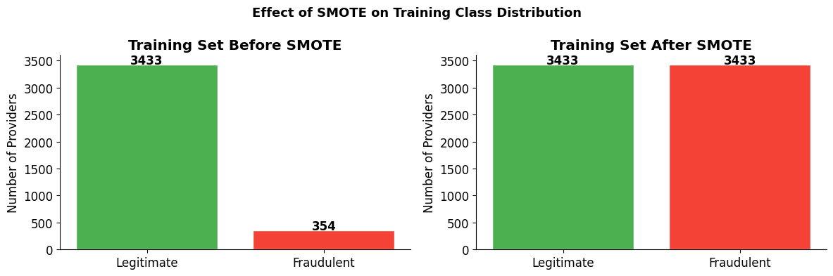
Feature engineering + evaluation design
The same provider features and same test set make the comparison fair.
Billing behavior
Diagnosis patterns
Physician network
claims, reimbursement, deductibles, inpatient share
unique codes, concentration, entropy
unique physicians, claims per physician
Patient mix
Temporal volatility
age, gender, renal, chronic conditions
months active, jumps, billing volatility
Train/test discipline: split first, fit preprocessing on train, keep the 30% test set untouched.
Unsupervised: labels used only for evaluation, not training.
Supervised: SMOTE applied only to the training set.
Metrics: ROC-AUC, PR-AUC, precision/recall/F1, bootstrap CIs, and ROI.
Hunter College | STAT 790 | Francesco Pecora
7
Notes:
Emphasize two things. First, the feature engineering is intentionally behavioral rather than purely mechanical. The 40 features capture billing scale, diagnosis behavior, physician networks, patient mix, and temporal changes. Second, the evaluation design is disciplined. The split happens first and the test set is never touched by SMOTE or tuning. That is what makes the supervised versus unsupervised comparison meaningful.

Slide 8
Scenario 1: unsupervised models solve the cold start
Use these before confirmed fraud labels exist.
Operational condition: no reliable adjudicated labels yet, but you need an investigation queue now.
Model
How it scores risk
Best use condition
Isolation Forest
How quickly random splits isolate a provider
Fast, simple cold-start baseline; threshold can be theory-based
Autoencoder
Reconstruction error from learned normal behavior
Best cold-start ranker when non-linear feature interactions matter
VAE
Reconstruction + probabilistic latent regularization
Less effective here; useful if generative latent structure matters
LOF
Sparse local neighborhoods
Not suitable for this mixed provider feature space
Unsupervised models do not prove fraud; they produce a ranked list for review.
Threshold choice becomes operational: theoretical cutoff vs top-k% investigation budget.
The value is speed: useful on day one, before a fraud unit has built a labeled training set.
Hunter College | STAT 790 | Francesco Pecora
8
Notes:
This is the first practical situation. A payer may not have enough confirmed investigation outcomes to train a supervised model. In that case, unsupervised anomaly detection is useful because it ranks providers using their behavior only. Isolation Forest is attractive because it is fast and has an interpretable anomaly threshold. The Autoencoder is stronger when normal behavior is non-linear. LOF is included as a classical baseline, but it performs poorly because the mixed feature space does not support stable local density estimates.

Slide 9
HUNTER COLLEGE
Why Scenario 1 behaves this way: no labels means “learn normal”
Unsupervised methods score providers by how unusual they look, not by a learned fraud boundary.
Method principle
What it means in plain English
Why the result happened
Autoencoder
Learns to reconstruct normal providers; high reconstruction error = unusual.
Works well because fraud can be an unusual combination of billing, diagnosis, and volume signals.
Isolation Forest
Random cuts isolate unusual providers faster than normal ones.
Strong because high-dollar/high-volume outliers can be isolated without estimating density.
LOF
Compares local density around neighboring providers.
Fails because “neighbors” are unreliable in mixed, skewed, sparse provider data.
VAE
Adds a smooth probabilistic latent space.
Too much smoothing can hide the reconstruction errors that flag anomalies.
Easy takeaway: Autoencoder and Isolation Forest avoid fragile local-density estimates; LOF depends on them.
STAT 790 | Francesco Pecora
8
Notes:
This slide is the simple intuition for the unsupervised results. Say: because there are no labels, the model cannot learn what fraud is directly. It can only learn what normal providers look like, then flag deviations. Autoencoder and Isolation Forest do that well. LOF fails because it needs reliable neighbors, and this data does not have clean neighborhoods.

Slide 10
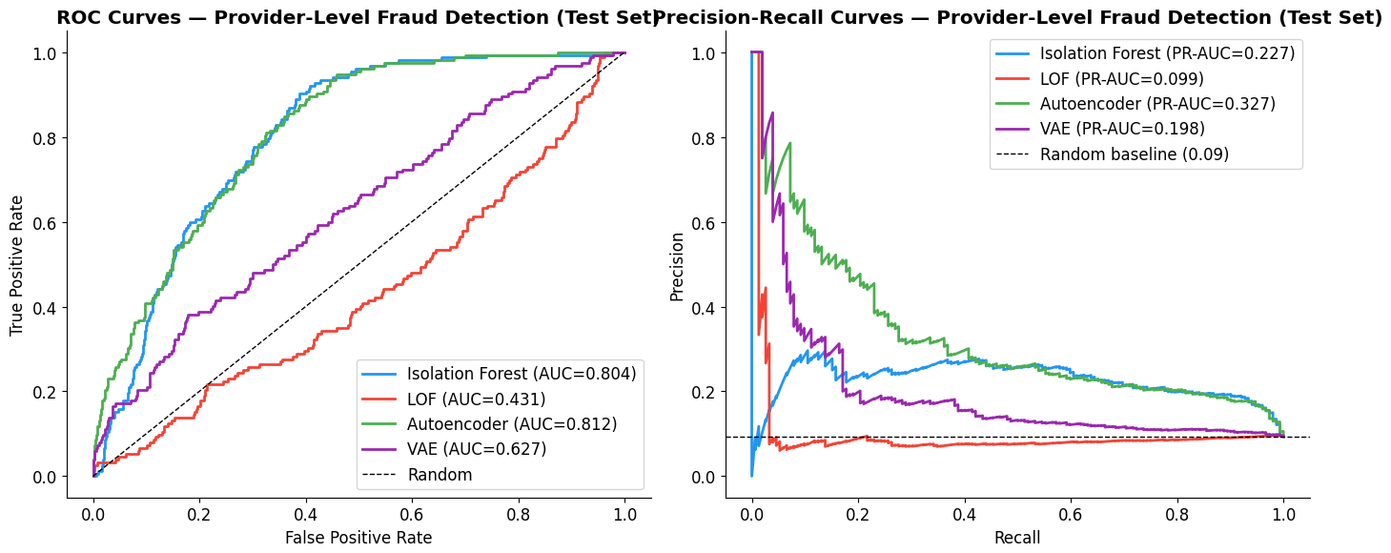
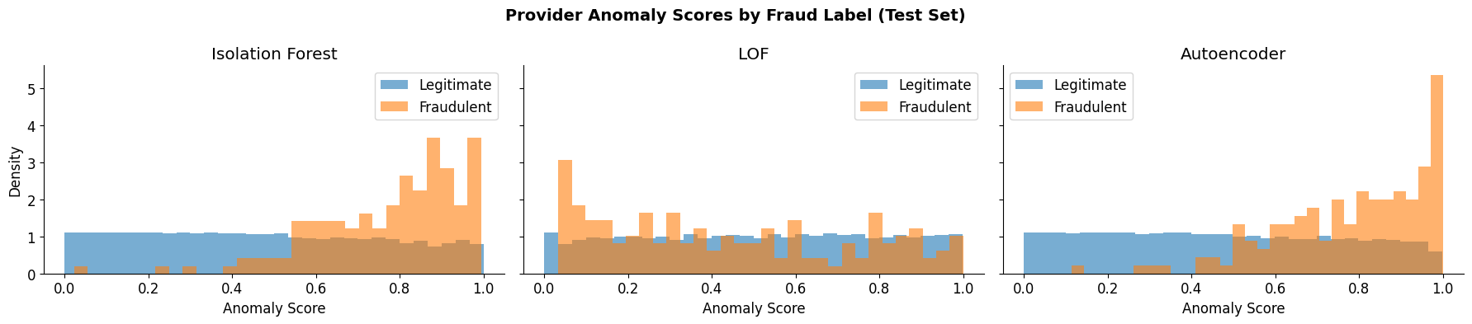
Unsupervised results: Autoencoder narrowly leads Isolation Forest
LOF fails; VAE underperforms the simpler Autoencoder.
Model
ROC-AUC
PR-AUC
Top-10% precision
Autoencoder
0.812
0.332
0.313
Isolation Forest
0.804
0.234
0.245
VAE
0.627
0.203
0.190
LOF
0.432
0.102
0.067
Interpretation: Autoencoder learns non-linear normal provider behavior; LOF loses neighborhood meaning in mixed data.
Hunter College | STAT 790 | Francesco Pecora
9
Notes:
This slide presents the unsupervised results clearly. The Autoencoder is the best unsupervised model with ROC-AUC around 0.812 and PR-AUC around 0.332. Isolation Forest is very close by ROC-AUC and is still a strong practical model. LOF is worse than random, which validates the concern that local-density approaches struggle on mixed healthcare claims data. The VAE underperforms because its KL regularization likely smooths away reconstruction failures that help identify fraud.

Slide 11
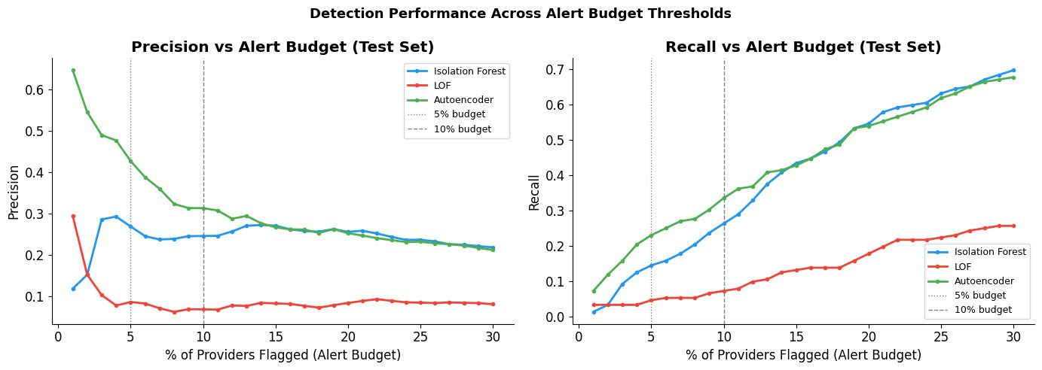
HUNTER COLLEGE
Alert-budget view: models must match investigator capacity
A fraud unit does not inspect every provider; it chooses a review budget.
At top 10%, Autoencoder flags 163 providers, catches 51 of 152 fraud providers, and reaches 31.3% precision.
Low budgets reward precision: Autoencoder is best in the most realistic early-review region.
Wider budgets increase recall but create more false positives.
Isolation Forest remains attractive when teams want a simpler method or theory-based threshold.
STAT 790 | Francesco Pecora
11
Notes:
Point to the left graph: this is precision as the investigation budget increases. The Autoencoder line is highest in the low-budget region, which is the realistic place for a fraud unit. Then point to the right graph: recall rises as we allow more providers into the queue. That is the tradeoff: more investigation capacity means more fraud caught, but lower precision.

Slide 12
HUNTER COLLEGE
Scenario 2: supervised models exploit confirmed labels
Use these once investigations produce trustworthy outcomes.
Operational condition: confirmed investigation outcomes now exist, so the organization can train on what fraud has looked like historically.
Model
What it is good at
Best use condition
Logistic Regression
Strong linear ranking; highly interpretable
When missed fraud is expensive and high recall matters
Random Forest
Non-linear baseline with robust feature importance
When the team wants stable tree-based screening
XGBoost
Boosted trees focused on high-confidence combinations
When investigation capacity is limited and false positives are costly
Neural Network
Flexible non-linear classifier
Useful benchmark, but less interpretable here
Supervised models dominate once labels are available, but the winner depends on the operating constraint.
Recall-first operations favor Logistic Regression.
Capacity-constrained operations favor XGBoost because it reduces false positives.
STAT 790 | Francesco Pecora
13
Notes:
Use this as the Scenario 2 counterpart to the unsupervised scenario slide. Say: once investigators have confirmed outcomes, the organization has labels. At that point the model can learn fraud patterns directly. But this does not automatically mean one model is always best. Logistic Regression is best when missing fraud is the bigger problem; XGBoost is better when the team cannot handle too many false positives.

Slide 13
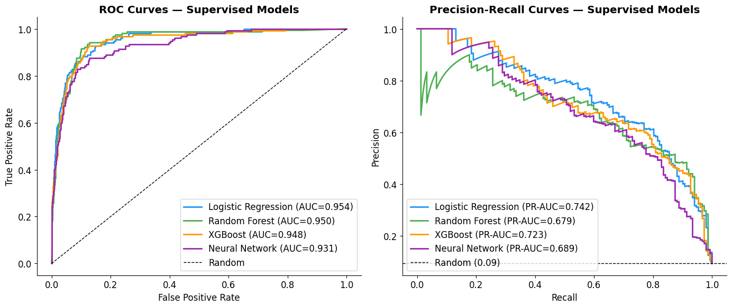
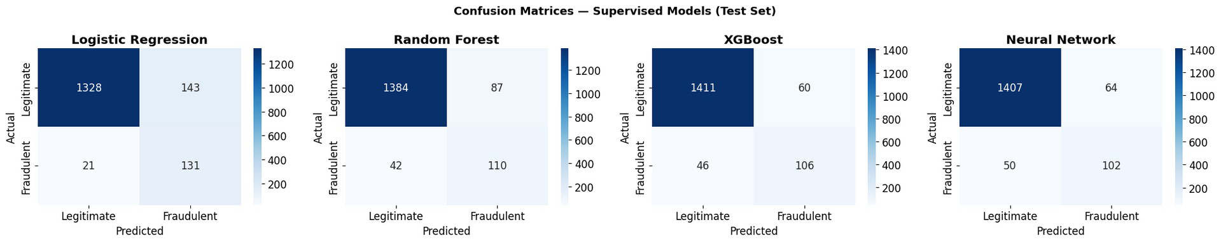
HUNTER COLLEGE
Supervised results: labels lift all models into a higher band
The engineered provider features carry strong supervised signal.
Model
Precision
Recall
F1
ROC-AUC
PR-AUC
Logistic Regression
0.478
0.862
0.615
0.953
0.742
Random Forest
0.558
0.724
0.630
0.950
0.679
XGBoost
0.639
0.697
0.667
0.947
0.723
Neural Network
0.614
0.671
0.642
0.930
0.689
STAT 790 | Francesco Pecora
14
Notes:
Point to the table: all supervised models have ROC-AUC around 0.93 to 0.95, much higher than unsupervised. Logistic Regression has the highest recall and AUC; XGBoost has the highest precision and F1. Then point to the ROC/PR curves: the curves are high and close together. Finally point to the confusion matrices: Logistic Regression catches the most fraud but has more false positives, while XGBoost catches fewer but wastes less investigation effort.

Slide 14
HUNTER COLLEGE
Supervised tradeoff: Logistic Regression vs. XGBoost
Compare the same numbers side by side: both models are useful under different constraints.
Metric / condition
Logistic Regression
XGBoost
True positives
131
106
False positives
143
60
Flagged total (TP + FP)
274
166
Precision
0.478
0.639
Recall
0.862
0.697
F1
0.615
0.667
Recoverable test-set reimbursement
$101.9M
$96.0M
Best condition
Missed fraud is costly; broad surveillance
Investigator capacity is limited; false positives are costly
Translation: Logistic Regression catches more fraud; XGBoost wastes fewer investigations.
STAT 790 | Francesco Pecora
15
Notes:
This slide fixes the comparison by showing the same metrics for both models. Point to true positives: Logistic Regression catches 131 fraud providers versus 106 for XGBoost. Then point to false positives: XGBoost has only 60 false positives versus 143 for Logistic Regression. So Logistic Regression is better if missed fraud is the main concern. XGBoost is better if the investigation team has limited capacity or false positives are expensive.

Slide 15
Head-to-head: labels are worth about 0.12–0.14 AUC points
But unsupervised models still solve an important first-stage problem.
1
2
3
4
Cold start
Review
Labels
Steady state
Unsupervised
ranking
Human
investigation
Confirmed
outcomes
Supervised
models
Deployment thesis: unsupervised first, supervised after labels accumulate — keep both running in parallel.
Hunter College | STAT 790 | Francesco Pecora
13
Notes:
This is the unique contribution of the project: the models are compared on the same test set. The best unsupervised model is the Autoencoder at about 0.812 ROC-AUC. The supervised models reach about 0.93 to 0.953. That means labels are worth roughly 0.12 to 0.14 AUC points. But the conclusion is not simply supervised is better. The lifecycle matters: unsupervised models help create the first investigation queue, those investigations create labels, and supervised models then take over for higher precision.

Slide 16
Financial impact: accuracy matters more than investigation cost
Recovery scale dwarfs false-positive cost in this dataset.
Family
Best model
TP
FP
Recoverable test
Scaled recovery
Unsupervised
Autoencoder
51
112
$68.8M
~$229M
Supervised
Logistic Regression
131
143
$101.9M
~$340M
Supervised
XGBoost
106
60
$96.0M
~$320M
Decision rules
No labels yet
Autoencoder or Isolation Forest
Creates the first queue.
High cost of missed fraud
Logistic Regression
Maximizes recall and total recovery.
Limited investigation capacity
XGBoost
Higher precision and fewer false positives.
Novel fraud patterns
Keep unsupervised running
Flags behavior outside labeled history.
Hunter College | STAT 790 | Francesco Pecora
14
Notes:
Now translate model results into dollars and decision rules. At the top-ten percent alert budget, the Autoencoder recovers about $68.8 million in the test set, while Logistic Regression reaches about $101.9 million. XGBoost recovers slightly less than Logistic Regression but does it with far fewer false positives. This is why the best model depends on context. If fraud misses are most costly, choose Logistic Regression. If investigation capacity or provider friction is the constraint, choose XGBoost.

Slide 17
HUNTER COLLEGE
18
Limitations: what needs to be improved next
These do not invalidate the result; they define what data and validation would make the system production-ready.
Limitation in this project | Why it matters | How I would address it
PotentialFraud is not conviction | The label is a screening flag, not final proof of fraud. | Validate on adjudicated investigation outcomes and recovery records.
One historical payer/year | Performance may change across time, regions, and policy rules. | Use newer years, other payer data, and out-of-time validation.
Provider aggregation loses detail | The model flags providers but does not identify the exact suspicious claims. | Add claim-level drill-down, examples, and explainability artifacts.
SMOTE cannot create new schemes | Supervised models learn from known fraud patterns only. | Keep unsupervised monitoring in parallel for novel behavior.
ROI is simplified | Recovery rate, staffing limits, and provider friction are not fully modeled. | Use actual collection rates, capacity constraints, and compliance costs.
Codes are compressed heavily | Diagnosis/procedure sequences may contain richer signal than summary features. | Test code embeddings, clinical groupers, and sequence-based features.
Better next step: validate on confirmed outcomes + richer claim-level explanations while keeping the unsupervised model for new fraud patterns.
STAT 790 | Francesco Pecora

Slide 18
Conclusion: a staged fraud-detection lifecycle
The right model changes as organizational knowledge accumulates.
The data is mixed and imbalanced
1
Provider-level aggregation converts messy claims into usable behavioral features.
Unsupervised is valuable before labels
2
Autoencoder is the best cold-start model; Isolation Forest is a strong simpler alternative.
Supervised models dominate once labels exist
3
Logistic Regression maximizes recall; XGBoost improves precision and F1.
Deployment should be sequential
4
Unsupervised → investigations → labels → supervised, with unsupervised monitoring still running.
Final recommendation: do not pick a model in isolation — pick the model that matches the label maturity and investigation constraint.
Hunter College | STAT 790 | Francesco Pecora
15
Notes:
Close with the lifecycle. The data is difficult because it is mixed, sparse, and imbalanced. Unsupervised models are not a substitute for labels, but they are the right starting point when labels do not exist. Once investigations create confirmed labels, supervised models improve ranking substantially. Finally, within supervised models, the choice depends on operations: Logistic Regression for recall and recovery, XGBoost for precision and capacity constraints.

