Slide 1
Resilient Multi-Agent Drone Coordinator
in Rust with Docker-Based Deployment

Slide 2
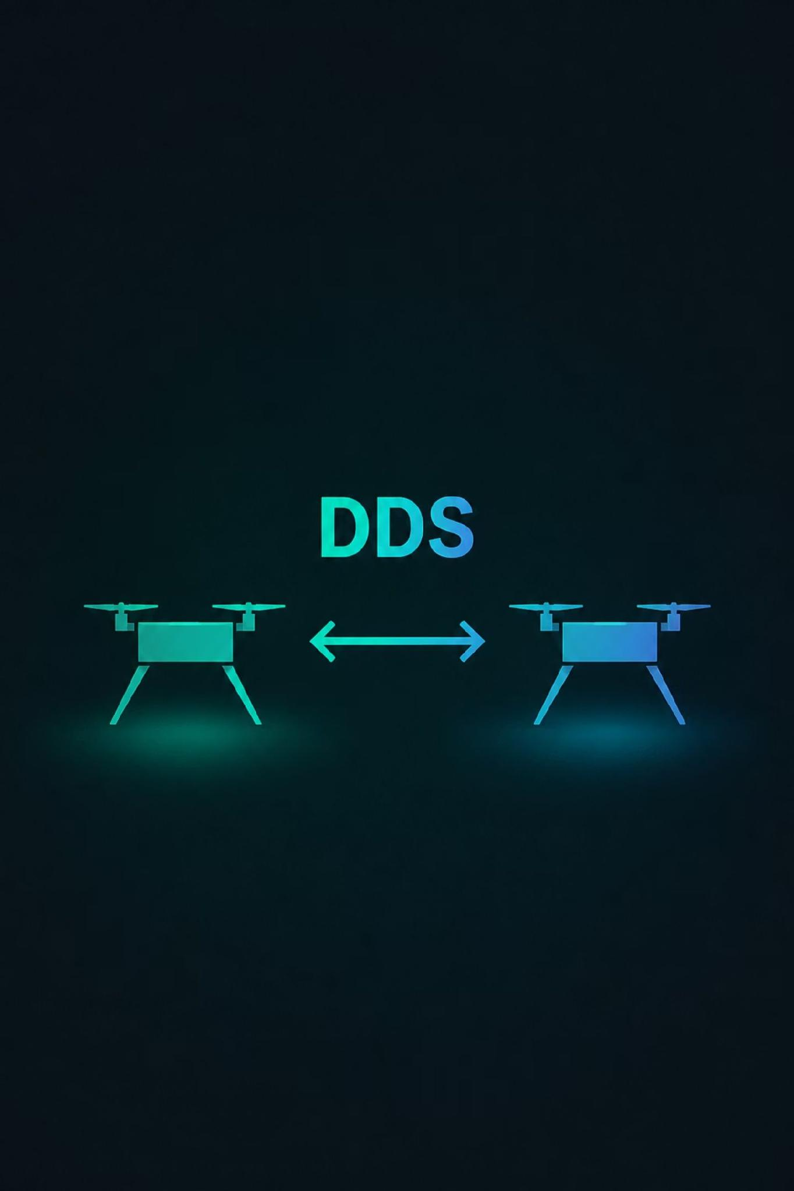
Project Overview
Our core objective is to develop a fault-tolerant coordination system for a drone swarm. This system leverages ROS2 and Gazebo for simulation and control, with its underlying logic implemented using a Rust actor-based runtime.
Our key technical approach relies on asynchronous message passing for robust inter-drone communication and a leader election mechanism to ensure fault tolerance and system stability.
The deployment architecture utilizes Docker containers for each component, ensuring isolated, scalable, and reproducible environments across the drone swarm.
For observability and control, the system includes a FastAPI backend, providing a REST interface for monitoring drone status, managing tasks, and receiving system alerts.

Slide 3
Expected Deliverables
Rust based coordinator
ROS2 node wrappers for each drone agent
Gazebo simulation scenario
Docker Compose deployment
FastAPI observability backend
Formal model of the FSM
Public GitHub repository with documentation

Slide 4
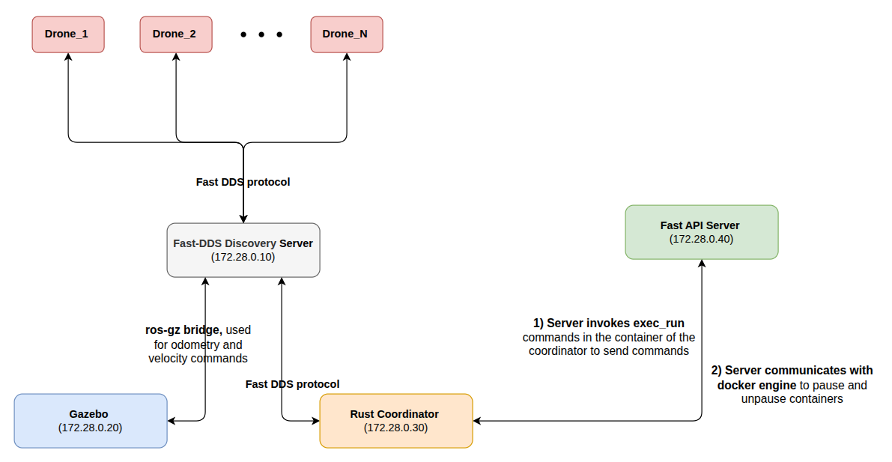
Architecture:

Slide 5

DDS and Communication Architecture
Swarm of drones Coordinator — Data Distribution Service for real-time distributed systems
OMG STANDARD
REAL-TIME SYSTEMS
IIOT

Slide 6

Formal Definition
What is DDS?
DDS (Data Distribution Service for Real-Time Systems) is an OMG (Object Management Group) standard that defines a data-centric publish/subscribe communication middleware for real-time distributed systems.
There are nowadays several variants of this protocol, like the wired one (RTPS).
In this project we use FastDDS based on eProsima, an open-source C++ implementation of the DDS standard (Apache 2.0 license). It implements the RTPS wire protocol and is the default middleware for ROS 2. It provides configurable real-time publish-subscribe communication with shared memory transport, multiple discovery mechanisms, and high-performance data exchange.

Slide 7
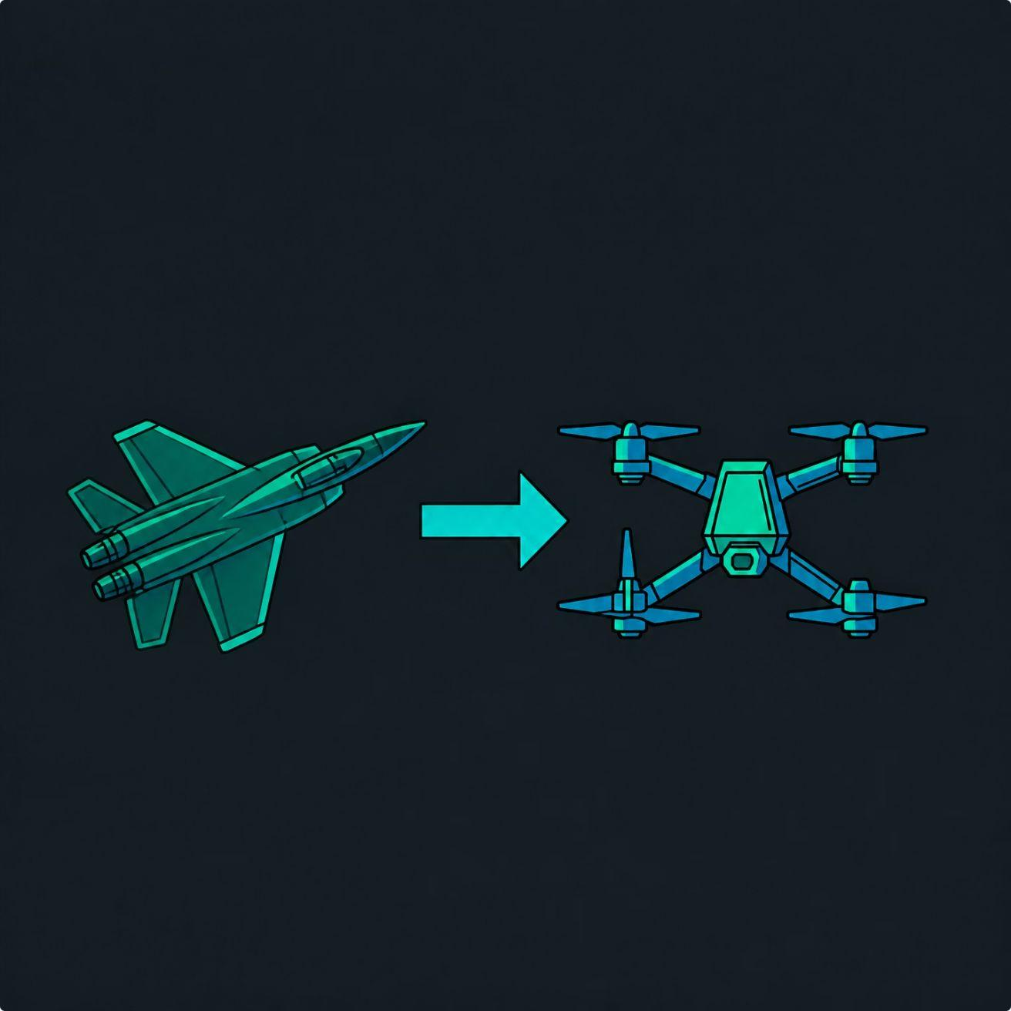
History & Adoption
From Military Protocol to Global Standard
1
1990s
Military and aerospace systems with 15+ incompatible proprietary middleware solutions.
2
2001–2003
OMG standardization. First DDS 1.0 specification published in 2003.
3
Implementations
RTI Connext DDS (F-35), OpenSplice (defense), FastDDS (ROS2 default).
4
Today
Aerospace, automotive (AUTOSAR Adaptive), robotics (ROS2), smart grid, healthcare.

Slide 8
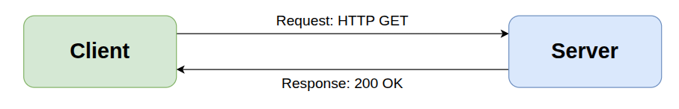

Client-Server Architecture: Request-Response Pattern
The client asks and the server responds. The pattern is synchronous request-response: every communication is actively initiated by whoever needs the data.
The server is passive with respect to real data — it waits for someone to request it.
While variants like WebSocket/SSE (persistent channels) and MQTT-style brokers (centralized pub/sub) exist, the core characteristic of client-server remains that all communication flows through a central point.
The core limitation is that all communication flows through a central point.

Slide 9
The 4 Main Limits of Client-Server Architecture
Problem | DDS Solution
Single Point of FailureIf the Server/Broker crashes, the entire system stops instantly. | Native Peer-to-Peer:There is no central node. If one node fails, the others continue communicating without any interruption.
Bottleneck (Latency and Bandwidth)All traffic must pass through the server. As data increases, the server struggles. | Direct Communication:Data goes straight from the producer to the consumer. No intermediate steps, minimal latency, and high scalability.
Rigid CouplingThe Client must know the Server's IP/port to send or request data. | Data-Centricity:Nodes don't ask "Who are you?", but rather "Who is interested in Topic X?". They publish and receive data without knowing each other's address.
"All or Nothing" Service ManagementIt is difficult to manage different requirements for different data on the same channel. | Granular QoS (Quality of Service):You can define specific rules for each data stream (e.g., reliability, frequency, persistence).

Slide 10
DDS Architecture
Domain & DomainParticipant
Domain
DomainParticipant
A logical isolation channel identified by a Domain ID. Participants with the same ID form a communication "bubble" invisible to other domains.
It is the root entity of every DDS application. It represents an app's presence in the domain and acts as a factory for Publishers, Subscribers, and Topics.
Domain 0
Domain 1
Domain 2
Smart City: Sensors ↔ Backend ↔ Traffic Lights
Maintenance: Technicians ↔ Diagnostics
Emergency: 112 ↔ Alerts

Slide 11



DDS Architecture
Topic, Publisher & Subscriber
Topic
Publisher
Subscriber
Three attributes: Name (unique within the domain), Type (data structure, type-safe), QoS (quality policies).
Grouping entity for DataWriters. Manages shared QoS. Can contain multiple DataWriters on different topics.
Grouping entity for DataReaders. Analogously to the Publisher, it defines default QoS for child readers.

Slide 12
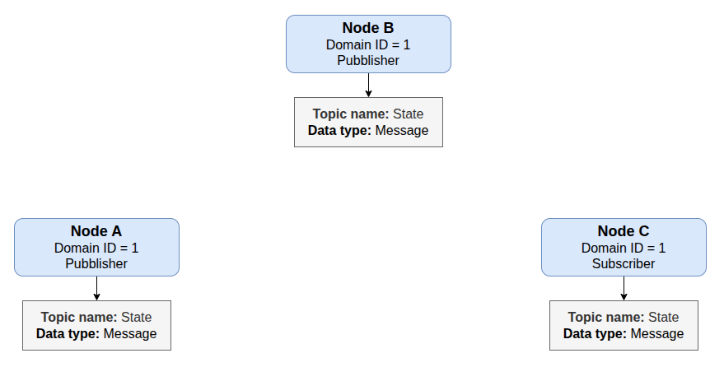
DDS Architecture
Example - 3 nodes in the Network:

Slide 13
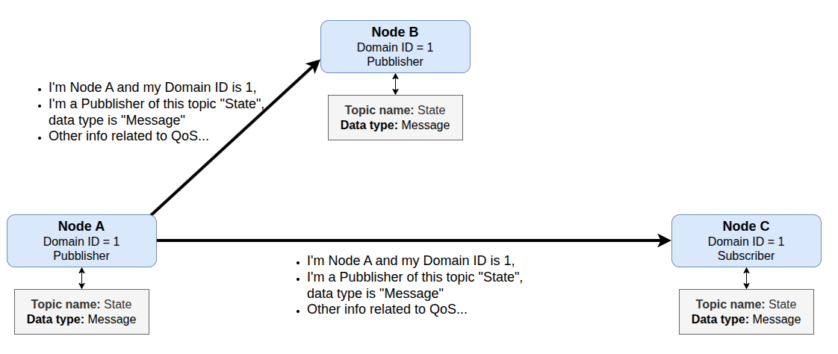
DDS Architecture
Example - 3 nodes in the Network:
Discovery phase starts, each node needs to be aware of all the other nodes that want to join in the DDS network, nodes start to send Multicast UDP packets to declare their presence to other nodes

Slide 14
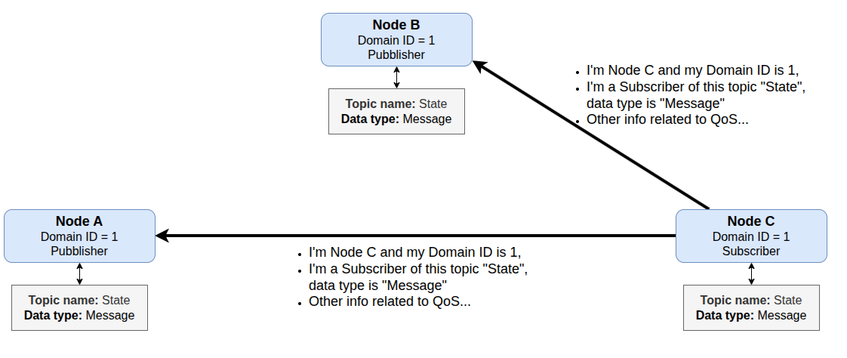
DDS Architecture
Example - 3 nodes in the Network:
Discovery phase starts, each node needs to be aware of all the other nodes that want to join in the DDS network, nodes start to send Multicast UDP packets to declare their presence to other nodes

Slide 15
DDS Architecture
Example - 3 nodes in the Network:
During the Discovery Phase:
Both nodes A and C belong to the same Domain ID, they want to write/read data on the same topic, the data type is the same → There is a Match!
The Machine A detect this match, and they understand they can directly communicate, now Node A knows the Node C is a DataReader interested on the data posted by A → They can start to communicate directly.
The same process is repeated for all the other nodes in the network.

Slide 16
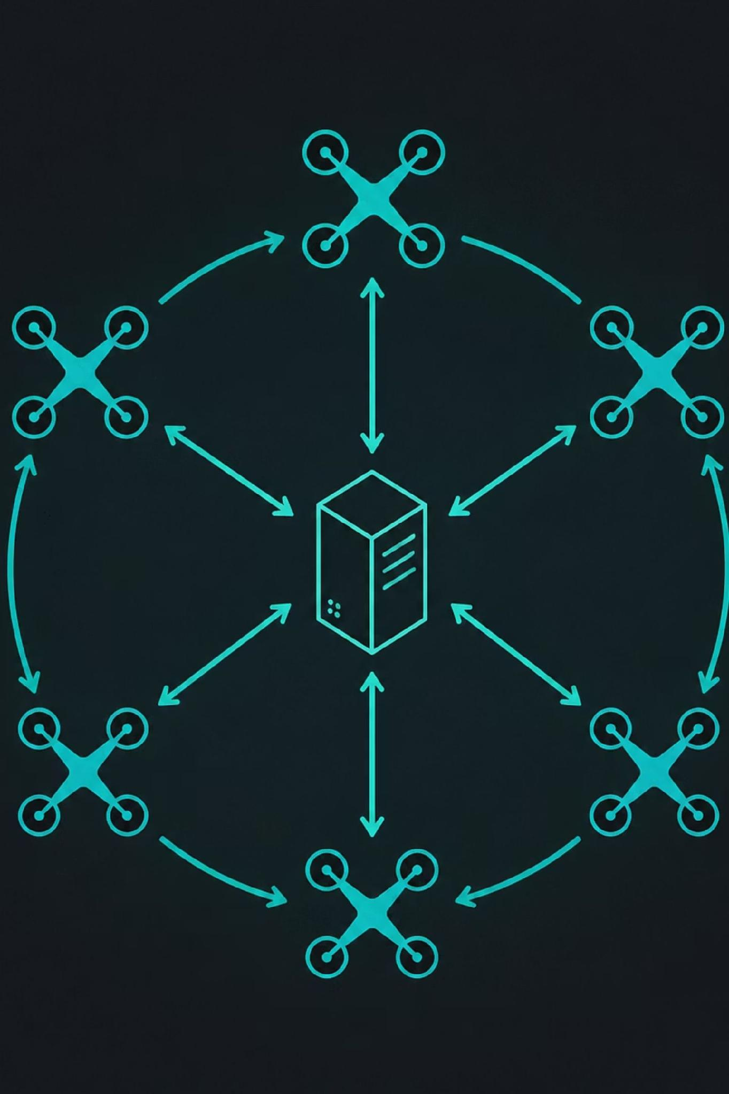
Fast DDS
A modern C++ implementation of the OMG DDS standard
Fast DDS is a variant and implementation of the standard DDS (Data Distribution Service) specification, tailored for high-performance and real-time applications.
Developed by eProsima
Implements the Real-Time Publish-Subscribe (RTPS) protocol
Default middleware for ROS 2 Jazzy Jalisco
Provides low-latency, deterministic data exchange for robotic systems
Open-source (Apache 2.0 license)

Slide 17

Why Fast DDS in This Project?
Main Problem: Network Isolation
The Solution: Fast DDS Discovery Server
By default, ROS 2 relies on UDP Multicast for dynamic peer discovery.
Containerized microservice architectures using Docker bridge networks frequently block or restrict UDP multicast packets across isolated containers.
This creates network isolation issues.
Replaces multicast discovery with a centralized unicast architecture.
Runs on port 11811
Each drone agent and the Rust coordinator register directly with the Discovery Server upon container startup.
Ensures deterministic, instant discovery of all ROS 2 nodes across Docker containers without packet loss or network isolation issues.
Key Benefit: Enables reliable peer-to-peer communication in containerized environments through a two-phase process: Server-Mediated Discovery followed by Direct Peer-to-Peer Data Communication.

Slide 18
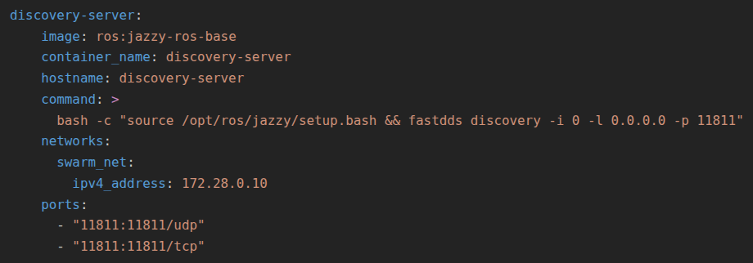
Fast DDS Implementation
1) Definition of the service in the docker-compose.yml
A container based on the official ROS 2 Jazzy image is instantiated.
The command fastdds discovery -i 0 -l 0.0.0.0 -p 11811 is executed, starting the Discovery Server daemon on server ID 0, listening on port 11811 (both UDP and TCP).
It is assigned the static IP address 172.28.0.10 within the swarm_net bridge network.

Slide 19
Fast DDS Implementation
2) Client Nodes Configuration
To ensure that the microservices connect to the Discovery Server instead of relying on standard Multicast discovery, a triad of environment variables is exported across all entrypoint.sh scripts:
RMW_IMPLEMENTATION=rmw_fastrtps_cpp: Forces the use of the Fast-DDS middleware implementation.
ROS_DISCOVERY_SERVER=172.28.0.10:11811: Provides the node with the Unicast IP address and port required for registration.
ROS_SUPER_CLIENT=true: Grants the node full visibility (Super Client status) over the complete ROS 2 graph and all active topics across the swarm.

Slide 20
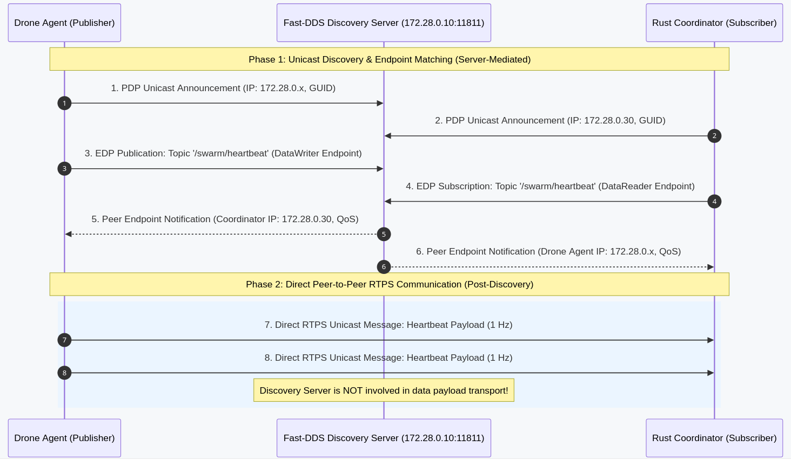
Fast DDS procedure:

Slide 21
How does Fast DDS works in simple terms:
Instead of shouting via Multicast hoping others will listen, a central node called the Discovery Server is created, serving as a "Registry or Phonebook of Nodes":
Container Registration: Upon startup, every container sends a Unicast (direct, IP:Port 172.28.0.10:11811) message to the Discovery Server stating: "I am drone_1, this is my IP address, and I publish/subscribe to these topics".
Endpoint Matching: The Discovery Server matches nodes that need to communicate with each other (e.g., it relays drone_1's IP address and endpoints to the Coordinator).
Direct P2P Data Flow: Once nodes have "discovered" each other, the Discovery Server steps out of the data path, and high-frequency data exchange (heartbeats, odometry, flight velocity commands) occurs directly Peer-to-Peer between containers with minimal latency.

Slide 22
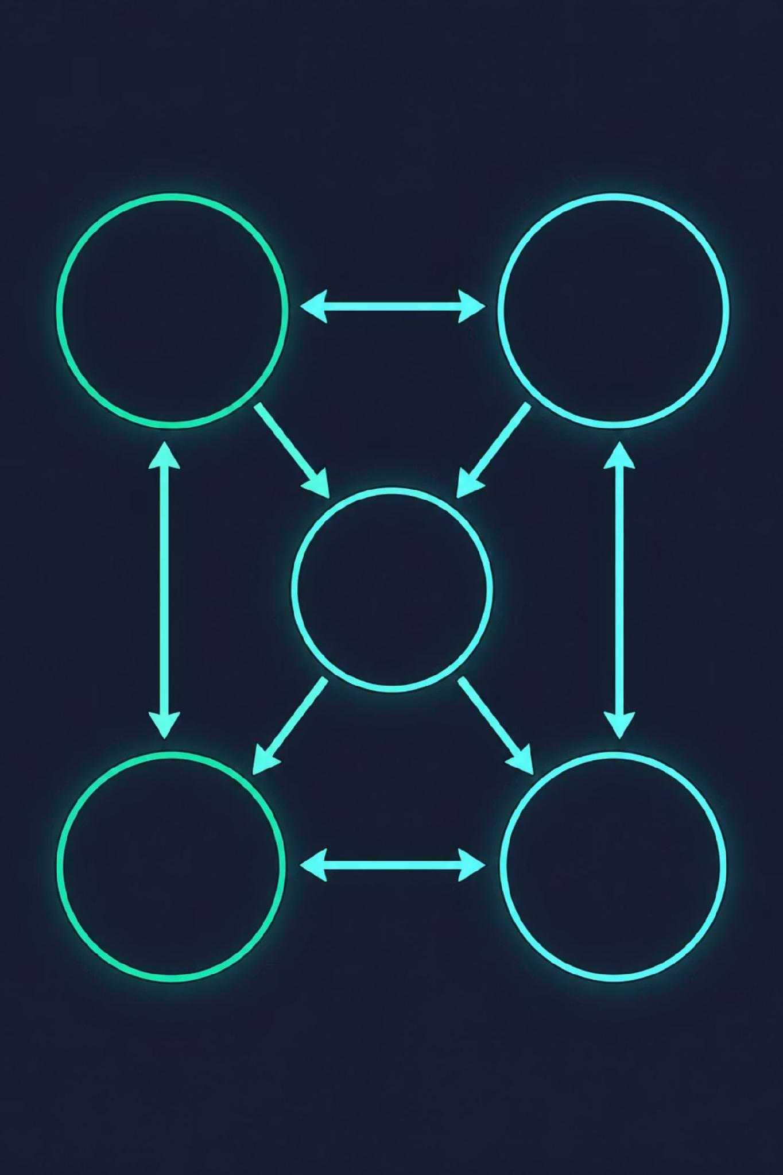
Finite State Machine (FSM)
Drone states management — Managing all the possible states and transitions events

Slide 23
What is a Finite State Machine (FSM)?
A Finite State Machine (FSM) is a mathematical model of computation used to design systems that can be in only one state at a time from a finite set of predefined states, changing state (transition) in response to external events or inputs.
Key elements of an FSM
States
Transitions
Events/Inputs
The distinct conditions the system can be in
Example: Off, On, Paused
The logical passage from one state to another
Bound by precise rules
The triggering factors that activate a transition
External signals that cause state changes
Actions
The behaviors executed by the system within or upon changing a state
Operations performed during transitions

Slide 24





FSM Main Applications:
Video Games
Communication Protocols
Embedded and IoT Systems
Manage AI logic of characters
Example: Enemy transitions from Patrol → Chase → Attack states
Regulate the lifecycle of network connections
Example: TCP connection states (SYN_SENT, ESTABLISHED, FIN_WAIT)
Control physical machinery
Examples: Vending machines, elevators, HVAC systems, traffic lights
Compilers and Parsing
User Interfaces (UI)
Lexical analysis to recognize syntactic structure
Used in source code parsing
Manage complex navigation flows
Example: Idle, Loading, Success, Error states
Why FSMs Are So Useful
Structural clarity: Replace long conditional chains with clean visual representation
Predictability and safety: Prevent invalid states, every transition is rigidly coded
Ease of maintenance: Scale by adding new states without altering entire architecture
Bug resolution: Simplify debugging by identifying where logical flow breaks

Slide 25
Dual Finite State Machines for Drone Coordination
Every drone in the swarm is represented by a dual-state tuple (S1, S2) maintained by the Rust coordinator. This dual FSM approach separates concerns into two independent but complementary state machines.
FSM 1 - Health State (S1):
FSM 2 - Swarm Role (S2):
Tracks the operational status and connectivity of each drone:
Tracks the role and responsibility of each drone within the swarm:
Unregistered: Drone newly spawned or initializing
Active: Operational drone emitting periodic heartbeats
Suspected: No heartbeat received for over 5 seconds
Failed: No heartbeat received for over 10 seconds (drone considered crashed/offline)
None: No role assigned (when S1 is Unregistered or Failed)
Candidate: Eligible to become Leader during an election process
Follower: Gregarious drone following the Leader's trajectory and formation directives
Leader: Active leader drone governing the swarm
Why Dual FSM?
Separation of Concerns: Health monitoring is independent from role assignment
Flexibility: A drone can change roles without affecting its health state and vice versa
Clarity: Each FSM has a single responsibility, making the system easier to understand and maintain
Robustness: Failures in one dimension don't necessarily cascade to the other

Slide 26
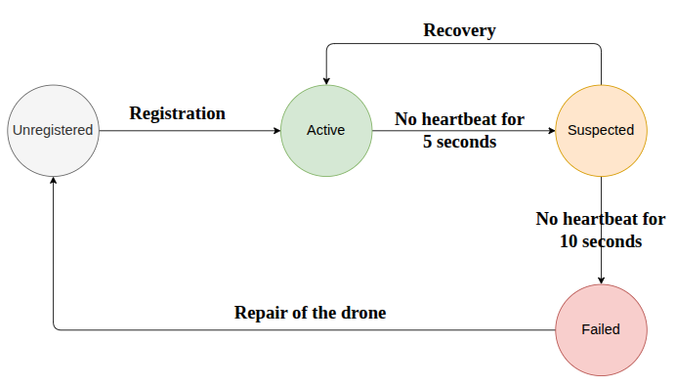
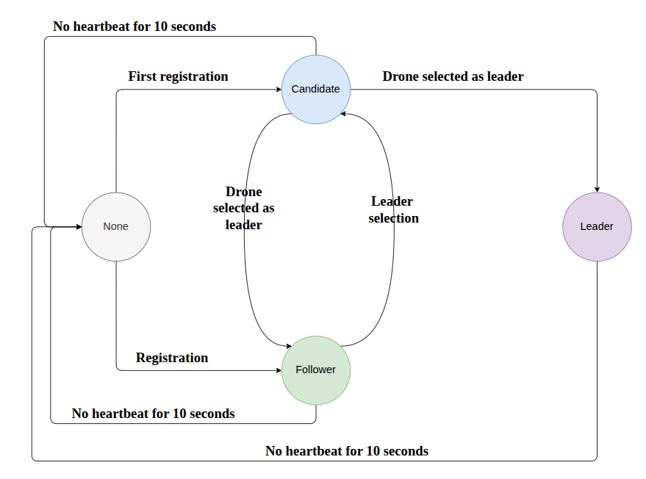
FSM 1 & FSM 2 State Diagrams
FSM 1: Health State
FSM 2: Swarm Role
Drone operational status and connectivity
Drone role within the swarm

Slide 27
Complete Dual-FSM Composition
The overall state of each drone agent is determined by combining both state machines into a unified dual-state tuple (S1, S2), where:
S1 = Health State (Unregistered, Active, Suspected, Failed)
S2 = Swarm Role (None, Candidate, Follower, Leader)
Not all combinations of (S1, S2) are valid. The complete state transition model defines which state pairs are reachable and what events trigger transitions between them. For example:
A Failed drone (S1=Failed) must have S2=None (no role)
Only Active drones (S1=Active) can be Leaders, Followers, or Candidates
Unregistered drones (S1=Unregistered) must have S2=None until they transition to Active

Slide 28
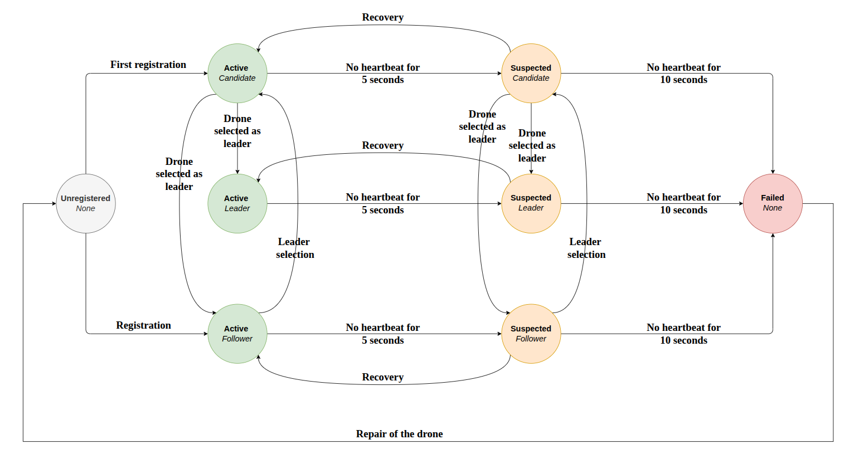
The complete state transition diagram below illustrates all valid state pairs and the transition events that move the system between them:
This unified model ensures that the swarm maintains consistency: health monitoring and role management are coordinated, preventing invalid states and ensuring robust fault tolerance.

Slide 29
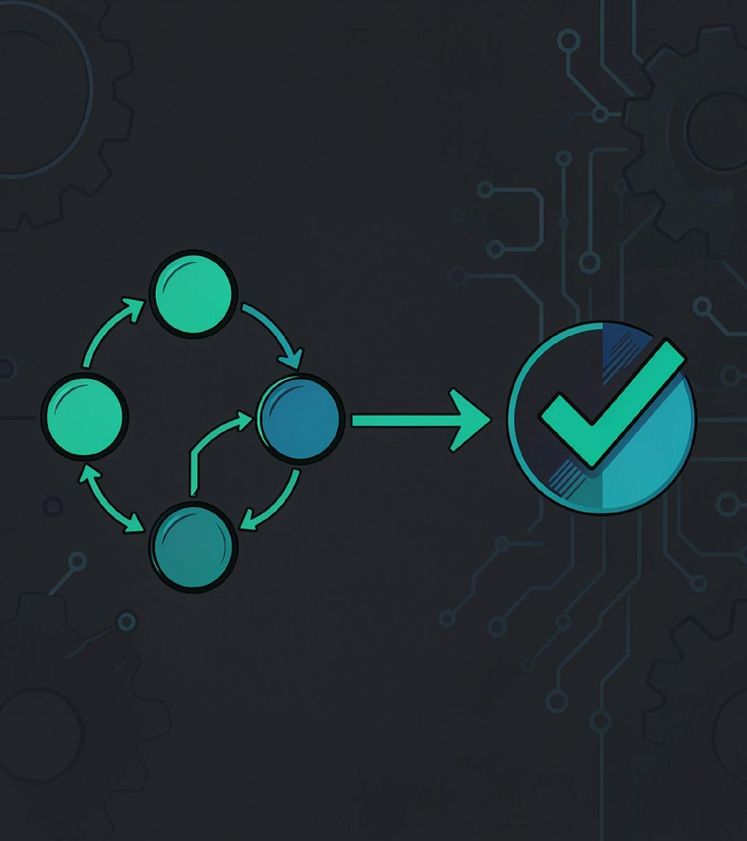
Formal model verification with Kani
Verifying FSM properties — Kani used to verify FSM correctness

Slide 30
What is Kani?
Kani is an open-source bit-precise model checker developed primarily for the Rust programming language. It uses symbol-based formal verification techniques to exhaustively analyze code, going far beyond traditional unit tests or compiler checks.
Kani serves to mathematically prove that a piece of Rust code satisfies specific safety and correctness properties for any possible input (exhaustive verification), rather than just testing a few sample cases. It analyzes code by leveraging logical solvers (SAT/SMT engines via CBMC) to spot logical bugs or undefined behaviors.
Main applications:
Verification of unsafe blocks
Panic and overflow checking
Although Rust natively guarantees memory safety, the use of unsafe blocks bypasses compiler checks
Kani is ideal for analyzing these critical sections and ruling out memory bugs
Essential for systems where memory safety is critical
Automatically detects whether an operation can cause a runtime panic
Examples: calling unwrap() on None values, arithmetic overflows
Prevents unexpected runtime failures

Slide 31




Why Kani is So Useful
Total coverage (100%)
Higher confidence in critical systems
Native integration
Unlike traditional tests that only check inputs written by the programmer, Kani explores all possible execution paths
Provides a concrete counterexample if it finds a violation
Guarantees exhaustive verification across all scenarios
Integrates directly with Rust's package manager (cargo kani)
Makes the execution of formal checks smooth within modern development workflows
Seamless CI/CD integration
No external tools or complex setup required
Helps achieve extremely high reliability standards in complex industrial fields
Applications: automotive, aerospace, embedded systems
Where a runtime error can be catastrophic
Provides mathematical proof of correctness

Slide 32
Events in the FSM verified with KANI:
Event Name (SwarmEvent) | Event Description | Previous State → Next State
RegistrationSuccess { has_active_leader } | Triggered when a drone completes registration. If no leader exists: Drone becomes a Candidate. If leader exists: Drone becomes a Follower. | if has_active_leader == false: (Unregistered, None) → (Active, Candidate); if has_active_leader == true: (Unregistered, None) → (Active, Follower)
LeaderSelection { is_chosen } | Applied to Candidate drones during leader election. If selected (is_chosen == true): Drone becomes Leader. If not selected (is_chosen == false): Drone becomes Follower. | if is_chosen == true: (Active, Candidate) → (Active, Leader); if is_chosen == false: (Active, Candidate) → (Active, Follower)
HeartbeatTimeout {elapsed_seconds} | Applied to drones when heartbeats are missing. If (5 < elapsed_seconds < 10) drone is not yet considered failed, but it is suspected. If (elapsed_seconds >= 10) drone is considered failed and is despawned from Gazebo, | If (5 < elapsed_seconds < 10): (Active, S2) → (Suspected, S2); If (elapsed_seconds >= 10) (Active, S2) → (Failed, S2)
HeartbeatRecovered | Heartbeat received within 10 seconds | (Suspected, S2) → (Active, S2)
LeaderFailedReelectionTrigger | The active Leader drone fails; triggers all Followers to enter election candidate status. | (Active, Follower) → (Active, Candidate); (Suspected, Follower) → (Suspected, Candidate)
RepairCompleted | Container unpaused/repaired; resets drone to initial state ready for re-registration. | (Failed, None) → (Unregistered, None)

Slide 33




Kani's Logical Workflow
Kani verifies safety properties through a structured three-phase process — from generating all possible states to mathematically proving (or disproving) a property holds.
Phase 1: Setup
Phase 2: Execution
Phase 3: Verification
kani::any() + kani::assume(...)
Code Execution / State Transition Loop
kani::assert(...)
kani::any() generates all possible values and states
kani::assume(...) filters out invalid or absurd combinations
Only valid initial states remain on the table
Kani runs the code through state transitions (or loop iterations)
Each valid state from Phase 1 is used as a starting point
All reachable execution paths are explored
Kani checks if any single trace makes the property FALSE
✅ VERIFIED — property holds in ALL valid cases
❌ ERROR — stops and shows exact counterexample
Key insight: Kani performs exhaustive mathematical verification — not random sampling. If no counterexample exists across all valid paths, the property is guaranteed to hold.

Slide 34
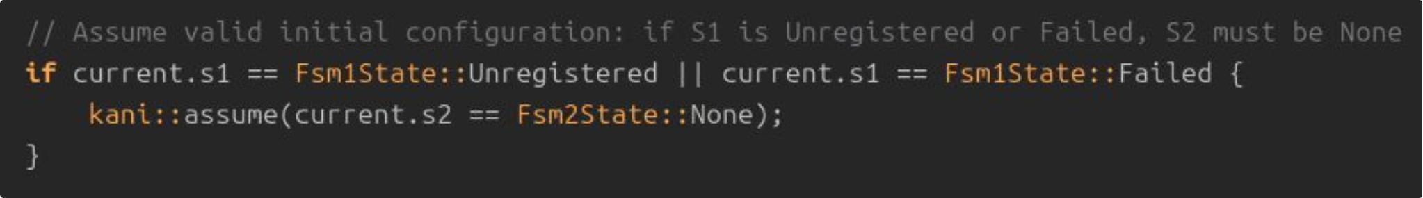
Kani Implementation:
The implementation of a formal model verification with Kani is based on verifying specific properties to ensure robustness and correctness of the FSM analyzed. We can make this by using two very important functions:
kani::assume — Defines valid pre-conditions of the system in formal logic. It tells Kani to consider only sensible initial configurations (e.g., if the starting state is Unregistered or Failed, assume initial role S2 is None). This ensures states always start from valid starting conditions.
This is an example of how to use kani::assume, here I'm using it to make an assumption in the block of code used to prove the property of Inactive role invariant (Harnesses verification function in the code)

Slide 35
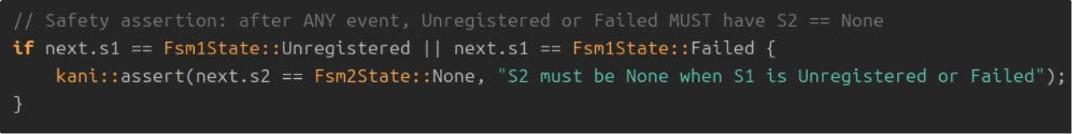
Kani Implementation:
kani::assert — Defines the safety property to be proven. It tells Kani to mathematically verify a specific condition (e.g., after applying an event, if the new state S1 is Unregistered or Failed, verify that role S2 is mandatorily None). If any single event or combination of events violates this rule, Kani immediately stops and reports an error with the exact counterexample.
This is an example of how to use kani::assert, kani checks whether there is even a single trace/combination among the valid ones that makes the property FALSE.

Slide 36
Verified Properties:
Located in the Kani_verify/ directory, proof harnesses written for the Kani model checker mathematically verify the following properties:
Property | Description | Significance
Inactive Role Invariant | An Unregistered or Failed drone must ALWAYS have S2 = None. | Ensures that drones without operational status cannot hold any swarm role, preventing invalid state combinations.
Suspected Role Preservation | Entering Suspected or recovering back to Active preserves the S2 role unchanged. | Guarantees that temporary health degradation does not affect role assignment, maintaining swarm structure during transient failures.
Single Leader & Recovery Invariant | In any valid swarm state, at most one active Leader exists. Upon Leader failure, re-election guarantees a single new Leader without violating the invariant when repaired drones rejoin. | Ensures swarm coordinator has one leader and shows that recovery re-election is never triggered prematurely before the 10-second no-heartbeat bound is exceeded.

Slide 37

Drone Agent Implementation
Drones — Each drone agent is an independent component communicating via asynchronous messages

Slide 38






Drone Agent Architecture:
drone_agent_wrapper.py is the ROS 2 node (written in Python) that represents the onboard intelligence of an individual drone within the swarm. It is not the centralized coordinator, but rather the Individual Agent running inside each drone's container/process (corresponding to the Drone_1, Drone_2, ..., Drone_N blocks in the architecture diagram).
Key Responsibilities:
Heartbeat & Registration (Telemetry)
Periodically publishes the drone's online status and current coordinates
Allows the Rust Coordinator to detect and track the drone
Collision Avoidance
The drone agent implements a sophisticated local control loop running at 20 Hz that combines attractive forces toward the target destination with repulsive forces from neighboring drones to achieve safe, collision-free navigation.
Receives 3D target destinations (x, y, z) via /swarm/goto topic from Rust Coordinator
Enables the drone to reach the point and perform steady hovering
Local Navigation
3D Decentralized Obstacle Avoidance (Artificial Potential Fields - APF)
Applies 3D repulsive forces to prevent collisions between neighboring drones
Layered Takeoff/Transit Strategy
Manages differentiated transit altitudes (e.g., vertical ascent before horizontal movement)
Prevents physical collisions during takeoff and formation phase

Slide 39


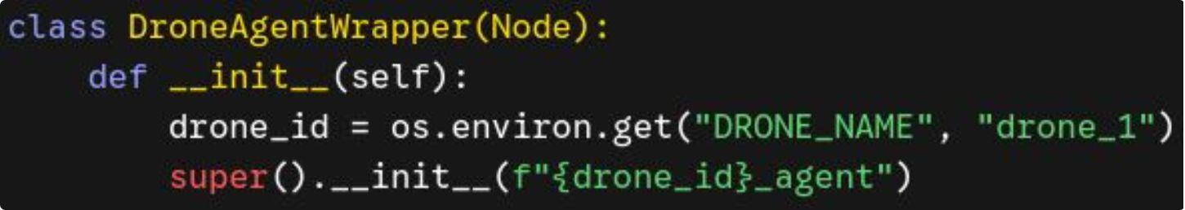
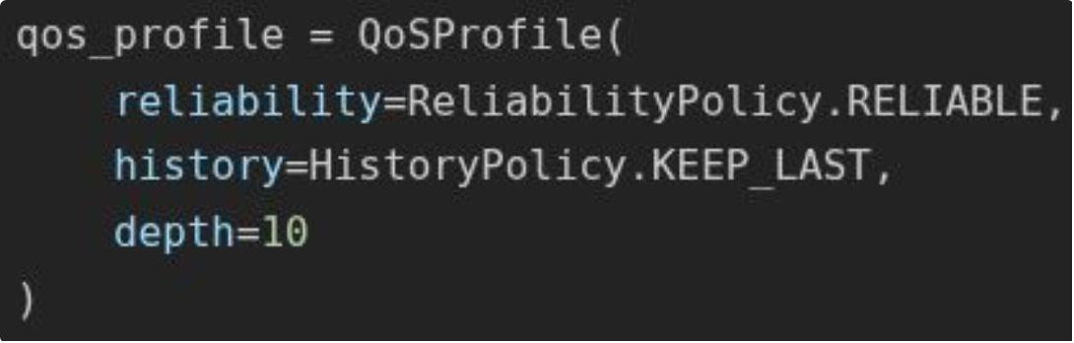
ROS 2 Integration with Drone Wrapper
Architecture & Inheritance from the Framework (rclpy)
Quality of Service (QoS Profile) Configuration
In the drone_wrapper file it is used the official ROS 2 client library for Python, rclpy. The main class inherits directly from the base ROS 2 Node class:
To ensure reliable communication with the Rust Coordinator and the Fast-DDS network, a custom QoS (Quality of Service) profile is configured:
This transforms the Python script into a native node of the ROS 2 graph, capable of:
This ensures that critical messages — such as registration and formation commands — are not lost over the DDS network.
Publishing and subscribing to topics
Managing asynchronous timers via the executor (rclpy.spin(node))

Slide 40




Drone’s Communication Topics:
Understanding how drones and the coordinator communicate is key to the system's distributed nature.
/swarm/register
/swarm/heartbeat
Drone → Coordinator
New drone registration and initialization
Drone → Coordinator
Real-time telemetry and position updates
/swarm/goto
/drone_X/odometry
Coordinator → Drone
Target coordinates for autonomous navigation
Gazebo → Drone
Avoid collisions

Slide 41
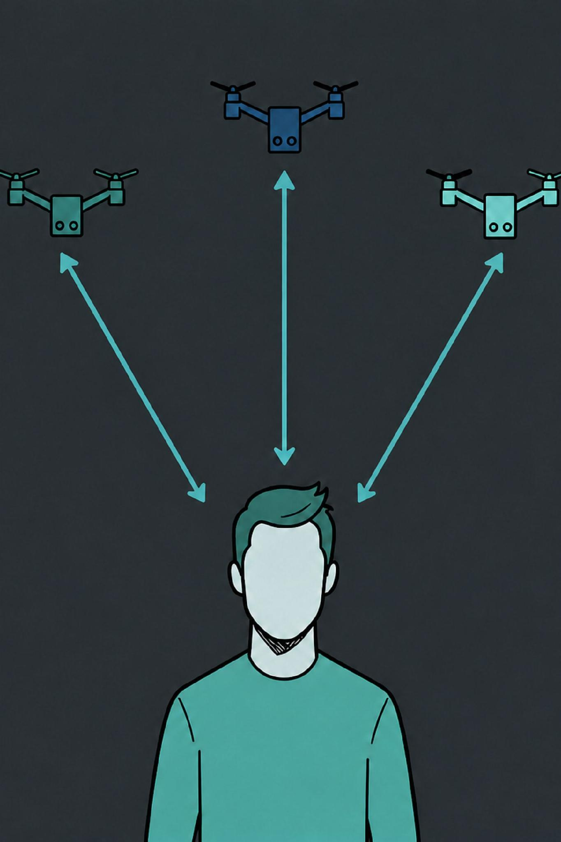
Rust Coordinator
Coordinator in Rust — The swarm is managed by a separate coordinator

Slide 42





The Rust Coordinator: 4 Key Roles
We can see the coordinator in this project like the "central brain", managing several key aspects of the entire simulation.
Registry & Swarm Telemetry
Listens for drone registrations, monitors health status and real-time 3D positions. Maintains a centralized drone database.
Formally Verified FSM Execution
Manages global swarm state transitions (Unregistered → Active → Suspected → Failed). Safety rules are formally verified with Kani.
Leader Election & Re-election
Determines swarm Leader using dynamic proximity/density-based algorithms. Ensures automatic re-election upon leader failure.
Formation Computation & Assignment
Translates global commands into individual 3D coordinates and manages altitude layering for collision prevention. Dispatches /swarm/goto commands.

Slide 43
Coordinator Architecture: Centralized Brain of the Swarm
What the Coordinator Does:
How It Communicates:
Centralized decision-making authority
Receives all drone telemetry and heartbeats
Executes formally verified FSM logic
Computes and assigns flight formations
Manages leader election and fault recovery
Listens to: /swarm/register, /swarm/heartbeat
Sends to: /swarm/goto (target coordinates)
Maintains: Global swarm state (Arc<Mutex<T>>)
Runs: Multi-threaded listener hierarchy
Ensures: Non-blocking asynchronous execution

Slide 44
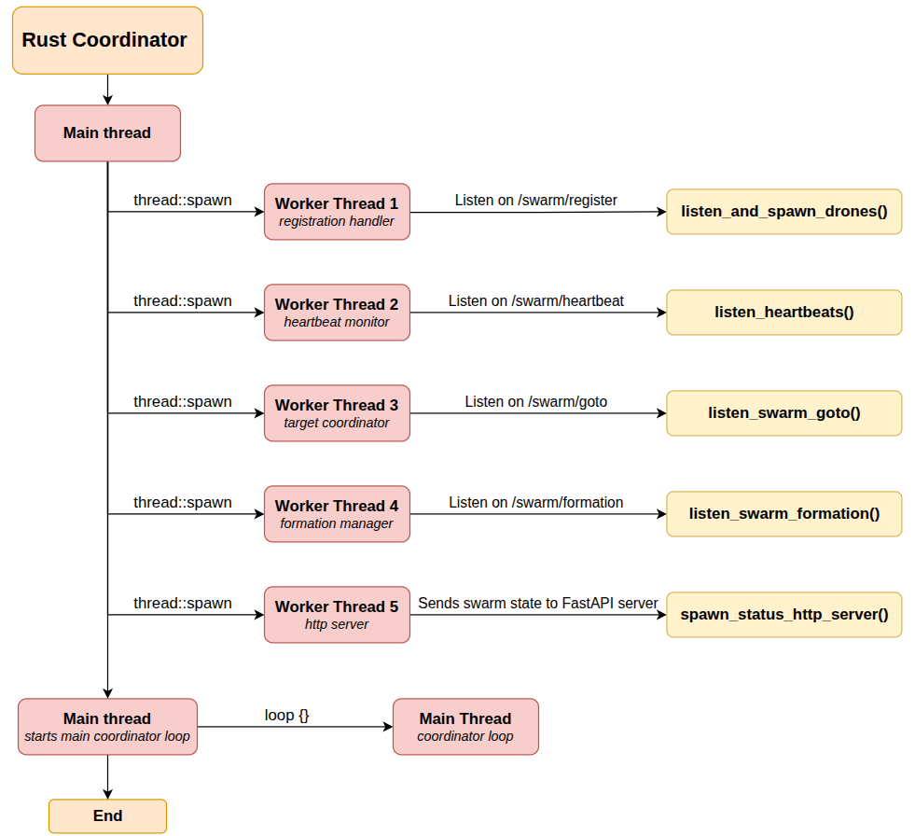





Thread Architecture:
Main Thread - Coordinator Loop
Monitors heartbeat timeouts (5 seconds for Suspected, 10 seconds for Failed)
Executes leader election algorithms when needed
Triggers dynamic swarm re-formations based on current state
Synchronizes with worker threads via thread-safe shared state
Worker Thread 1: Registration Handler
Listens continuously to /swarm/register topic
Handles new drone registrations and initialization
Triggers Gazebo spawning of new drone instances
Updates SwarmCoordinatorState with new drone metadata
Worker Thread 2: Heartbeat Monitor
Listens continuously to /swarm/heartbeat topic
Receives real-time 3D telemetry and position updates
Updates drone timestamps for timeout detection
Maintains current position data for collision avoidance

Slide 45




Thread Architecture:
Worker Thread 3: Target Coordinator
Listens continuously to /swarm/goto topic
Tracks individual coordinate target vectors for each drone
Coordinates with formation algorithms
Ensures each drone receives its assigned destination without blocking other operations
Worker Thread 4: Formation Manager
Listens continuously to /swarm/formation topic
Triggers global swarm pattern algorithms
Manages formation transitions and reconfigurations
Broadcasts formation commands to all drones
Handles dynamic formation changes in response to swarm state
Worker Thread 5: Http server
Exposes an HTTP REST endpoint on coordinator port 8080.
Reads FSM state thread-safely from the shared Mutex.
Returns structured JSON status responses to the FastAPI backend.
Integration with Main Thread:
All worker threads update the shared Arc<Mutex<SwarmCoordinatorState>>
Main thread reads the updated state every 2 seconds
Formation and navigation updates are immediately available to the coordinator
No blocking I/O operations interfere with FSM state machine execution

Slide 46
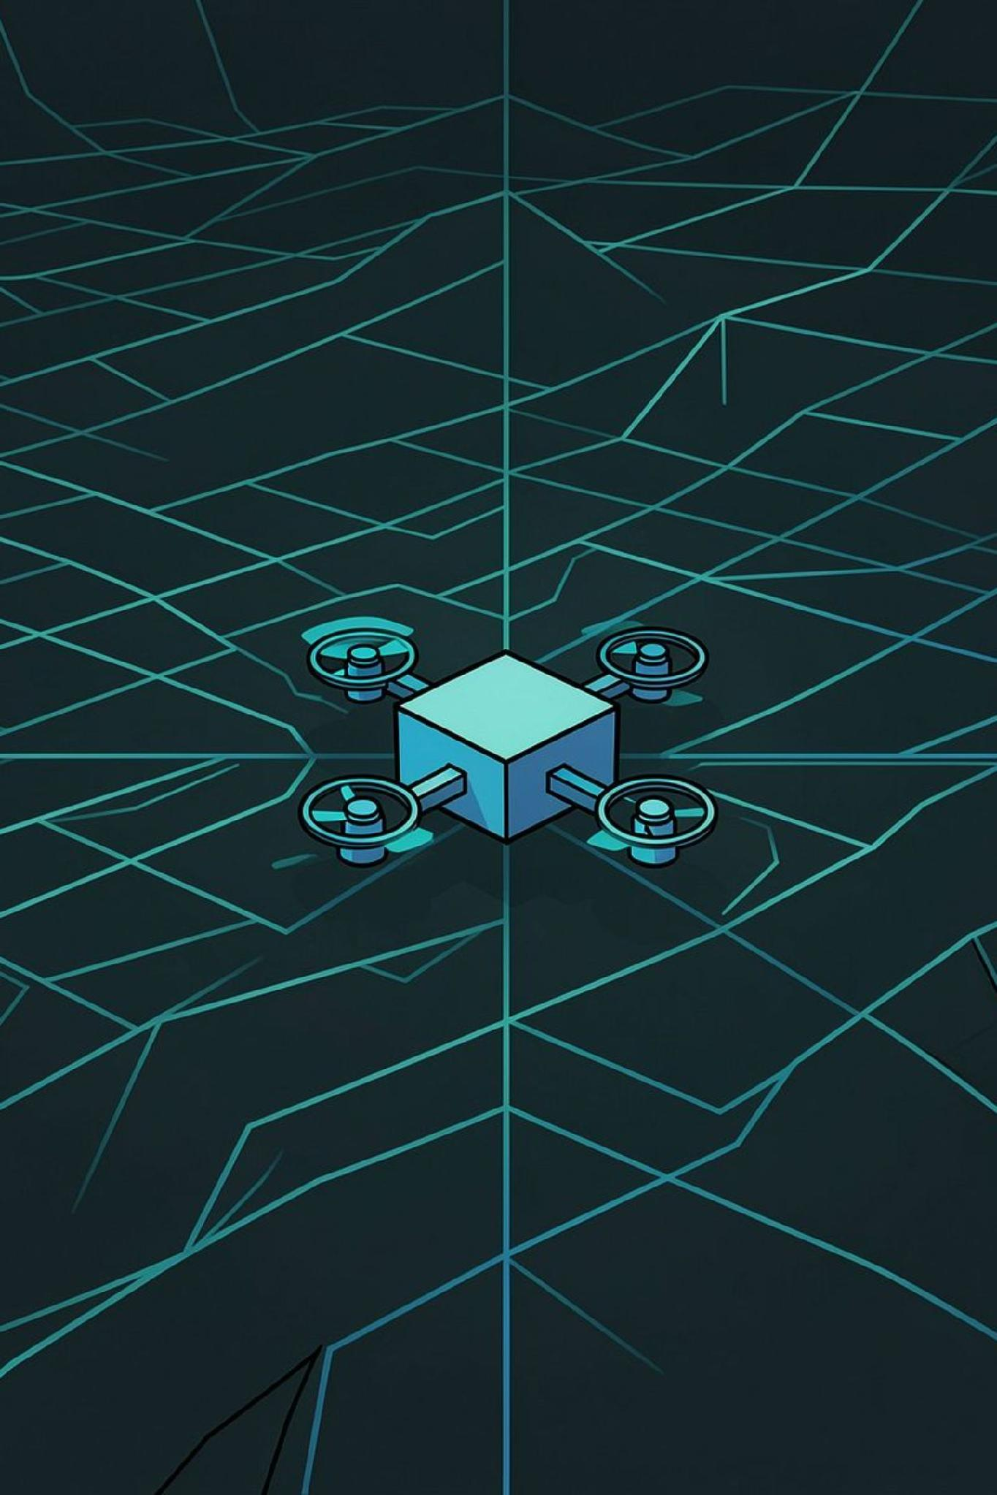
How to spawn a Drone
Spawning drones — Full logical steps to make drones appear in the simulation

Slide 47
Step 1: Drone Container Startup & Environment Configuration
This command triggers the entire project, spawning N drones: docker compose up --scale drone=N
01
02
Docker Engine instantiates N separate containers
Entrypoint script configures ROS 2 / Fast-DDS network environment
(drone_1, drone_2, drone_3, etc.)
03
04
Dynamically calculates initial 3D ground spawn coordinates (X, Y, Z)
Each drone container is isolated and independent
Files & Technology:
entrypoint_drone_agent.sh
Docker Compose, Bash Scripting, Fast-DDS Discovery Server

Slide 48
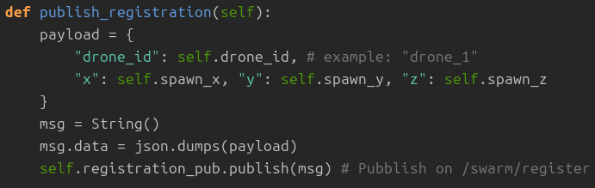
Step 2: ROS 2 Node Initialization & Registration Request
Each drone announces itself to the coordinator by publishing a registration message. A 2-second timer triggers the payload, sending the drone's ID and initial coordinates to the shared /swarm/register topic via Fast-DDS with RELIABLE QoS.
Steps:
Container boots
Construction of JSON payload
ROS 2 Node pubblishes on /swarm/register
Files & Technology:
drone_agent_wrapper.py && entrypoint_drone_agent.sh
rlcpy, Fast-DDS

Slide 49
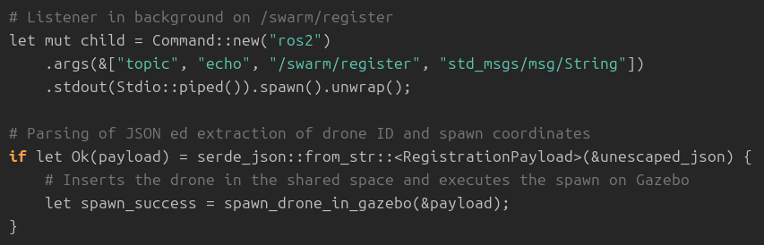
Step 3: Coordinator intercepts registration request
Steps:
Coordinator actively listens for drone registrations
Multi-threaded architecture enables concurrent listening
JSON parsing extracts critical drone metadata
call function spawn_drone_in_gazebo()
Files & Technology:
main.rs
Rust (std::process::Command, std::thread), Serde JSON

Slide 50
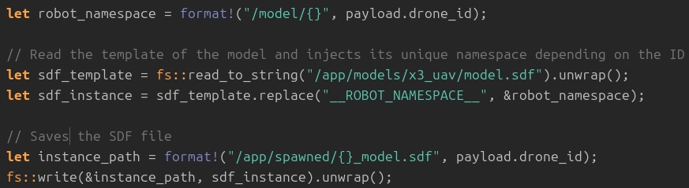
Step 4: Dynamic 3D SDF Model Generation (Namespace Injection)
The Rust Coordinator dynamically generates 3D SDF (Simulation Description Format) models for each drone, ensuring isolated environments within the simulation.
Steps:
Rust Coordinator reads generic 3D SDF model template (x3_uav/model.sdf)
Clones the template for each drone
Replaces __ROBOT_NAMESPACE__ placeholder with unique namespace
Example: /model/drone_1, /model/drone_2, etc.
Each drone gets isolated topic arguments and plugins inside Gazebo
Files & Technology:
main.rs
Rust File I/O (std::fs), SDFormat (SDF 3D Specification)

Slide 51
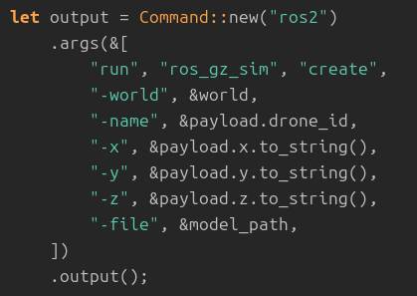
Step 5: Invoking ros_gz_sim create (Gazebo Simulation Spawn)
Steps:
Rust Coordinator executes ros_gz_sim create CLI utility
Passes Gazebo world name, target 3D coordinates (X, Y, Z)
Passes drone name and generated SDF file path
Network command instructs Gazebo simulator engine
Gazebo instantiates 3D drone mesh inside active world
Files & Technology:
main.rs
ros_gz_sim (ROS 2 - Gazebo Harmonic Bridge), Gazebo Sim Service Client

Slide 52
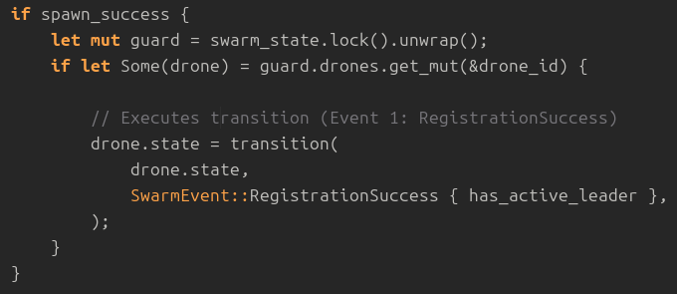
Step 6.1: Formally Verified FSM Update & Telemetry Stream Activation
Steps:
If spawn call has success the Coordinator locks the shared state and triggers the Kani-verified state transition function moving the drone state from Unregistered to Active.
At this point, the drone physically appears in Gazebo, the ros_gz_bridge begins publishing ground-truth odometry, and the Python agent takes control of flight navigation.

Slide 53
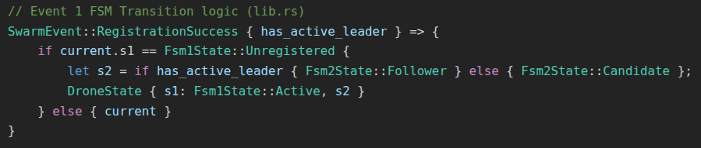
Step 6.2: Candidate drones
Steps:
Once all drones are spawned, at the very beginning there are no active leaders.
The Rust Coordinator applies FSM Event 1 (RegistrationSuccess). Since no active leader exists yet (has_active_leader == false), each registering drone transitions from (Unregistered, None) to (Active, Candidate), making them eligible participants for the upcoming election.
Files & Technology:
main.rs & lib.rs (Kani_verify)
Kani Formal Verification Engine, Rust State Machine (transition)

Slide 54
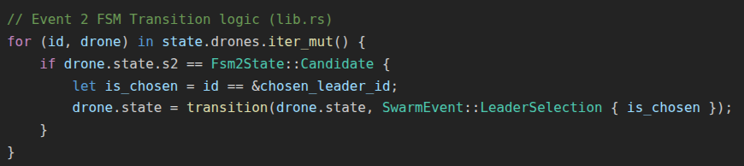
Step 7: Leader election & FSM role assignment
Steps:
Once the election algorithm picks a winner (e.g., drone_1), the Coordinator iterates through all Candidate drones and applies FSM Event 2 (LeaderSelection):
For the chosen candidate (is_chosen == true): State transitions to (Active, Leader).
For all non-chosen candidates (is_chosen == false): State transitions to (Active, Follower).
The Leader election is offically complete, now the drones are spawner and are on the ground, waiting for the order to arrange themselves in formation to take off
Files & Technology:
main.rs & lib.rs (Kani_verify)
Kani Formal Verification Engine, Rust State Machine (transition)

Slide 55
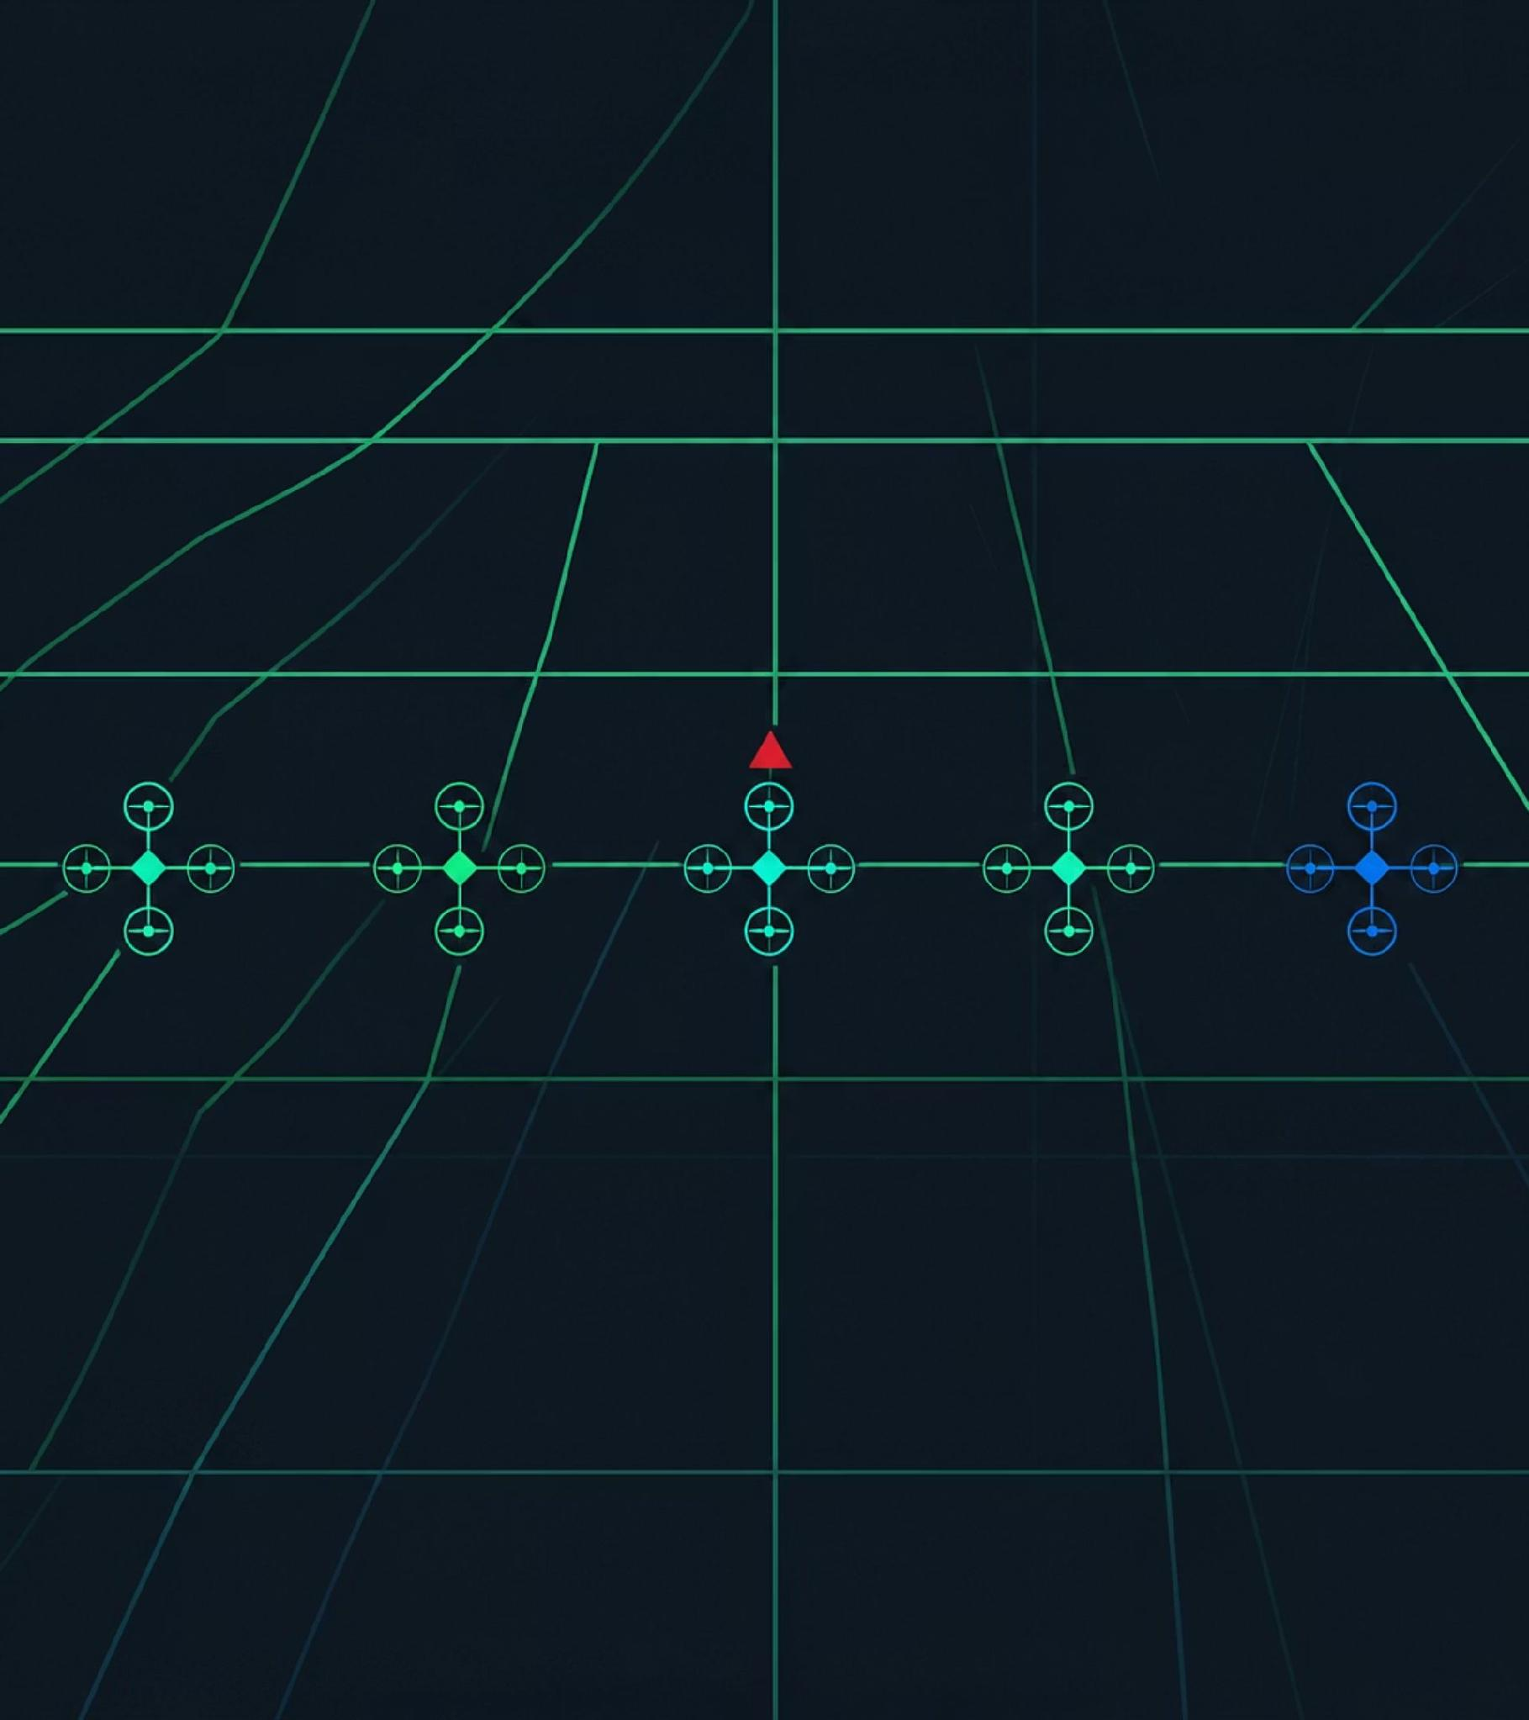
How to put drones in formation
Line Formation — Full logical steps to make drones arrange in formation

Slide 56
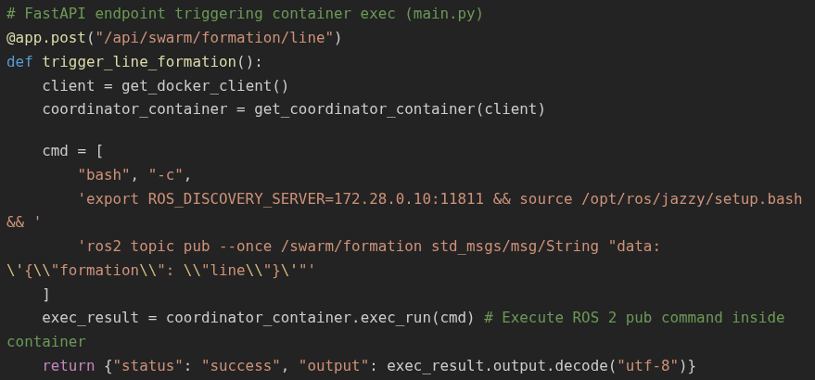
Step 1: Line formation request
Steps:
The frontend sends an HTTP POST request to the /api/swarm/formation/line endpoint. The FastAPI server interacts with the Docker SDK (docker.from_env()) to invoke a ros2 topic pub --once CLI command inside the running Coordinator container via Docker Engine exec_run.
Payload published on /swarm/formation topic over the Fast-DDS Discovery Server network (IP 172.28.0.10:11811).
The CLI command publishes the one-shot JSON payload onto the ROS 2 network. The Fast-DDS Discovery Server routes this publication towards all subscribers listening to topic /swarm/formation.
Files & Technology:
main.py & app.js
FastAPI, Docker SDK for Python (exec_run), JavaScript (Fetch API).

Slide 57
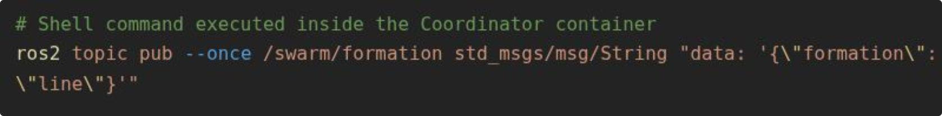
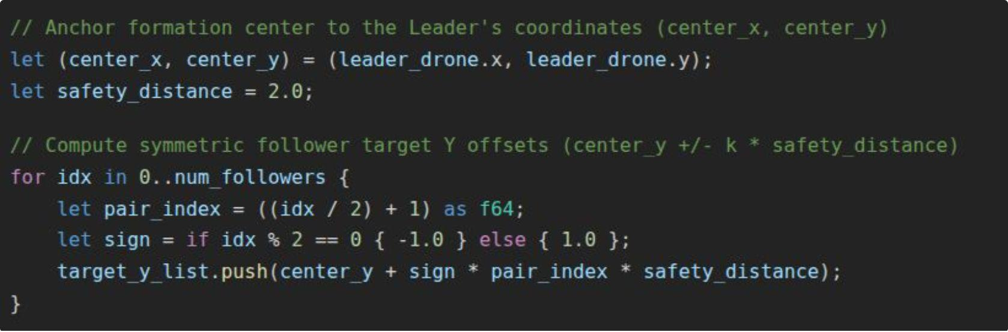
Step 2: Formation Request Interception & Geometric Slot Calculation
Steps:
The coordinator receives the request to arrange drones in formation (e.g., "line" on topic /swarm/formation)
the Rust Coordinator locks the active Leader at the center and symmetrically computes target 3D offsets for all active Followers.
Files & Technology:
main.rs
ROS 2 Topic Subscriber

Slide 58
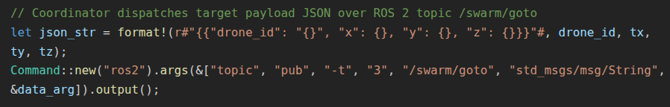
Step 3: Asynchronous Target Dispatch
Steps:
The Coordinator dispatches individual target commands via ros2 topic pub on topic /swarm/goto
Each drone's Python agent receives its assigned target
Each drone drives its motors using a P-Controller at 20 Hz, while applying Artificial Potential Fields (APF) to maintain safe distances from peer drones avoiding collisions
Files & Technology:
main.rs & drone_agent_wrapper
ROS 2 Topic Publisher, Python P-Controller, 3D Artificial Potential Fields (APF).

Slide 59
Step 4: Collision avoidance
Steps:
To prevent mid-air collisions during formation changes, the Coordinator assigns staggered transit flight altitudes 4.8m for even-indexed followers, 5.6m for odd-indexed followers). Adjacent drones never cross horizontal space at the same height.
APF (Artificial Potential Fields): each drone applies a 3D repulsive forces to prevent collisions between neighboring drones
Files & Technology:
main.rs
Altitude Layering Collision Avoidance Protocol, Rust State Matching.

Slide 60
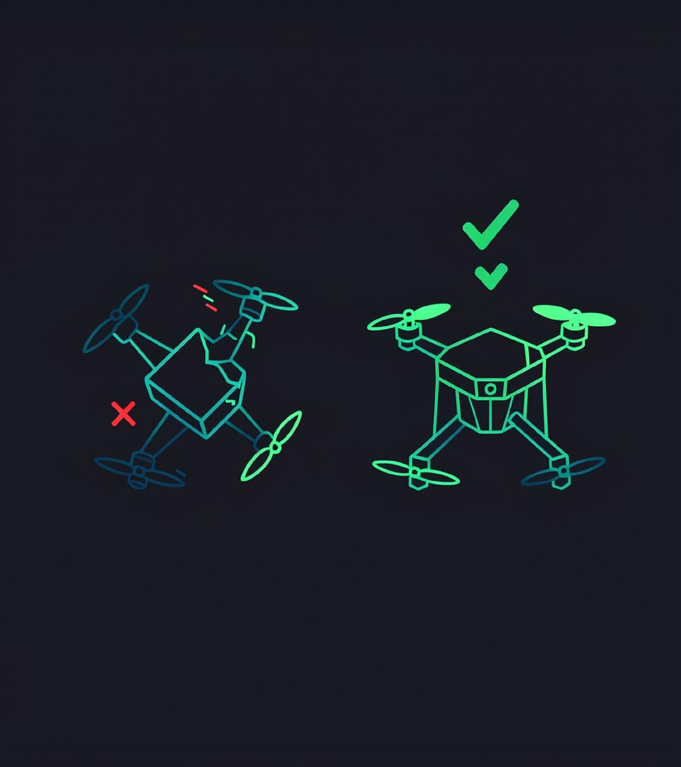
Failure and repair
Fail and Recovery — Full logical steps to simulate failure of a drone and recovery

Slide 61

Scenario 1: Follower Drone Failure
1
2
Failure Detection
State Persistence
Heartbeat timeout (10s)
Drone marked as Failed in FSM
Despawned from Gazebo
Coordinator maintains target coordinates in memory
Previous 3D position stored for every drone

Slide 62



Scenario 2: Leader Drone Failure & Reconfiguration
1) FSM Role Reset
Leader drone fails (detected via heartbeat timeout). All active Followers transition to Candidate state. Drones become eligible for new leader election.
2) Smart Leader Election
Algorithm considers spatial proximity to failed leader's slot. Selects candidate from denser wing (side with more drones). Ensures balanced formation.
3) Ripple-Shift Re-formation
New Leader moves to center position. Opposite wing remains stationary (no unnecessary moves). Vacant wing performs cascade shift inward by 2.0m safety distance. Formation automatically rebalances.

Slide 63
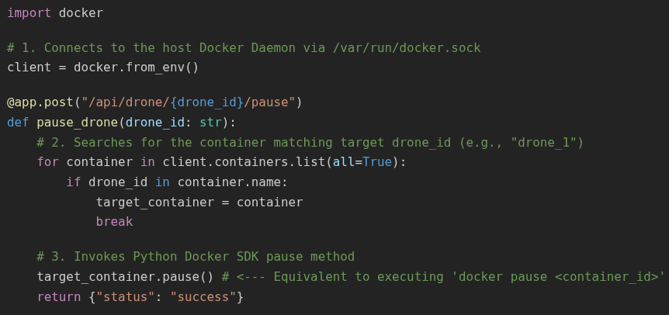
Step 1: User simulates the failure
Steps:
When the users click this button, the JavaScript code (app.js) intercepts the click event and sends an HTTP POST request to the REST endpoint: POST /api/drone/drone_1/pause
The FastAPI server utilizes the official docker library (Docker SDK for Python) to communicate directly with the Docker daemon running on the host OS.
Files & Technology:
main.py & app.js
FastAPI, Docker SDK for Python (exec_run), JavaScript (Fetch API).

Slide 64
Step 2: Docker pauses the container
The call target_container.pause() is functionally identical to running the CLI command:
docker pause implementation-drone-N
At the Linux Operating System level:
It issues a SIGSTOP signal to all running processes inside that specific container.
The Python process (drone_agent_wrapper.py) inside that container is instantly frozen in its current execution state.
IMMEDIATE EFFECT: The drone stops broadcasting messages across the ROS 2 / Fast-DDS bus. Odometry streaming and heartbeats on /swarm/heartbeat cease entirely.

Slide 65
Step 3: How rust coordinator reacts to docker pause
Because the container process is frozen:
After 5 seconds of missing heartbeats, the Rust Coordinator's main event loop detects elapsed_seconds > 5s and triggers FSM transition from Active to Suspected.
After 10 seconds, the critical failure threshold is reached (elapsed_seconds > 10s) and triggers FSM transition from Suspected to Failed.
  Applies FSM event DroneFailed (Failed state).
  Despawns the drone mesh from 3D Gazebo (despawn_drone_from_gazebo).
  If the failed drone was the Leader, it triggers dynamic Leader Re-election and wing ripple-shift formation re-alignment!

Slide 66

Drone Repair & Re-integration: Two Scenarios
Scenario 1: No Reconfiguration
Formation remains unchanged while drone is offline. Upon repair, the drone automatically returns to its original slot. The coordinator sends it back to its previous position.
Scenario 2: Formation Reconfigured
Leader fails and formation is reconfigured with ripple-shift. Original slot no longer exists. Upon repair, the drone is assigned to one of the formation ends and integrates at the edge.

Slide 67
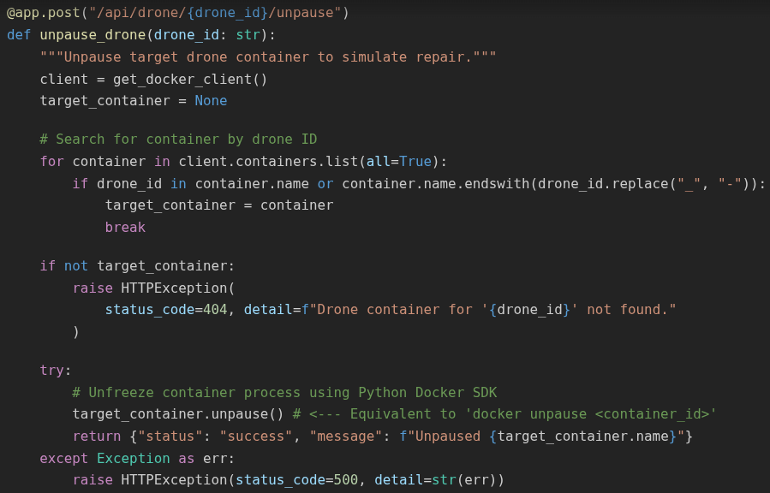
Repair:
Steps:
When you click "Simulate Repair", it sends POST /api/drone/drone_1/unpause.
FastAPI executes target_container.unpause() (equivalent to docker unpause)
The container process is unfrozen (SIGCONT) and the process resumes execution, re-broadcasts on /swarm/register.
The Rust Coordinator applies FSM event RepairCompleted ( Unregistered → Active), respawns the 3D model in Gazebo, and the drone autonomously navigates back to its designated formation slot!

Slide 68



Summary: Key Results
Distributed & Fault-Tolerant Swarm Architecture
Formally Verified FSM Correctness
Decentralized 3D Navigation & Collision Avoidance
100% formal verification using Kani Model Checking
Safety guarantees for state transitions
Coordinated swarm based on ROS 2 & Docker
Actor Model with asynchronous messaging
Real-time APF (Artificial Potential Fields)
Autonomous obstacle avoidance
Smart leader selection and reconfiguration

Slide 69
Thanks for Your Attention
Student: Francesco Raimondo
Course: Engineering in Computer Science, University of Messina
GitHub Repository: https://github.com/francesco-raimondo/iiot-drone-coordinator-rust-docker

