Slide 1
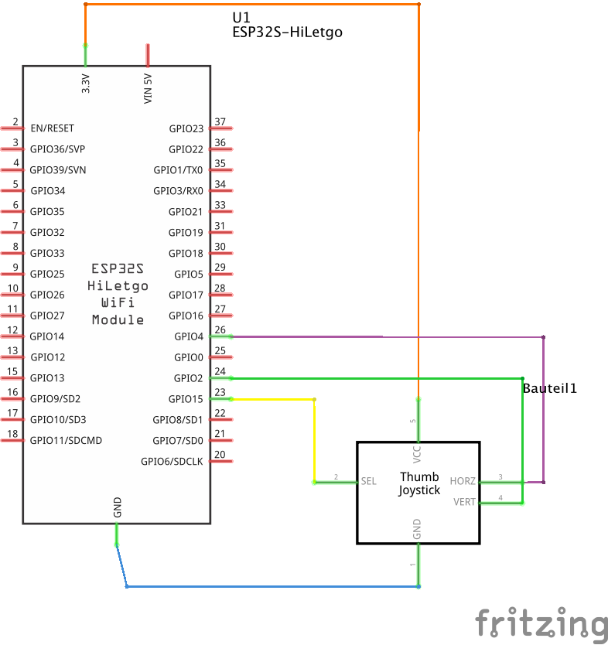
Thumb Joystick
Voltage: 0-5V
Potentiometers: 12 bit (0-4096 values)
Switch: 3.3V (0 when completely pressed)
int VRx = 4;
int VRy = 2;
int SW = 15;
int switchValue;
int lastSwitchState = LOW;
int delayMs = 500;
int elapsedTime = 0;
void setup() {
// put your setup code here, to run once:
pinMode(VRx, INPUT);
pinMode(VRy, INPUT);
pinMode(SW, INPUT);
//digitalWrite(VRx, HIGH);
//digitalWrite(VRy, HIGH);
digitalWrite(SW, HIGH);
Serial.begin(9600);
}
void loop() {
// put your main code here, to run repeatedly:
/*
switchValue = analogRead(SW);
if (switchValue == 0) {
Serial.println("Switch pressed, value " + (String) switchValue);
Serial.println("Digital switch value " + (String) digitalRead(SW));
}
*/
if (millis() > elapsedTime) {
elapsedTime += delayMs;
Serial.println("X: " + (String) analogRead(VRx));
Serial.println("Y: " + (String) analogRead(VRy));
}
}

