Slide 1
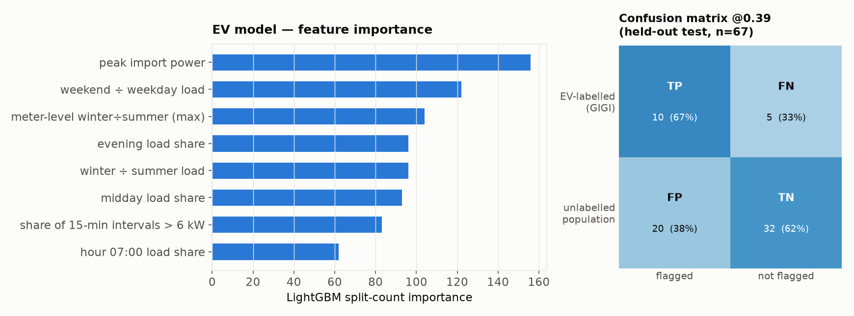
EV — results & takeaways
LightGBM (E22_lgbm_total, all-net-load features) · held-out test, n=67 properties, 15 GIGI-labelled EV
Takeaways
• 45 features: annual load aggregates + 24-hr mean hourly profile + windowed multi-meter context (heat-pump-like meters, winter-dominance) for the property
• Picked by validation PR-AUC among 9 candidates (dummy, 3 heuristic rules, 2 logistic, 2 gradient-boosted, LightGBM); threshold frozen on validation, refit on dev+val, test opened once
• Held-out test: ROC-AUC 0.67, recall 67%, precision 33% (n=67, prevalence 22% — small sample, wide CIs)
• Negative class is subsidy-register-unlabelled, not verified EV-absent — reported false-positive rate likely overstates the true one
• Post-hoc plateau-rescue / steep-slope heuristics tested on top of LightGBM and rejected (no test-set improvement); base model remains deployed

