Slide 1
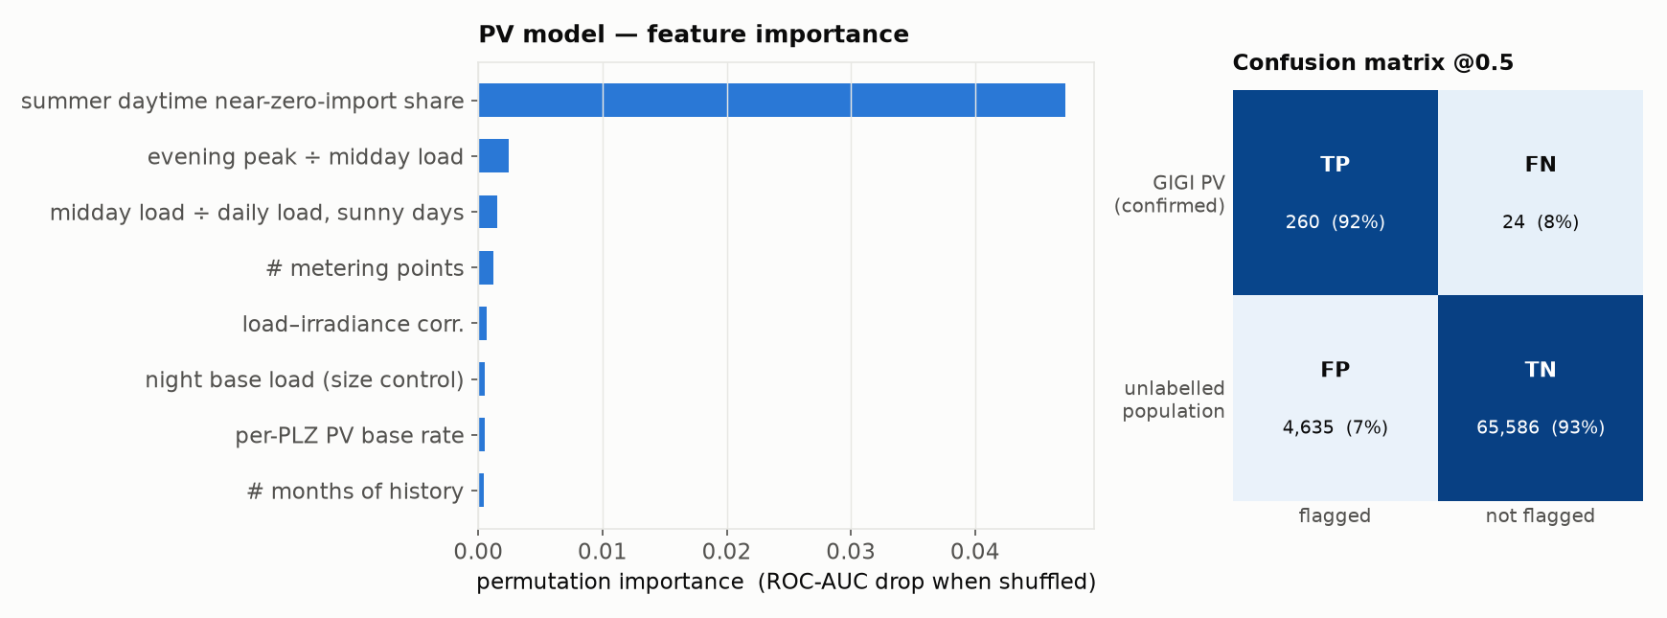
PV — results & takeaways
HistGradientBoosting, Positive–Unlabeled (Elkan–Noto) · 5-fold out-of-fold; held-out GIGI positives as ground truth
Takeaways
• 23 features from the grid-import load shape only (feed-in register used offline, for silver labels, never as a feature): midday depression / duck curve, weather–solar coupling, seasonality, night base load, year-on-year change-point
• No confirmed non-PV households exist, so the model is trained Positive–Unlabeled with Elkan–Noto correction and calibrated to the 12% ElPA canton base rate rather than fit as ordinary binary classification
• ROC-AUC 0.92 (GIGI vs rest), recall 92% on held-out known PV, flags 7% of the unlabelled population at threshold 0.5
• Confusion matrix (right): GIGI-confirmed PV vs strictly unlabelled households; ~6.2k silver feed-in-derived positives excluded from both classes so they don't skew the negative pool
• Weak spots: geographic agreement with the PV register modest (ρ≈0.1); change-point feature does not track install dates yet

