Slide 1
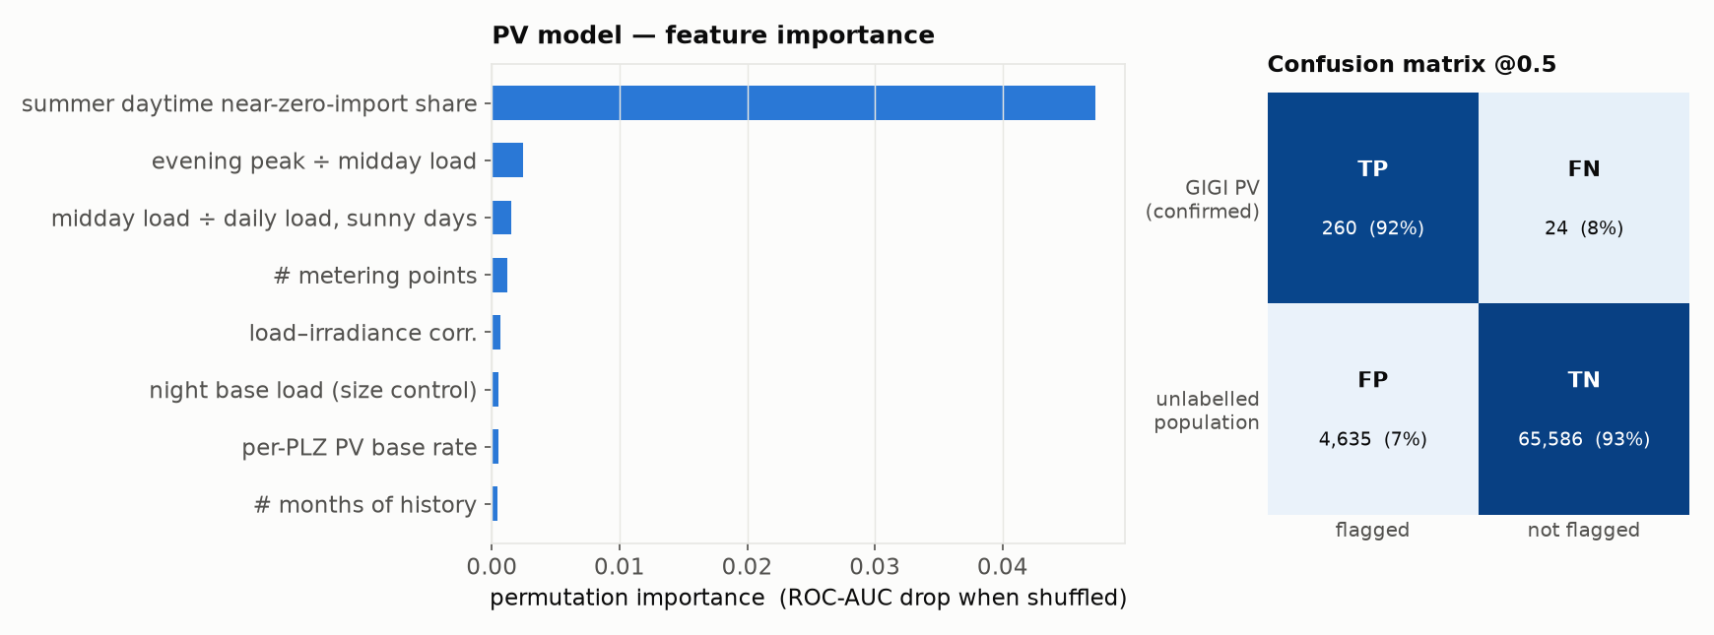
PV — results & takeaways
HistGradientBoosting, Positive–Unlabeled (Elkan–Noto) · 5-fold out-of-fold; held-out GIGI positives as ground truth
Takeaways
• 23 features from the grid-import load shape only (feed-in register used offline, for silver labels, never as a feature): midday depression / duck curve, weather–solar coupling, seasonality, night base load, year-on-year change-point
• No confirmed non-PV households exist, so the model is trained Positive–Unlabeled with Elkan–Noto correction and calibrated to the 12% ElPA canton base rate rather than fit as ordinary binary classification
• ROC-AUC 0.92 (GIGI vs rest), recall 92% on held-out known PV, flags 7% of the unlabelled population at threshold 0.5
• Confusion matrix (right): GIGI-confirmed PV vs strictly unlabelled households; ~6.2k silver feed-in-derived positives excluded from both classes so they don't skew the negative pool
• Weak spots: geographic agreement with the PV register modest (ρ≈0.1); change-point feature does not track install dates yet

Slide 2
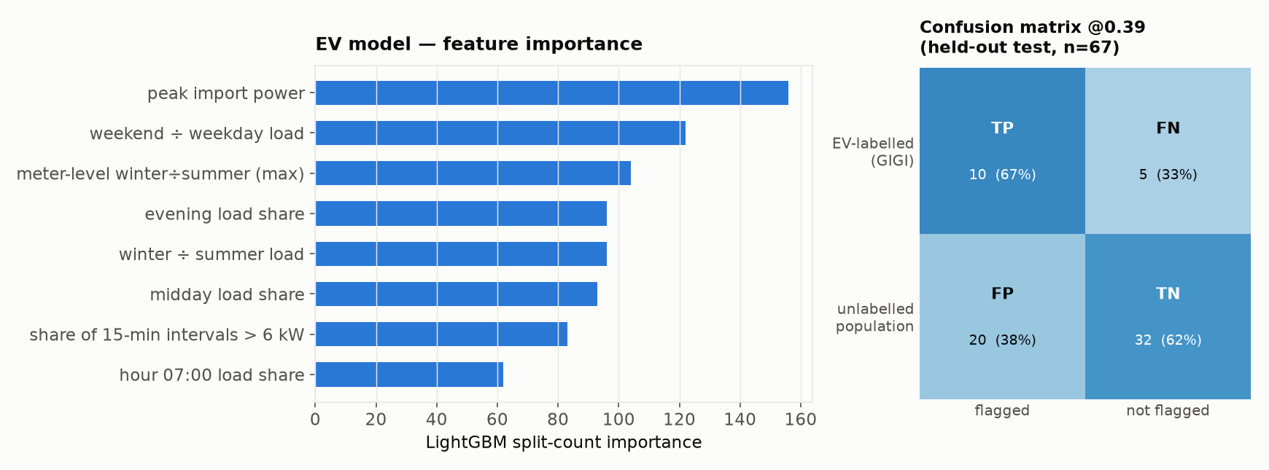
EV — results & takeaways
LightGBM (E22_lgbm_total, all-net-load features) · held-out test, n=67 properties, 15 GIGI-labelled EV
Takeaways
• 45 features: annual load aggregates + 24-hr mean hourly profile + windowed multi-meter context (heat-pump-like meters, winter-dominance) for the property
• Picked by validation PR-AUC among 9 candidates (dummy, 3 heuristic rules, 2 logistic, 2 gradient-boosted, LightGBM); threshold frozen on validation, refit on dev+val, test opened once
• Held-out test: ROC-AUC 0.67, recall 67%, precision 33% (n=67, prevalence 22% — small sample, wide CIs)
• Negative class is subsidy-register-unlabelled, not verified EV-absent — reported false-positive rate likely overstates the true one
• Post-hoc plateau-rescue / steep-slope heuristics tested on top of LightGBM and rejected (no test-set improvement); base model remains deployed

Slide 3
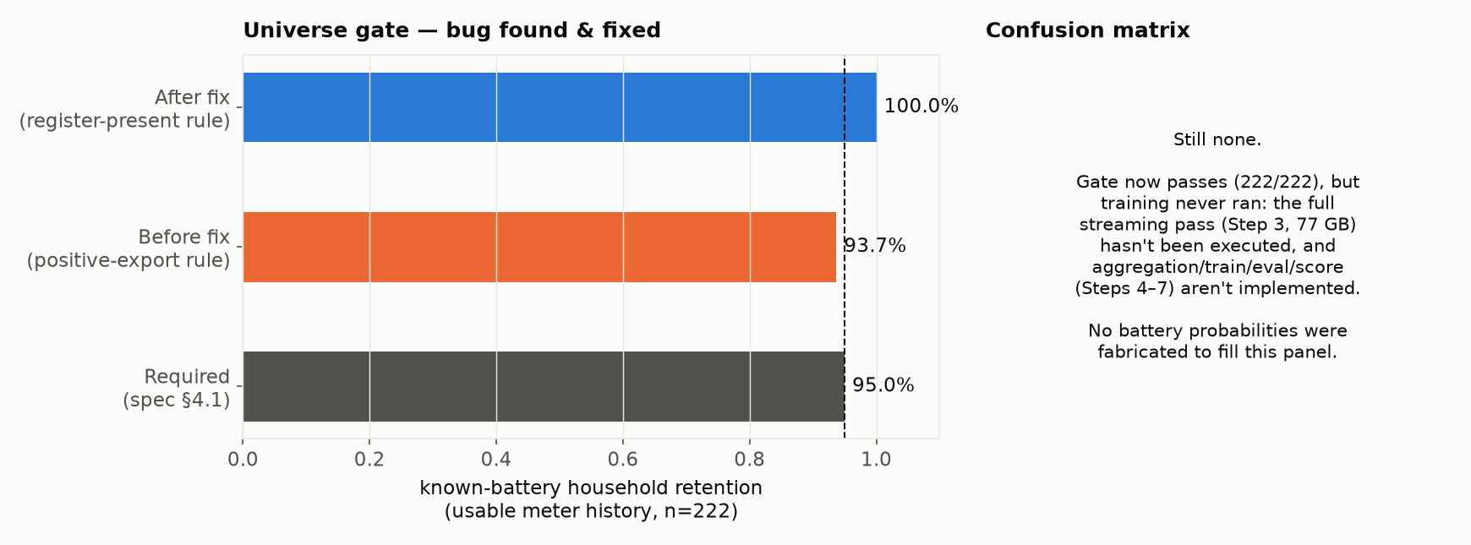
Battery — design & status
Universe-gate bug found & fixed (2026-09-11) — still no score or confusion matrix, for a different reason now
Takeaways
• Fixed: the gate's "measured" test required a positive export reading, so it treated a working register that reads exactly zero every day the same as a missing meter — but a greedy self-consumption / feed-in-limited battery is expected to leave no export at all. All 14 rejected households have a confirmed-working register (100+ daily readings, always 0.0 kWh). Admitting register presence instead of positive readings takes retention from 208/222 (93.7%) to 222/222 (100%), label-blind throughout
• Design: reuses the PV pipeline's I/O + PU learner (Elkan–Noto); contrast is battery vs PV-without-battery, not vs the general population — 96% of GIGI battery households also have PV, so a population-wide model would just relearn “has PV”
• Intended feature families (literature-grounded, not yet scored): zero-import / flat-interval plateaus, feed-in shaping (delayed & clipped export), ramp smoothing, evening-zero → step recovery, charge/discharge energy-balance check (η≈0.80–0.95)
• 82 GIGI “no battery” households remain a held-out audit set, never used as training negatives
• Not yet done: the full streaming pass (Step 3, 77 GB) hasn't run, and aggregation/train/evaluate/score (Steps 4–7) aren't implemented — the gate no longer blocks the pipeline, but nothing downstream of it has been built or run

Slide 4
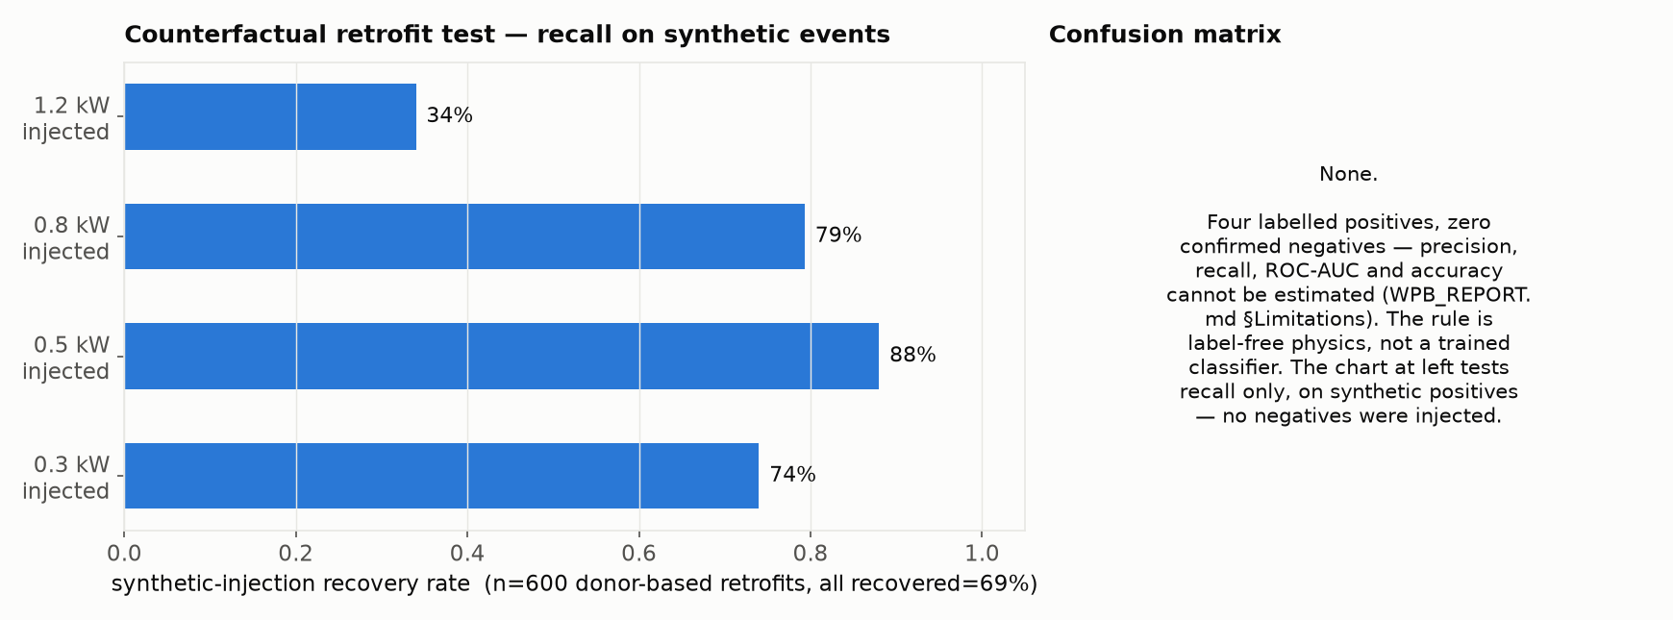
Heat-pump boiler (WPB) — design & status
Label-free physical rule on 15-min grid import — no supervised classifier, so no confusion matrix
Takeaways
• Design: per meter-month p10 (10th-percentile) envelope across all days — a load must repeat on ≥90% of days to show up, which structurally rules out irregular loads like a part-time EV
• Plateau ≥0.25 kW above the quietest rolling hour; flagged only if amplitude 0.25–1.2 kW and duration 1.5–9 h (physical bands from COP≈3, not fit to labels), and it must reappear in both January and July to reject seasonal confounders (dehumidifiers, floor heating, part-load heat pumps)
• Only 4 GIGI-labelled households have meter data and zero are confirmed negatives, so precision, recall, ROC-AUC and accuracy cannot be estimated (WPB_REPORT.md)
• Closest available validation (left): inject a real resistance boiler's energy at WPB power/duration into 150 real households per amplitude and see if the rule recovers it — recall only, no negatives tested
• 838 of 75,094 households flagged (1.1%); rank correlation with the BFS building register is weak and inconsistent (ρ=+0.27, p=0.03 at ≥100 meters/postcode; ρ=+0.12, p=0.30 at ≥30) — not a validation, just the same order of magnitude

