Slide 1
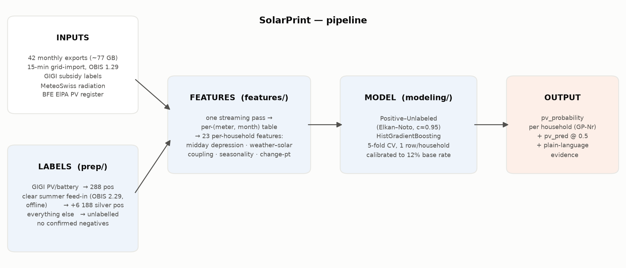
SolarPrint — architecture
Per-household P(rooftop PV) from 15-min grid-import readings (OBIS 1.29 only)
• Positive–Unlabeled (no confirmed non-PV households) · GBDT · 5-fold CV · Elkan–Noto correction · calibrated to the 12 % ElPA base rate

Slide 2
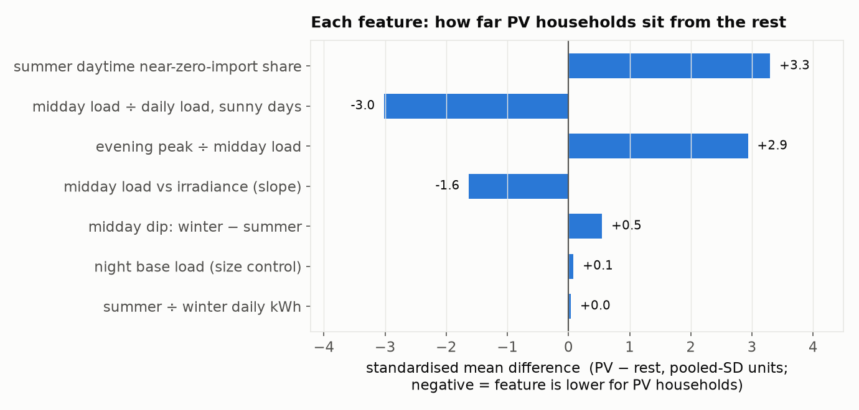
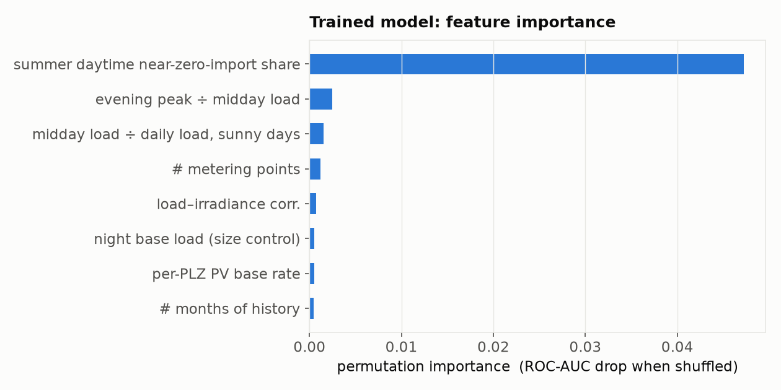
SolarPrint — features
23 features from the grid-import load shape; feed-in register used offline only
Feature groups
• Midday depression / duck curve
• Weather–solar coupling (MeteoSwiss radiation)
• Seasonality · load level · night base load
• Year-on-year change-point (new installs)
Sources
Duck-curve midday depression — NREL, Denholm et al. 2015 · Weather–solar coupling — SunDance, Chen & Irwin, ACM e-Energy 2017 · Net-load + weather-status ML detection — Electricity Journal 2022
Weather — MeteoSwiss SwissMetNet open data · Base rate — BFE ElPA register · Method — challenge label-first approach

Slide 3
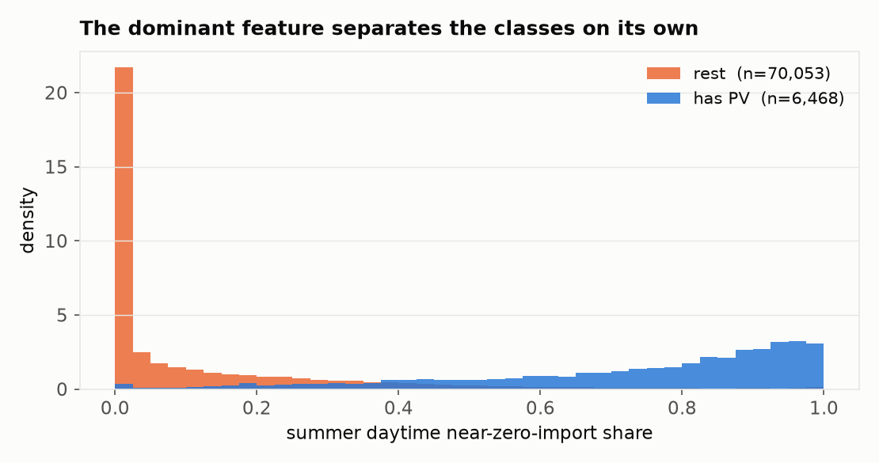
SolarPrint — the dominant signal
When PV covers the load, net grid-import falls to ~zero during the day
• PV homes: most summer daytime intervals near zero net import
• Rest: daytime import stays well above zero
• This one feature, trained the same way, gives ROC-AUC 0.90 (recall 0.87) — the other 22 add ~2–3 points and sharper probabilities

Slide 4
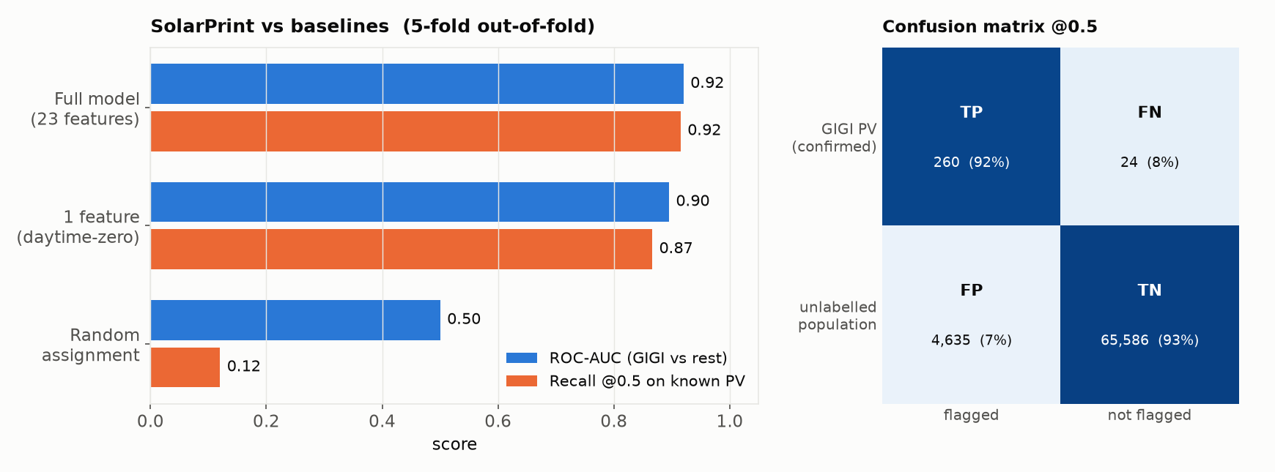
SolarPrint — results vs baselines
5-fold out-of-fold; held-out GIGI positives as ground truth. PU-adjusted: ranking reliable, absolute calibration approximate.
Approach | ROC-AUC | Recall@0.5 | Flag-rate
Random assignment | 0.50 | 0.12 | 0.12
Heuristic rule | — | — | —
1 feature (daytime-zero) | 0.90 | 0.87 | 0.08
Full model (23 feat.) | 0.92 | 0.92 | 0.07
• Flags 7% of the population (ElPA base rate ≈ 12 %) and catches 92% of held-out known PV homes.
• Confusion matrix (right): GIGI-confirmed PV vs strictly unlabelled households; ~6.2k silver feed-in-derived positives excluded from both classes so they don't skew the negative pool.
• Weak spots: geographic agreement with the PV register modest (ρ≈0.1); change-point feature does not track install dates yet.

Slide 5
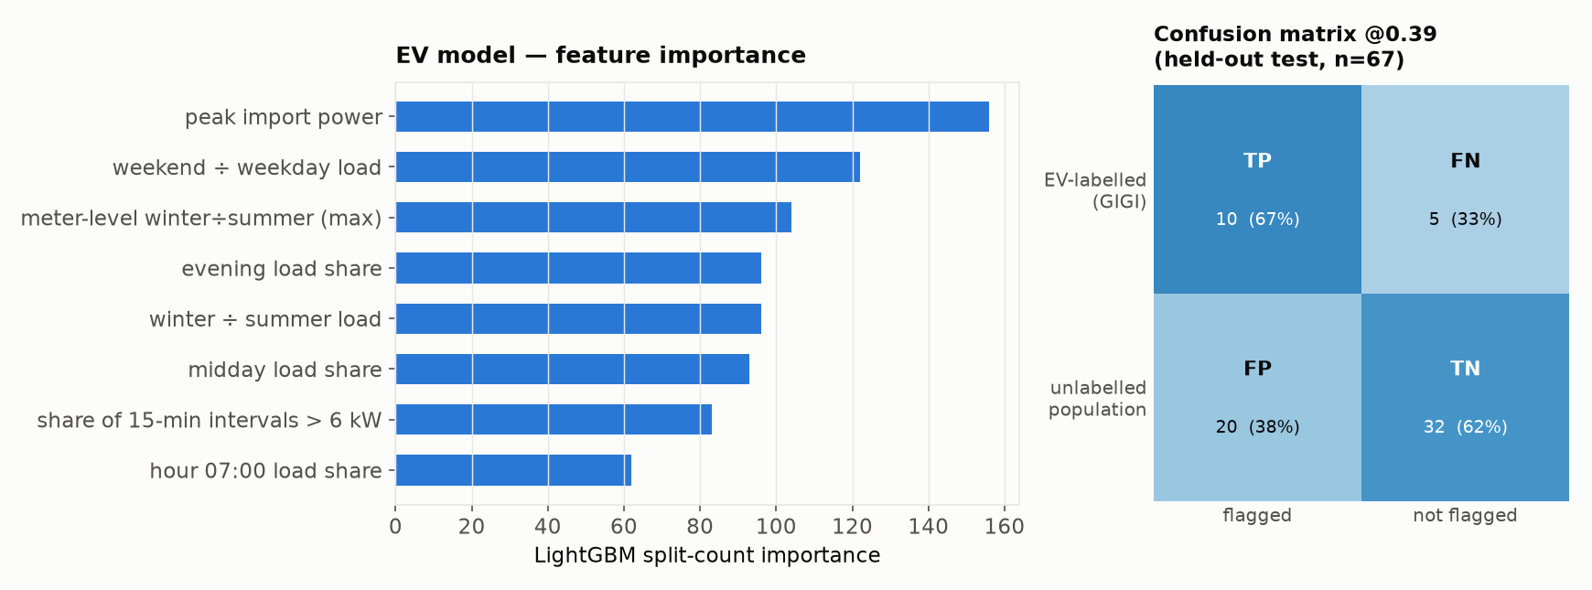
EV — results & takeaways
LightGBM (E22_lgbm_total, all-net-load features) · held-out test, n=67 properties, 15 GIGI-labelled EV
Takeaways
• 45 features: annual load aggregates + 24-hr mean hourly profile + windowed multi-meter context (heat-pump-like meters, winter-dominance) for the property
• Picked by validation PR-AUC among 9 candidates (dummy, 3 heuristic rules, 2 logistic, 2 gradient-boosted, LightGBM); threshold frozen on validation, refit on dev+val, test opened once
• Held-out test: ROC-AUC 0.67, recall 67%, precision 33% (n=67, prevalence 22% — small sample, wide CIs)
• Negative class is subsidy-register-unlabelled, not verified EV-absent — reported false-positive rate likely overstates the true one
• Post-hoc plateau-rescue / steep-slope heuristics tested on top of LightGBM and rejected (no test-set improvement); base model remains deployed

Slide 6
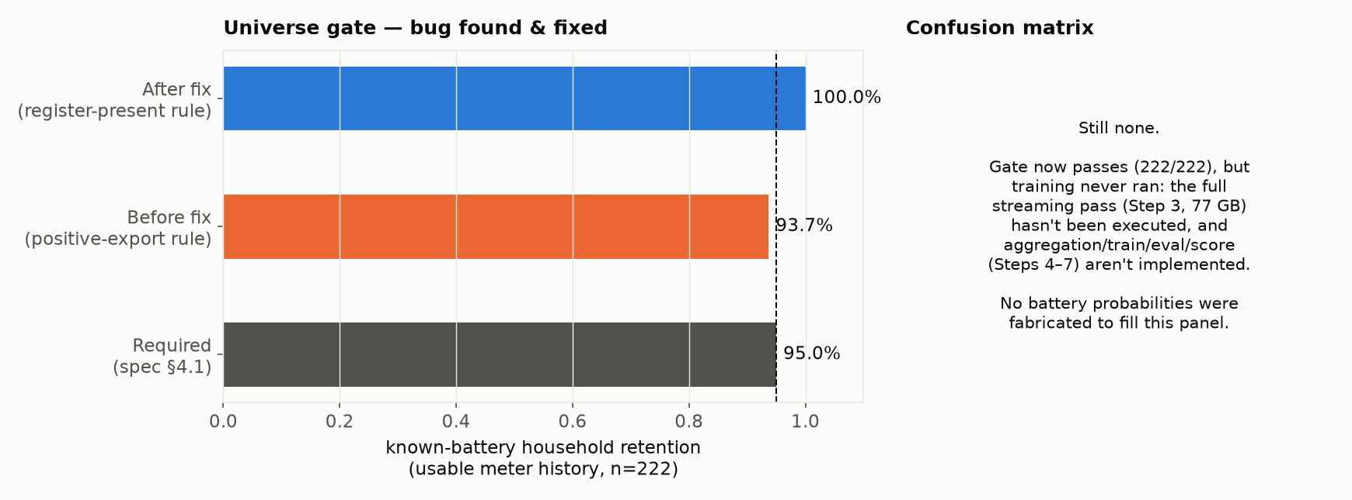
Battery — design & status
Universe-gate bug found & fixed (2026-09-11) — still no score or confusion matrix, for a different reason now
Takeaways
• Fixed: the gate's "measured" test required a positive export reading, so it treated a working register that reads exactly zero every day the same as a missing meter — but a greedy self-consumption / feed-in-limited battery is expected to leave no export at all. All 14 rejected households have a confirmed-working register (100+ daily readings, always 0.0 kWh). Admitting register presence instead of positive readings takes retention from 208/222 (93.7%) to 222/222 (100%), label-blind throughout
• Design: reuses the PV pipeline's I/O + PU learner (Elkan–Noto); contrast is battery vs PV-without-battery, not vs the general population — 96% of GIGI battery households also have PV, so a population-wide model would just relearn “has PV”
• Intended feature families (literature-grounded, not yet scored): zero-import / flat-interval plateaus, feed-in shaping (delayed & clipped export), ramp smoothing, evening-zero → step recovery, charge/discharge energy-balance check (η≈0.80–0.95)
• 82 GIGI “no battery” households remain a held-out audit set, never used as training negatives
• Not yet done: the full streaming pass (Step 3, 77 GB) hasn't run, and aggregation/train/evaluate/score (Steps 4–7) aren't implemented — the gate no longer blocks the pipeline, but nothing downstream of it has been built or run

