Slide 1
Finding the Wärmepumpenboiler
A physical, interpretable search for a small daily hot-water load in four years of 15-minute meter data.

Slide 2
The device, and why it is not the heat pump
• A Wärmepumpenboiler heats a 200–300 L hot-water tank, not the house.
  – WPB: 0.3–1.0 kW, 3–8 h, ~2 kWh/day, flat across the year
  – Resistance Elektroboiler: 2–4 kW, ~1–2 h, ~7 kWh/day
  – Space heat pump: many cycles/day, tracks heating degree-days
• Same hot water, different power — the ratio is roughly the COP.
• Why it matters: ~2 kWh/day of shiftable load on a tank that is already a thermal store.
The amplitude split is physics, not a fitted threshold.

Slide 3
The constraint that shaped everything
• 10 households in GIGI are flagged Wärmepumpenboiler. 4 have meter data.
  – '-' in the column means 'row is about another asset', never 'no WPB'
  – → zero confirmed negatives, so no supervised classifier
• So: a rule-based physical detector, validated without labels.
Reported as a sensitivity study, not an accuracy number.

Slide 4
Method — the p10 'always-on' envelope
• Per meter-month, take per-slot quantiles across all days.
• Run detection on the 10th percentile, not the mean.
  – a load must appear on ≥90% of days to lift p10
  – → once-a-day timer regularity is enforced structurally
  – → an EV charged a few nights a week cannot produce a plateau
• Plateau = contiguous run ≥0.25 kW above the quietest rolling hour, wrapping midnight.
• Confirm in BOTH a summer and a winter month.
  – dehumidifier, floor heating, part-load heat pump: all seasonal
  – a WPB tracks cold-water inlet temperature, not degree-days

Slide 5
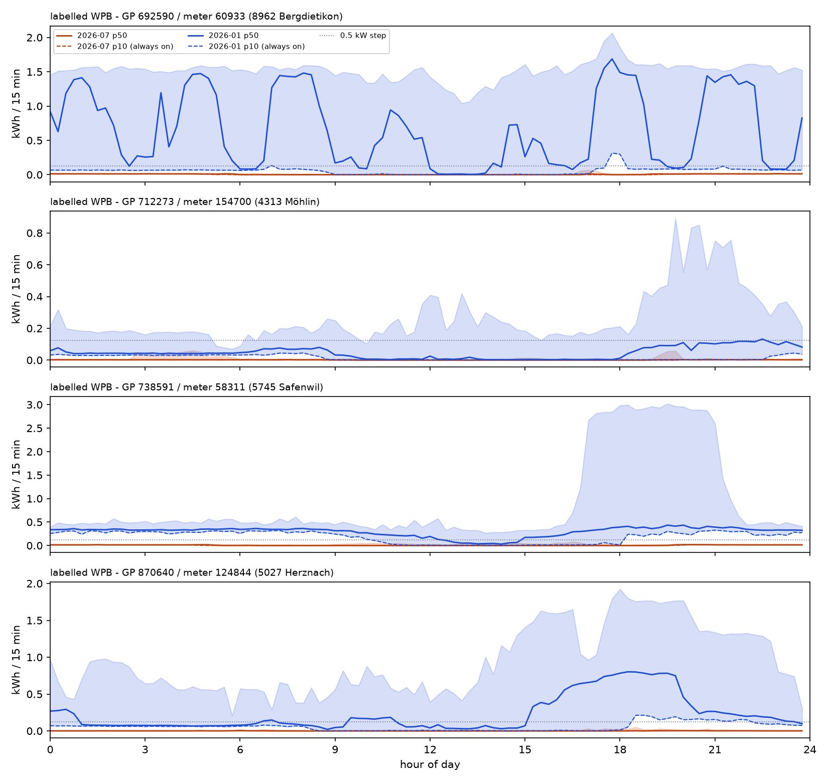
Evidence: the labelled households
Median day profile (solid) with the p10 always-on envelope (dashed). Dotted line = the 0.125 kWh/slot a 0.5 kW WPB adds.

Slide 6
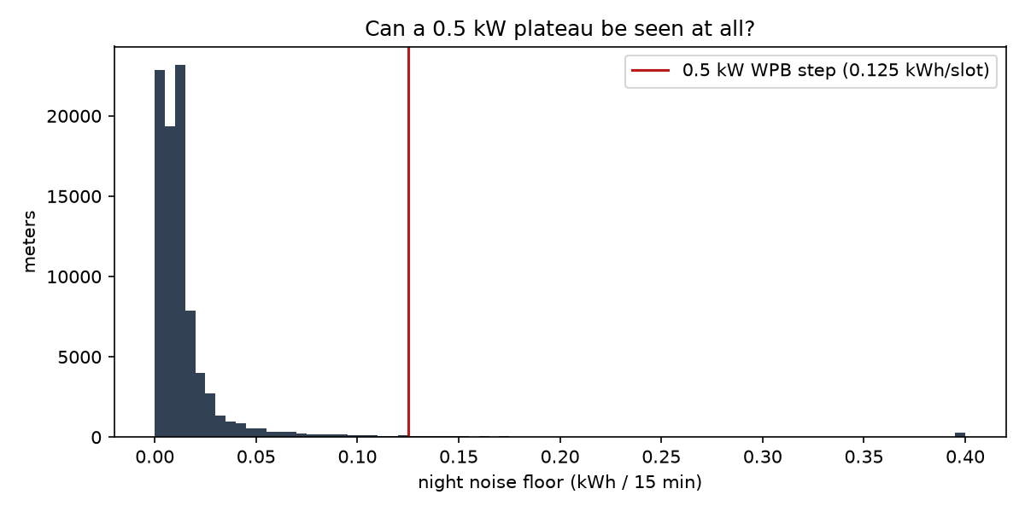
Go/no-go: can a 0.5 kW plateau be seen at all?
Night-load noise floor per meter against the step a WPB makes. If the floor sits above the line, nothing else works.

Slide 7
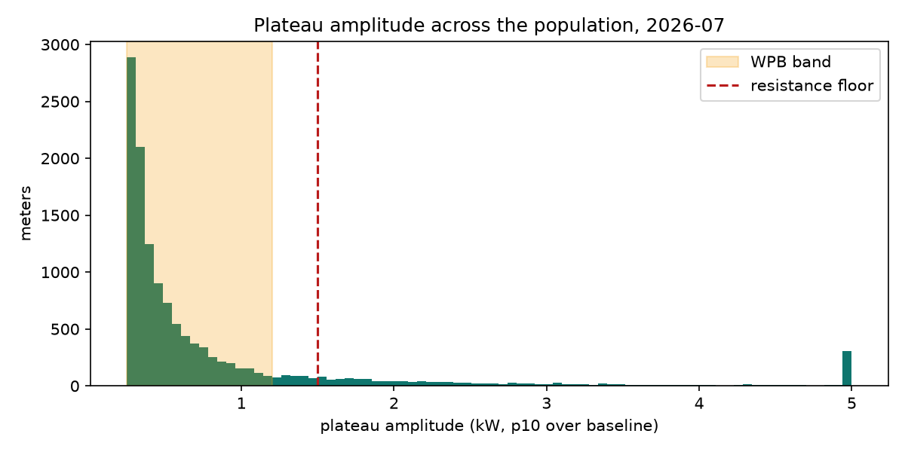
Is the population bimodal?
Plateau amplitude across all meters. Two clusters near 0.5 kW and 3 kW would be the WPB / resistance split showing itself.

Slide 8
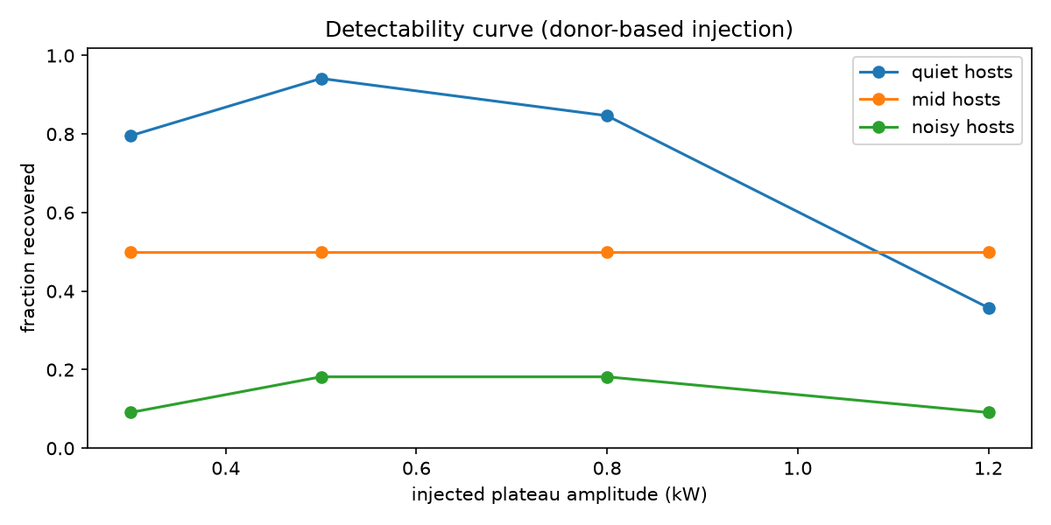
Validation without labels: counterfactual retrofit
Take a real resistance boiler's daily event, hold its energy fixed, trade power for duration — the Elektroboiler→WPB swap — add it to an unlabelled household, and see if we find it.

Slide 9
Population result
• 838 of 75,094 mapped households flagged in the latest pair.
• 87,860 meters scored; 863 flagged at score ≥ 0.8 (1.0%).
  – median amplitude 0.39 kW (band 0.25–1.2 kW)
  – median 1.36 kWh/day (a WPB tank is ~1.5–2.5)
• Labelled WPB households score 0.00–0.35.
• Every row carries its evidence: amplitude, duration, start time, kWh/day, and why.
Inspectable evidence, not a black-box label.

Slide 10
External comparison does not confirm the flags
• Across 72 postcodes with ≥30 meters, Spearman ρ = -0.12 (p = 0.30).
• The GWR field covers all hot-water heat pumps, including combined space-heating systems; it is a broader ecological comparator.
• The weak association is inconclusive and provides no accuracy claim.

Slide 11
What we are not claiming
• No accuracy figure — 4 positives and no confirmed negatives.
• A PV-controlled WPB can run at midday and be invisible in grid import.
  – GIGI is ~9:1 PV-skewed, so this creates selection bias
• None of the four labelled meters passes the year-round threshold.
• Detected duration is a lower bound: start jitter erodes the p10 core.
• Next: 4-year change detection finds the install date; the Elektroboiler→WPB swap is the most legible fingerprint in the data.

