Slide 1
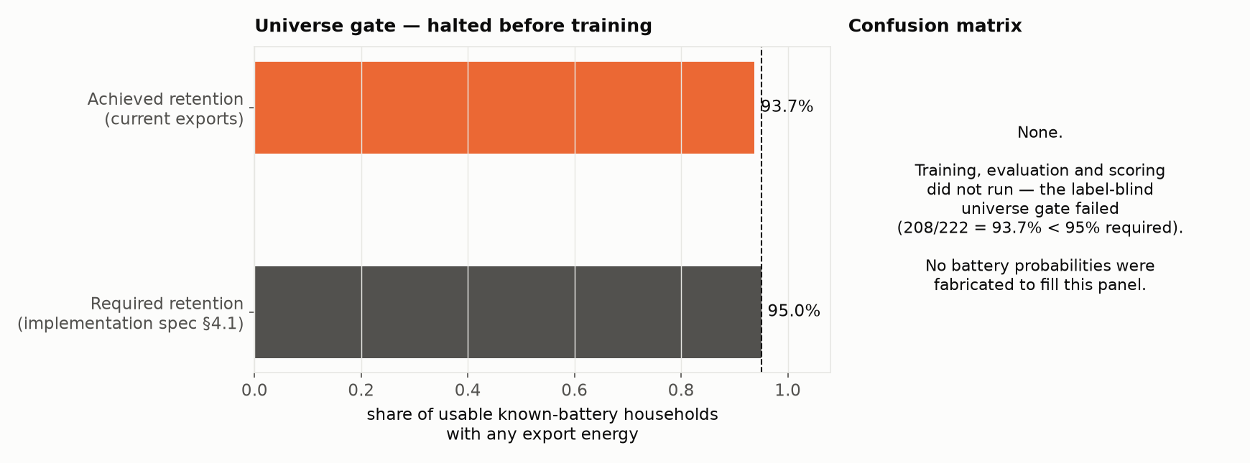
Battery — design & status
Evaluation is blocked before any score or confusion matrix exists
Takeaways
• Design: reuses the PV pipeline's I/O + PU learner (Elkan–Noto); contrast is battery vs PV-without-battery, not vs the general population — 96% of GIGI battery households also have PV, so a population-wide model would just relearn “has PV”
• Intended feature families (literature-grounded, not yet scored): zero-import / flat-interval plateaus, feed-in shaping (delayed & clipped export), ramp smoothing, evening-zero → step recovery, charge/discharge energy-balance check (η≈0.80–0.95)
• 82 GIGI “no battery” households are a held-out audit set, never used as training negatives
• Universe gate (label-blind) requires ≥95% of known-battery households to show any export energy; current exports give 93.7% (208/222) — pipeline halted per spec rather than weakening the gate or fabricating a result

