Slide 1
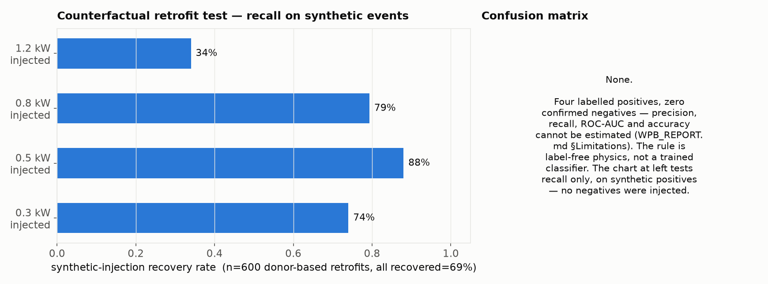
Heat-pump boiler (WPB) — design & status
Label-free physical rule on 15-min grid import — no supervised classifier, so no confusion matrix
Takeaways
• Design: per meter-month p10 (10th-percentile) envelope across all days — a load must repeat on ≥90% of days to show up, which structurally rules out irregular loads like a part-time EV
• Plateau ≥0.25 kW above the quietest rolling hour; flagged only if amplitude 0.25–1.2 kW and duration 1.5–9 h (physical bands from COP≈3, not fit to labels), and it must reappear in both January and July to reject seasonal confounders (dehumidifiers, floor heating, part-load heat pumps)
• Only 4 GIGI-labelled households have meter data and zero are confirmed negatives, so precision, recall, ROC-AUC and accuracy cannot be estimated (WPB_REPORT.md)
• Closest available validation (left): inject a real resistance boiler's energy at WPB power/duration into 150 real households per amplitude and see if the rule recovers it — recall only, no negatives tested
• 838 of 75,094 households flagged (1.1%); rank correlation with the BFS building register is weak and inconsistent (ρ=+0.27, p=0.03 at ≥100 meters/postcode; ρ=+0.12, p=0.30 at ≥30) — not a validation, just the same order of magnitude

