Slide 1
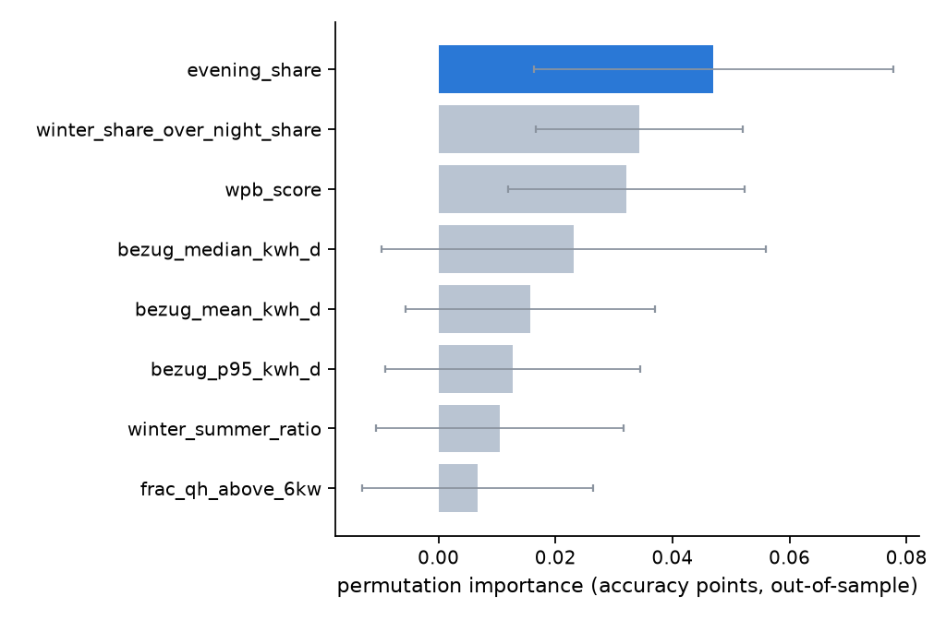
Heat-pump classifier — most important feature and performance
H21_hgb_compact · held-out test, 67 properties (21 heat-pump-labelled) · threshold 0.72 frozen on validation
76.1%
accuracy on the sealed test set
68.7%
majority-class baseline (predict 'no heat pump')
Confusion matrix — held-out test
 | predicted: no HP | predicted: HP
actual: no HP | 44 (TN) | 2 (FP)
actual: HP | 14 (FN) | 7 (TP)
Top feature: evening_share — permuting it costs 0.047 accuracy points (±0.031), more than any seasonality or meter feature.
• Validation accuracy 71.6%; the model recovers 7 of 21 labelled heat pumps at 2 false positives.
• Label 0 is subsidy-register-unlabelled, not verified heat-pump-absent, so accuracy is a floor estimate.
Known gaps vs the plan
• Temperature coupling (daily import vs heating-degree-days) is not implemented: it needs per-household daily series, and neither train_property_sequences.csv nor load_property_daily.csv exists in this checkout.
• The WPB boiler-detector score contributes little — it flags only 2 of 342 households.
• Both are documented in models/heat_pump/README.md, not papered over.
Population check vs GWR
At the GWR rate (31% of AG residential buildings) the score ranks postcodes with Spearman ρ=0.39 (n=78), but the accuracy-optimal threshold flags 2.7× too many households — rank is usable, absolute calibration is not.

