Slide 1
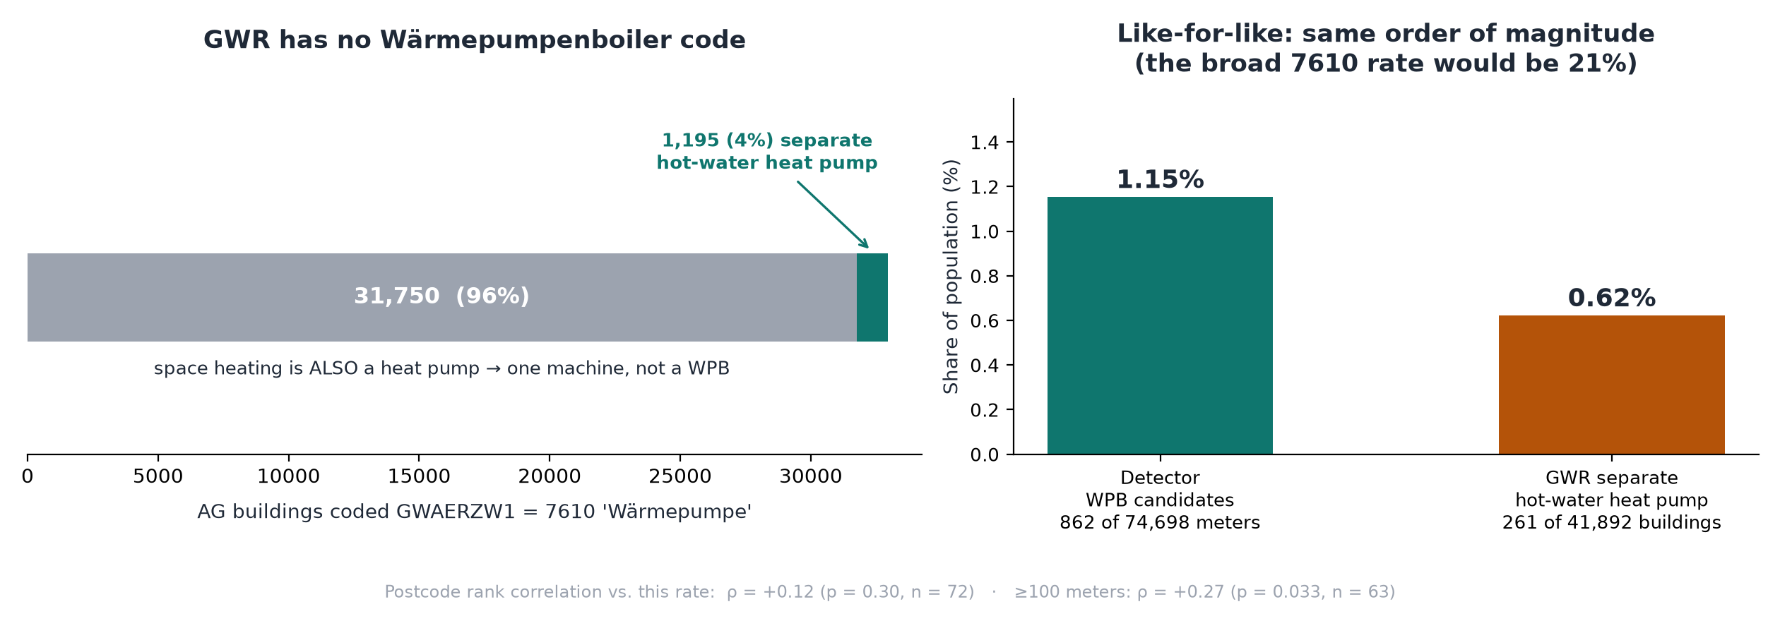
Wärmepumpenboiler: method, and what the public register can confirm
Label-free physical detection on 15-min grid import, canton Aargau · January/July 2026 pair · compared against BFS GWR
METHOD
CLASSIFIED vs. EXPECTED FROM THE PUBLIC REGISTER
• Per meter-month: 10th percentile (p10) of consumption across all valid days, per 15-min slot.
  – a load must repeat on ≥90% of days to lift p10 → timer regularity is enforced structurally
• Find plateaus ≥0.25 kW above the meter's quietest rolling hour, wrapping midnight.
• WPB candidate only if amplitude 0.25–1.20 kW and duration 1.5–9 h.
  – bands come from device physics (COP≈3 vs. a resistance boiler), not fit to labels
• Require a matching plateau in BOTH January and July, similar amplitude and start time.
  – rejects seasonal confounders: dehumidifiers, floor heating, part-load space heat pumps
• Score = 0.5 + amplitude-ratio + start-time-similarity; flagged at ≥0.8.
• No supervised classifier: 4 labelled positives, zero confirmed negatives.
• GWR has no Wärmepumpenboiler code. GWAERZW1=7610 is plain "Wärmepumpe"; 96% of those buildings also have a heat pump for space heating — one machine, not a WPB.
• Restricting to hot-water heat pump AND space heating that is not a heat pump leaves 0.62% of buildings, against 1.15% of meters flagged — the same order of magnitude.
• Not a validation. The register count is a lower bound (a WPB behind a space-heating heat pump is absorbed into the 96%), buildings are not meters, and the rank correlation is only ρ=+0.27 (p=0.033) on postcodes with ≥100 meters, ρ=+0.12 (p=0.30) at ≥30.

