Slide 1
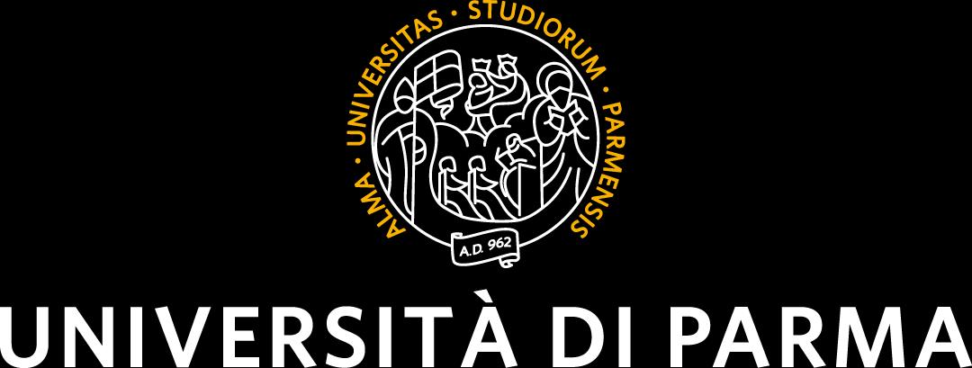
3D PERCEPTION, LEARNING-BASED DATA FUSION
Real-Time Face Detection and Distance Measurement Using Kinect and YOLOv3
Made by
Francesco De Patre and Davide Faroldi Lo Presti
23.10.2024

Slide 2
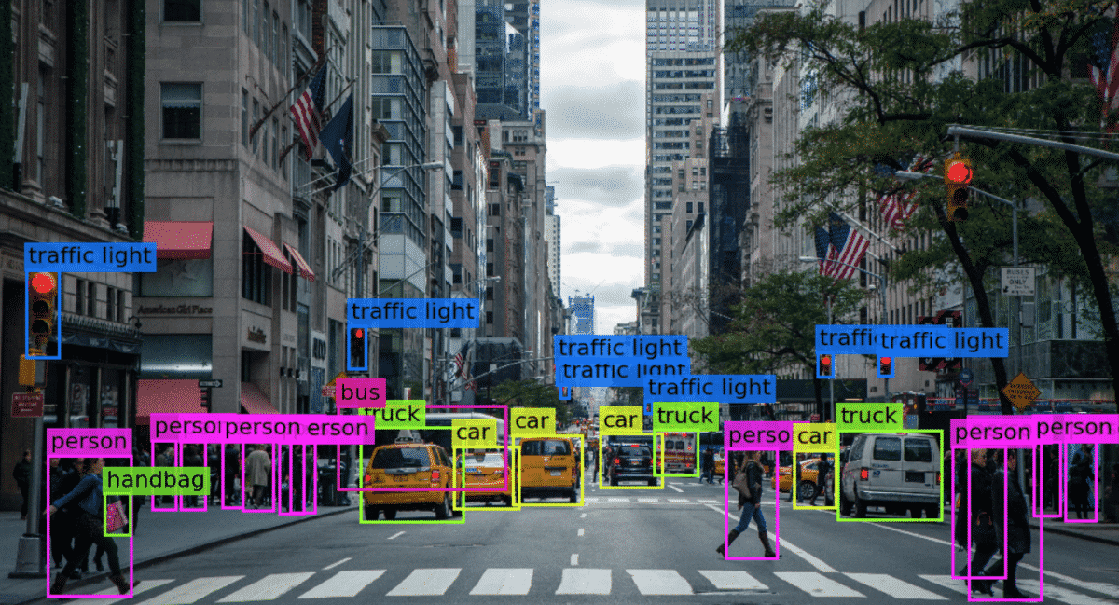
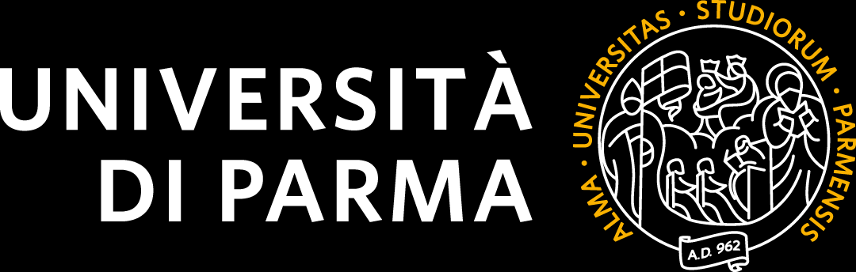
Project Overview
Main Objectives:
Develop a Python program that uses Kinect to capture real time video and depth data
Analyze the video using YOLOv3 to detect human faces
Calculate the distance of each detected face from the Kinect
KEY TOOLS:
FREENECT library for python
OPENCV
YOLOv3
Darknet
3D Perception: 1° project

Slide 3
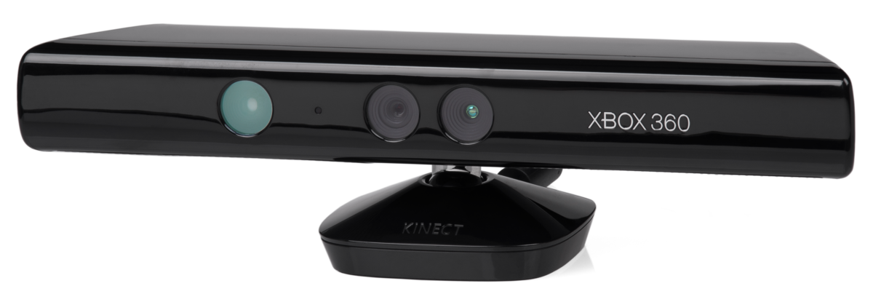
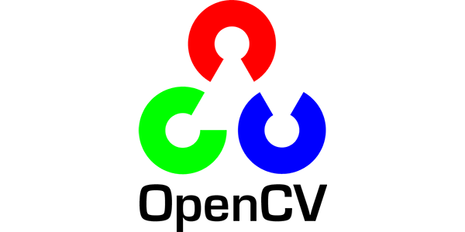
Tools and Libraries Used
KINECT: RGB color camera
Depth sensor
Multi-array microphone
FREENECT (OpenKinect) : Drivers and libraries open source for the Xbox Kinect
OPENCV (Open Source Computer Vision Library): Library for computer vision and machine learning
3D Perception: 1° project

Slide 4
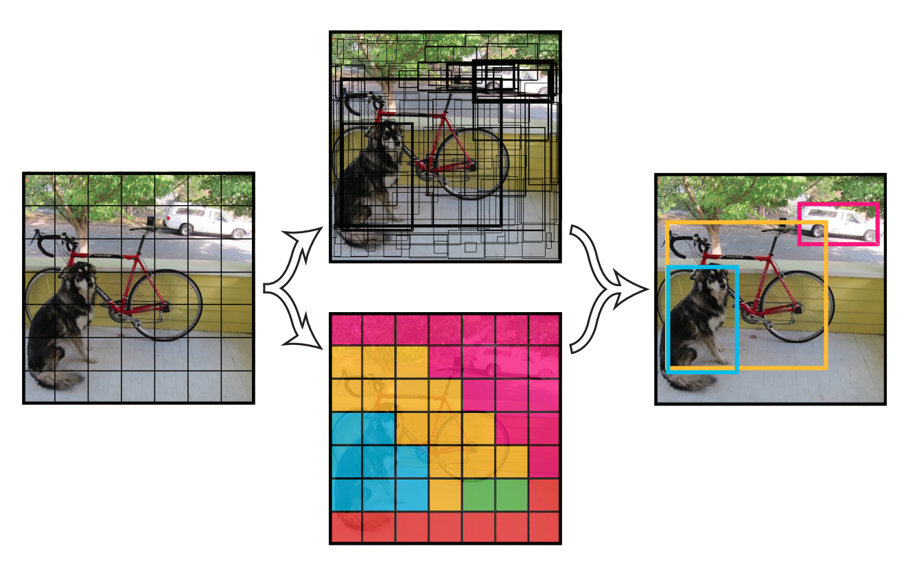
YOLOv3 Overview
YOLO: «You Only Look Once» Real-Time object detection
It uses a CNN to divide the image into a grid. Each grid cell predicts bounding boxes and probability classes for objects that fall within that cell.
YOLO is a single-step algorithm; it predicts the positions of objects and their classes simultaneously.
The yolo algorithm is trained using the Darknet deep learning framework
3D Perception: 1° project

Slide 5
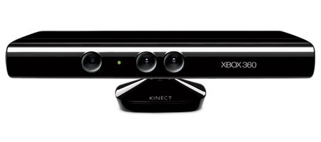
How It Works
Rgb data & depth data
Python process with
YOLOv3
YOLO Detections
Positions &
YOLO Detections Classes
Bounding box
OpenCV python module
Distance
3D Perception: 1° project

Slide 6
Challenges in Real-Time Processing
N°1 PROBLEM:
COMPUTATIONALLY HEAVY even with CUDA
Solution: Yolov3-tiny
Trade-off: A small increase in speed but with a large loss of accuracy
N°2 PROBLEM:
SENSORS ARE NOISY
Changes in brightness or atmospheric phenomena (such as rain, fog...)
can affect perception, also if the object or scene is moving rapidly the perception of the object and on its depth may be inaccurate.
3D Perception: 1° project

Slide 7
Dataset and YOLOv3 Training
Dataset used:
Wider Face
Open Images Dataset V7
4500+ negatives
Annotations: needed .txt file for every image file
<class_id> <x_center> <y_center> <width> <height>
How to train:
Install Darknet and OpenCV (with CUDA if possible)
Gain dataset and annotation
Modify yolov3.cfg, train.txt, obj.data and obj.names
3D Perception: 1° project

Slide 8
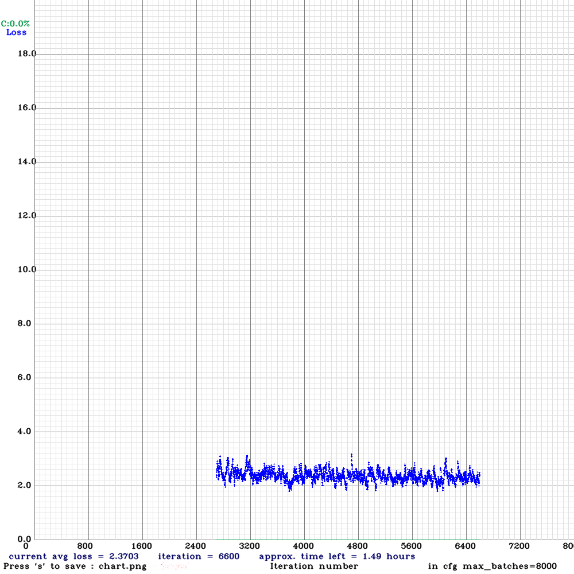
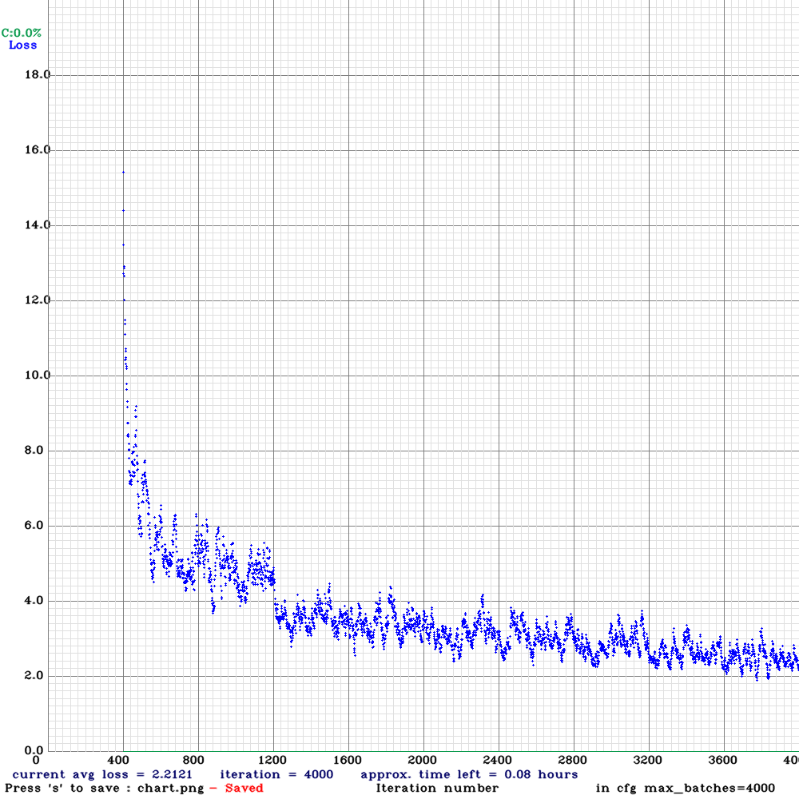
Training Results
3D Perception: 1° project

Slide 9
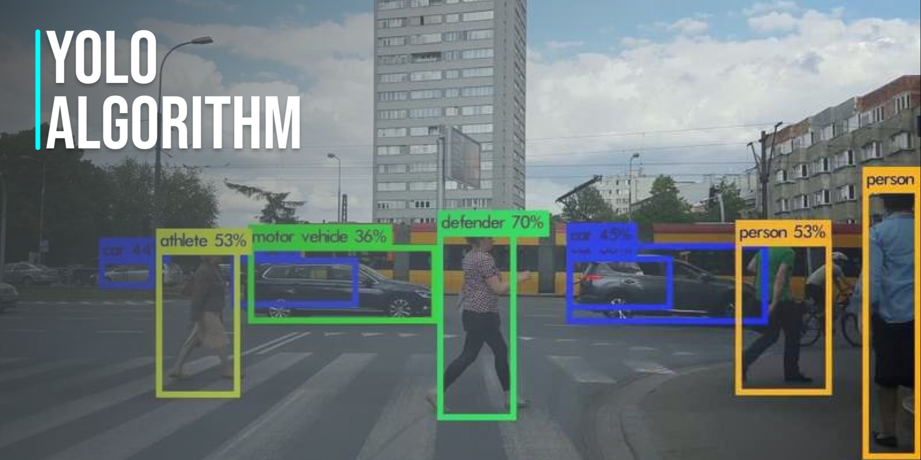
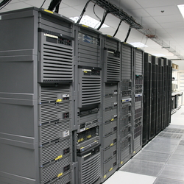
Future Improvements
Use of more advanced detection models such as YOLOv4 or YOLOv5
Improved training using a better dataset
Implementation of algorithms to handle partial/total occlusions in crowded environments
Integration with other sensors to improve perception
Running the algorithms on high-performance computing (HPC) systems.
3D Perception: 1° project

Slide 10
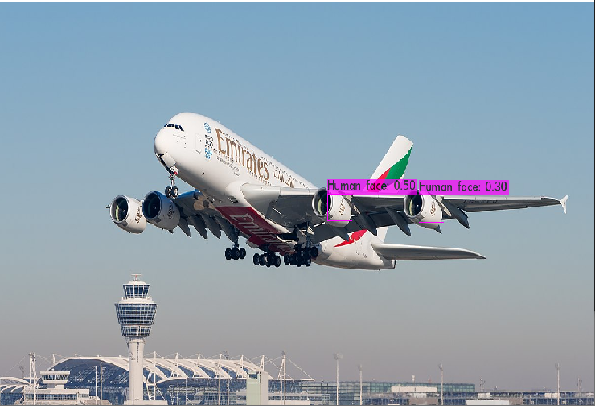
Problems Faced
Difficulty installing the freenect library on the machine due to poor documentation (only works on linux for us)
Cannot decrease below 2% the avg.loss during training
Detection of false positives
Running on inefficient machines results in significant overheating
Depth detection is still very inaccurate at very short distances from the sensor, this is a physical limitation of the device, designed to operate in a certain range of distances from 0.80m to 2.5m.
3D Perception: 1° project

Slide 11
THANK YOU FOR YOUR ATTENTION

