Slide 1

3D Perception, Learning-Based Data Fusion
Face detection, distance measurement and global position using KINECT, YOLO and LSTM neural network
Proof of concept
Made by Francesco De Patre and Davide Faroldi Lo Presti

Slide 2

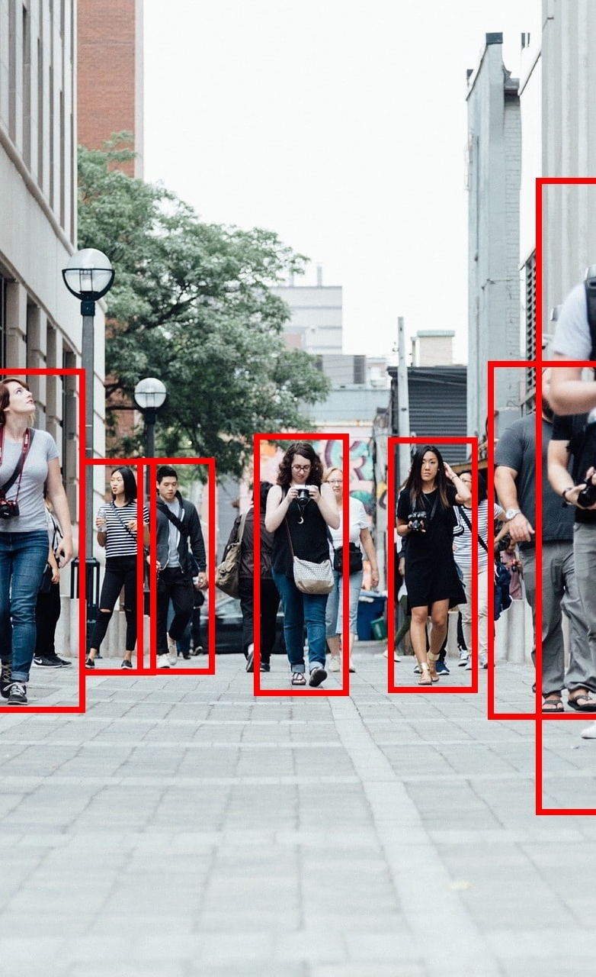


PROJECT OVERVIEW
Main Objectives
Integrate the previous project compass data and LSTM neural network

Slide 3





KEY TOOLS
Freenect
OpenCV
YOLOv11
PyTorch
Open source drivers and libraries for the Kinect sensor.
Library for computer vision and machine learning.
Latest deep learning model for fast object detection.
Framework for training YOLO and our custom nn

Slide 4





Rgb, depth and GPS data
Python process with YOLO11
Human Face
Human Face
HOW IT WORKS
YOLO detections positions and YOLO detections classes
Bounding boxes on video
Neaural Network
Distance + GPS data+ Compass data
OpenCV python module

Slide 5



SMALL DATASET
We couldn’t find and put together a large dataset. This leads the model to predict the distance based on data that, in our case, are secondary
HEAVY TRAINING
Why proof of concept?
Even on high-performance machines, a training cycle of 10 epochs takes more than 5 hours

Slide 6

01
Puts RGB and numeric data tensors in a lists
02
OUR NEURAL NETWORK
Use ResNet18 for RGB feature extraction
03
Use LSTM for analyze frame sequence
04
Concatenate and extract prediction

Slide 7

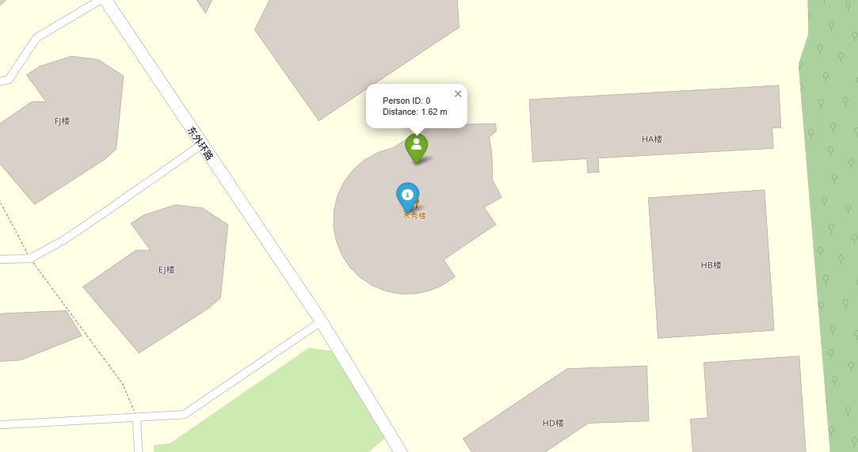
OUTPUT RESULTS

Slide 8

POSSIBLE FUTURE IMPROVEMENTS AND APPLICATION FOR OUR PROJECT
RESEARCH AND CREATE A LARGER DATASET
HIGH-PERFORMANCE COMPUTING SYSTEMS
NOT ONLY STATIC SYSTEMS
DETECTION AND DEPTH PERCEPTION ON AUTONOMOUS, NOT STATIC, SYSTEMS

Slide 9


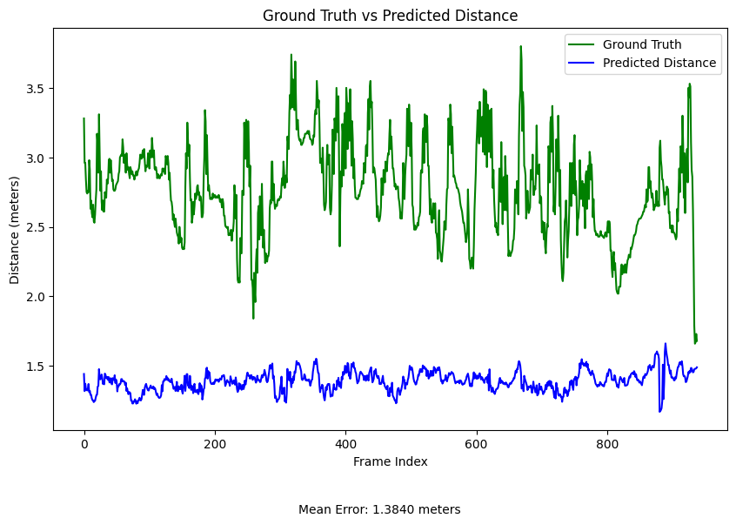
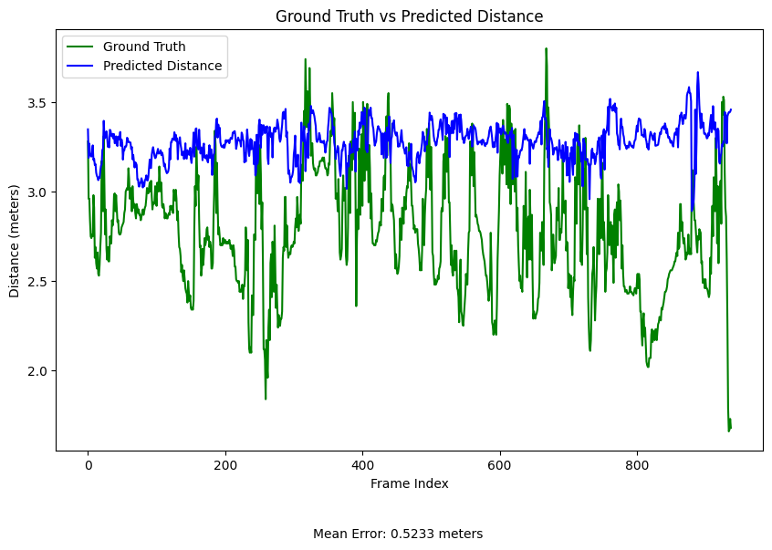
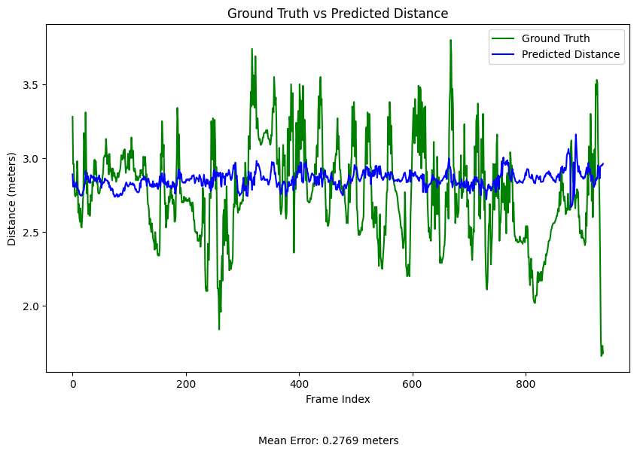
OUR CHALLENGES
DUE TO LACK OF TRAINING EVEN SECONDARY DATA INLFUENCE THE PREDICTION
Compass=10.2° Compass=189° Compass=358°

Slide 10


Thank you for your attention
CREDITS
Francesco De Patre
and
Davide Faroldi Lo Presti

