Slide 1
1
3
1
4
1
3
D
S
1
2
7
2
4
1

Slide 2




1
S1
3
1
D1
$$∞$$
4
$$∞$$
Sf
2
7
Df
2
5
D2
S2
$$∞$$
$$∞$$
6
3
4

Slide 3
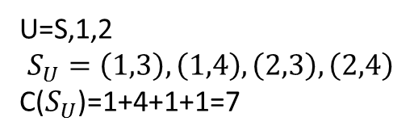
U=S,1,2
$$S_{U}=\left(1,3\right), \left(1,4\right), \left(2,3\right), \left(2,4\right)$$
C($S_{U}$)=1+4+1+1=7
1
3
1
4
1
3
D
S
1
2
7
2
4
1

Slide 4
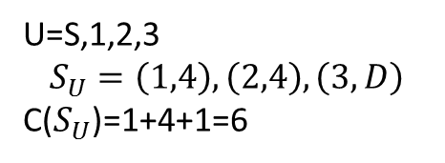
U=S,1,2,3
$$S_{U}=\left(1,4\right), \left(2,4\right), \left(3,D\right)$$
C($S_{U}$)=1+4+1=6
1
3
1
4
1
3
D
S
1
2
7
2
4
1

Slide 5
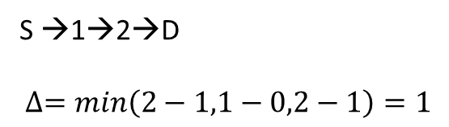
1
S →1→2→D
$$∆=min\left(2−1,1−0,2−1\right)=1$$
1/2
1/2
S
D
0/1
1
(1+1)/2
1/2
1/2
2
1/2
S
D
(0+1)/1
Flusso uscente da S=1+1=2 (= flusso entrante in D)
1/2
2
(1+1)/2
Flusso uscente da S=2+1=3

Slide 6
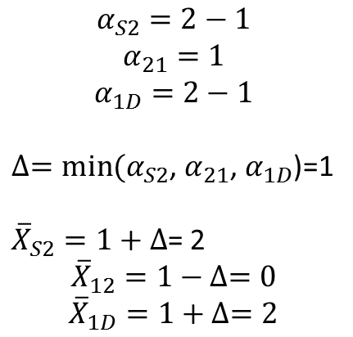
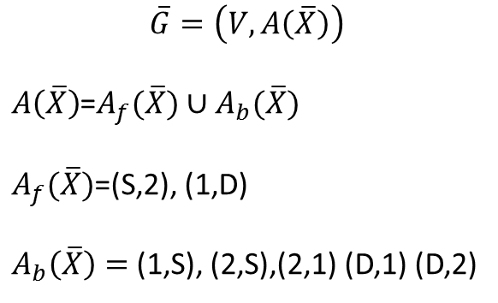
1
S→2→1→D
S
D
$$α_{S2}=2−1$$
$$α_{21}=1$$
$$α_{1D}=2−1$$
$∆=min⁡(α_{S2}$, $α_{21}$, $α_{1D}$)=1
${\overline{X}}_{S2}=1+∆$= 2
$${\overline{X}}_{12}=1−∆=0$$
$${\overline{X}}_{1D}=1+∆=2$$
2
$$\overline{G}=\left(V,A\left(\overline{X}\right)\right)$$
$A\left(\overline{X}\right)$=$A_{f}(\overline{X})∪A_{b}(\overline{X})$
$A_{f}(\overline{X})$=(S,2), (1,D)
$A_{b}\left(\overline{X}\right)=$ (1,S), (2,S),(2,1) (D,1) (D,2)

Slide 7



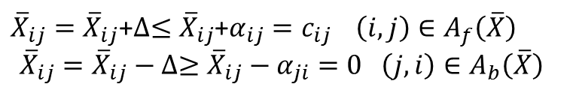





${\overline{X}}_{ij}={\overline{X}}_{ij}$+$∆≤{\overline{X}}_{ij}$+$α_{ij}=c_{ij } \left(i,j\right)∈A_{f}\left(\overline{X}\right)$
$${\overline{X}}_{ij}={\overline{X}}_{ij}−∆≥{\overline{X}}_{ij}−α_{ji}=0 \left(j,i\right)∈A_{b}\left(\overline{X}\right)$$
f
f
+$∆$
+$∆$
f
b
+$∆$
-$∆$
b
f
-$∆$
+$∆$
b
b
-$∆$
-$∆$

Slide 8
1
2/2
2/2
S
D
0/1
2/2
2
2/2
Flusso uscente da S=2+2=4

Slide 9
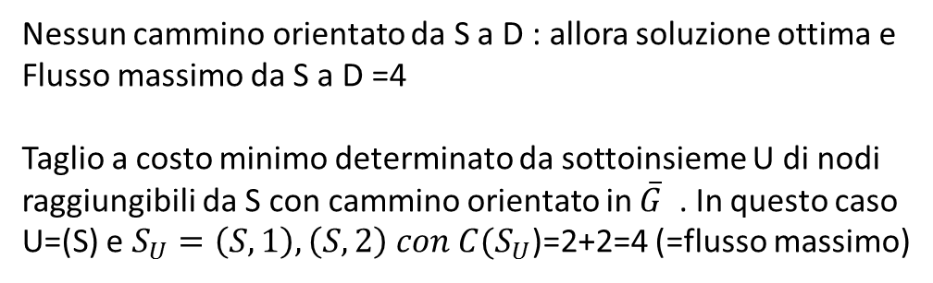
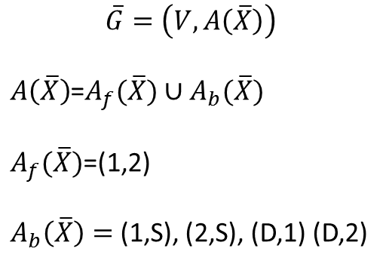
1
S
D
2
Nessun cammino orientato da S a D : allora soluzione ottima e
Flusso massimo da S a D =4
Taglio a costo minimo determinato da sottoinsieme U di nodi
raggiungibili da S con cammino orientato in $\overline{G}$ . In questo caso
U=(S) e $S_{U}=\left(S,1\right), \left(S,2\right) con C(S_{U}$)=2+2=4 (=flusso massimo)
$$\overline{G}=\left(V,A\left(\overline{X}\right)\right)$$
$A\left(\overline{X}\right)$=$A_{f}(\overline{X})∪A_{b}(\overline{X})$
$A_{f}(\overline{X})$=(1,2)
$A_{b}\left(\overline{X}\right)=$ (1,S), (2,S), (D,1) (D,2)

Slide 10





$$(2,\min\left(1,1\right))$$
1
1
2/2
1/2
S
D
S
D
1/1
$$(S,∞)$$
$$(1,\min\left(1,2−1\right))$$
1/2
2
2/2
2
$$(S,\min\left(∞,2−1\right))$$
E=S,2,1,D
R=S,2,1
S→2→1→D con $∆=1$

Slide 11
S
D

Slide 12








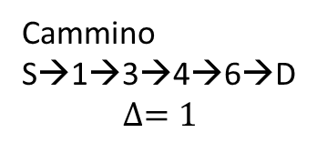
1
0/M
3
0/M
5
0/M
0/M
S
D
0/1
E=S,1,2,3,4,5,6,D
R=S,1,3,4,6
0/M
2
4
6
0/M
0/M
0/M
(1,$min⁡(M,M−0))$
(3,$min⁡(M,M−0))$
1
3
5
(6,$min⁡(1,M−0))$
S
(S,$min⁡(∞,M−0))$
D
(S,$∞)$
(4,$min⁡(1,M−0))$
Cammino
S→1→3→4→6→D
$$∆=1$$
2
4
6
(S,$min⁡(∞,M−0))$
(3,$min⁡(M,1−0))$

Slide 13
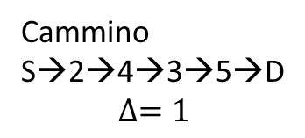






1
1/M
3
0/M
5
0/M
1/M
S
D
1/1
E=S,1,2,4,3,6,5,D
R=S,2,4,3,5
0/M
2
4
6
1/M
0/M
1/M
(4,$min⁡(M,1))$
(3,$min⁡(1,M−0))$
1
3
5
(5,$min⁡(1,M−0))$
S
(S,$min⁡(∞,M−1))$
D
(S,$∞)$
Cammino
S→2→4→3→5→D
$$∆=1$$
2
4
6
(S,$min⁡(∞,M−0))$
(2,$min⁡(M,M−0))$
(4,$min⁡(M,M−1))$

Slide 14






1
1/M
3
1/M
5
1/M
1/M
S
D
0/1
E=S,1,2,3,4,56,D
R=S,1,3,4,6
1/M
2
4
6
1/M
1/M
1/M
(1,$min⁡(M−1,M−1))$
(3,$min⁡(M,M−1))$
1
3
5
(6,$min⁡(1,M−1))$
S
(S,$min⁡(∞,M−1))$
D
(S,$∞)$
Cammino
S→1→3→4→6→D
$$∆=1$$
2
4
6
(S,$min⁡(∞,M−1))$
(3,$min⁡(M−1,1))$
(4,$min⁡(1,M−1))$

Slide 15




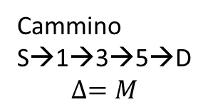
1
0/M
3
0/M
5
0/M
0/M
S
D
0/1
E=S,1,2,3,4,5,6,D
R=S,1,2,3,4,5
0/M
2
4
6
0/M
0/M
0/M
(1,$min⁡(M,M−0))$
(3,$min⁡(M,M−0))$
1
3
5
(5,$min⁡(M,M−0))$
S
(S,$min⁡(∞,M−0))$
D
(S,$∞)$
(4,$min⁡(M,M−0))$
Cammino
S→1→3→5→D
$$∆=M$$
2
4
6
(S,$min⁡(∞,M−0))$
(2,$min⁡(M,M−0))$

Slide 16
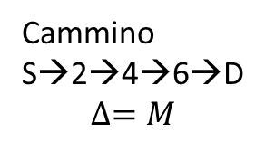


1
M/M
3
M/M
5
M/M
M/M
S
D
0/1
E=S,2,4,6,D
R=S,2,4,6
0/M
2
4
6
0/M
0/M
0/M
1
3
5
(6,$min⁡(M,M−0))$
S
D
(S,$∞)$
(4,$min⁡(M,M−0))$
Cammino
S→2→4→6→D
$$∆=M$$
2
4
6
(S,$min⁡(∞,M−0))$
(2,$min⁡(M,M−0))$

Slide 17
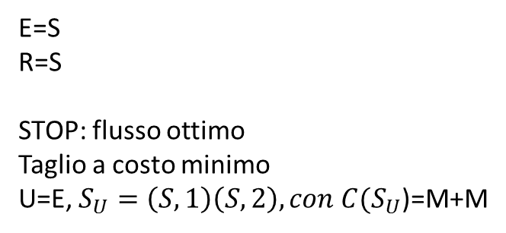
1
M/M
3
M/M
5
M/M
M/M
S
D
E=S
R=S
STOP: flusso ottimo
Taglio a costo minimo
U=E, $S_{U}=\left(S,1\right)\left(S,2\right), con C(S_{U}$)=M+M
0/1
M/M
2
4
6
M/M
M/M
M/M
1
3
5
S
D
(S,$∞)$
2
4
6

Slide 18
1
0/2
3
Flusso uscente da S=5+0=5
Flusso ammissibile
3/10
5/5
5/9
D
S
0/4
3/3
0/6
2/4
4
2
2/8

Slide 19
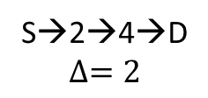






(2,$min(6,5))$
(1,$min(5,2−0))$
1
3
E=S,2,1,4,3,D
R=S,2,1,4
S
D
S→2→4→D
$$∆=2$$
(4,$min(6,4−2))$
(S,$∞)$
2
4
(S,$min(∞,6−0))$
(2,$min(6,8−2))$

Slide 20
1
0/2
3
Flusso uscente da S=5+2=7
Flusso ammissibile
3/10
5/5
5/9
D
S
0/4
3/3
2/6
4/4
4
2
4/8

Slide 21
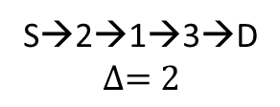





(2,$min(4,5))$
(1,$min(4,2−0))$
1
3
E=S,2,1,4,3,D
R=S,2,1,4,3
S
D
S→2→1→3→D
$$∆=2$$
(3,$min(2,10−3))$
(S,$∞)$
2
4
(S,$min(∞,6−2))$
(2,$min(4,8−4))$

Slide 22
1
2/2
3
Flusso uscente da S=5+4=9
Flusso ammissibile
5/10
5/5
3/9
D
S
0/4
3/3
4/6
4/4
4
2
4/8

Slide 23
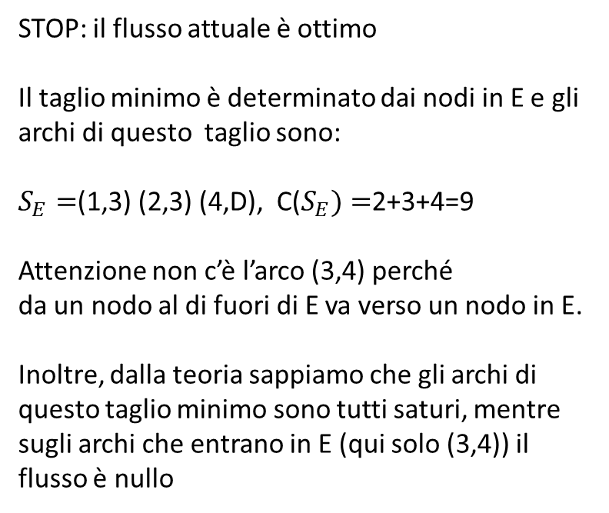




(2,$min(2,3))$
3
E=S,2,1,4
R=S,2,1,4
1
S
D
STOP: il flusso attuale è ottimo
Il taglio minimo è determinato dai nodi in E e gli archi di questo taglio sono:
$S_{E}=$(1,3) (2,3) (4,D), C($S_{E})=$2+3+4=9
Attenzione non c’è l’arco (3,4) perché
da un nodo al di fuori di E va verso un nodo in E.
Inoltre, dalla teoria sappiamo che gli archi di
questo taglio minimo sono tutti saturi, mentre sugli archi che entrano in E (qui solo (3,4)) il flusso è nullo
(S,$∞)$
2
4
(S,$min(∞,6−4))$
(2,$min(2,8−4))$

