Slide 1

T’
T
$$∀ x∈T:f′(x)≥f(x)$$

Slide 2

T
T1
T2
….
Tm
Se U(T2)$≤LB$
T
T1
T2
….
Tm

Slide 3


C=(S)
Q=
LB
C=(S1,S2)
Q=
LB
$$∅$$
$$∅$$
S
S
U(S)
U(S)
S1
S2
U(S1)
U(S2)
U(S2)>U(S1)
U(S1), U(S2) > LB

Slide 4
C=(S1,S3)
Q=(S4)
LB
S
U(S)
S1
S2
U(S1)
U(S2)
S3
S4
U(S3)>U(S1), U(S4)
U(S1), U(S3) > LB
U(S4)<=LB
U(S3)
U(S4)

Slide 5
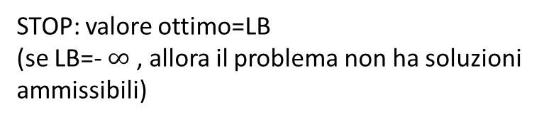
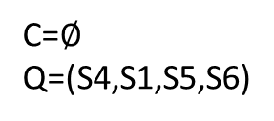
C=$∅$
Q=(S4,S1,S5,S6)
LB
S
U(S)
S1
S2
U(S1)
U(S2)
S4
U(S1),U(S5),U(S6)<=LB
S3
U(S3)
S3
U(S4)
STOP: valore ottimo=LB
(se LB=- $∞$ , allora il problema non ha soluzioni
ammissibili)
S5
S6

Slide 6



 | 1 | 2 | 3 | 4 | 5
V | 8 | 4 | 6 | 9 | 12
P | 3 | 1 | 2 | 4 | 5
B=7
1
2
3
4
5
1
1
1
4
4
2
2
3
Peso=3+4<=7
SI: Valore=8+9=17
Peso=1+2+3<=7
SI: Valore=8+4+6=18
Peso=3+1+4>7
NO
$$x_{1}=x_{4}=1{ x}_{2}=x_{3}=x_{5}=0$$
$$x_{1}={x_{2}=x}_{4}=1 x_{3}=x_{5}=0$$
$$x_{1}=x_{2}=x_{3}=1{ x}_{4}=x_{5}=0$$

Slide 7

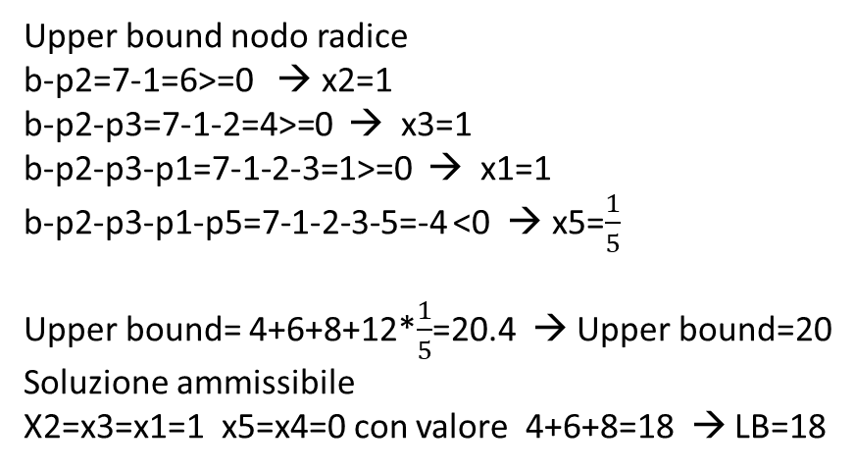




$$\frac{v_{1}}{p_{1}}=\frac{8}{3}=2.66$$
$$\frac{v_{2}}{p_{2}}=\frac{4}{1}=4$$
$$\frac{v_{3}}{p_{3}}=\frac{6}{2}=3$$
$$\frac{v_{4}}{p_{4}}=\frac{9}{4}=2.25$$
$$\frac{v_{5}}{p_{5}}=\frac{12}{5}=2.4$$
ORDINAMENTO: 2; 3; 1; 5; 4
Upper bound nodo radice
b-p2=7-1=6>=0 → x2=1
b-p2-p3=7-1-2=4>=0 → x3=1
b-p2-p3-p1=7-1-2-3=1>=0 → x1=1
b-p2-p3-p1-p5=7-1-2-3-5=-4 <0 → x5=$\frac{1}{5}$
Upper bound= 4+6+8+12*$\frac{1}{5}$=20.4 → Upper bound=20
Soluzione ammissibile
X2=x3=x1=1 x5=x4=0 con valore 4+6+8=18 → LB=18

Slide 8
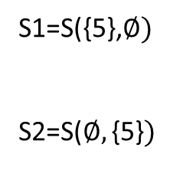
LB=18 [(1,2,3)]
S
U(S)=20
S1=S({5},$∅)$
S2=S($∅,\text{\{5\}})$
X5=0
X5=1
S1
S2

Slide 9
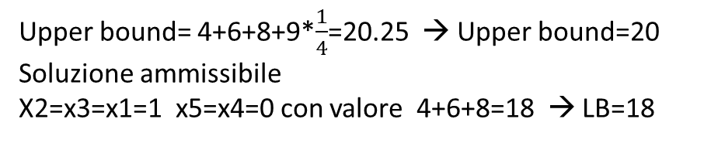
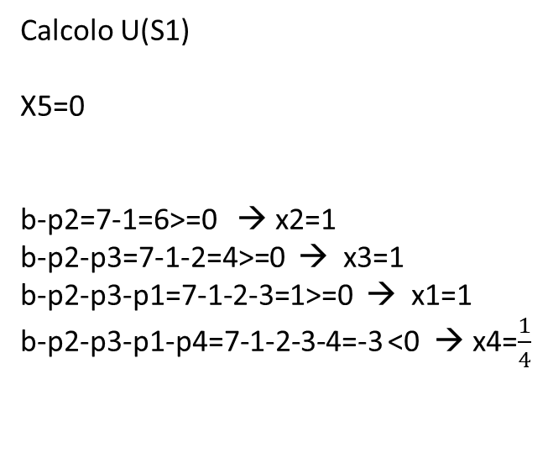
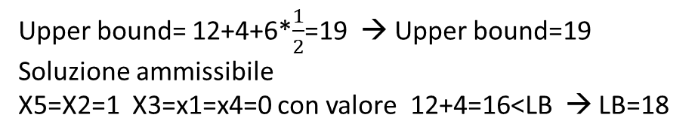
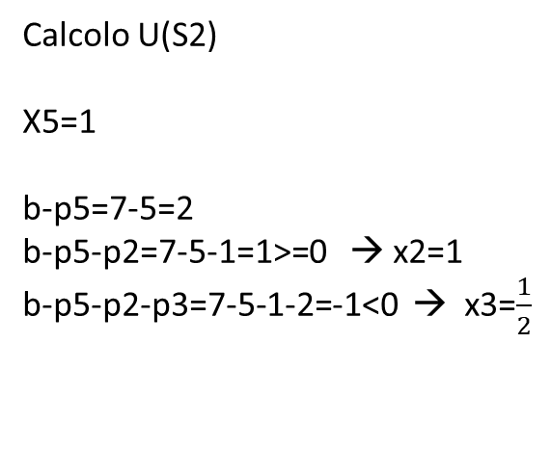
Calcolo U(S1)
X5=0
b-p2=7-1=6>=0 → x2=1
b-p2-p3=7-1-2=4>=0 → x3=1
b-p2-p3-p1=7-1-2-3=1>=0 → x1=1
b-p2-p3-p1-p4=7-1-2-3-4=-3 <0 → x4=$\frac{1}{4}$
Calcolo U(S2)
X5=1
b-p5=7-5=2
b-p5-p2=7-5-1=1>=0 → x2=1
b-p5-p2-p3=7-5-1-2=-1<0 → x3=$\frac{1}{2}$
Upper bound= 4+6+8+9*$\frac{1}{4}$=20.25 → Upper bound=20
Soluzione ammissibile
X2=x3=x1=1 x5=x4=0 con valore 4+6+8=18 → LB=18
Upper bound= 12+4+6*$\frac{1}{2}$=19 → Upper bound=19
Soluzione ammissibile
X5=X2=1 X3=x1=x4=0 con valore 12+4=16<LB → LB=18

Slide 10
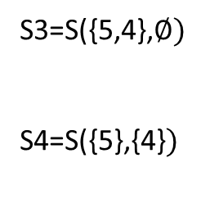
LB=18 [(1,2,3)]
S
S3=S({5,4},$∅)$
S4=S($\text{\{5\}}\text{,\{4\}})$
X5=0
X5=1
U(S1)=20
S1
S2
U(S2)=19
X4=0
X4=1
S3
S4

Slide 11
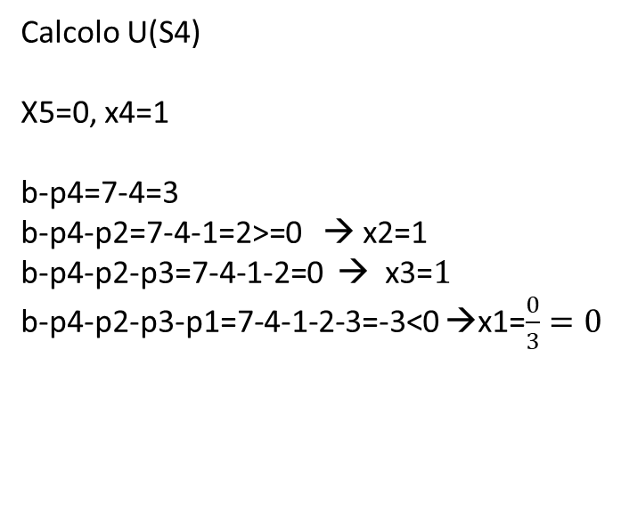
Calcolo U(S3)
X5=x4=0
b-p2=7-1=6>=0 → x2=1
b-p2-p3=7-1-2=4>=0 → x3=1
b-p2-p3-p1=7-1-2-3=1>=0 → x1=1
Calcolo U(S4)
X5=0, x4=1
b-p4=7-4=3
b-p4-p2=7-4-1=2>=0 → x2=1
b-p4-p2-p3=7-4-1-2=0 → x3=$1$
b-p4-p2-p3-p1=7-4-1-2-3=-3<0 →x1=$\frac{0}{3}=0$
Upper bound= 4+6+8=18 → Upper bound=18
Soluzione ammissibile
X2=x3=x1=1 x5=x4=0 con valore 4+6+8=18 → LB=18
Upper bound= 9+4+6+8*0=19 → Upper bound=19
Soluzione ammissibile
X4=X2=x3=1 x1=x5=0 con valore 9+4+6=19>LB → LB=19

Slide 12
LB=19 [(2,3,4)]
S
X5=0
X5=1
S1
S2
U(S2)=19
X4=0
X4=1
U(S3)=18
S3
S4
U(S4)=19
U(S2), U(S3), U(S4)<=LB
STOP: Valore ottimo=LB=19
Soluzione ottima: (2,3,4)

Slide 13
 | 1 | 2 | 3 | 4 | 5
V | 7 | 5 | 9 | 10 | 11
P | 4 | 1 | 3 | 5 | 6
B=12
1
2
3
4
5

Slide 14

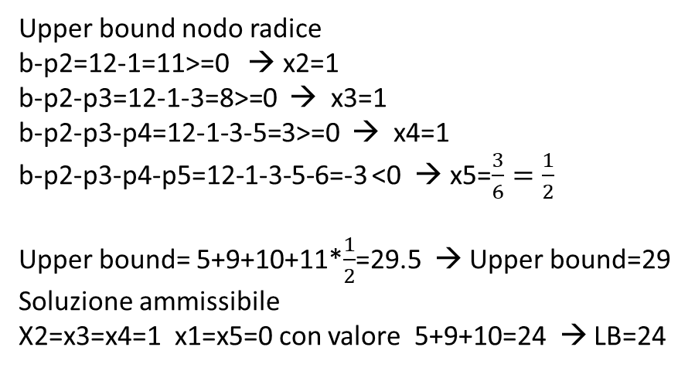




$$\frac{v_{1}}{p_{1}}=\frac{7}{4}=1.75$$
$$\frac{v_{2}}{p_{2}}=\frac{5}{1}=5$$
$$\frac{v_{3}}{p_{3}}=\frac{9}{3}=3$$
$$\frac{v_{4}}{p_{4}}=\frac{10}{5}=2$$
$$\frac{v_{5}}{p_{5}}=\frac{11}{6}=1.83$$
ORDINAMENTO: 2; 3; 4; 5; 1
Upper bound nodo radice
b-p2=12-1=11>=0 → x2=1
b-p2-p3=12-1-3=8>=0 → x3=1
b-p2-p3-p4=12-1-3-5=3>=0 → x4=1
b-p2-p3-p4-p5=12-1-3-5-6=-3 <0 → x5=$\frac{3}{6}=\frac{1}{2}$
Upper bound= 5+9+10+11*$\frac{1}{2}$=29.5 → Upper bound=29
Soluzione ammissibile
X2=x3=x4=1 x1=x5=0 con valore 5+9+10=24 → LB=24

Slide 15
LB=24 [(2,3,4)]
S
U(S)=29
S1=S({5},$∅)$
S2=S($∅,\text{\{5\}})$
X5=0
X5=1
S1
S2

Slide 16
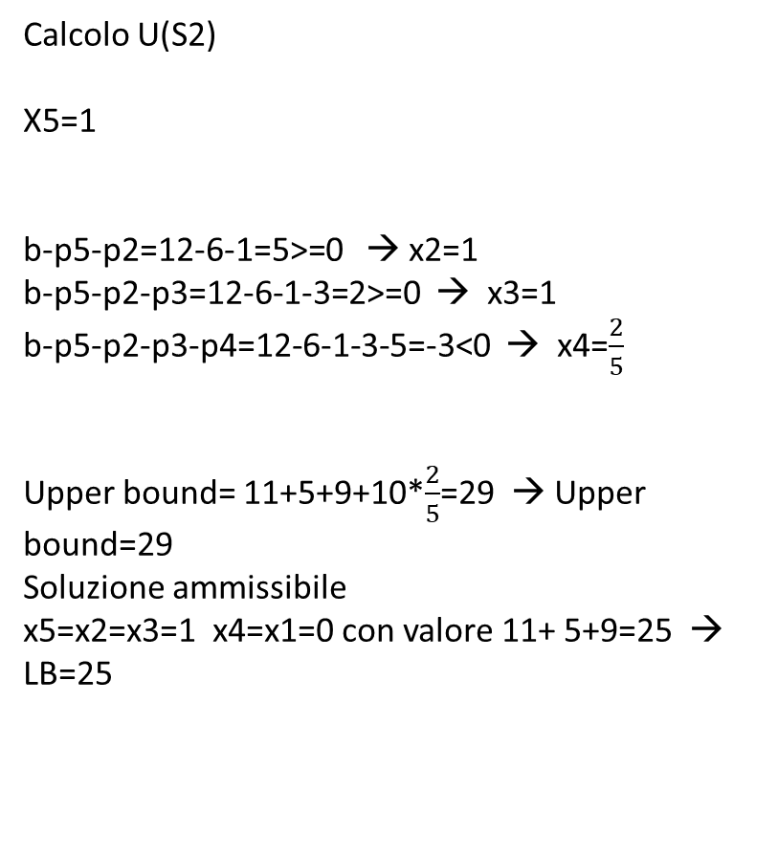
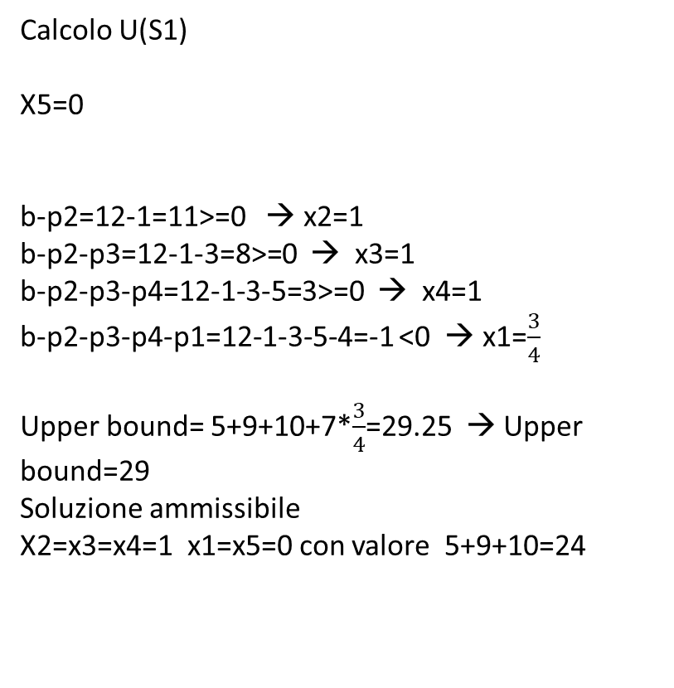
Calcolo U(S1)
X5=0
b-p2=12-1=11>=0 → x2=1
b-p2-p3=12-1-3=8>=0 → x3=1
b-p2-p3-p4=12-1-3-5=3>=0 → x4=1
b-p2-p3-p4-p1=12-1-3-5-4=-1 <0 → x1=$\frac{3}{4}$
Upper bound= 5+9+10+7*$\frac{3}{4}$=29.25 → Upper bound=29
Soluzione ammissibile
X2=x3=x4=1 x1=x5=0 con valore 5+9+10=24
Calcolo U(S2)
X5=1
b-p5-p2=12-6-1=5>=0 → x2=1
b-p5-p2-p3=12-6-1-3=2>=0 → x3=1
b-p5-p2-p3-p4=12-6-1-3-5=-3<0 → x4=$\frac{2}{5}$
Upper bound= 11+5+9+10*$\frac{2}{5}$=29 → Upper bound=29
Soluzione ammissibile
x5=x2=x3=1 x4=x1=0 con valore 11+ 5+9=25 → LB=25

Slide 17
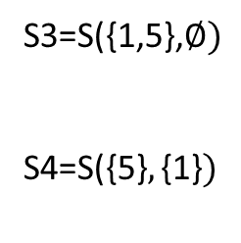
LB=25 [(2,3,5)]
S
U(S)=29
S3=S({1,5},$∅)$
S4=S($\text{\{5\}},\text{\{}\text{1}\text{\}})$
X5=0
X5=1
S1
S2
U(S1)=29
U(S2)=29
X1=0
X1=1
S3
S4

Slide 18
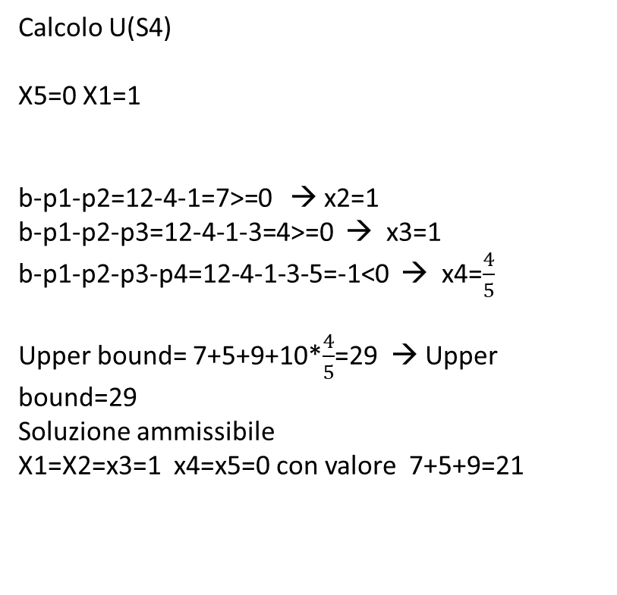
Calcolo U(S3)
X5=X1=0
b-p2=12-1=11>=0 → x2=1
b-p2-p3=12-1-3=8>=0 → x3=1
b-p2-p3-p4=12-1-3-5=3>=0 → x4=1
Upper bound= 5+9+10=24 → Upper bound=24
Soluzione ammissibile
X2=x3=x4=1 x1=x5=0 con valore 5+9+10=24
Calcolo U(S4)
X5=0 X1=1
b-p1-p2=12-4-1=7>=0 → x2=1
b-p1-p2-p3=12-4-1-3=4>=0 → x3=1
b-p1-p2-p3-p4=12-4-1-3-5=-1<0 → x4=$\frac{4}{5}$
Upper bound= 7+5+9+10*$\frac{4}{5}$=29 → Upper bound=29
Soluzione ammissibile
X1=X2=x3=1 x4=x5=0 con valore 7+5+9=21

Slide 19
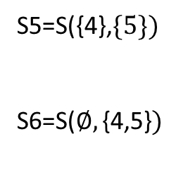
LB=25 [(2,3,5)]
S
U(S)=29
S5=S({4},$\{5\})$
S6=S($∅,\text{\{}\text{4,5}\text{\}})$
X5=0
X5=1
S1
S2
U(S1)=29
U(S2)=29
X1=0
X1=1
X4=0
X4=1
S3
S4
S6
U(S3)=24
S5
U(S4)=29

Slide 20
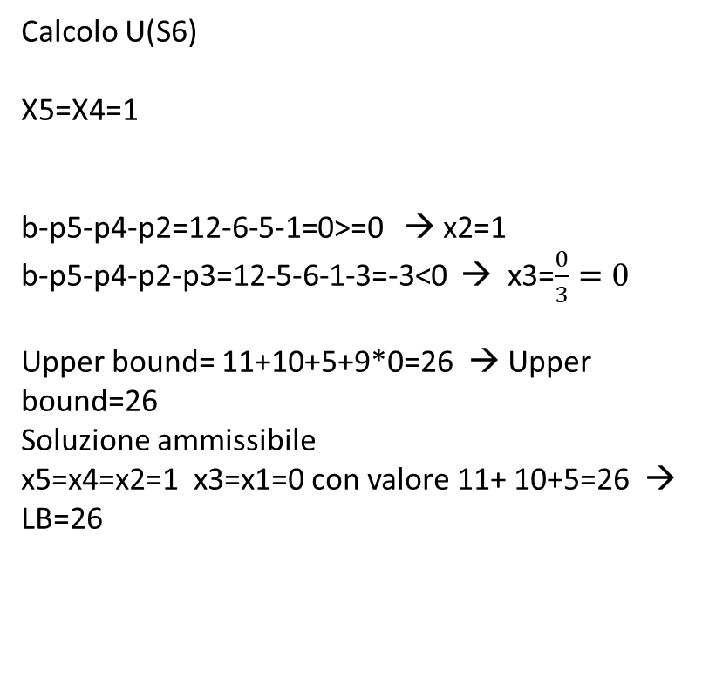
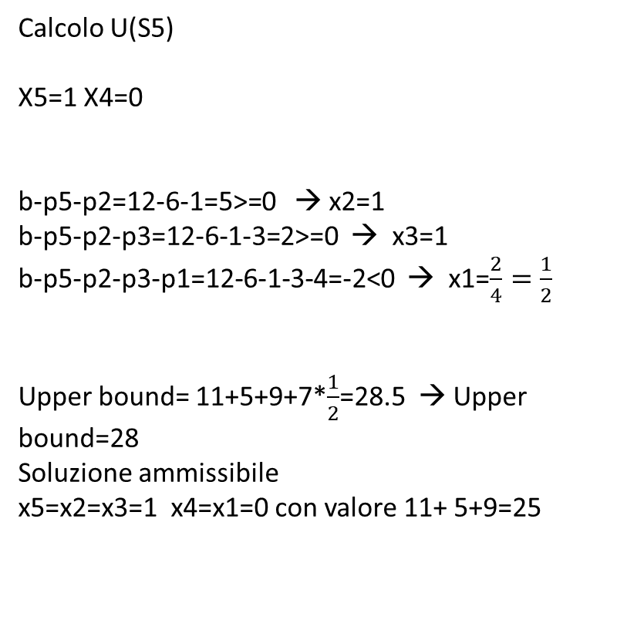
Calcolo U(S5)
X5=1 X4=0
b-p5-p2=12-6-1=5>=0 → x2=1
b-p5-p2-p3=12-6-1-3=2>=0 → x3=1
b-p5-p2-p3-p1=12-6-1-3-4=-2<0 → x1=$\frac{2}{4}=\frac{1}{2}$
Upper bound= 11+5+9+7*$\frac{1}{2}$=28.5 → Upper bound=28
Soluzione ammissibile
x5=x2=x3=1 x4=x1=0 con valore 11+ 5+9=25
Calcolo U(S6)
X5=X4=1
b-p5-p4-p2=12-6-5-1=0>=0 → x2=1
b-p5-p4-p2-p3=12-5-6-1-3=-3<0 → x3=$\frac{0}{3}=0$
Upper bound= 11+10+5+9*0=26 → Upper bound=26
Soluzione ammissibile
x5=x4=x2=1 x3=x1=0 con valore 11+ 10+5=26 → LB=26

Slide 21
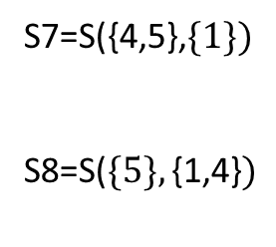
LB=26 [(2,4,5)]
S
U(S)=29
S7=S({4,5},$\{1\})$
S8=S($\{5\},\text{\{}\text{1,4}\text{\}})$
X5=0
X5=1
S1
S2
U(S1)=29
U(S2)=29
X1=0
X1=1
X4=0
U(S5)=28
X4=1
S3
S4
S6
U(S6)=26
U(S3)=24
S5
U(S4)=29
X4=0
X4=1
S7
S8

Slide 22
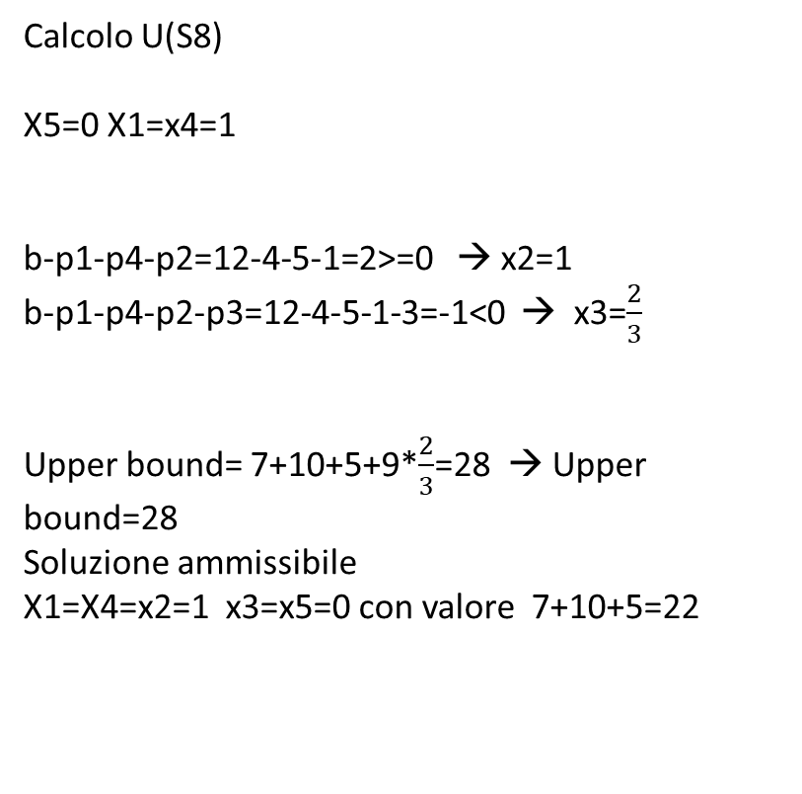
Calcolo U(S7)
X5=x4=0 X1=1
b-p1-p2=12-4-1=7>=0 → x2=1
b-p1-p2-p3=12-4-1-3=4>=0 → x3=1
Upper bound= 7+5+9=21 → Upper bound=21
Soluzione ammissibile
X1=X2=x3=1 x4=x5=0 con valore 7+5+9=21
Calcolo U(S8)
X5=0 X1=x4=1
b-p1-p4-p2=12-4-5-1=2>=0 → x2=1
b-p1-p4-p2-p3=12-4-5-1-3=-1<0 → x3=$\frac{2}{3}$
Upper bound= 7+10+5+9*$\frac{2}{3}$=28 → Upper bound=28
Soluzione ammissibile
X1=X4=x2=1 x3=x5=0 con valore 7+10+5=22

Slide 23
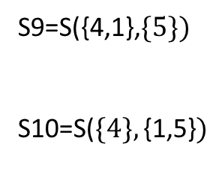
LB=26 [(2,4,5)]
S
U(S)=29
S9=S({4,1},$\{5\})$
S10=S($\{4\},\text{\{}\text{1,5}\text{\}})$
X5=0
X5=1
S1
S2
U(S1)=29
U(S2)=29
X1=0
X1=1
X4=0
U(S5)=28
X4=1
S3
S4
S6
U(S6)=26
U(S3)=24
S5
U(S4)=29
X4=0
X4=1
X1=0
X1=1
S7
S8
U(S7)=21
S9
S10
U(S8)=28

Slide 24
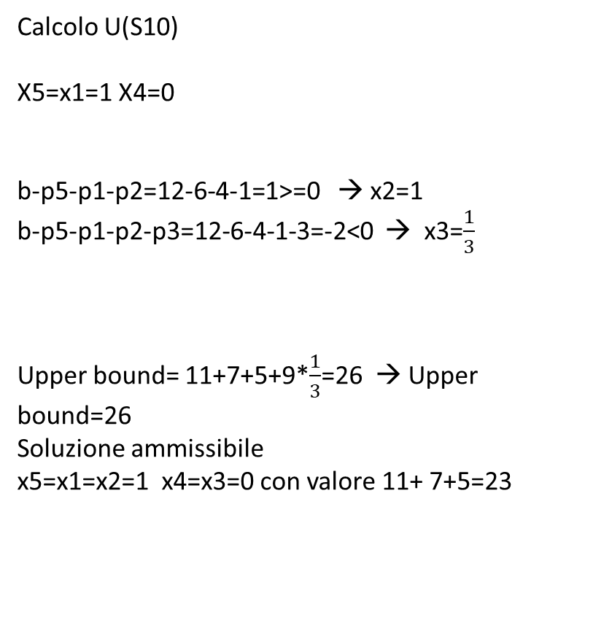
Calcolo U(S9)
X5=1 X4=x1=0
b-p5-p2=12-6-1=5>=0 → x2=1
b-p5-p2-p3=12-6-1-3=2>=0 → x3=1
Upper bound= 11+5+9=25 → Upper bound=25
Soluzione ammissibile
x5=x2=x3=1 x4=x1=0 con valore 11+ 5+9=25
Calcolo U(S10)
X5=x1=1 X4=0
b-p5-p1-p2=12-6-4-1=1>=0 → x2=1
b-p5-p1-p2-p3=12-6-4-1-3=-2<0 → x3=$\frac{1}{3}$
Upper bound= 11+7+5+9*$\frac{1}{3}$=26 → Upper bound=26
Soluzione ammissibile
x5=x1=x2=1 x4=x3=0 con valore 11+ 7+5=23

Slide 25
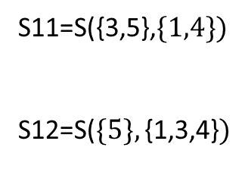
LB=26 [(2,4,5)]
S
U(S)=29
S11=S({3,5},$\{1,4\})$
S12=S($\{5\},\text{\{}\text{1,3,4}\text{\}})$
X5=0
X5=1
S1
S2
U(S1)=29
U(S2)=29
X1=0
X1=1
X4=0
U(S5)=28
X4=1
S3
S4
S6
U(S6)=26
U(S3)=24
S5
U(S4)=29
X4=0
X4=1
X1=0
X1=1
S7
S8
U(S7)=21
S9
S10
U(S8)=28
X3=0
X3=1
S11
S12
U(S9)=25
U(S10)=26

Slide 26
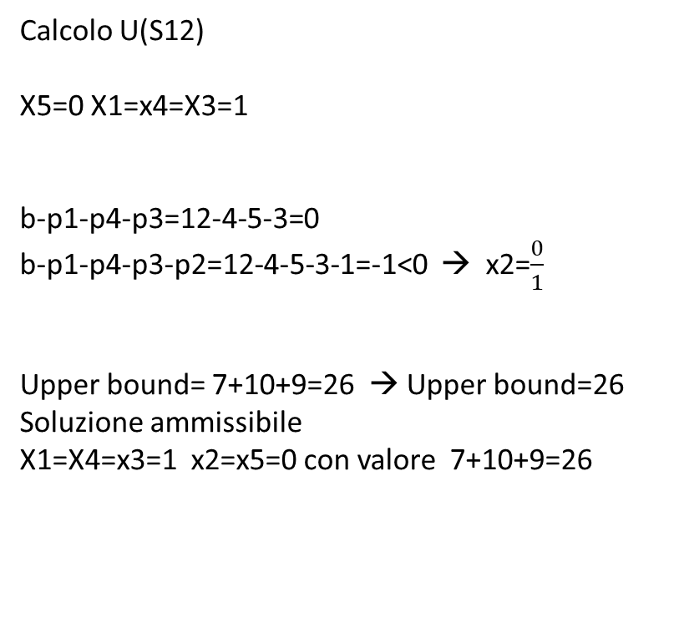
Calcolo U(S11)
X5=X3=0 X1=x4=1
b-p1-p4-p2=12-4-5-1=2>=0 → x2=1
Upper bound= 7+10+5=22 → Upper bound=22
Soluzione ammissibile
X1=X4=x2=1 x3=x5=0 con valore 7+10+5=22
Calcolo U(S12)
X5=0 X1=x4=X3=1
b-p1-p4-p3=12-4-5-3=0
b-p1-p4-p3-p2=12-4-5-3-1=-1<0 → x2=$\frac{0}{1}$
Upper bound= 7+10+9=26 → Upper bound=26
Soluzione ammissibile
X1=X4=x3=1 x2=x5=0 con valore 7+10+9=26

Slide 27
LB=26 [(2,4,5), (1,4,3)]
S
U(S)=29
X5=0
X5=1
STOP
Valore ottimo = 26
Soluzioni ottime: (2,4,5); (1,4,3)
S1
S2
U(S1)=29
U(S2)=29
X1=0
X1=1
X4=0
U(S5)=28
X4=1
S3
S4
S6
U(S6)=26
U(S3)=24
S5
U(S4)=29
X4=0
X4=1
X1=0
X1=1
S7
S8
U(S7)=21
S9
S10
U(S8)=28
X3=0
X3=1
S11
S12
U(S9)=25
U(S10)=26
U(S11)=22
U(S12)=26

