Slide 1
Machine Failure Classifier
Data Mining and Machine Learning
Francesco De Vita

Slide 2
Brief Introduction to the Work
This project aims to apply data analysis and machine learning techniques for fault prediction in industrial production, using a real dataset from a metal component manufacturing process. The dataset contains information on various physical and chemical parameters of the process.

Slide 3
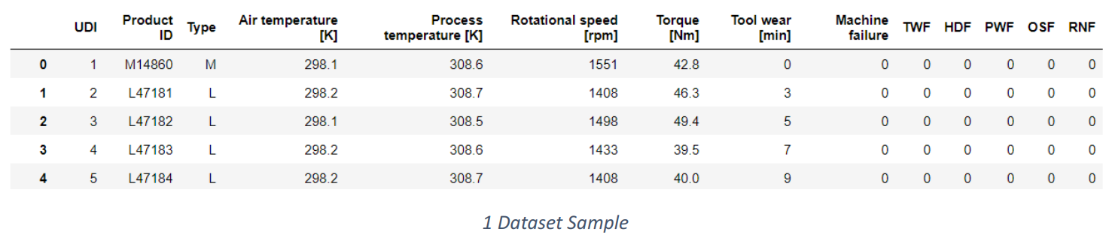

Dataset
The dataset we are using is called ‘ai4i2020’ and comes from an industrial production process of metal
components.
The dataset contains 10 000 rows and 14 columns, each of which represents a feature of the process.
Our goal is to use these features to predict failures and classify them into different types, such as tool wear, overheating, overvoltage, overload and random failures.

Slide 4
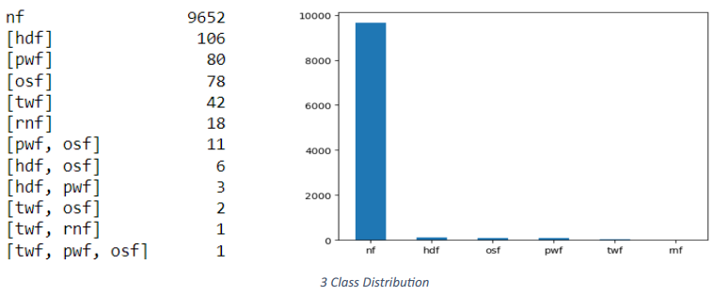
Dataset
The dataset is really unbalanced because the ‘no failure’ class has too much samples respect to the other classes, that’s why we are going to perform an OverSampling

Slide 5
Attribute Creation
Train-Test Split
Data
Pre-Processing
Outlier Detection
Feature Selection
Oversampling
Normalization

Slide 6
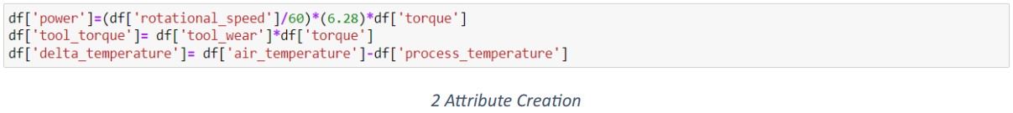
Attribute Creation
Some of those feature were summarized into one to help the prediction of a specific type of Failure.
power: is the power absorbed by the machine during the process, calculated as the product of the rotational speed and the torque. Usefull to predict power failure (PWF).
tool_torque: Is the product between the input torque and the output torque. Usefull to predict overstrain failure (OSF).
delta_temperature: is the temperature difference between the air and the metal component, calculated as the air temperature minus the process temperature. Usefull to predict heat dissipation failure (HDF)

Slide 7
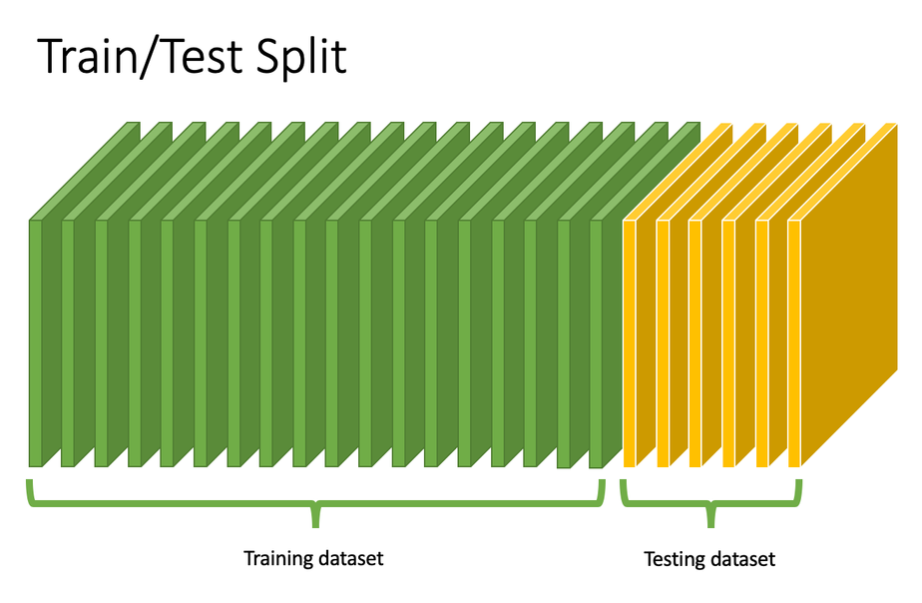
Train-Test Split
The first step after removing the null values and encode the features the dataset was divided into training and test sets.
We used 30% of the samples as test set with the Stratify option to maintain the same proportion of classes in both train and test set

Slide 8
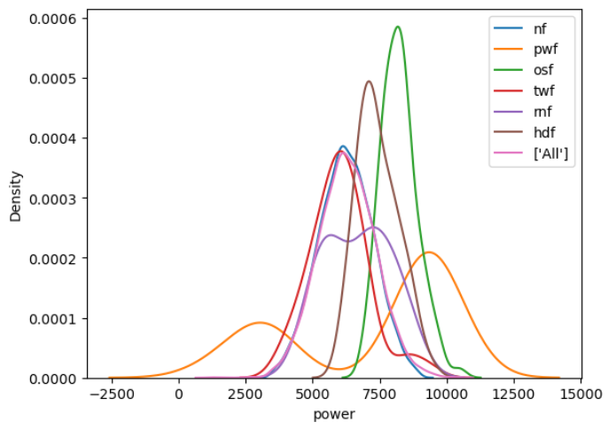
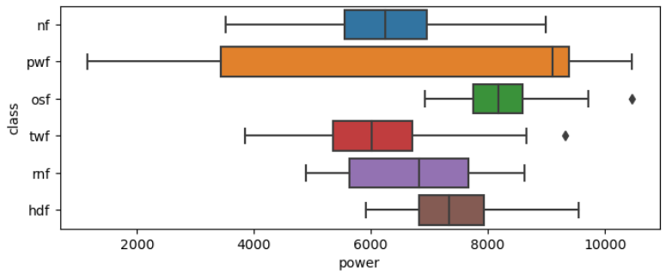
Outlier Detection
We performed an analysis of the boxplots and the distribution plots of each variable for each Class and no outliers were found.

Slide 9
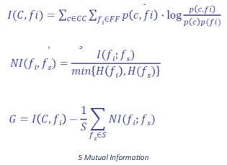
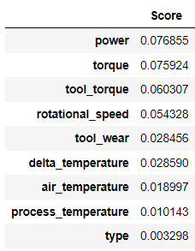
Features Selection
To select the most relevant features for the classification model, eliminating those that are useless, we used the mutual information criterion. In particular, we applied the “mutual_info_classif” method, which calculates the mutual information between each feature and the class variable, returning a value between 0 and 1.
Than the column with Mutual Information really close to 0 has been dropped from the DataFrame

Slide 10
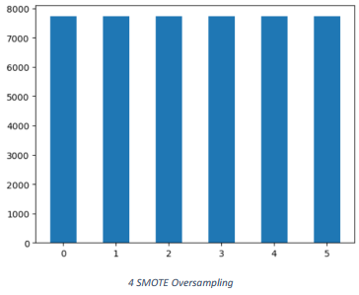
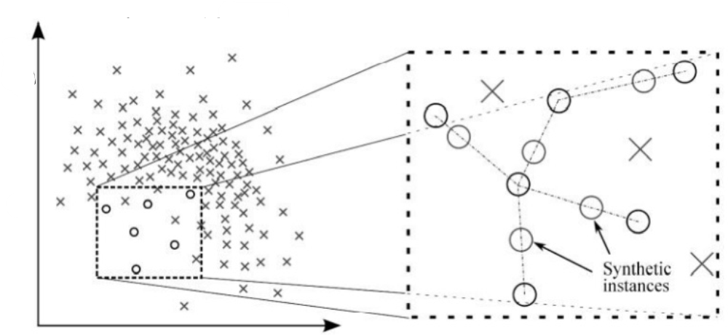
Oversampling
We use SMOTE oversampling to address the class imbalance problem during the training. This could prevent the model from being biased towards the class with more samples.

Slide 11
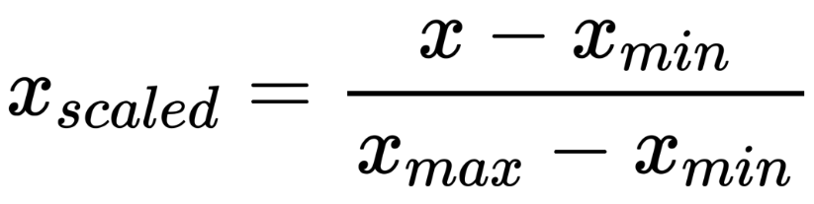
Normalization
Since there are no outliers, we can use MinMax Normalization to make the values of a variable homogeneous and to facilitate the use of the machine learning models.

Slide 12
KNN
Classification
Decision Tree
Random Forest
Naive Bayes

Slide 13
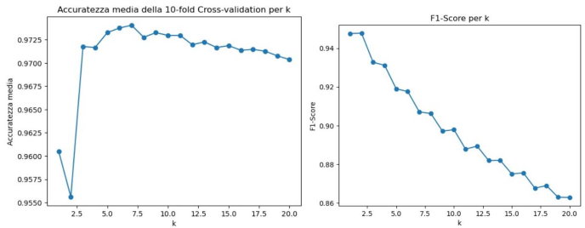
KNN
We tried to perform the KNN with different k (from 1 to 20) to understand which was the best value
As we can see from the Image the best k is 3 because it gives us the best F1-Score and accuracy

Slide 14
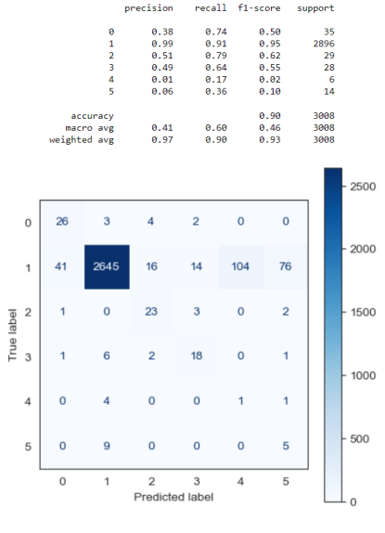
KNN

Slide 15
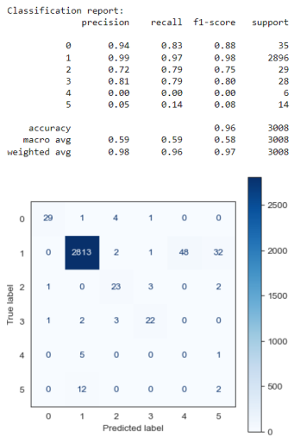
Decision Tree

Slide 16
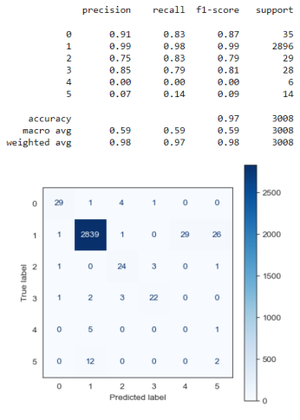
Random Forest

Slide 17
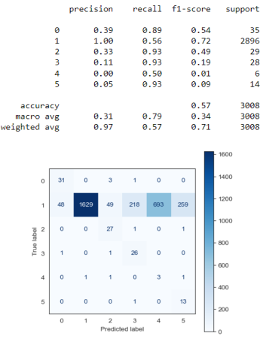
Bayesian Classifier

Slide 18
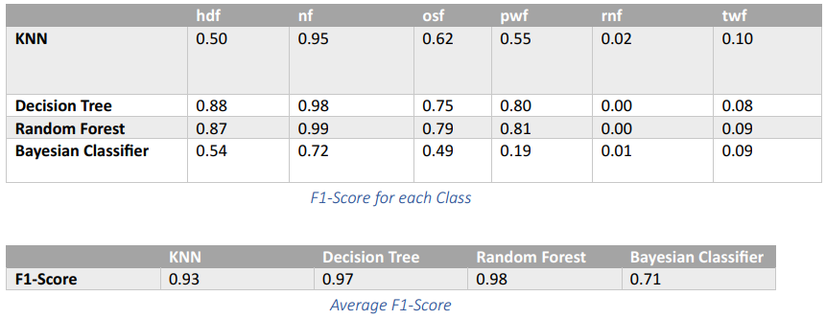
Results Comparison
From the results of the classification report and the confusion matrix, it emerges that the most performing classifier is the Random Forest, which achieved the highest values in all the metrics.

Slide 19
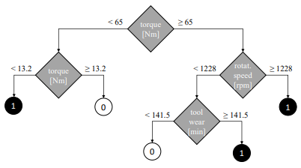
Comparison with other Works
“Explainable Artificial Intelligence
for Predictive Maintenance Applications” by S. Matzka
In this paper they used a Bagged Tree Model composed by 15 Trees, each tree has built only on 4 different features to be more understandable from human

Slide 20
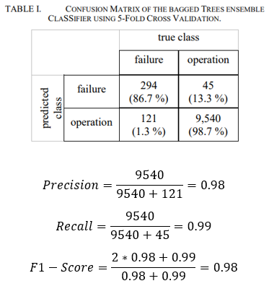
Comparison with other Works
We have quite the same result as this model but their has an advantage on the Understandability and the Simplicity of the Results

Slide 21
Comparison with other Works
In this domain, the explainability of the results is essential. That is why the paper’s evaluation focused on the model’s explanation rather than the classification results.
To improve the explanation quality, they applied the Z-Score normalization and selected the best 2 Features in absolute value for explanation.

Slide 22
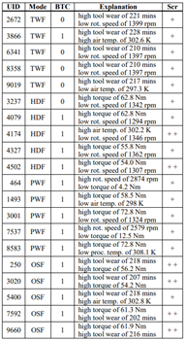
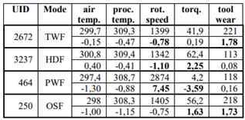
Comparison with other Works

Slide 23
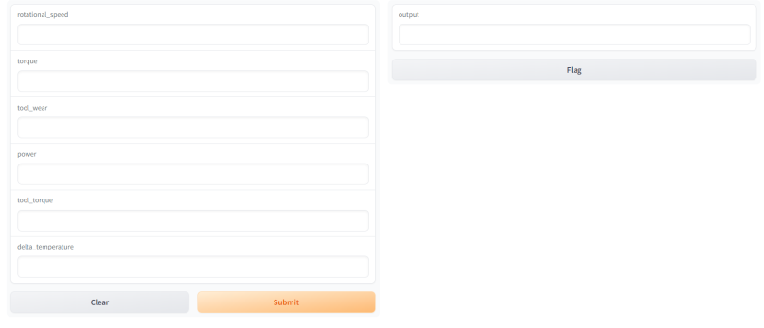
User Interface

Slide 24

Possible Improvements
Adding to the user Interface an Explanation of the Decision
Train the model on Dataset with better Data Quality
Implementation with sensors for a real-time Prediction

