Slide 1

No More Guessing: a Verifiable Gradient Inversion Attack in Federated Learning
Francesco Diana, Chuan Xu, André Nusser, Giovanni Neglia
16/04/2026

Slide 2
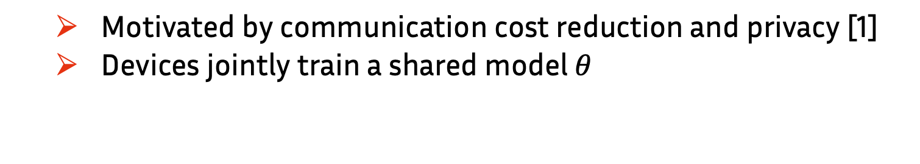
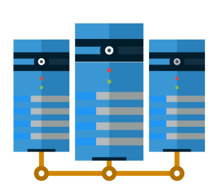
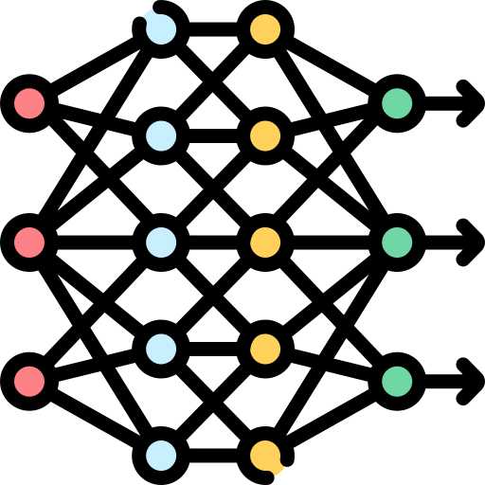
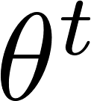

Federated Learning (FL)
[1] McMahan, B.; Moore, E.; Ramage, D.; Hampson, S.; and Agüera y Arcas, B. 2017. Communication-efficient learning of deep networks from decentralized data. In Artificial Intelligence and Statistics,1273–1282. PMLR

Slide 3
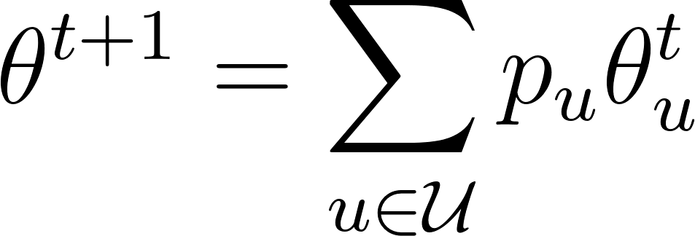
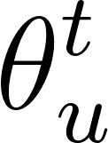
Federated Learning (FL)
[1] McMahan, B.; Moore, E.; Ramage, D.; Hampson, S.; and Agüera y Arcas, B. 2017. Communication-efficient learning of deep networks from decentralized data. In Artificial Intelligence and Statistics,1273–1282. PMLR

Slide 4
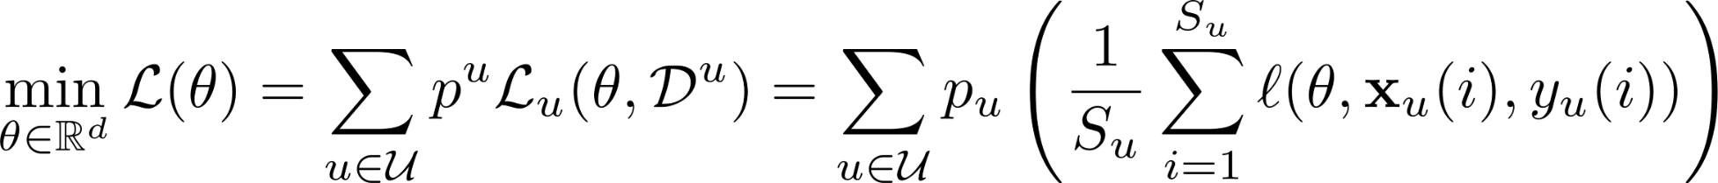
Federated Learning (FL)
[1] McMahan, B.; Moore, E.; Ramage, D.; Hampson, S.; and Agüera y Arcas, B. 2017. Communication-efficient learning of deep networks from decentralized data. In Artificial Intelligence and Statistics,1273–1282. PMLR

Slide 5
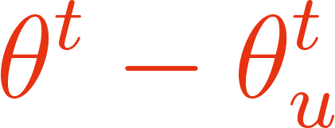
Federated Learning (FL)
Updates contain information
[1] McMahan, B.; Moore, E.; Ramage, D.; Hampson, S.; and Agüera y Arcas, B. 2017. Communication-efficient learning of deep networks from decentralized data. In Artificial Intelligence and Statistics,1273–1282. PMLR

Slide 6

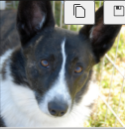
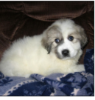
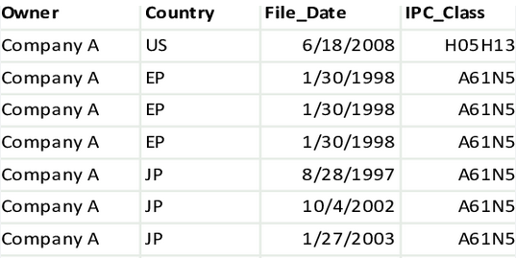
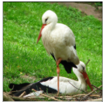
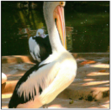
Federated Learning (FL)
[1] McMahan, B.; Moore, E.; Ramage, D.; Hampson, S.; and Agüera y Arcas, B. 2017. Communication-efficient learning of deep networks from decentralized data. In Artificial Intelligence and Statistics,1273–1282. PMLR

Slide 7
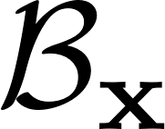
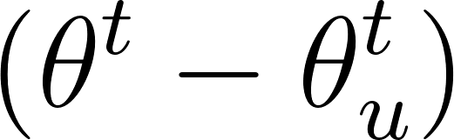
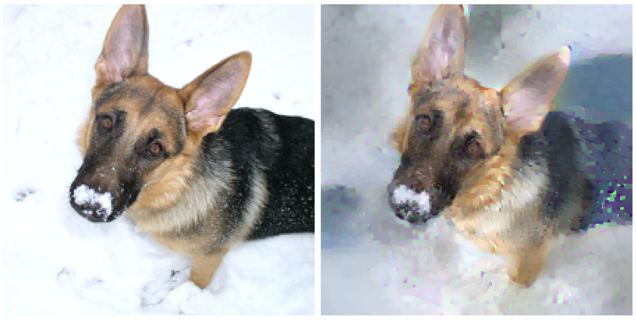
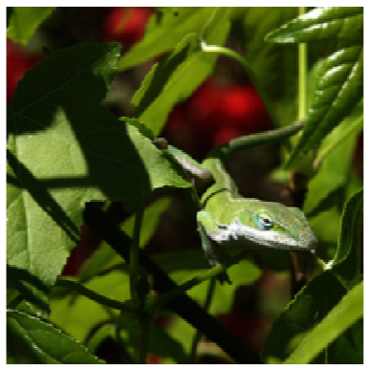
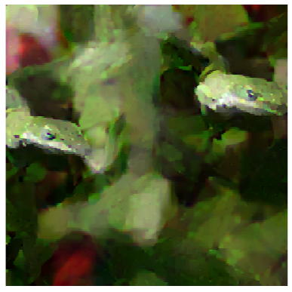
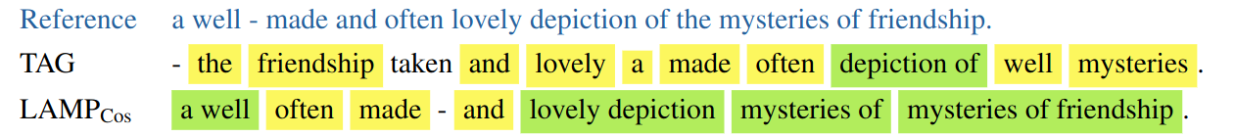
Data Reconstruction Attacks
Goal: reconstruct client’s input dataset from shared gradients updates
[2] Geiping, J., Bauermeister, H., Dröge, H., & Moeller, M. (2020). Inverting gradients - how easy is it to break privacy in federated learning? In Proceedings of the 34th International Conference on Neural Information Processing Systems

Slide 8
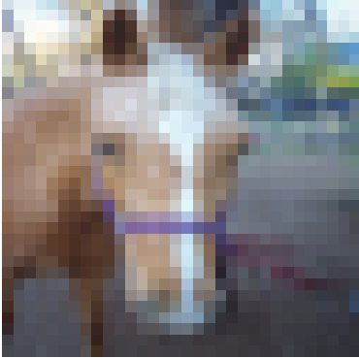

What do attacks recovery?
Human inspection can help sometimes…

Slide 9
What do attacks recovery?
Human inspection can help sometimes…
…but is not enough!

Slide 10
Our questions
Is tabular data less vulnerable?
Without ground truth, can attackers differentiate between accurate and flawed reconstructions?

Slide 11
Our Contributions
Introduce VGIA, a novel analytical attack
Achieves exact reconstruction of private inputs
Provides a subspace-based test to certify isolation
Eliminates the need for unverified, heuristic-based guessing

Slide 12




Three Families of Attacks
Optimization-based
Solve an optimization problem to minimize the distance between dummy and real gradients.
[3] Carletti, V., Foggia, P., Mazzocca, C., Parrella, G., & Vento, M. (2025). SoK: Gradient Inversion Attacks in Federated Learning. In 34th USENIX Security Symposium (USENIX Security 25).

Slide 13
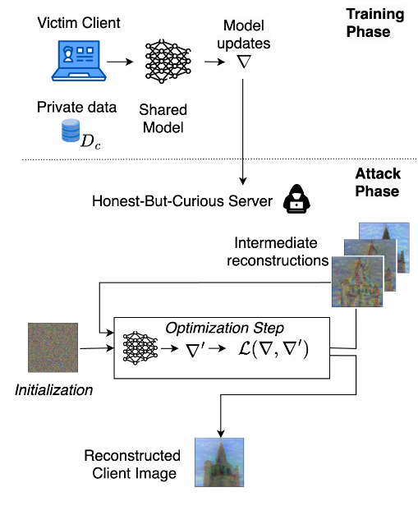
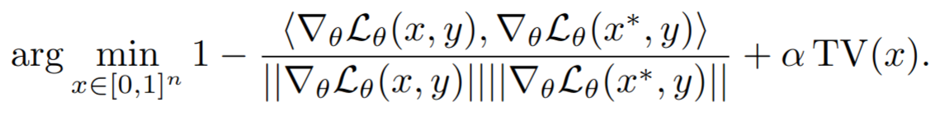
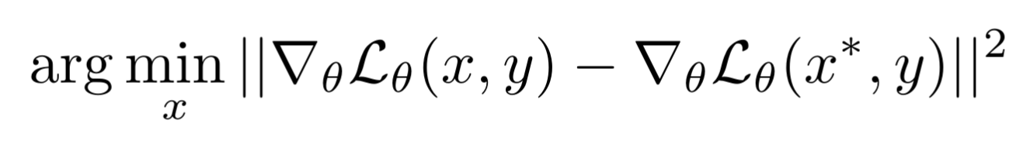
Optimization-based Attacks
The attacker minimizes the distance between dummy and observed gradients
[3] Carletti, V., Foggia, P., Mazzocca, C., Parrella, G., & Vento, M. (2025). SoK: Gradient Inversion Attacks in Federated Learning. In 34th USENIX Security Symposium (USENIX Security 25).

Slide 14
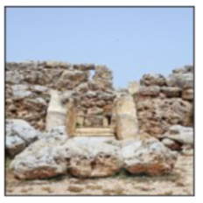
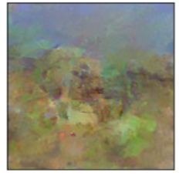

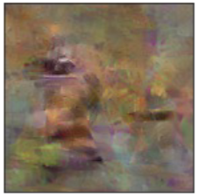
Optimization-based attacks
[2] Geiping, J., Bauermeister, H., Dröge, H., & Moeller, M. (2020). Inverting gradients - how easy is it to break privacy in federated learning? In Proceedings of the 34th International Conference on Neural Information Processing Systems
Notes:
Performance improved, but require additional data assumptions. The idea here is to modify the model parameters in such a way to isolate the gradient of a single input in the batch.

Slide 15


Three Families of Attacks
Optimization-based
Generative-based
Solve an optimization problem to minimize the distance between dummy and real gradients.
Leverages pre-trained generative models (like GANs) as priors to guide the search toward realistic images or directly generate the inputs
[3] Carletti, V., Foggia, P., Mazzocca, C., Parrella, G., & Vento, M. (2025). SoK: Gradient Inversion Attacks in Federated Learning. In 34th USENIX Security Symposium (USENIX Security 25).

Slide 16
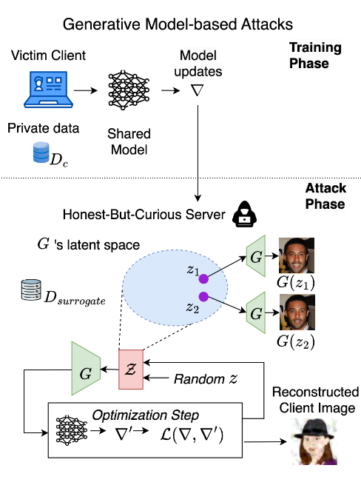

Generative-based Attacks
The attacker uses a generator to reconstruct individual inputs from extracted features or to generate samples.
[3] Carletti, V., Foggia, P., Mazzocca, C., Parrella, G., & Vento, M. (2025). SoK: Gradient Inversion Attacks in Federated Learning. In 34th USENIX Security Symposium (USENIX Security 25).

Slide 17
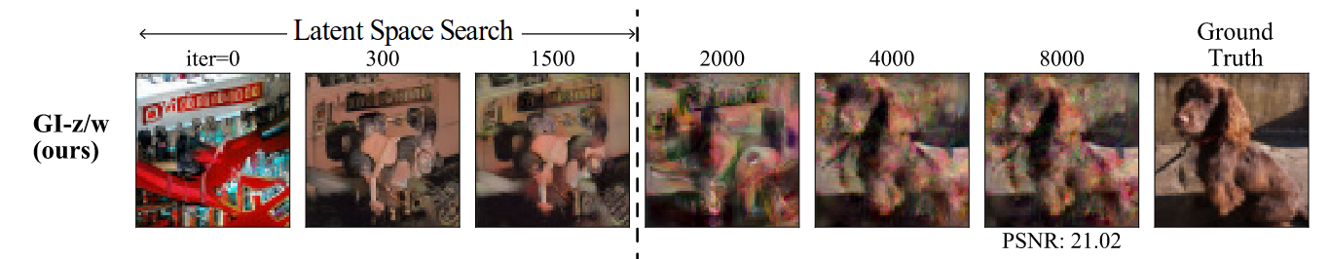
Generative-based Attacks
Figure: Reconstruction example from [5].
[5] Jeon, Jinwoo, Jaechang Kim, Kangwook Lee, Sewoong Oh, and Jungseul Ok. Gradient Inversion with Generative Image Prior. Neurips 2021

Slide 18





Three Families of Attacks
Optimization-based
Generative-based
Analytic-based
Batch size limit
Reconstruction quality
Tabular data
Batch size limit
Rely on pre-trained models
Require surrogate dataset
Tabular data
Perfect reconstruction
Batch size limit
Tabular data
[3] Carletti, V., Foggia, P., Mazzocca, C., Parrella, G., & Vento, M. (2025). SoK: Gradient Inversion Attacks in Federated Learning. In 34th USENIX Security Symposium (USENIX Security 25).

Slide 19

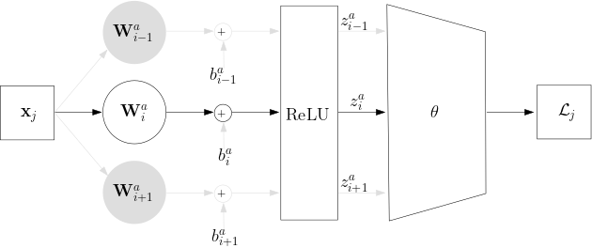


Analytical attacks
Linear layers followed by ReLU naturally leak information [2]
[2] Geiping, J., Bauermeister, H., Dröge, H., & Moeller, M. (2020). Inverting gradients - how easy is it to break privacy in federated learning? In Proceedings of the 34th International Conference on Neural Information Processing Systems
Notes:
Forward propagation

Slide 20

Analytical attacks

Slide 21
Analytical attacks
we can reconstruct x_{j}!
Notes:
Forward propagation

Slide 22

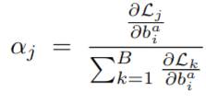
Analytical attacks
The attacker observes:
The Goal: Use ReLU sparsity to filter the aggregated batch update down to a single sample gradient

Slide 23
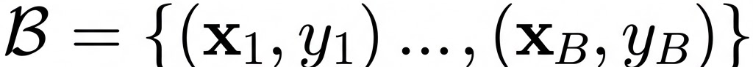
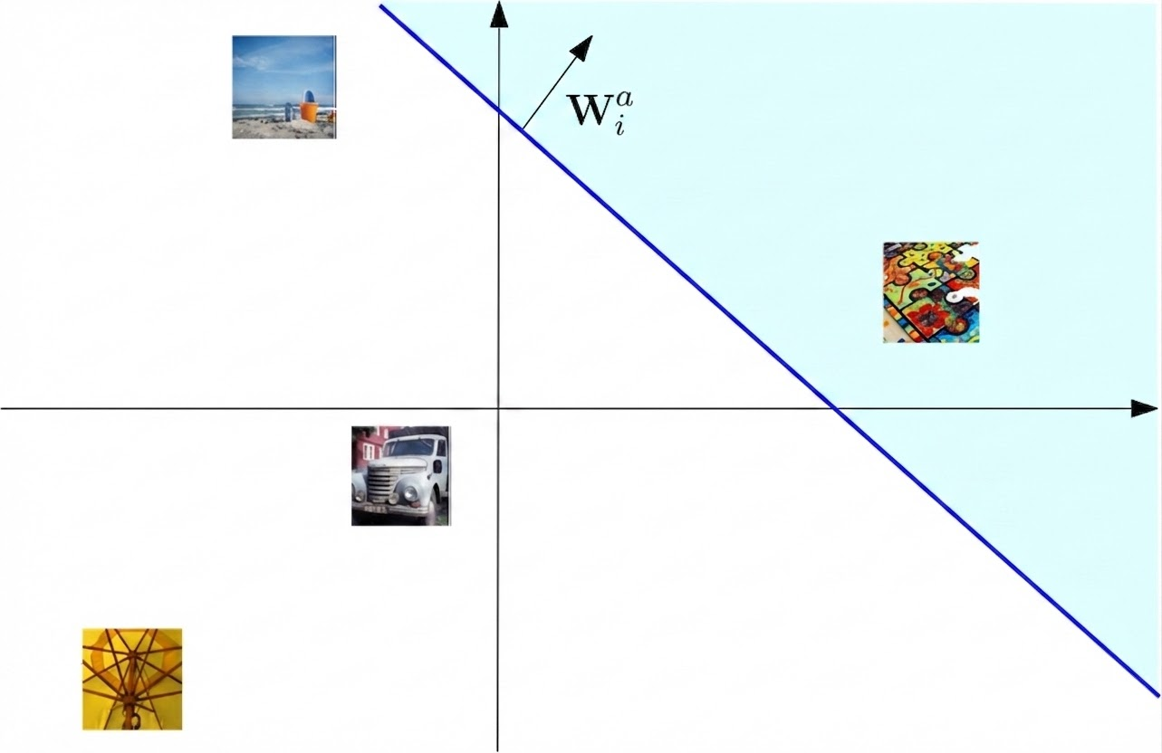


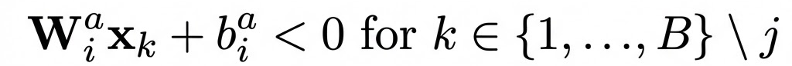

Geometric interpretation
Exploit sparseness induced by the ReLU
Batch
Notes:
Previous attack from this perspective

Slide 24
Geometric interpretation
Exploit sparseness induced by the ReLU
Batch
Notes:
Previous attack from this perspective

Slide 25
Threat model
Server is an active attacker
No prior knowledge on data distribution
FedSGD
Full-batch update
Regression task

Slide 26
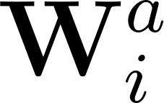
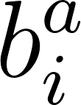

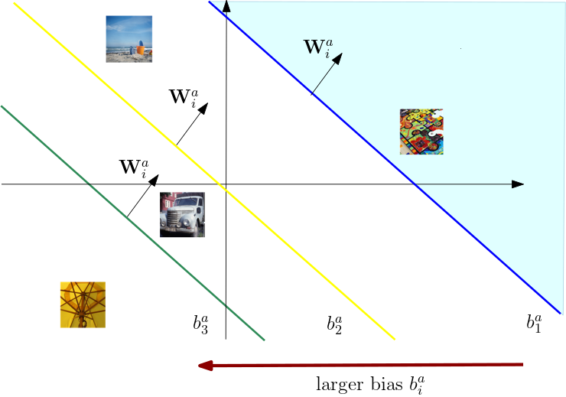
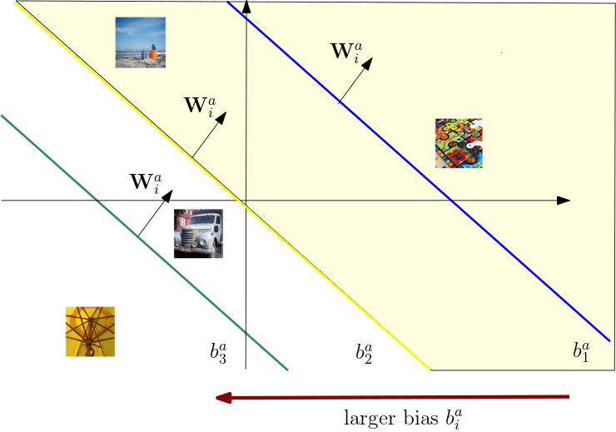
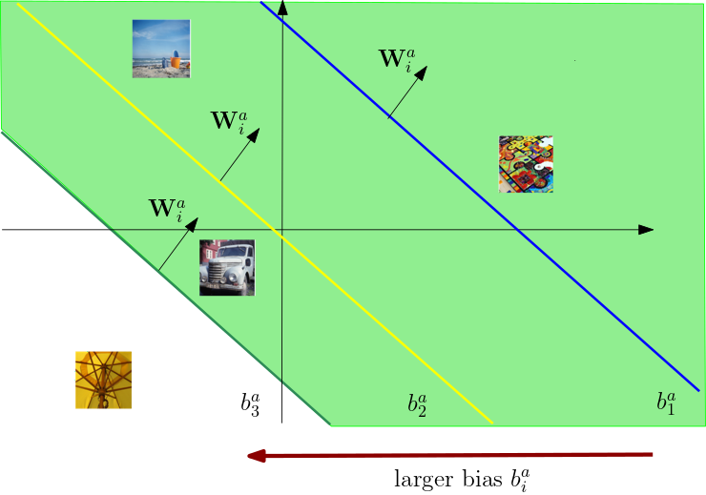
Cutting Through Privacy Attack (CTP)
Server sets a direction for
Server updates to scan input space and find
[7] Diana, F., Nusser A., Xu, C, Neglia, G., Cutting Through Privacy: A Hyperplane-Based Data Reconstruction Attack in Federated Learning. UAI 2025

Slide 27
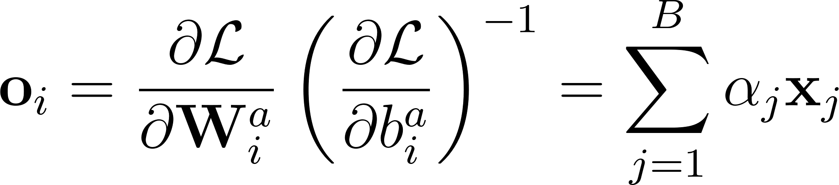
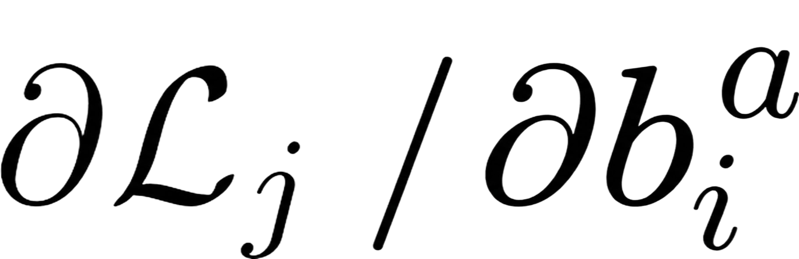
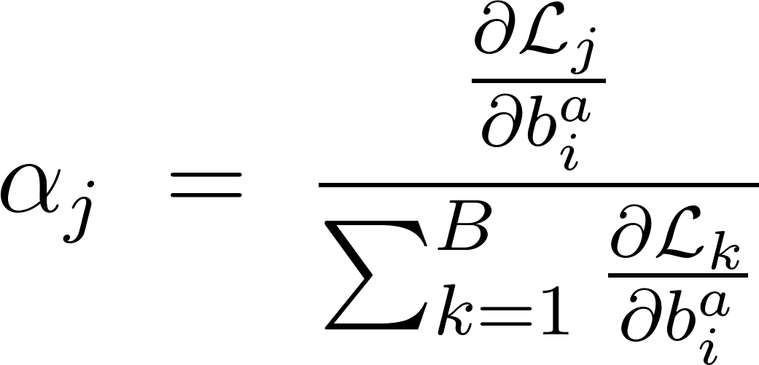
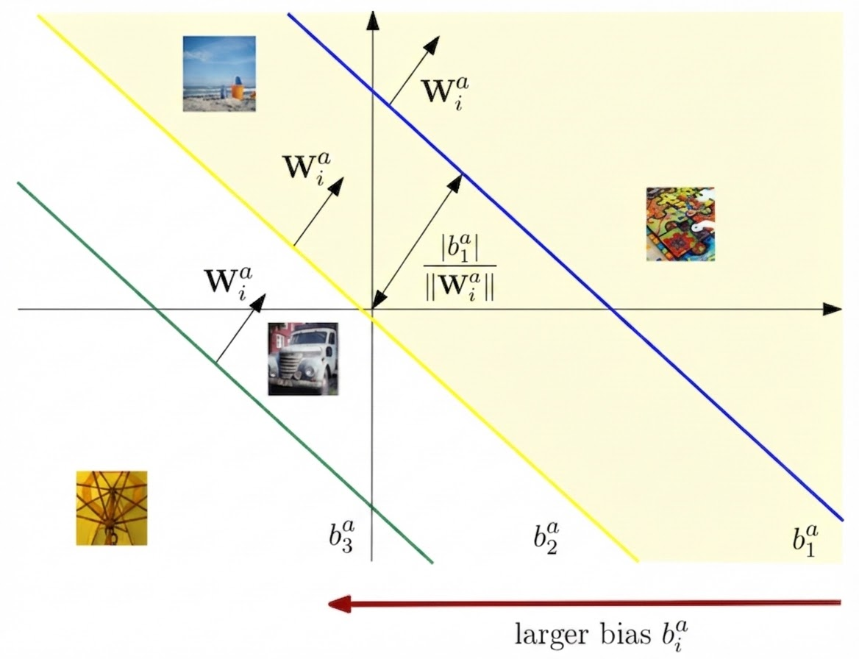
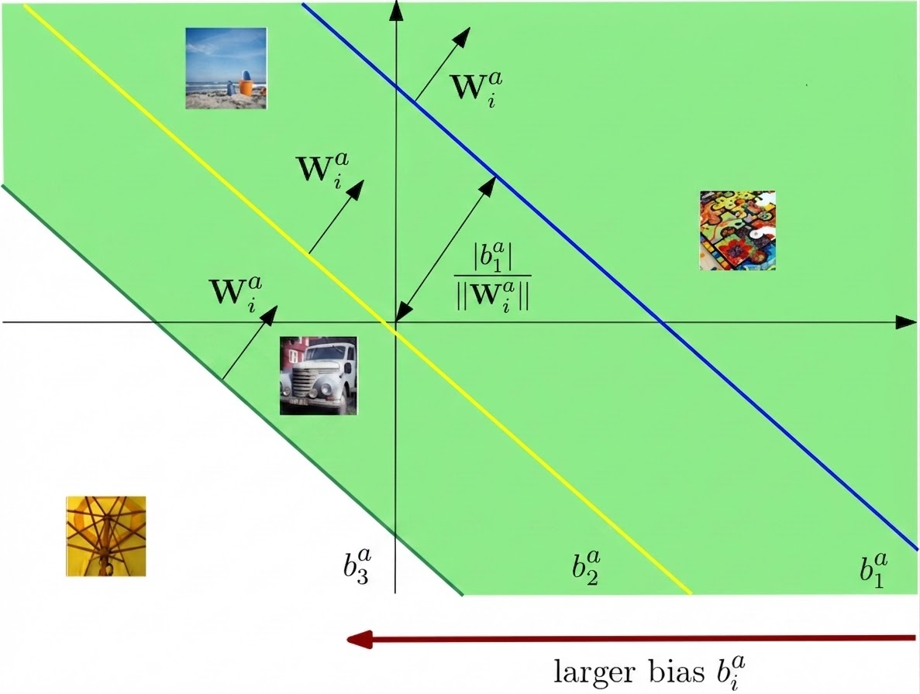
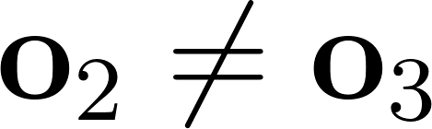
Cutting Through Privacy Attack (CTP)
Assume independent of once neuron i is activated by x_{j}
Notes:
In this case we do not make assumption on the type of the model, and we can consider a generale neural network model.

Slide 28
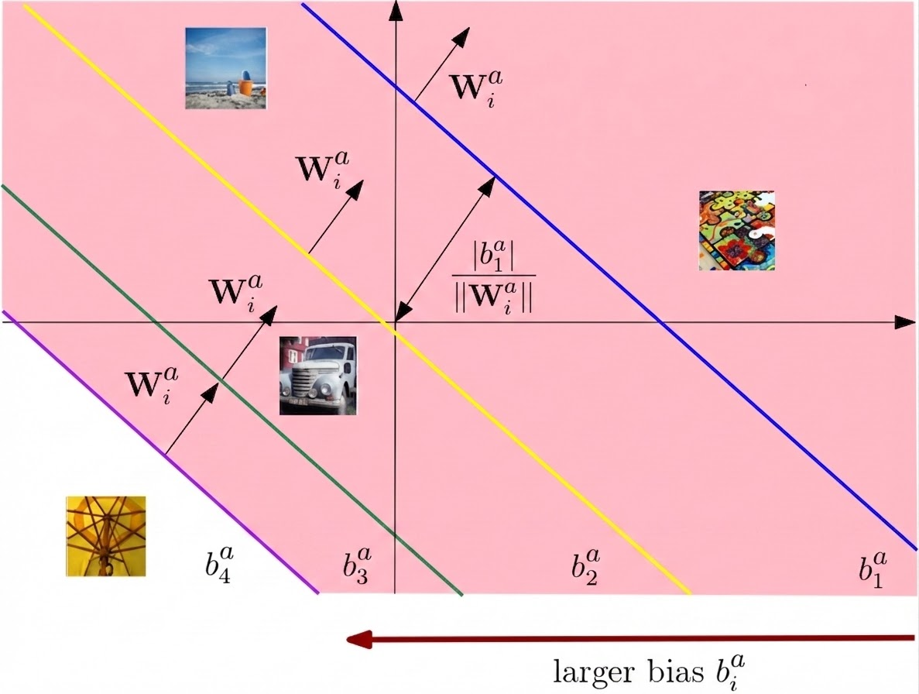

Cutting Through Privacy Attack (CTP)
Assume independent of once neuron i is activated by x_{j}

Slide 29
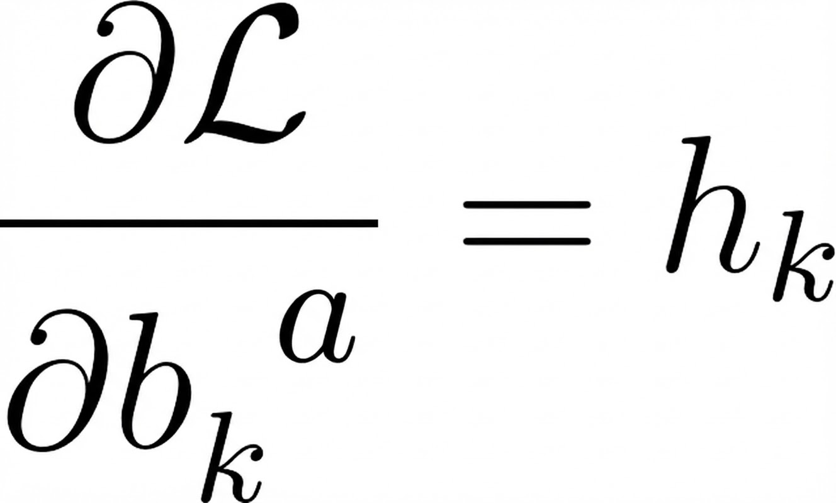
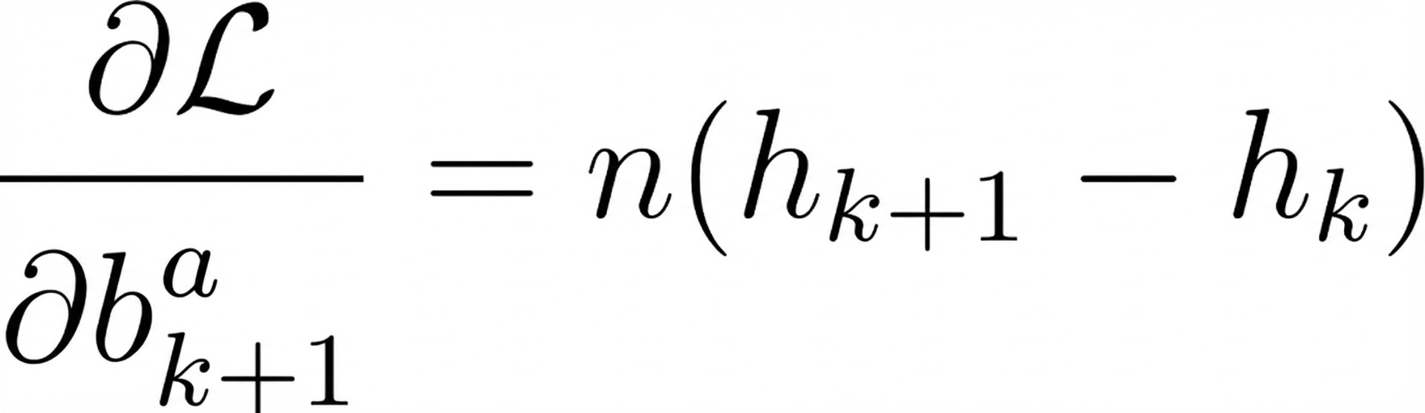
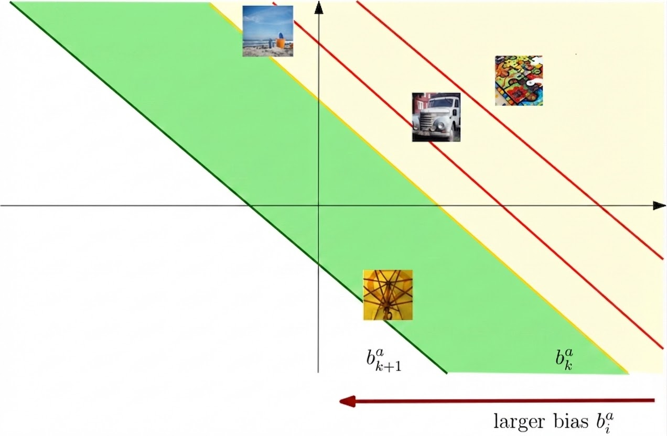

Reconstruct the Data
Suppose we recovered the first inputs
Then:
Notes:
Now, we assume that we have located all the hyperplanes, such that each image is isolated
Kth reconstruction, image j

Slide 30

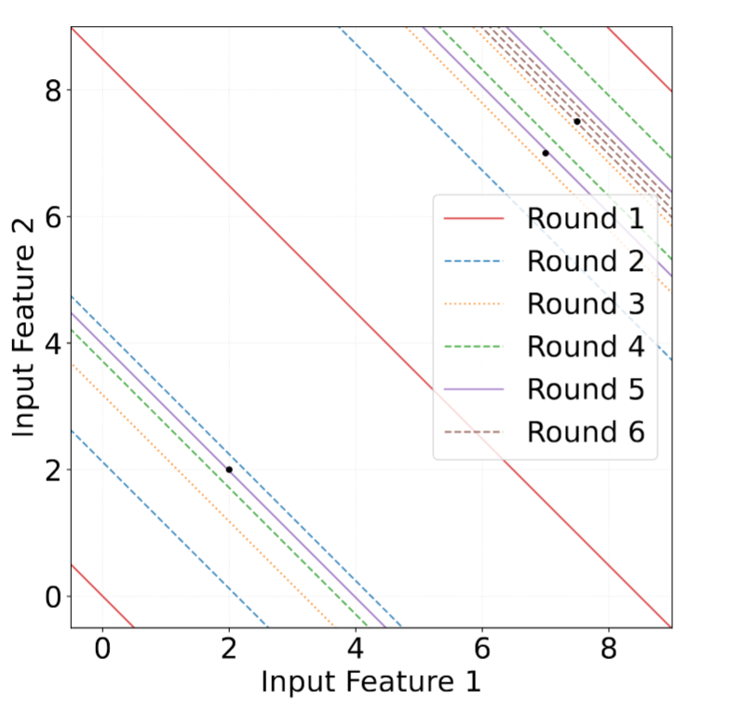
Limitations
Bisects all the non-empty regions to resolution

Slide 31
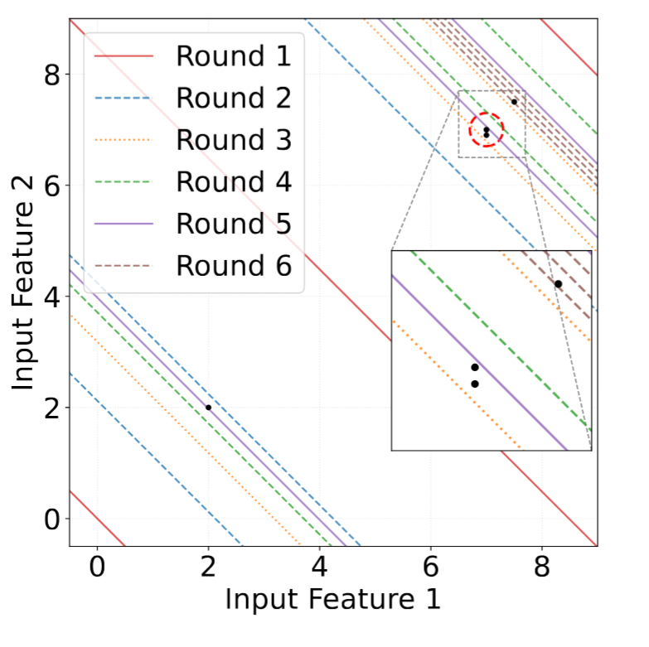
Limitations
Bisects all the non-empty regions to resolution
CTP cannot certify the correctness of reconstructed samples

Slide 32


Verifiable Gradient Inversion Attack (VGIA)

Slide 33
Verifiable Gradient Inversion Attack (VGIA)

Slide 34
Verifiable Gradient Inversion Attack (VGIA)

Slide 35



Verifiable Gradient Inversion Attack (VGIA)
The attacker controls
ReLU activation pattern after layer can be fixed

Slide 36


Verifiable Gradient Inversion Attack (VGIA)
The attacker controls
ReLU activation pattern after layer can be fixed

Slide 37

Verifiable Gradient Inversion Attack (VGIA)
The attacker controls
ReLU activation pattern after layer can be fixed
Set positive weights and bias values to all parameters after

Slide 38

Verifiable Gradient Inversion Attack (VGIA)
The attacker controls
ReLU activation pattern after layer can be fixed

Slide 39



Slicing gradients
Consider two neurons i and i+1 in the attack layer

Slide 40

Slicing gradients
Consider two neurons i and i+1 in the attack layer

Slide 41

Slicing gradients
Consider two neurons i and i+1 in the attack layer

Slide 42

Slicing gradients
Regions with points are kept

Slide 43

Slicing gradients
Empty regions are detected and discarded

Slide 44





Verify isolation
Consider an interval and the corresponding slice
At round t+1, the attacker tests q > 2 bias values in the interval, at positions
obtaining slices

Slide 45



Verify isolation
Consider an interval and the corresponding slice
At round t+1, the attacker tests q > 2 bias values in the interval, at positions
obtaining slices

Slide 46

Verify isolation
Consider an interval and the corresponding slice
At round t+1, the attacker tests q > 2 bias values in the interval, at positions
obtaining slices

Slide 47



Reconstruct the input
When a single sample is isolated we get:
And we can compute to finally recover:

Slide 48


VGIA Example

Slide 49

VGIA Example

Slide 50

VGIA Example

Slide 51

VGIA Example

Slide 52

VGIA Example

Slide 53

VGIA Example

Slide 54

VGIA Example

Slide 55

VGIA Example

Slide 56

VGIA vs CTP
CTP
VGIA
VGIA correctly isolates all the samples
VGIA stops after verification

Slide 57

Experimental Results
Tested on Acs Income dataset
Results on FedSGD for B=2048
Compared with CTP

Slide 58


Experimental Results
The attack can be extended to classification
Results on CIFAR 10

Slide 59

Experimental Results
Reconstruction example on ImageNet

Slide 60
Future works and conclusions
First attack that verifies correct isolation and perfectly recovers inputs
Extend to different activation functions (e.g. SiLU and GeLU)
Extend to different models (e.g. Transformers ResNets)
Adapt to DP-SGD setting

Slide 61
Thank You!

